Slide 1
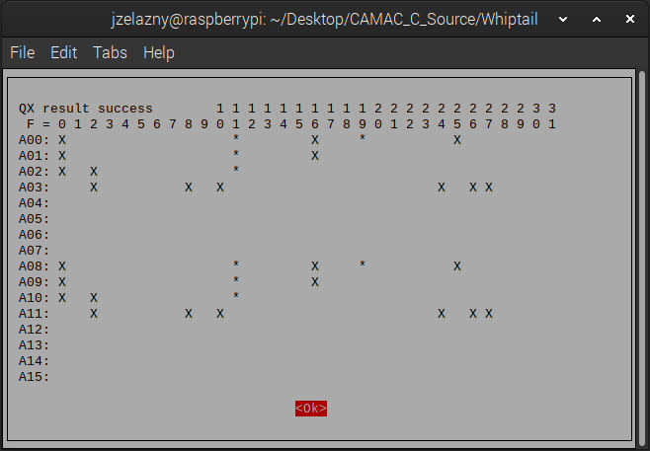
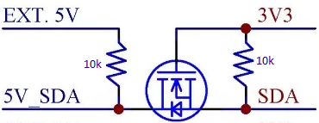
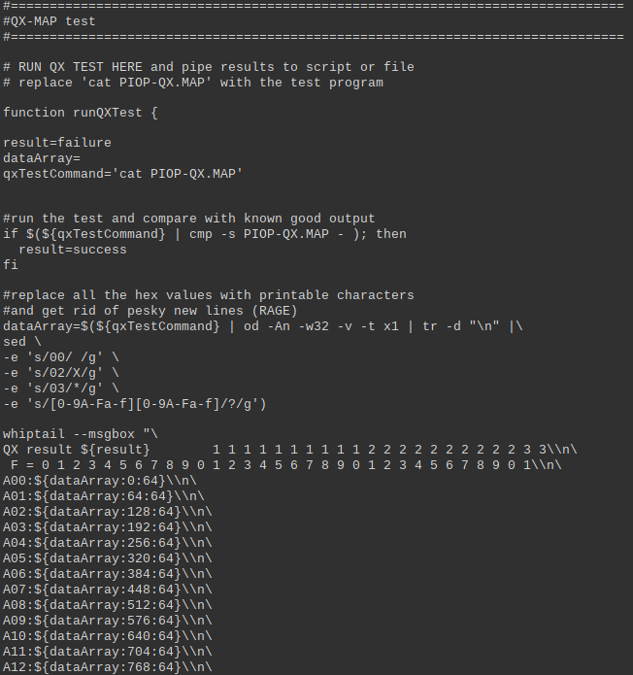
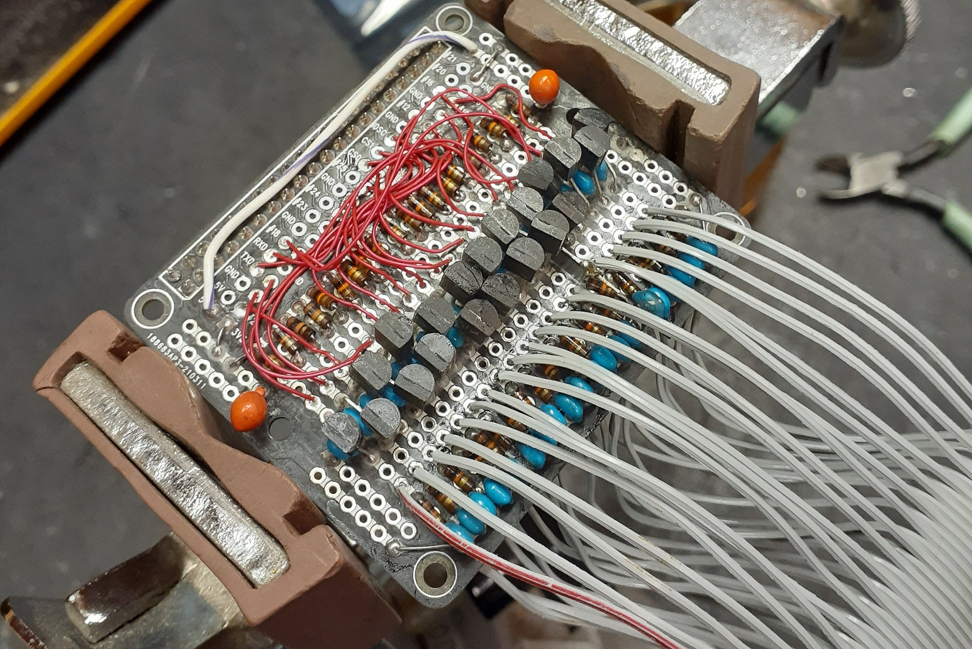
CAMAC Repair Bench
Modernization
By: Julian Zelazny
Introduction
The two devices must be able to read and write to the same data bus, resulting in the Raspberry Pi being unable to assert enough voltage (3.3v) for the TTL (5v) to understand. In contrast, if the TTL asserts data on the bus, the Raspberry Pi can be damaged by overvoltage. The solution was to use a bidirectional logic-level shifter circuit
Future Applications
The Computer-Aided Measurement And Control (CAMAC) system is a modular-crate electronic standard used at SLAC to measure various accelerator electron beam parameters. A repair bench is set up where these card modules are repaired and tested with an MS-DOS machine, from 1988, running custom software. This DOS machine does not have a replacement for when it breaks beyond economical repair, nor does the software work with any current operating system, as the programming language and framework rely too much on DOS functions and memory management.
Due to the amount of time debugging the hardware and the difficulty of reverse engineering the CAMAC crate controller card before switching over to a different card, only a single test program was developed. There are still a dozen test programs to port over, and the CAMAC abstraction layer is still incomplete. With more time, one can finish the abstraction layer and reverse engineer how the CAMAC card's test software works.
Project Body
Conclusions
The project’s purpose is to develop a replacement for the DOS machine running the test stands with a Raspberry Pi and, consequently, replace all the programs used in the DOS machine with Linux equivalents. All the software to test CAMAC modules is written in a language known as Forth, a stack-based, reverse polish notation language that is hard to understand. Part of the project is to replace the Forth with C. C was chosen because it can be easily bound to other languages, unlike Forth. To interface the Raspberry Pi with the CAMAC crate controller used by the test stand, a custom Raspberry Pi 'hat' had to be created to facilitate the translations between the different logic families. The Raspberry Pi uses CMOS, while the CAMAC cards and crate controller operate at TTL.
The CAMAC system is still a vital system used at SLAC. For example, the LCLS Copper Linac High Power RF is controlled by CAMAC. Maintaining the system is still necessary. However, many cards were designed and built at SLAC, so the lab is the only place that can repair these CAMAC Cards. In addition, new tests require the development of new cards or modifications to existing cards. This requires new sets of testing software for the new features added to CAMAC. Therefore, we need to keep the hardware and software updated to facilitate the changes in the CAMAC system.
Custom built for the Raspberry Pi, this hat
had to be hand-made to interface with the
CAMAC crate controller before application
development could begin properly. After an
examination of the Forth source code, it was
determined quickly that it was unusable due
to poor readability and portability, and a
decision was made to rewrite everything
from scratch. Unfortunately, due to a lack of
documentation about the crate controller
being used, switching to SLAC's internal
crate controller instead of the original would
be better than reverse engineering the
original crate controller. However, we could
not get a working controller due to time
constraints.
Another aspect of the project required us to redevelop the GUI used in the test software due to Forth having built-in GUI tools. To mimic the GUI, Linux shell scripts and Whiptail were used. The Whiptail was used for the user interface, while the shell scripts were used for functionality. The applications are standalone as there is nothing unique about Whiptail or shell scripts. Changing the GUI framework to another, such as PyDM, is possible as long as the framework can call external applications.
Acknowledgments
Thanks to Richard Burgess for assisting in designing and troubleshooting the hardware and Kristi Luchini for information on the Serial Crate Controller.

