Slide 1
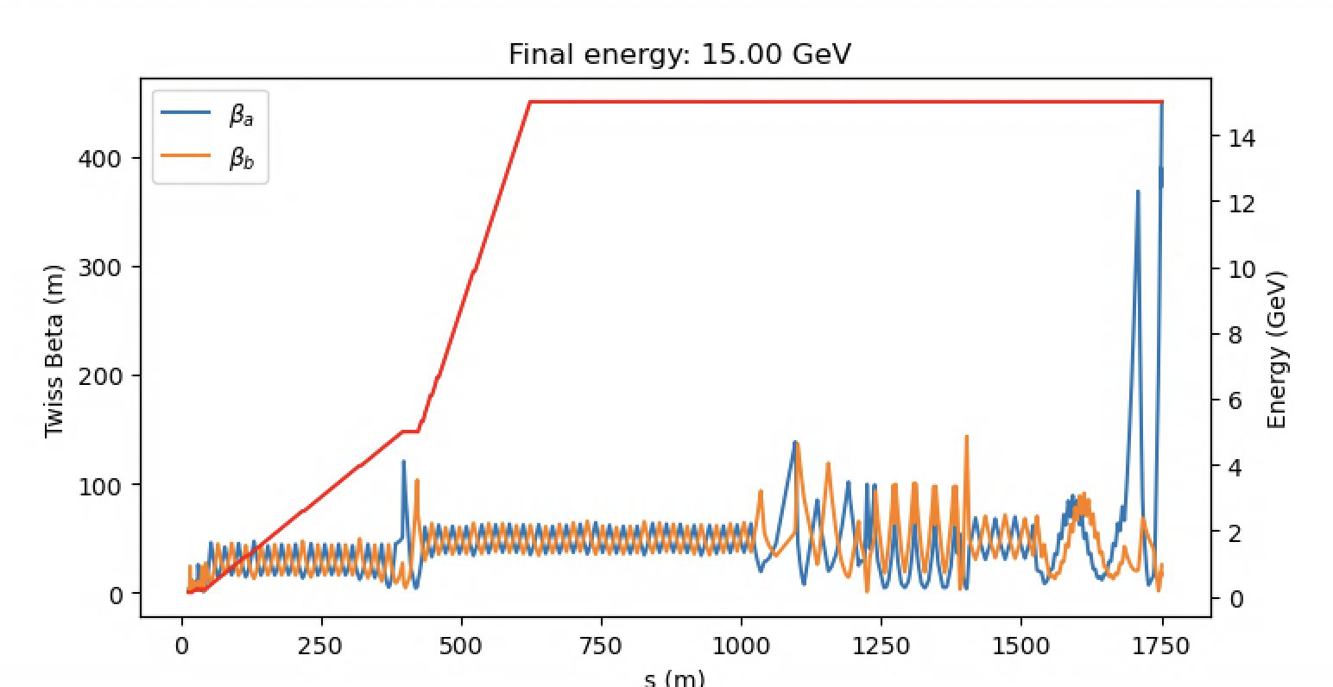
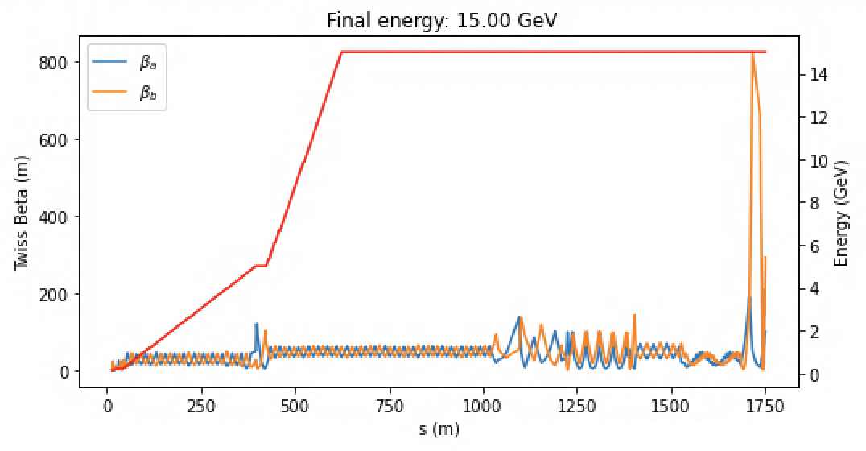
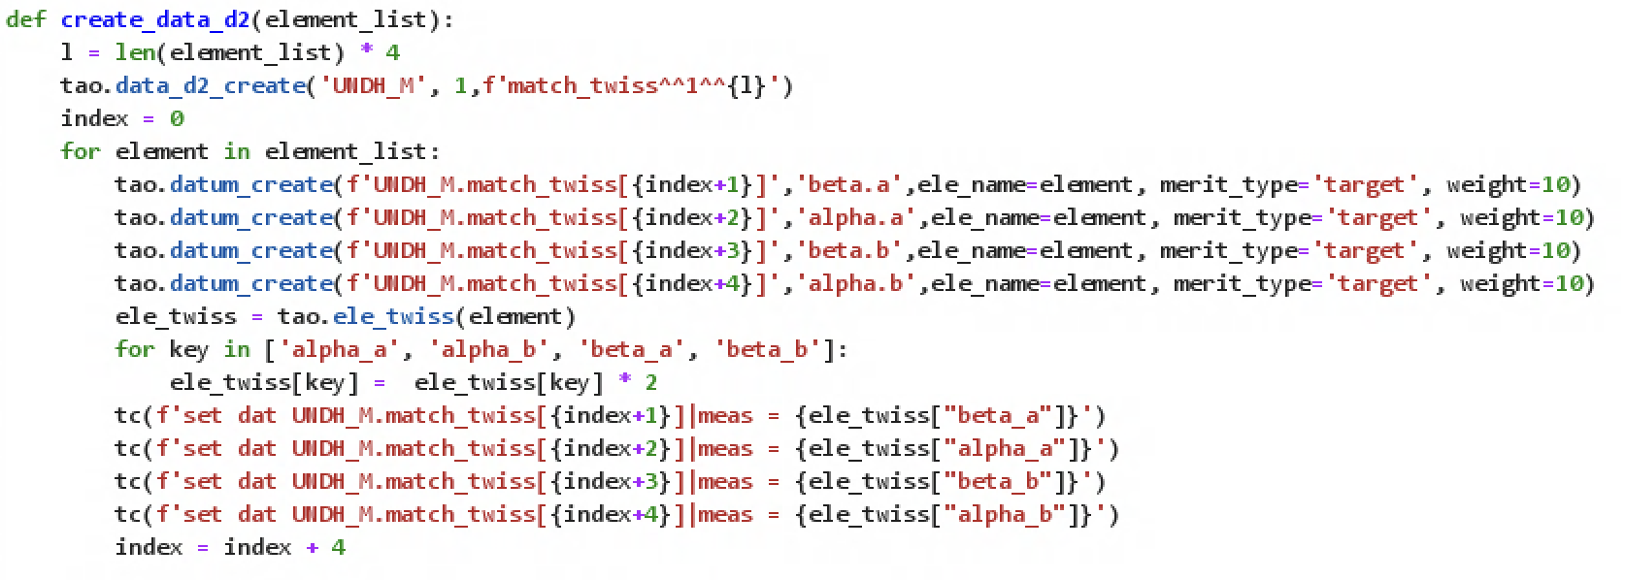
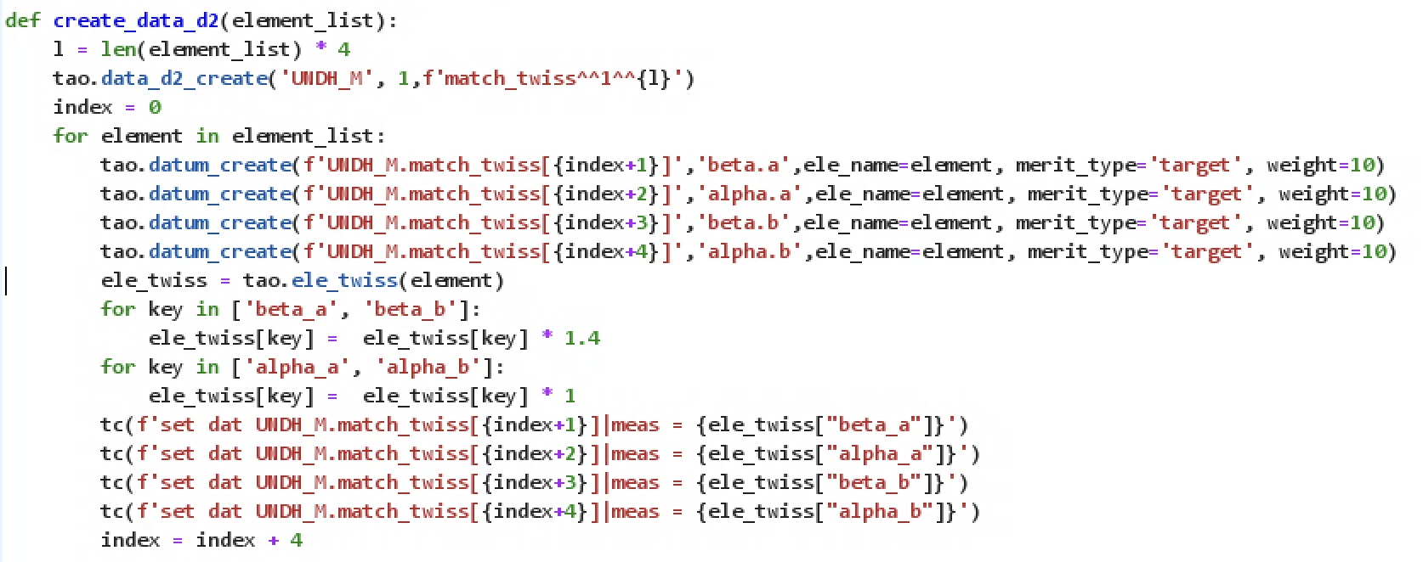
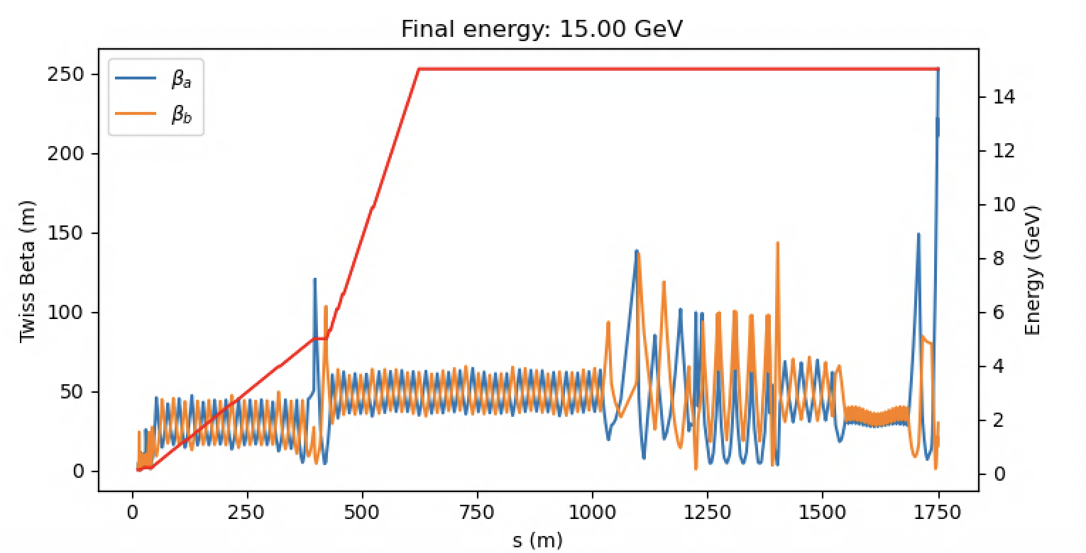
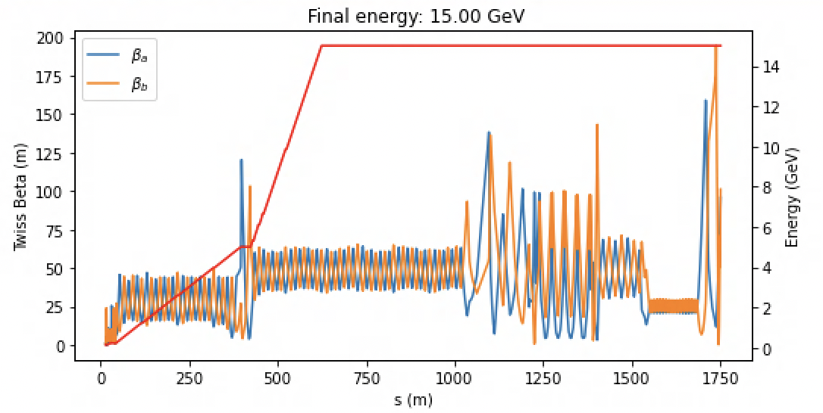
Undulator beta matching
Stephanie Keyes, physics student, Oregon State University
William Colocho, accelerator physicist, Linac Coherent LIght Source
Introduction
Start of project
Quadrupole field increase and result
Need
In the Linac Coherent Light Source Copper Hard X-Ray beam path, there is a need to match and optimize the beta function within the undulator at an electron energy of 15 GeV. The beta function is related to the thickness of the electron beam at any point in the machine. This value had extra, unwanted oscillations within the undulator. As a result, the laser energy dropped off sharply.
The optimization process uses the accelerator physics program Bmad, and uses Tao to interface with Python. Correcting the oscillation required parameters to be adjusted manually within the simulation code. Additionally, an automated optimizer was used to find ideal quadrupole field strengths in the region before the undulator and its associated quadrupoles.
Currently, LCLS runs electron beams up to 10 GeV. Operations at 15 GeV ideally would generate a higher energy laser, which would allow for improved X-ray spectroscopy. However, the beta function in the undulator is not yet optimized at this energy. The laser energy, therefore, is actually reduced compared to lasers from a 10 GeV electron beam.
By design, an undulator induces oscillation in an electron beam to generate photons. Without an optimized beta function, there is an extra, unwanted layer of oscillation that adversely impacts the quality of the laser beam.
Figure 1. LCLS beta function with quadrupole field strengths at 30 kilogauss, and no optimization applied yet. The boxed section is the beta function in the CU_HXR undulator.
Figure 4. Beta function before optimizations, with quadrupole fields increased to 40 kG.
Approach
Figure 2. Lines of code where manual optimization took place; a factor of 2 multiplying beta and its energy derivative alpha resulted in a reduced, but still noticeable, level of oscillation.
Optimization begins with accelerator physics simulation programs Bmad and Tao. Tao is the "bridge" between Bmad and Python, allowing control of Bmad within Python. This project uses both automated and manual optimization procedures.
Automated optimization involves setting data as parameters for the program to work within, along with variables for the program to change in search of an optimal solution. Parameters are input into a merit function to find this solution. The program adjusts variable inputs until the merit function puts out its smallest possible value with the input data.
This project uses an optimizer called lmdif. It uses a Levenburg-Marquardt algorithm, where it collects variables in a derivative matrix over multiple cycles. It aims to find a local minimum in a specific parameter. The fixed data input in this project are the beta function and its energy derivative alpha, in the quadrupoles in the area of the undulator. The variables are the field strengths in four quadrupoles preceding the set of quadrupoles where beta matching is being done.
Manual optimization involves adjusting a multiplicative factor on the beta function to smooth out the larger, unwanted oscillations. The images at right show this process. The plots are the beta function of the program model of the LCLS hard x-ray line.
Figure 5. Here, beta and alpha no longer share the same factor. Alpha is multiplied by 1, and beta by 1.4.
Conclusions
Optimal beam operation at 15 GeV would require quadrupoles QHXH13-QHXH45 to be set to a field strength of 40 kG. The beta function should be multiplied by 1.4 to limit the extra layer of oscillations and produce a higher energy laser. Meanwhile, alpha should not be multiplied by anything, to avoid disruption of the beta function in the dump. Quadrupoles QUM1, QUM2, QUM3, and QUM4 should be set to 41.19 kG, -34.43 kG, 19.30 kG, and –24.24 kG respectively. For a dump beta of at most 250m, the quadrupole settings for QHXH46, QUE1, QUE2, QDMP1, and QDMP2 are –53.92 kG, 42.47 kG, -30.32 kG, -44.68 kG, and –29.12 kG respectively. Unfortunately, QHXH46 can only reach a field of –42.46 kG, so more studies are needed for proper beam dumping.
Figure 3. The beta function after optimizations. A significant oscillation still appears in the boxed area, and further manual optimizations were still necessary at this point.
The project began with quadrupoles QHXH13 to QHXH46 set to a field strength of 30 kilogauss. Manual optimization proceeded based on graph appearance and a value called "bmag". This value quantifies how far off the model is from optimal machine design values. In Fig. 1, the factor was set to 2 and automated optimization hadn't occurred yet. The best bmag value obtainable at 30 kG was 1.41 ± 0.0153 for a and 1.43 ± 0.00879 for b, with the factor set at 1.8. The large oscillation had been reduced, but was still noticeable. Bmag averages and errors were calculated without data for QHXH46, as its data point was an outlier and the magnet is also used for the beam dump.
Figure 6. The best optimization of undulator beta achieved during this project. The large oscillation is greatly reduced. Dump betas in this graph are at the lowest value achieved during multiple code runs.
Here, the quadrupole field strengths were increased from 30 kG to 40 kG. This had favorable effects overall. The large oscillation became barely noticeable, and the bmag values reduced to 1.13 ± 0.00729 for horizontal beta and 1.13 ± 0.00489 for vertical beta. Again, bmag averages and errors were calculated without data for QHXH46. After optimizing undulator quads, optimization was done for quads in the beam dump line, leading to the graph in Fig. 6. This graph seemed to vary every time the program was run, with the undulator betas unaffected and dump beta maxima ranging between 200 and 250 m.
Acknowledgments
I would like to thank Auralee Edelen for making me aware of this opportunity, William Colocho for his guidance in this project, and Franz-Josef Decker for his contributions. Thank you to LCLS for giving me this opportunity to contribute to their scientific mission.

