Slide 1
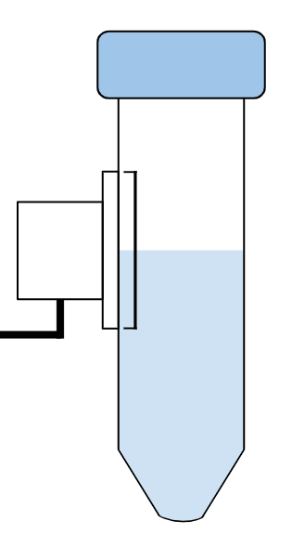
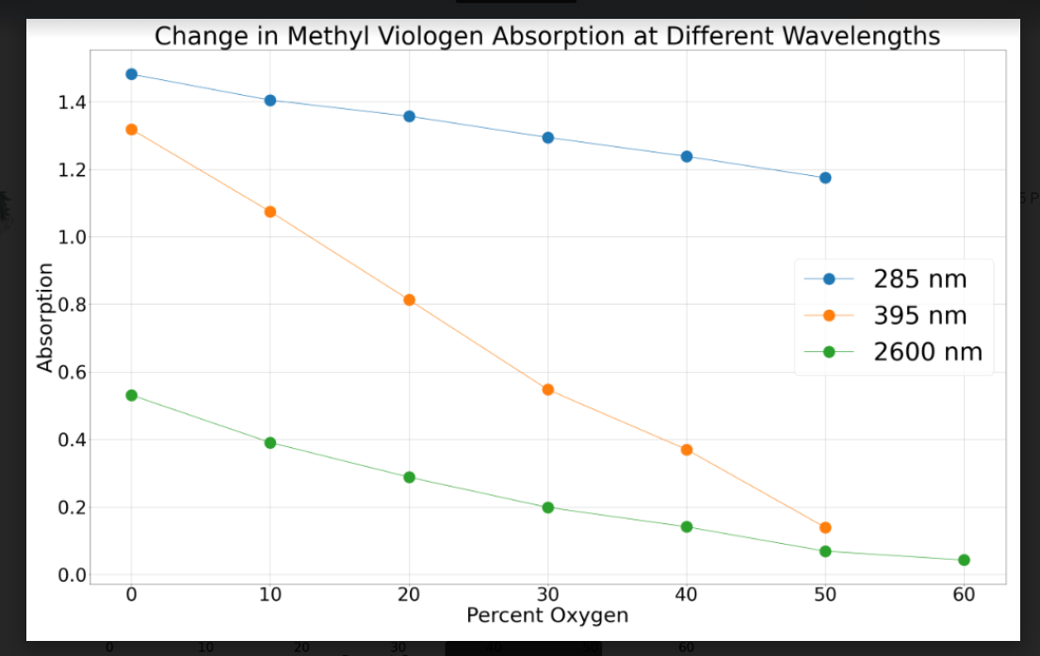
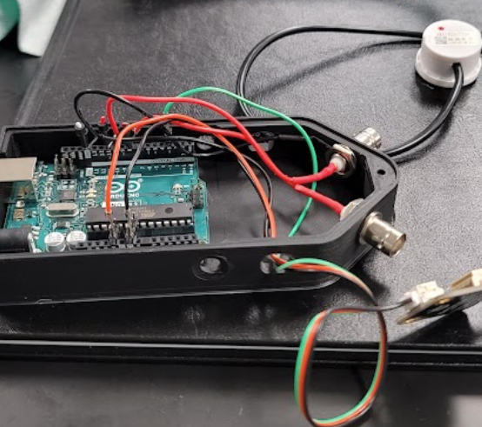
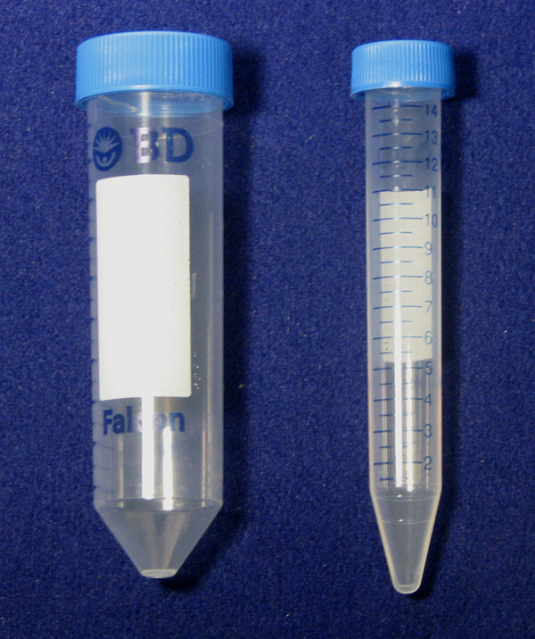
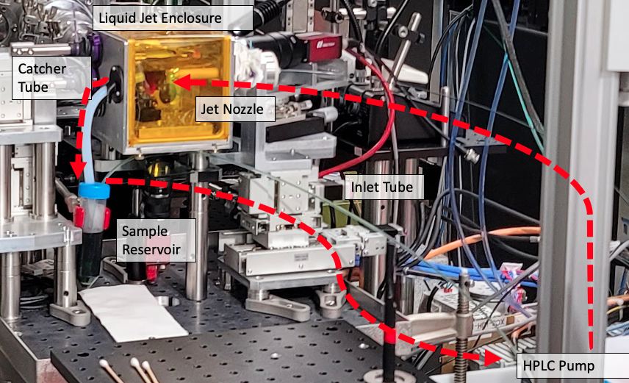
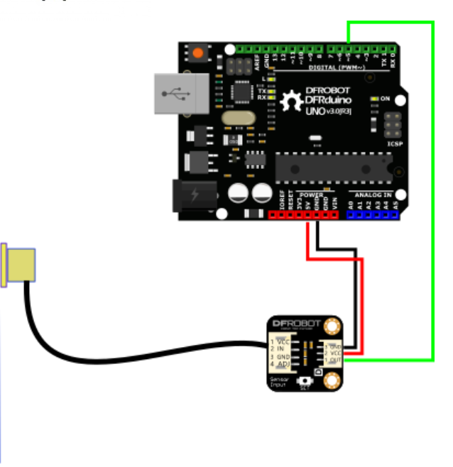
Development of a Liquid-Level Monitoring System and Molecular Oxygen Sensor
Stephanie Muggler, Leland Bruce Gee Jr.
LCLS, SLAC National Accelerator Laboratory, Menlo Park, California 94025
Why Liquid Level Monitoring?
Building the Monitor
Acknowledgements
Analyzing UV-Vis Data
Volatile solvents evaporate easily in the LCLS liquid jet enclosure, resulting in constant concentration chances as well as adding downtime to experiments. This creates uncertainty in LCLS experiments, creating a need for a way to monitor liquid levels within these reservoirs, hence the need for a liquid level monitor.
Thank you to both Leland and SLAC LCLS for hosting and mentoring me this summer. Thank you so much!
Change in Methyl Viologen Absorption at Different Wavelengths
Since the sensor is a binary capacitance sensor and can’t display liquid level as percentages, it was best to position it to only alert when the liquid level fell below a certain amount. This would mean an 8 mL drop for 50 mL, and 2 mL for 15 mL.
= 1.1”
= 8 mL
(50)
= 2 mL
(15)
Molecular Oxygen Sensing at LCLS
600 nm
Due to many inorganic and bioinorganic systems being intolerant to oxygen environments and no currently no way to assess how anaerobic the liquid jet system is. By performing benchtop anaerobic UV-Vis experiments “offline” we can calibrate the sensitivity of potential oxygen sensors to ensure anaerobicity. This experiment focused on calibrating Methyl Viologen as a possible oxygen sensor.
A change in absorption was shown most prominently at 285, 395, and 600 nm; graphing these changes as a function of percent oxygen gives a linear trend, as predicted by Beer’s Law.
There are some discrepancies, as at 600 nm, the trend was more curved than linear, most likely due to not adding the exact amount of oxygen.
The Arduino monitor was then hooked up to BNC cables and placed in a 3D printed case.
Sensor Considerations
In order to fit into the liquid jet enclosure, the monitor must fit into both a 50 mL and 15 mL Falcon tube.
Designing the Experiment
O₂
[MV]⁺ ⇌ [MV]⁺² + e⁻
Future Improvements
Na₂S₂O₄
The sensor must also be able to communicate with its user via python.
Deep Blue
Clear
The solution was to place the UV-Vis fiber optics and cuvette holder in a glove bag, and conduct the experiment inside.
Our solution was to use a non-contact sensor that is programmable via Arduino and Pyserial.
Anaerobic Solution immediately after dithionite is added
Solution around 4 minutes after
Glove Bag with UV-Vis fiber-optic cables
UV-Vis
Spectrometer
O₂ / Moisture
Removal
Column
Despite sparging separately with both N₂ and Ar, the methyl viologen solution still lost color, due to oxidation, after a few minutes. This indicates that the crimp bottles weren’t completely airtight.
A future goal would be to connect the Liquid Level monitor to the liquid jet or to regenerate reduced Methyl Viologen using light with EDTA and proflavine.

