Slide 1
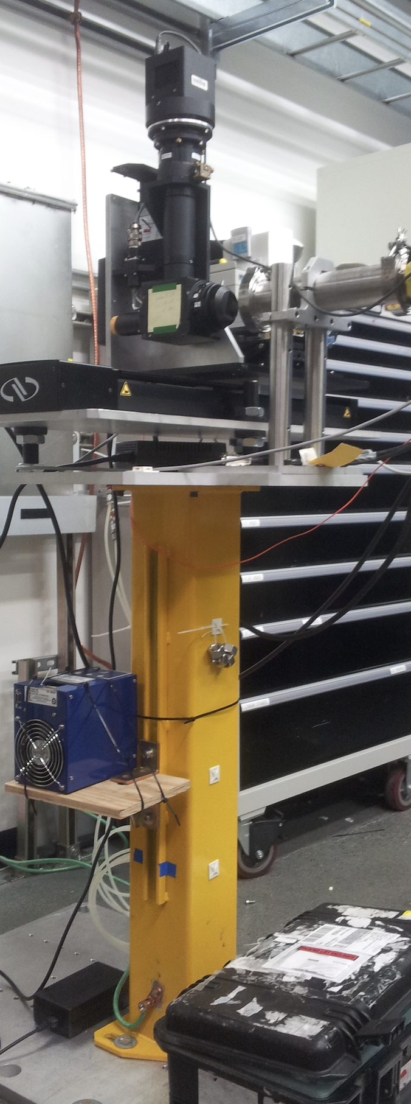
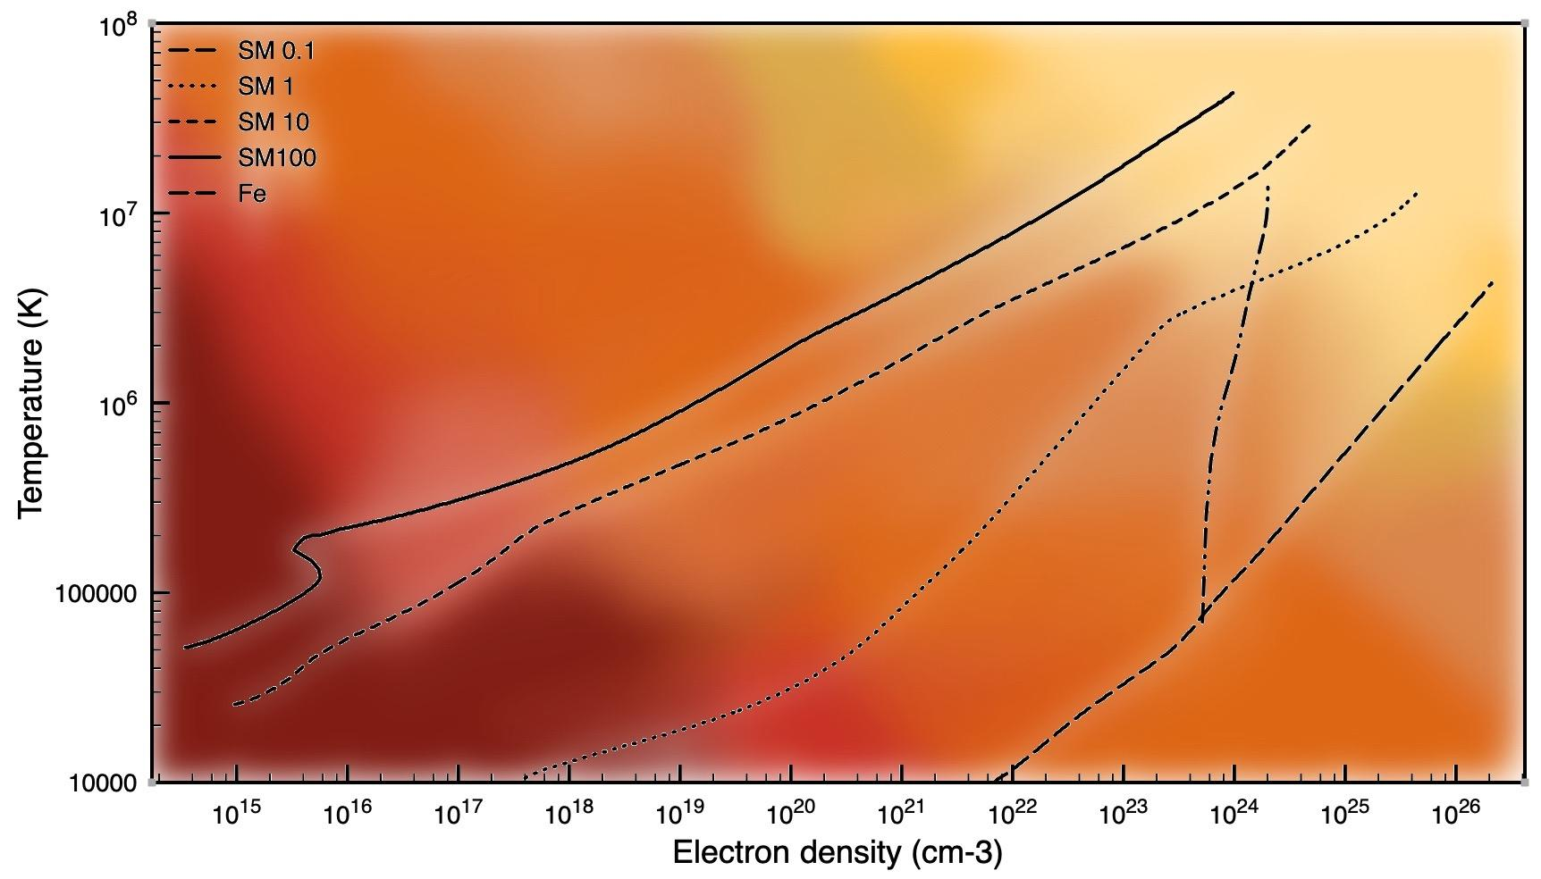
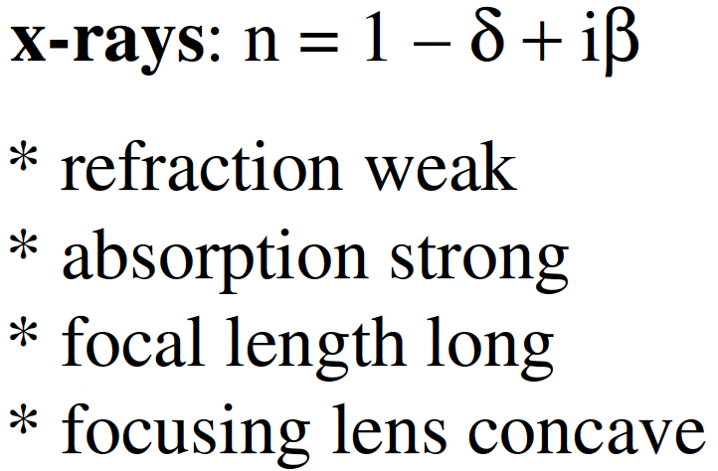
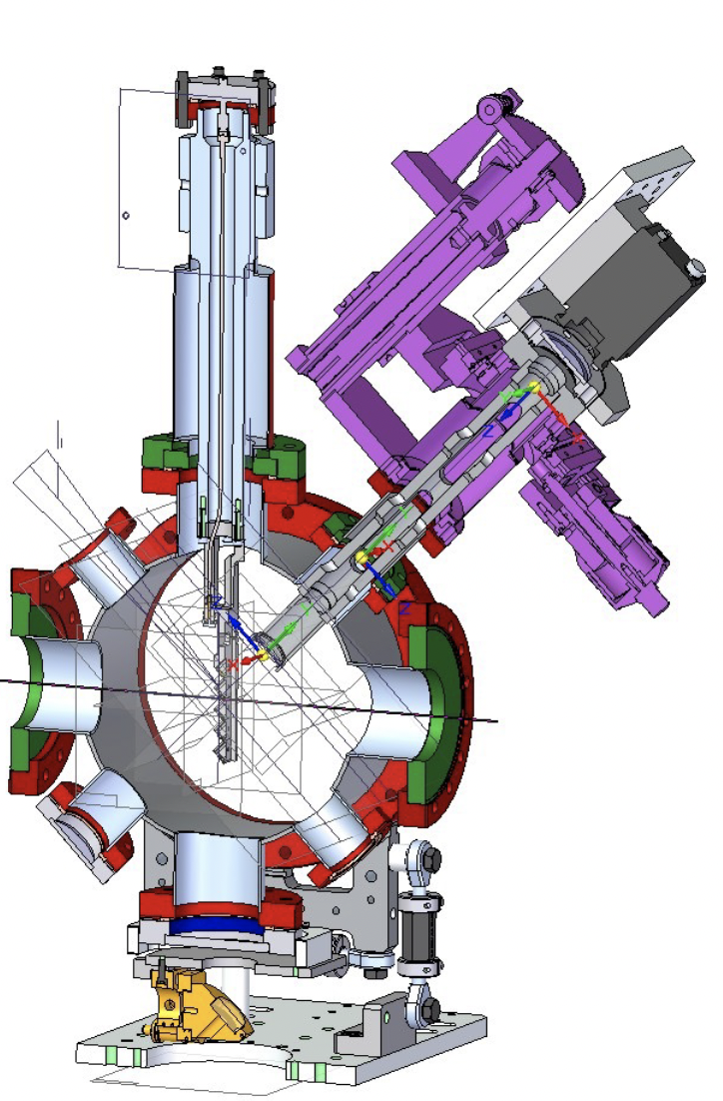
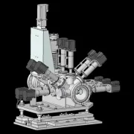
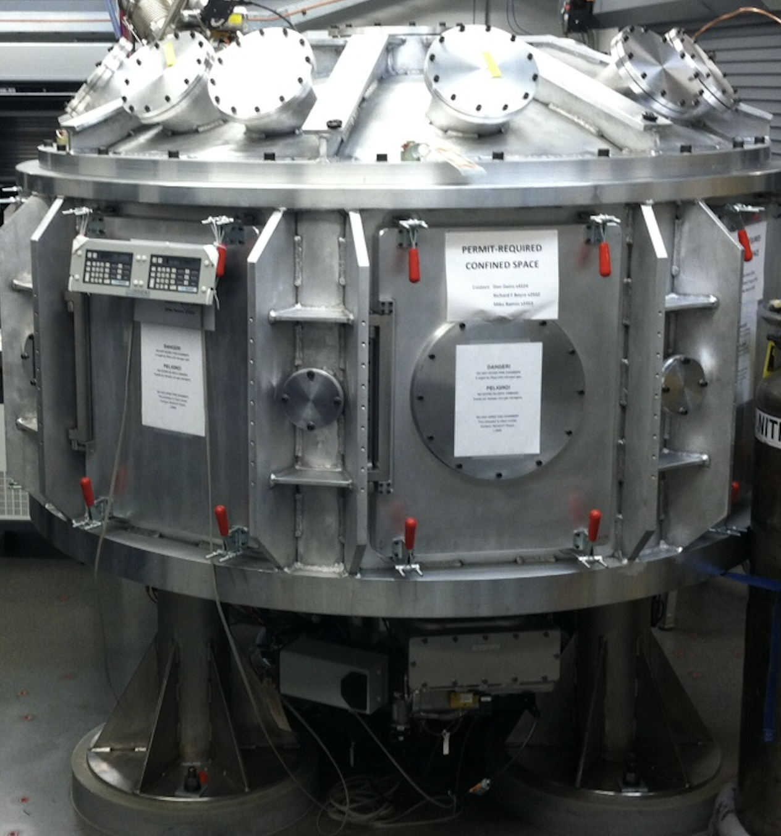
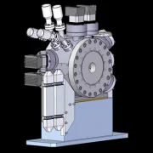
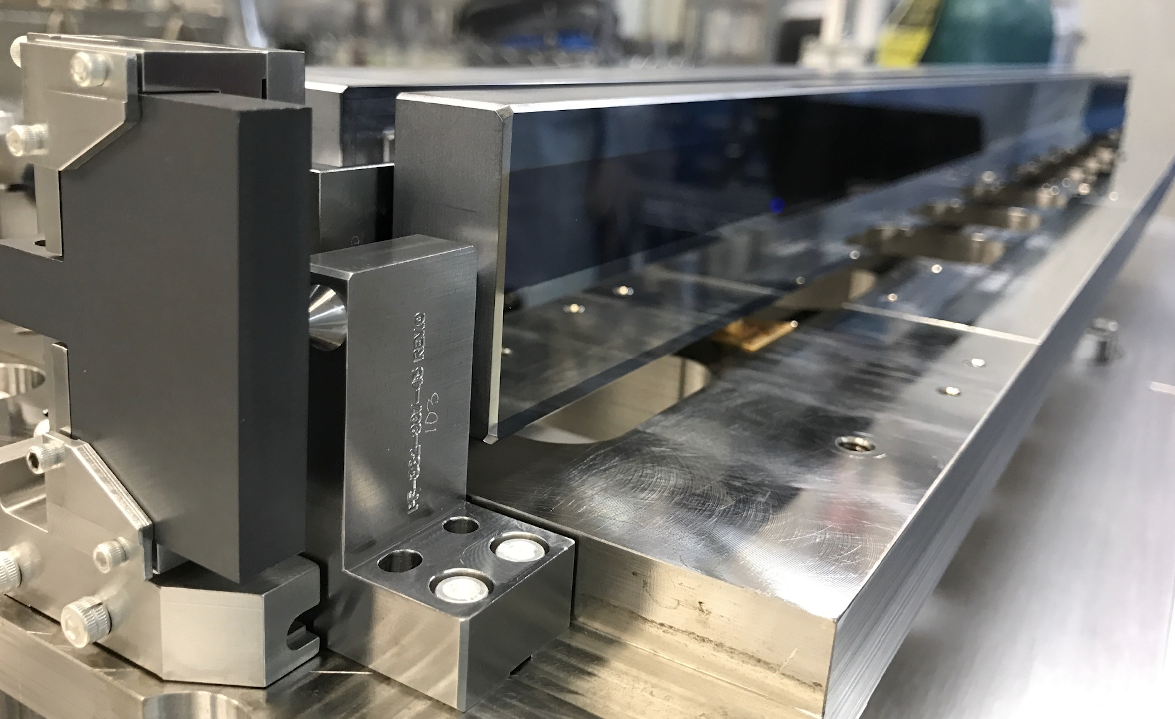
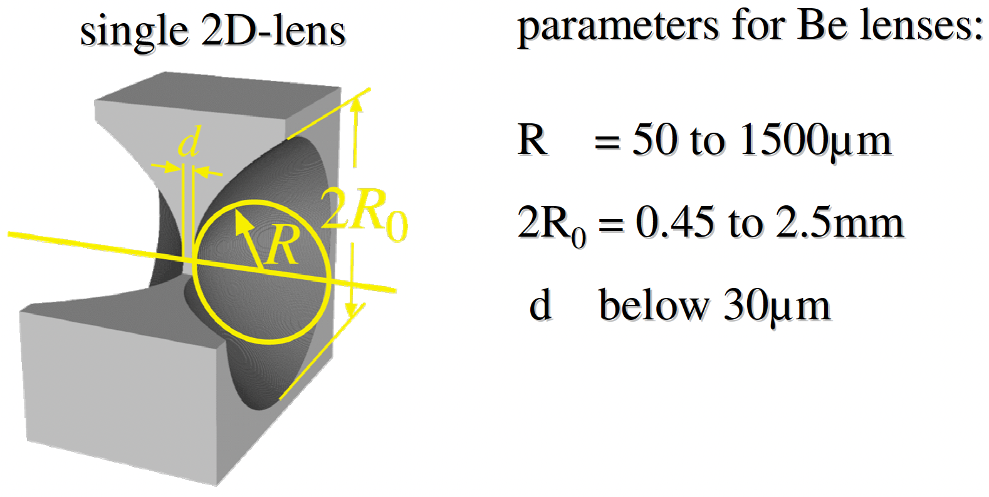
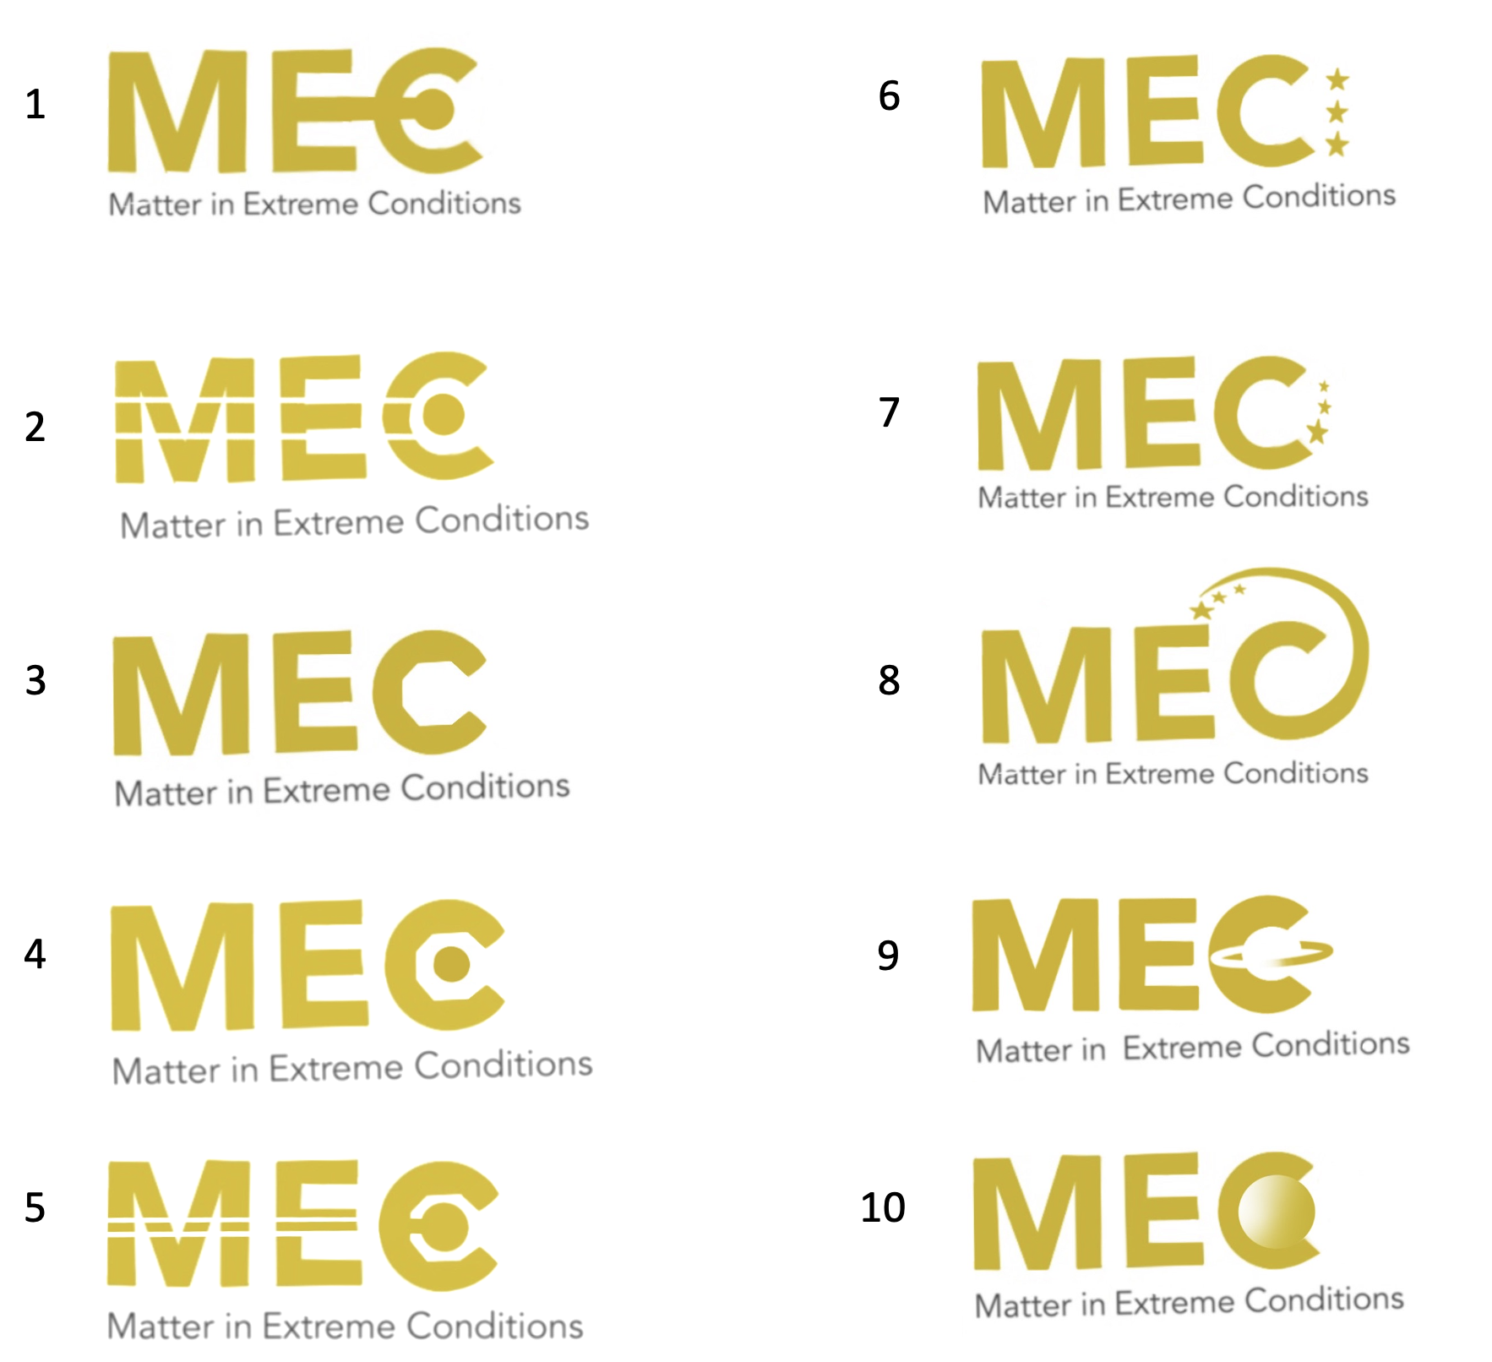
Visualization of Matter in Extreme
Conditions(MEC) Instrument
Samantha Welch and Hae Ja Lee
Introduction
I am a sophomore at Grand Canyon University. My Degree that I am working towards is Digital Design and Animation and this internship helped me be familiar with scientific instruments and idea and learn what my job will be like in the future.
My internship this summer was focused on redesigning some of the figures on the MEC schematics of X-ray beamline and recreate it to be more modern as well as creating icons.
Zyla is a detector coupled to Optique-Peter X-ray beam imaging microscopes.
MEC target chamber is used to confine FEL beam, optical laser light and sample’s interaction within vacuum. It has 2m diameter optical table inside and accommodates sample stages, optics relays, and various X-ray diagnostics including spectrometers and diffraction detectors. I created each icon similar to the real object.
This is a single slit, I created this in this matter to describe its function, these slits are made of silicone because silicone does not get destroyed by the laser and allows the laser to continue its job correctly and is formed is a hatchet like way.
Be lens system is used to focus the X-ray beam down to 1~2 micron size. The travel stage underneath the Be lens system allows to change the X-ray beam size at TCC.
Time Tool allows us to measure the jitter of the X-ray’s jitter. The jitter is on the order of hundred femtoseconds. This tool enables better characterization of error for MEC short pulse experiments.
Beam stopper 6(S6) aims to block the X-ray beam and not allow any X-ray beam pass through.
The pre-focusing lens is built to slightly focus and send the X-ray beam to X-ray focusing lens in hutch 6. It increases X-ray transmission at MEC by allowing geometrical acceptance of Be lens wider.
A pulse picker and attenuators allow one pulse through the chambers and attenuate the X-ray beam’s intensity, respectively. Chopper wheel icon is applied to present pulse picker and attenuation of the beam.
HOMS Mirror (MR1L4)
Phase Diagram of Solar Mass (SM) and isochorically Heated status of Fe by X-ray FEL beam
a.k.a XRT-M2 mirror located at XRT is a mirror deflecting the X-ray beam toward MEC or MFX. It provides high, single-surface reflectivity, R>90%, over an acceptable, large fraction of the LCLS-II hard X-ray range, 1 keV-25 keV.
This figure presents density-temperature track from the surface to the core stars on the Zero Age Main Sequence, with solar masses. The color lines are showing interior structure models for main-sequence stars of different masses: 0.1, 1, 10, 100 times of solar mass. By LCLS hard X-ray pulses, the Fe can be isochorically heated to 10⁶⁻⁷ K and the condition is noted as a red-dotted line in the figure. Indeed, X-ray heating experiments at CXI and MEC have showed that the solid-density Fe plasma at temperatures in excess of 10 million K and electron densities greater than 2☓10²⁴ cm⁻³, passing through stellar core-like conditions as the figure shows.
This figure was created using the Procreate software and a background of the heat signatures shows from warm to hot and is filling in what needed to be changed according to where the heat is coming from.
MEC Icons
A side project that I had worked on during my internship was creating icons for MEC. The selected one is going to be used as an unofficial icon at versatile purpose when it is needed. I created a variety of icons for MEC to choose from and MEC members had a chance to vote for which one they would want more. The one chosen for the use was number 5 which represented the octagonal chamber within the C, the white lines representing the laser, and circle for interaction.
Conclusions
This summer I have learned to create new and exciting things that has helped MEC with the improvements on figures for the MEC websites and X-ray beamline. This experience has helped me with my communications and finding out what I can do to help benefit MEC and their work.
1. The circle presents the MEC target chamber, and the line from E representing the LCLS light.
2. This is a similar design to number 1 with the same reasonings but the design of the LCLS light is slightly different.
3. The 8 flat sides inside the C represent the 8 sides of the MEC target chamber.
4. Similar design to number 3 and with the circle showing interaction.
5. This was the chosen icon representing the octagonal chamber within the C, the white lines representing the laser, and circle for interaction.
6. The three stars represent something different for each star, one for MEC, X-ray, and optical beam and same for 7 and 8.
9. This and 10 represented planets.
Acknowledgments
I would like to thank everyone in MEC that has helped me throughout the internship. Meriame, Eric, and Dimitri not only helped me gain more knowledge and experience but they have also became great friends and I appreciated the time I had at SLAC to get to know them.

