Slide 1
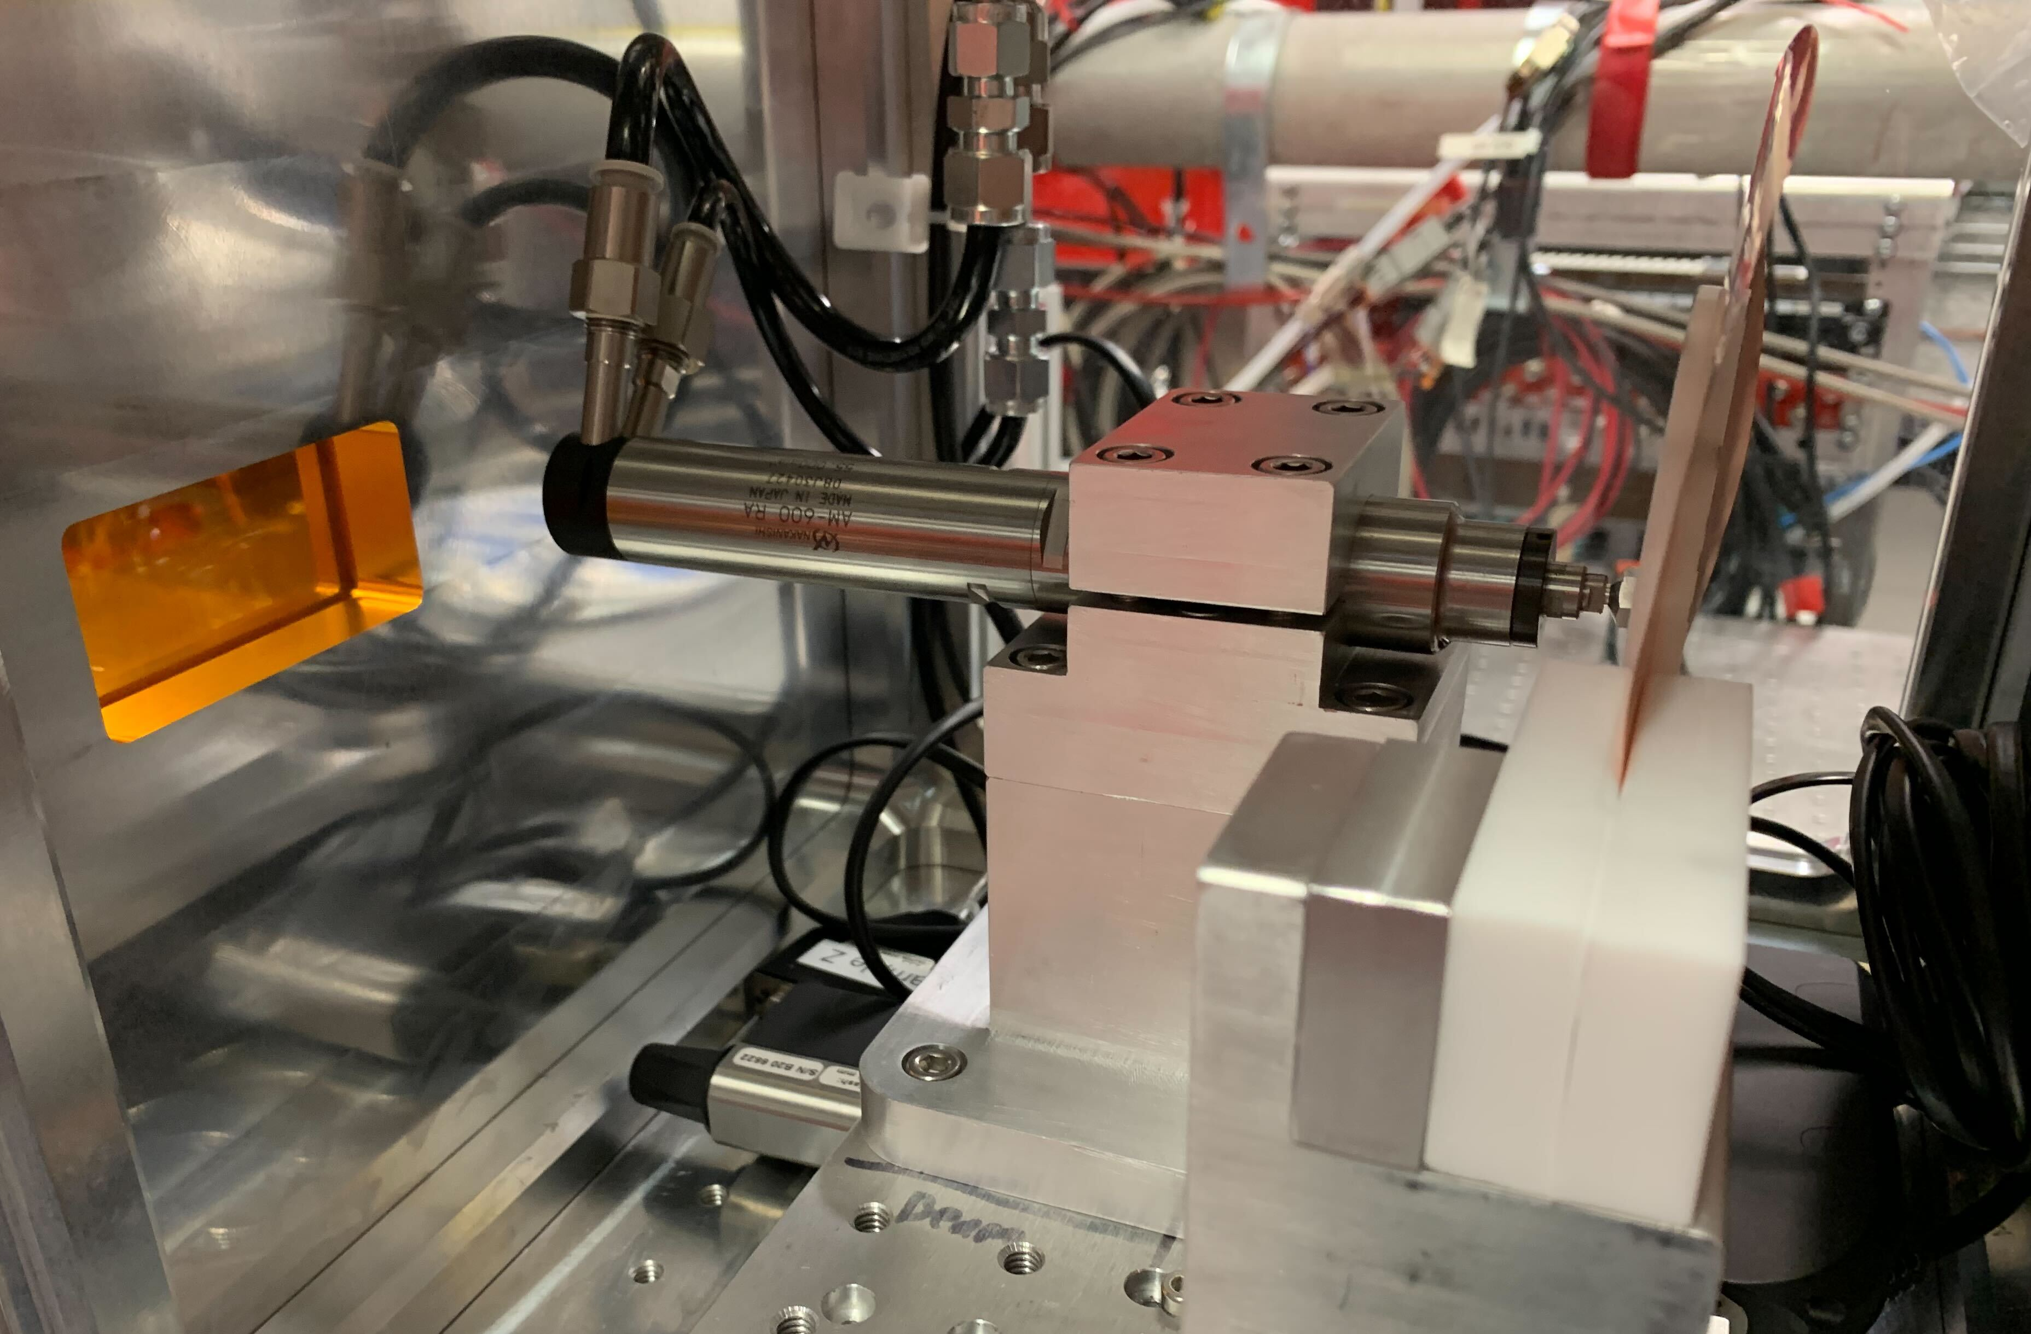
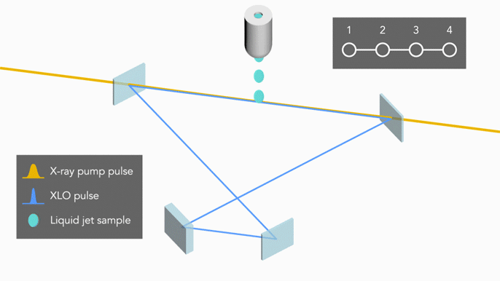
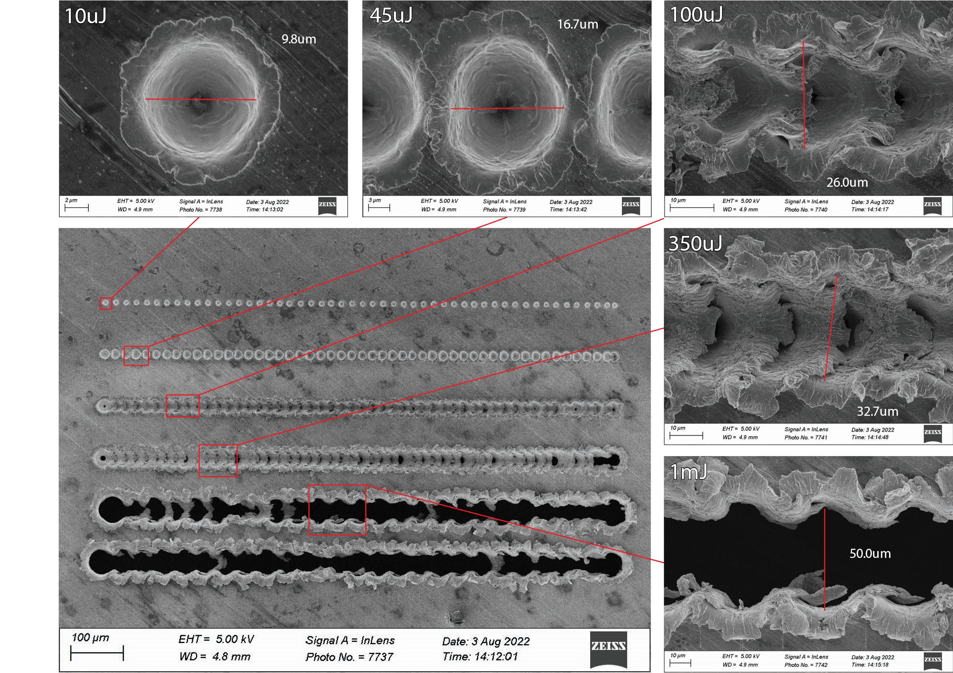
Development of a Stable High Velocity Solid Target Gain Medium for XLO at CXI
Noah Welke, Alex Halavanau
Introduction
Fast but Short-Lived
Slow but Long-Lived
Further Development
X-ray Free Electron Lasers (XFELs) are an integral tool for examining the electronic and molecular structure of materials on the fs time scale. Yet the sometimes-significant pulse variation provides a consistent difficulty for many experiments. To solve this issue one proposal is to create an X-ray Laser Oscillator (XLO) that can take the stochastic XFEL beam and create coherent and highly stable pulses.
Such an XLO needs a gain medium that the XFEL pulse excites into amplified spontaneous emission (ASE). The target energy of the pulse we want to produce is 8 keV and thus Copper’s Kα line was a natural choice.
In this project we designed, constructed, and tested a stable high velocity solid target gain medium at the copper Kα line for use in an XLO cavity.
The two common options for rapid sample delivery are using a liquid jet and mechanical motion. In our case previous experiments have shown a sample jet doesn’t contain enough copper atoms in the Rayleigh length to get efficient ASE so that left us with mechanical motion of a copper metal target.
For speeds of 300m/s there are few if any linear stages that can achieve those speeds. Thus, rotational motion became the only viable option. A reasonable sized rotor that fits in XLO is around 150mm in diameter requiring a rotational speed of around 30,000 rpm.
The best method to achieve this speed under the load of the target is an air spindle system that uses high pressure gas to drive a turbine to extremely high speeds.
For the alignment system we want to prioritize stability over speed as it only needs to match the 120Hz (7200 rpm) repetition rate of the XFEL pulses.
For low speed, stable, and consistent operation a traditional DC motor will more than suffice. We implemented a low vibration, low heat, low noise motor as to get the most consistent rotation and stability from our gain medium during alignment.
Currently the system is operational but there are several big areas that could be improved in the future.
Fast Target Lifetime: The fast target currently needs to be replaced multiple times per hour, this is fine for the development phase but for operation of a fully functional XLO this is not acceptable.
Speed Tuning: In order to get the most out of each copper target tuning the rotational speed and linear travel together to create a rastering effect on the foil would be ideal.
Characterization of Minimum Gain Medium Travel for ASE: In order to get more consistent performance out of the system the lower we can go in speed the better. As such characterizing what our ASE signal is after traveling different distances from the created crater would give us valuable information on what speeds are acceptable.
Design Constraints
Deployment in XLO
DC Alignment Assembly
The copper gain medium is subject to a rather specific set of design constraints due to the XLO application.
High Speed: The XLO cavity is approximately 10m in pathlength, corresponding to just under 35ns pulse separation. The gain medium must be able to replenish to fresh copper in this time due to the next constraint.
Consumable/Replaceable: The 9 keV XFEL pulses that are used to excited ASE also cause a plasma to form which rapidly expands and destroys the target in a cylinder of around 20μm diameter around the beam.
Extremely Thin and Stable: The Kirkpatrick–Baez (KB) mirrors used to focus the XFEL beam have a Rayleigh length of around 100μm. So, to be in focus the target must be smaller than that, with oscillations not exceeding that range.
Lifetime: The lifetime of the gain must be sufficiently long as to allow alignment of the cavity’s crystals and optics without interruption.
These constraints directly conflict with each other on several accounts. Due to the stresses that the required 300m/s speed put on the required foil (thickness<100μm) the target will rapidly deteriorate much quicker than the required lifetimes for cavity alignment. Thus, the decision was made to bifurcate the project into:
Slow but long-lasting target
Fast but short-lived target
This was possible because the alignment only requires a single pulse to traverse the cavity due to relatively high-fidelity diffraction of the Si Crystals.
By using a slit system, we also made it so that alignment does not rely on the spindle assembly but instead on this guiding slit and so we can hot swap in the air spindle for two pulse operation and back to the DC motor for alignment with no problem.
Air Spindle Assembly
Crater Characterization
Figure: SEM images of craters caused by XFEL pulses at various powers incident to 25um thick copper foil. 20um horizontal spacing between shots. 100um vertical spacing between powers.
An important step before using this setup in XLO was to do a crater characterization with SEM to verify the speeds required for the gain medium motion. As can be seen in the 100uJ case, which is the most similar to the power XLO will use, the crater size is indeed on the order of 20μm. This provided important verification that the initial conception of a solid target was indeed accurate.
The folding effect observed here in 100uJ and 350uJ is also a good result as it shows that the 20um spacing between the shots is sufficiently high to prevent a clean cut like in 1mJ that would destroy the copper target within a few thousand shots.
The XLO Cavity is made of four silicon crystals that form a tunable cavity specific to the copper Kα line. The jet in this cavity would be replaced by our solid target gain medium.
The solid target will be used in a beamtime in conjunction with the XLO cavity later this week and will also be used in November after the shutdown when we will hopefully be able to get a closed cavity with high-speed two pulse operation.
Acknowledgments
Big thanks to Dr. Alex Halavanau, Dr. Claudio Pellegrini, and Dr. Uwe Bergmann
SLAC National Accelerator Laboratory, LCLS

