Slide 1
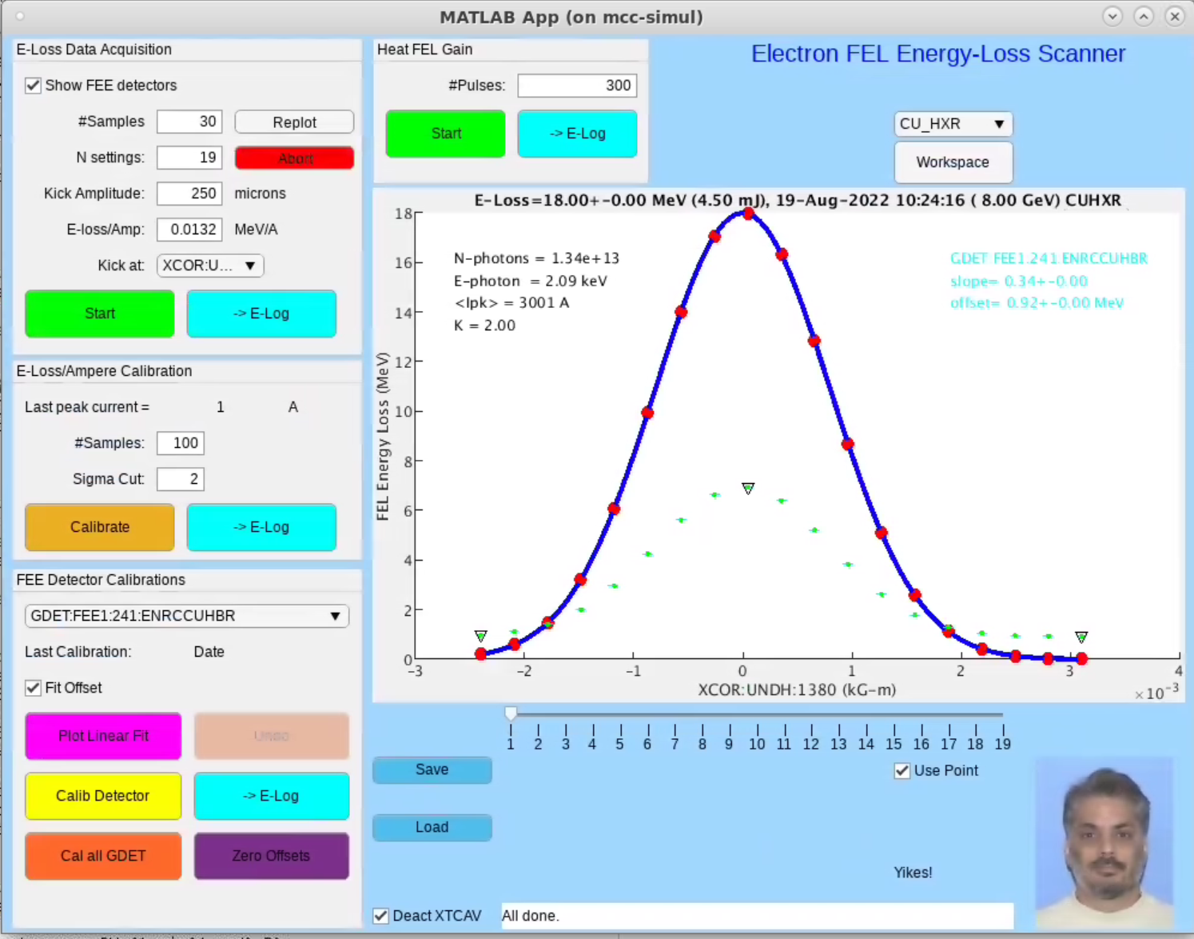
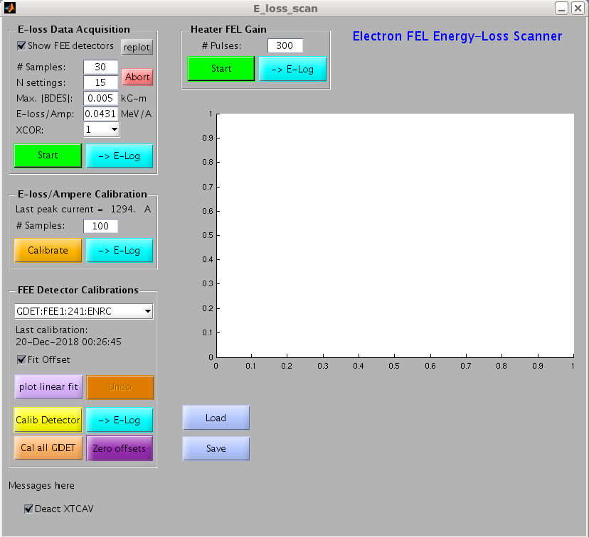
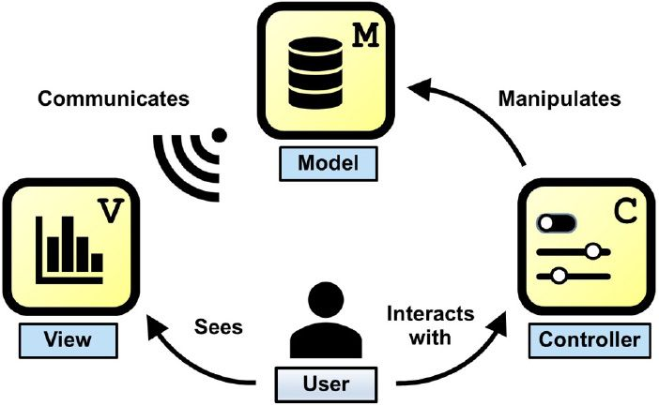
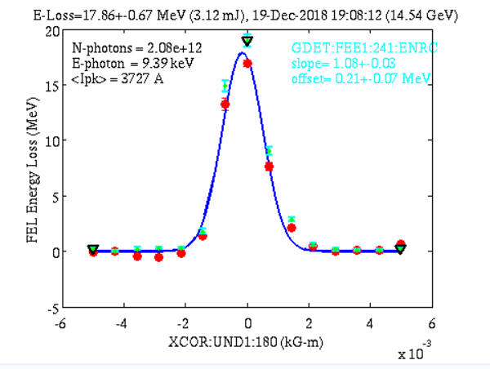
Development of the Energy
Loss GUI
Nathan Chang
With their new release of Matlab 2020, MathWorks has decided to shift their UI tools away from Matlab GUIDE and towards their new product Matlab App Designer. With this new focus, many of SLAC’s GUIs (Graphical User Interface) have been left obsolete and must be updated before GUIDE support completely stops. One of these GUIs was assigned to me for my 10 week LCLS internship, more specifically the Energy Loss GUI.
The Energy Loss GUI is used on LCLS I for both the soft x-rays and the hard x-rays. However, there are plans to expand this GUI for LCLS II.
What the E-Loss GUI specifically does is help us measure the pulse intensity of the x-rays that are created. This is done by using gas detectors, however one problem is that the gas detectors need to be properly calibrated in order to get an accurate reading of pulse intensity. Now, in order to calibrate these gas detectors, we take an energy loss scan because the amount of energy lost is proportional to the amount of photons produced.
The Model View Controller Architecture, is a type of programming architecture that follows the principle of separation of concerns. The way this architecture is implemented is by splitting each GUI into two parts, a model and an mlapp. This allows the model to function as the model, while the mlapp functions as both the view and controller.
The reason why SLAC has decided to use the MVC approach is because it drastically reduces the runtime needed to compute data. This is because Matlab App Designer is designed to be very light weight and not computationally intensive at all. We learned this in a meeting a few months before my internship with a meeting with Matlab. Which means that during my time as an intern, my job was to help figure out the implementation of this architecture. Which was successfully accomplished by looking at documentation, copy pasting code, and basic testing.
Completed GUI
Introduction
Energy Loss GUI
Model View Controller
The primary tool in developing this GUI is Matlab. However the environment for Matlab is on Linux, specifically CentOS. Development of this GUI was also through Simulacrum, which simulates the accelerator so users don’t have to interact with the actual accelerator when developing and testing their programs and equipment.
Materials and Methods
The implementation of MVC into SLAC will allow us to make better GUIs for the ACR, which will make the control of the beam a lot easier. Specifically, the E-Loss GUI is ran practically every day and will be used in the ACR after it is has been fully tested.
Conclusions
What is Simulacrum? (Bmad, Tao, Services, and PVs) - Superconducting RF - SLAC Confluence (stanford.edu)
E-Loss - MCC Wiki (stanford.edu)
Developing MATLAB Apps Using the Model-View-Controller Pattern - MATLAB & Simulink (mathworks.com)
Literature Cited
I would like to thank Jake Rudolph for teaching me how to implement MVC, along with William Colocho and Eric Tse for explaining to me how the E-Loss GUI works
Acknowledgments

