Slide 1
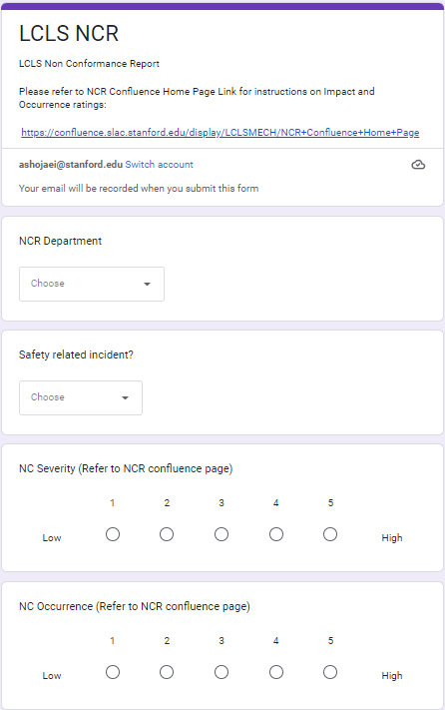
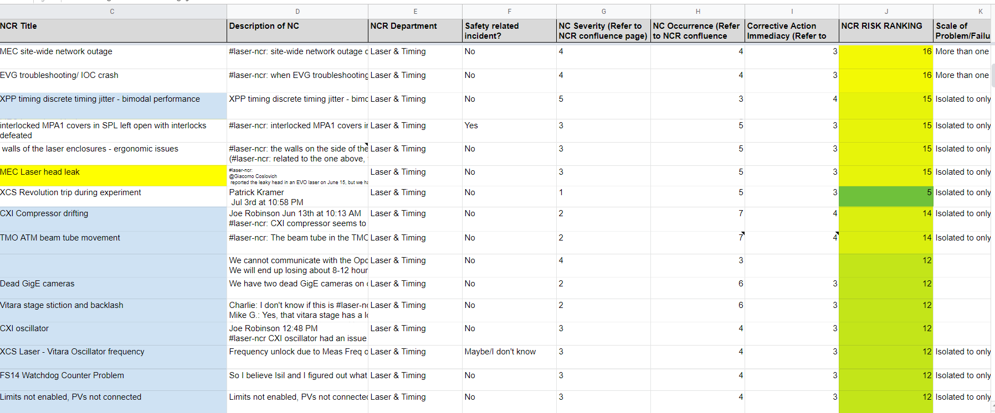
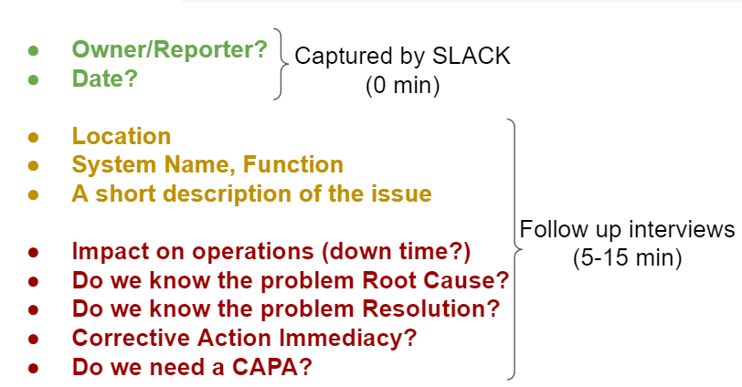
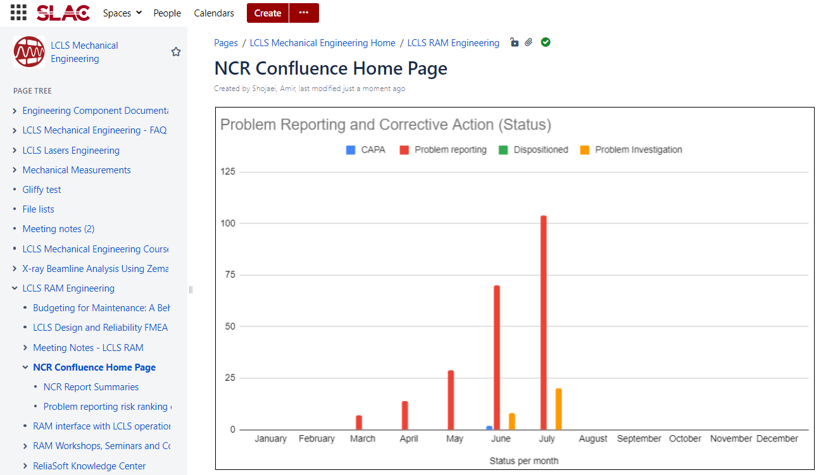
Failure Reporting and Corrective Action System (FRACAS) for RAM Program
Lucia Rogers (Mech Engineering, Missouri University of Science and Tech)
Mentor: Amir Shojaei (LSR Eng. and Timing Systems)
Introduction
STEP 1: Non-Conformance Report Entry
STEP 2: Data Entry/Problem Assessment
LCLS Laser engineering is launching a Reliability, Availability, and Maintainability (RAM) program. Failure reporting is a key tool in a successful RAM program.
My internship this summer was focused on developing a test case protype for a failure reporting and corrective action system software for laser operations.
SLACK: #laser-ncr
FRACAS Process:
Non-Conformance Report entry
Data Entry/Problem Assessment
Corrective Action Preventive Action
Data Analysis and Feedback to Ops
STEP 3: Corrective Action Preventive Action (CAPA)
STEP 4: Data Analysis and Feedback to Ops
Conclusions
Three key FRACAS take aways from my summer internship
Finding the balance between reporting issues in a detailed manner, and not interrupting laser ops
Being proactive and taking precautionary measures instead of running a system to failure
Robust collaboration with Laser Ops is essential for success in the FRACAS program
LCLS Laser engineering is launching a RAM program. RAM requires rapid failure entry. We developed a homegrown FRACAS tool to identify the major challenges and lessons to be learned as we establish the official XFRACAS program.
Acknowledgments
Special thanks to my mentor Amir Shojaei, my manager Mikael Martinez, Steven Yang, Nina Lui, fellow staff engineers, and everyone else whose contributions made my LCLS intern experience possible.

