Slide 1
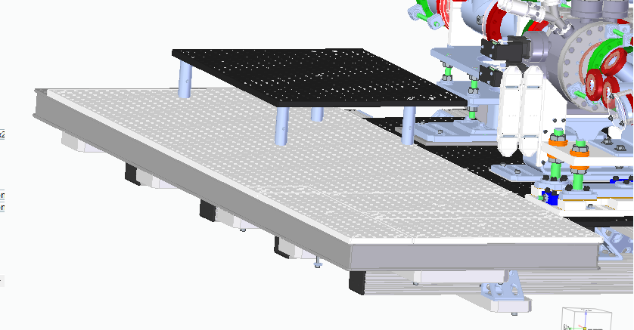
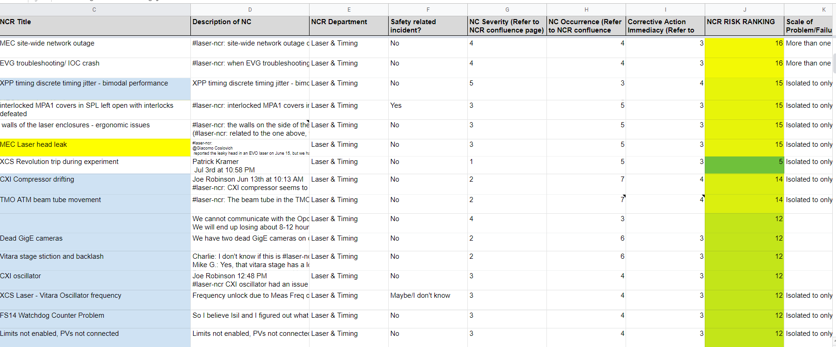
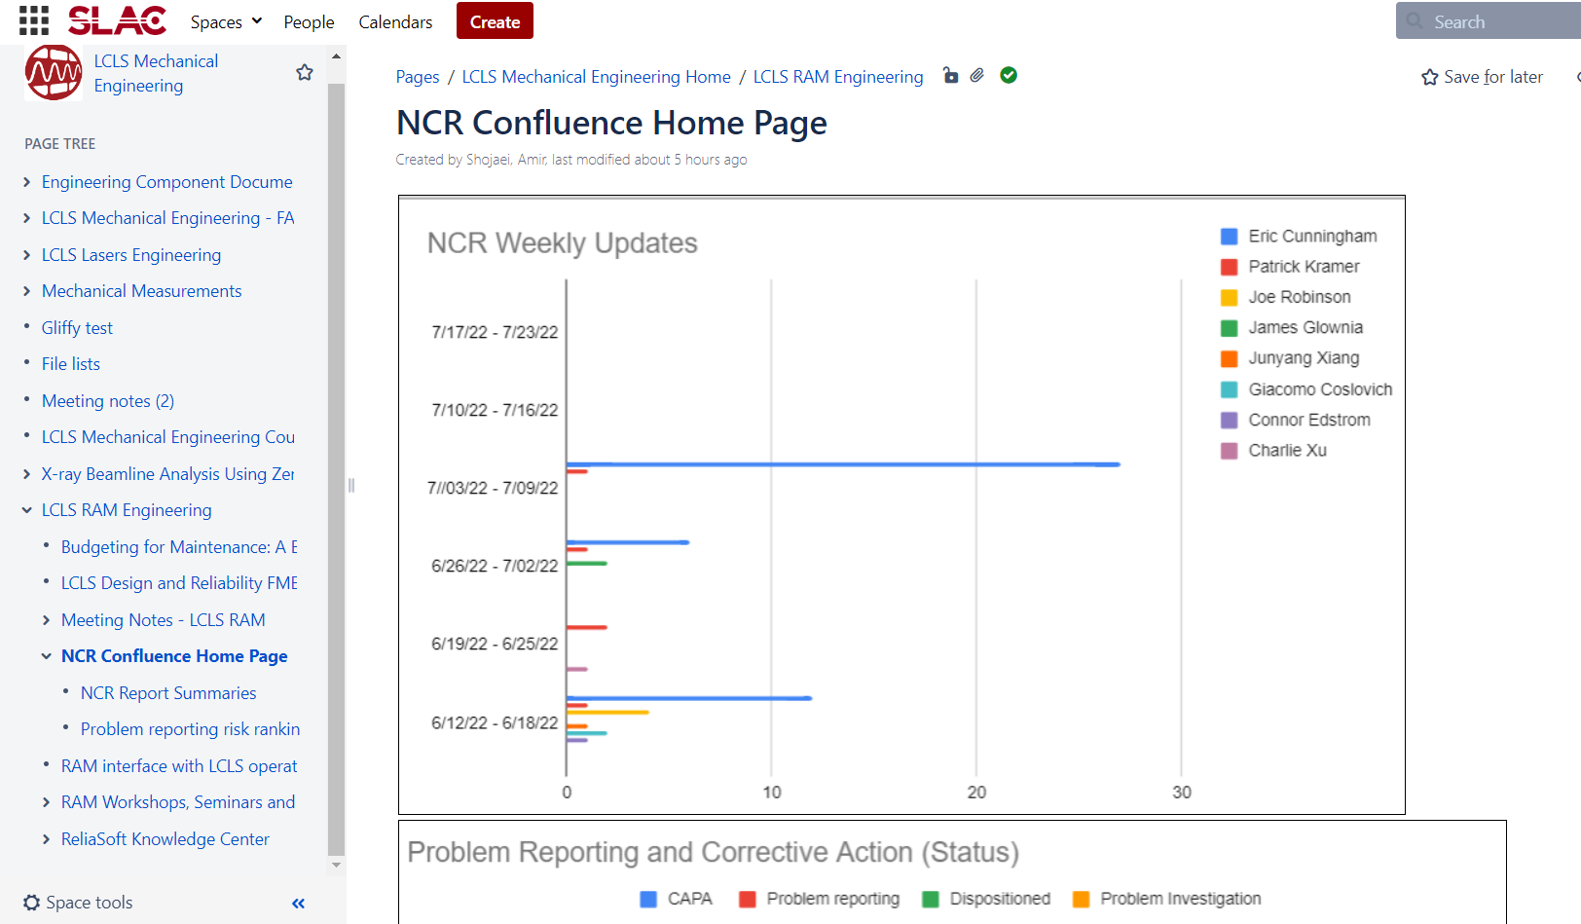
Failure Reporting and Corrective Action System (FRACAS) for RAM Program
Lucia Rogers
Mentor: Amir Shojaei (LCLS Eng and Timing Systems)
Introduction
LCLS is working toward transforming the OPCPA lasers from a scientific R&D set up to a reliable operational setting. To achieve this, the Failure Reporting and Corrective Action System (FRACAS) must be fully developed. To develop OPCPA FRACAS requirements, my focus during my internship was to work closely with the LCLS Lasers Ops to formalize the processes. I captured the Non-Conformance Reports (NCR), analyzed the data, and guided the reported problems to a solution. Perfecting these processes will eventually optimize OPCPA RAM system and laser operations.
Conclusions
There are many reasons why LCLS equipment/systems fail. Therefore, it is in the best interest for the lab to sustain a process where these issues can be recorded and addressed. Through many people's work with FRACAS software, the LCLS RAM system can one day function and guarantee smooth operations.
Sequence of Events:
1- Quick NCR Reporting
2- Data entry (NCR Google Form)
3- Problem Investigation
4- CAPA (if needed)
5- Updating NCR Confluence Page
Acknowledgments
Special thanks to my mentor Amir Shojaei, my manager Mikael Martinez, Nina Lui, fellow staff engineers, and everyone else whose contributions made my LCLS intern experience possible.

