Slide 1
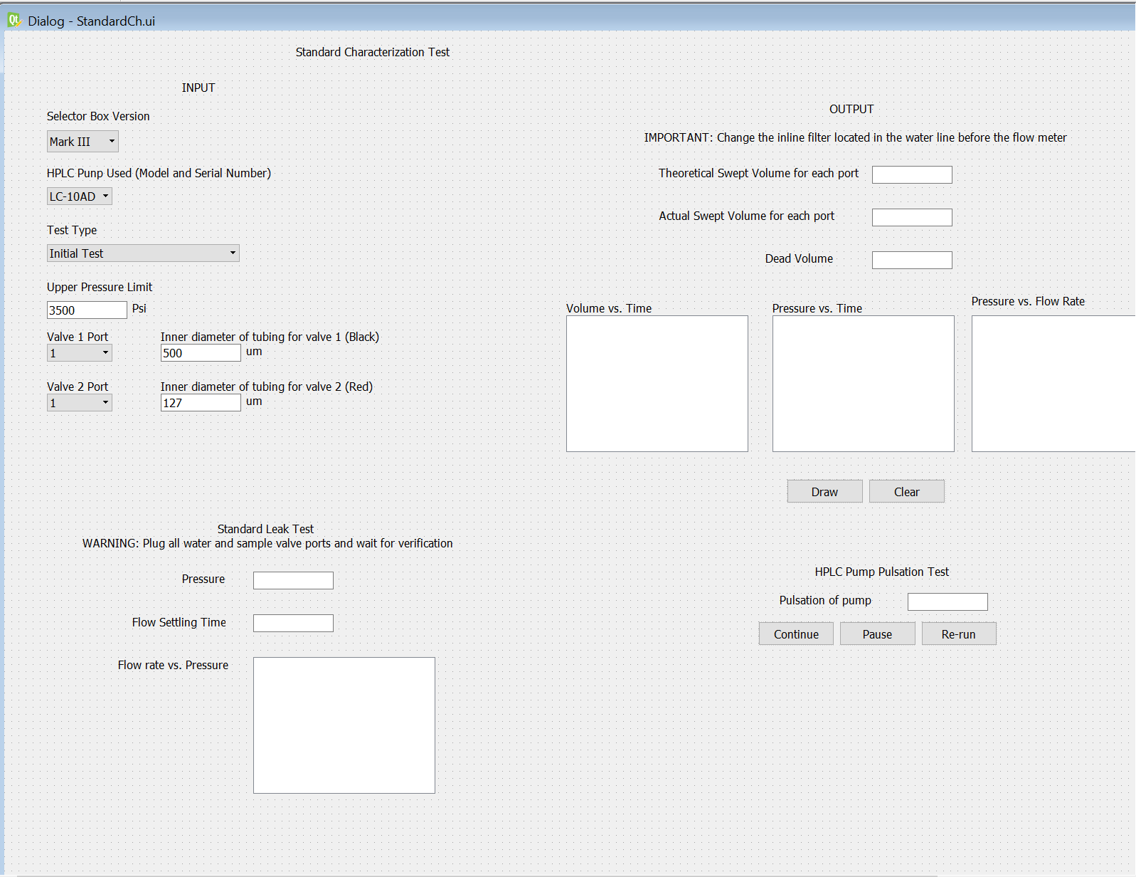
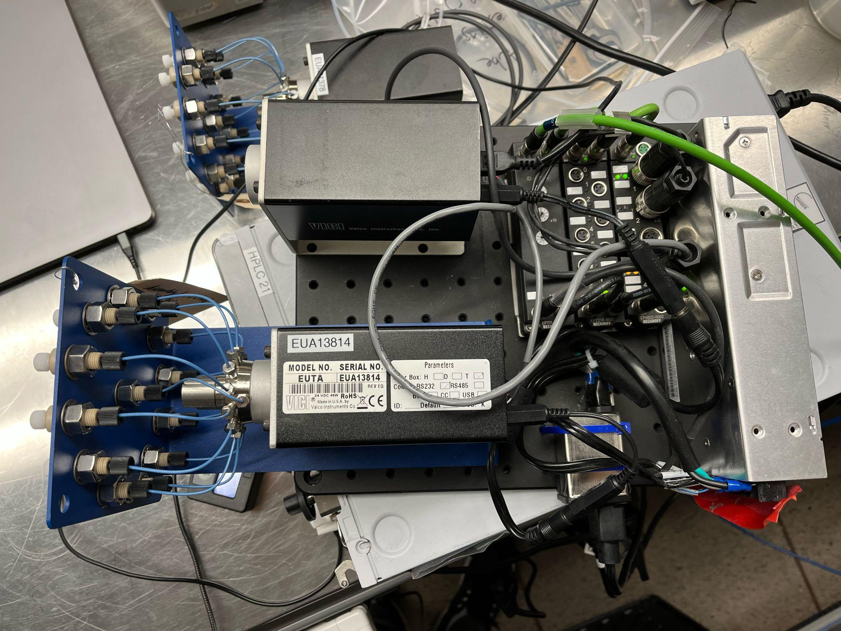
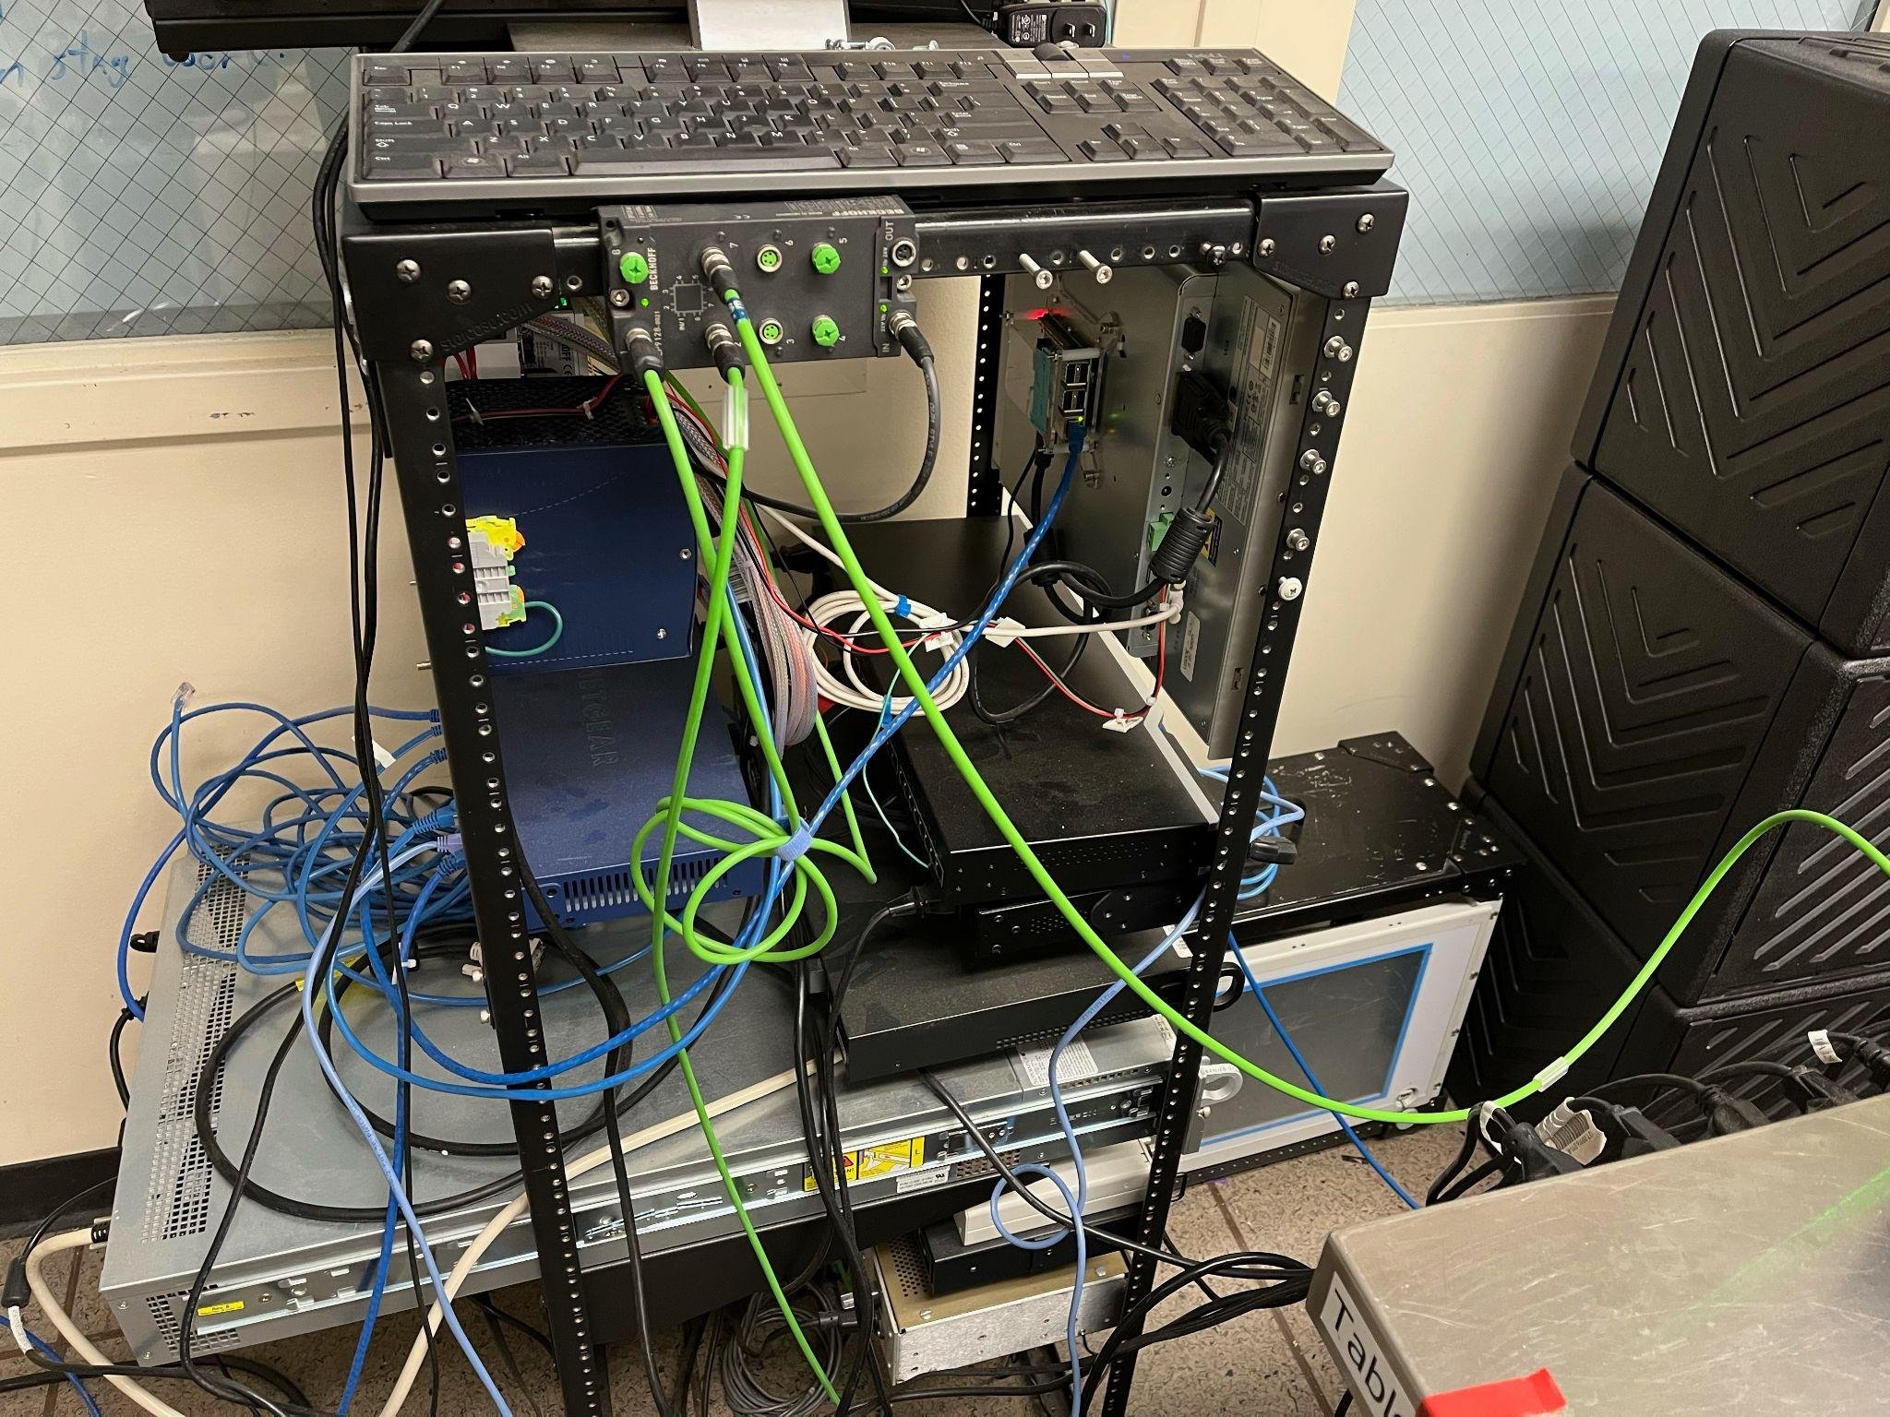
HPLC Pumps and Selector Box GUI
Last year, the goal was to create a GUI that would help researchers use the HPLC machine more easily and present the information in an easy to understand manner.
By Kenny Chang
However, the GUI was created on PyQt which uses Python while we were only able to control the machine manually through a virtual desktop on the command prompt. As a result, the goal of this year was to find a way to connect the GUI to the commands that were run on the command prompt.
To do so, we used the PV class from epics in order to use object oriented programming. It creates a variable that allows us to connect to a pump and pull any information that we know of, such as max pressure or pump number.
It’ll end up looking like this

