Slide 1
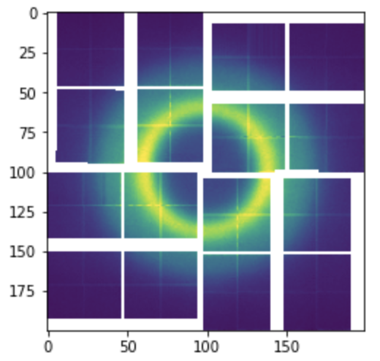
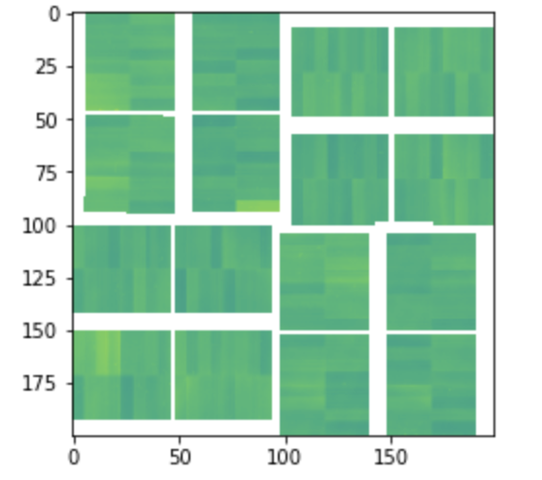
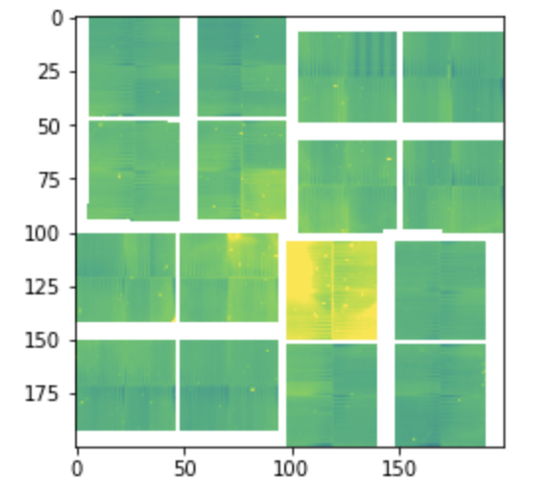
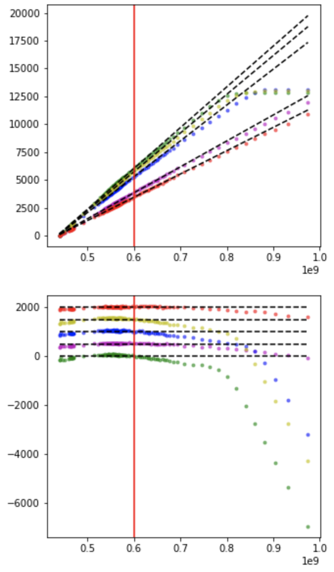
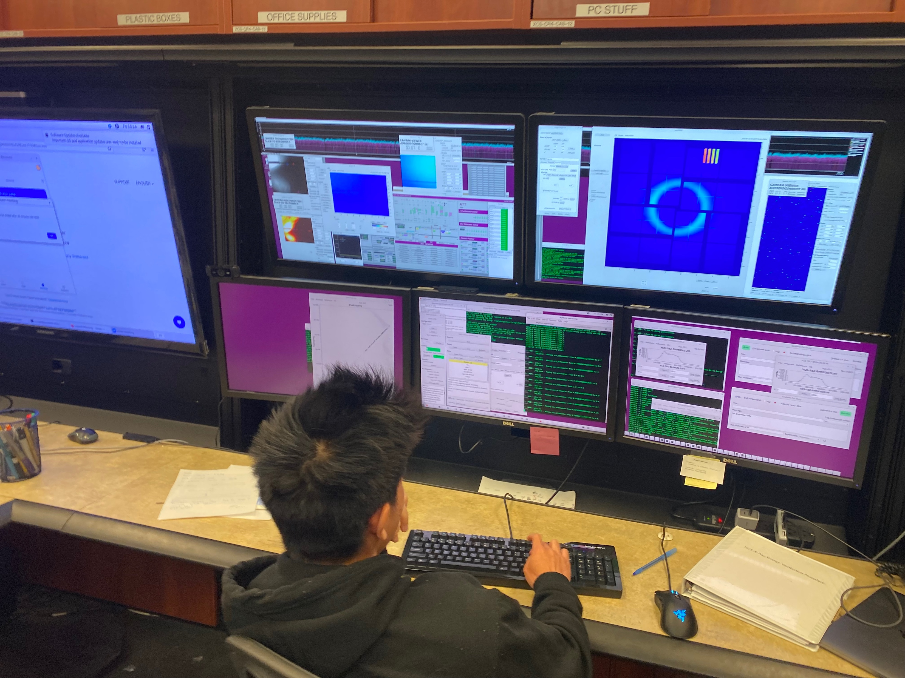
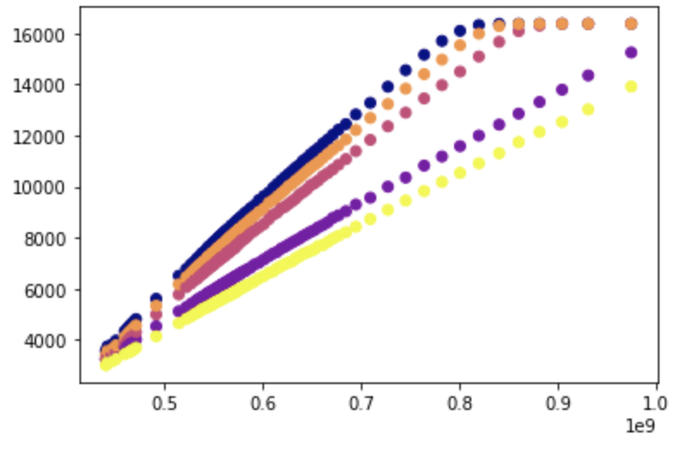
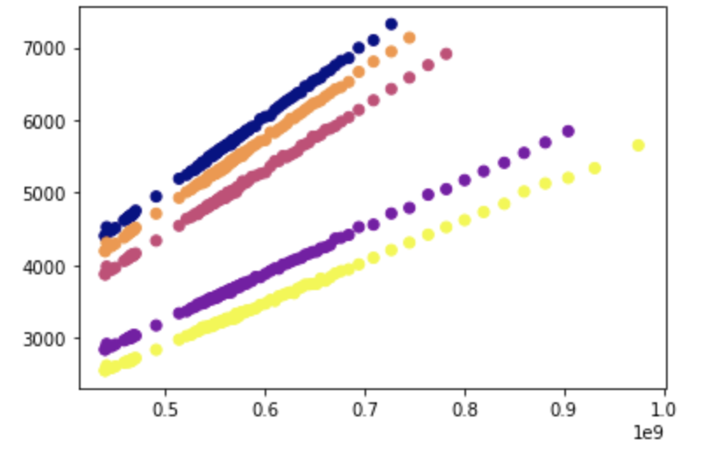
Gain Correction for
ePix10k
Joseph Pon
Introduction
ePix10k: a large area
detector developed for X-ray
free electron laser
applications
Purpose: analyze the
linearity and overall
detector performance
Average Pedestal
Standard Deviation
For each gain mode we
obtained ten’s of thousands
of shots, and binned the
data based on the intensity
level of the laser.
Pedestal is taken from
Unexposed shots and used to
zero out the detector
readings. The standard
deviation can show us the
imprecision of the detector
Low gain
Used polynomial equations to
create an algorithm in order
to straighten out the plot
Conclusions
The ePix10k detector has a
depth of 14 bits, but due to
saturation and the pedestal,
the detector cannot utilize
the full 14 bit range.
Operating the laser in XCS
For this experiment we are
using the detector to analyze
the X-ray diffuse scattering
from a recirculating thin
water jet.
water jet: the control variable
The inconsistencies of the
detector can ruin future
experiments if not taken into
account
Linearity of medium gain
begins to drop at higher
intensity levels. In theory,
it should be a straight line
up to the point of saturation.
Acknowledgments
Medium gain
LCLS program
Tim van Driel
The medium gain produces
less data for the correction
due to saturation.

