Slide 1
Data Analysis of Soot Inception Using X-Ray Scattering Techniques
Jonathan Silberstein

Slide 2
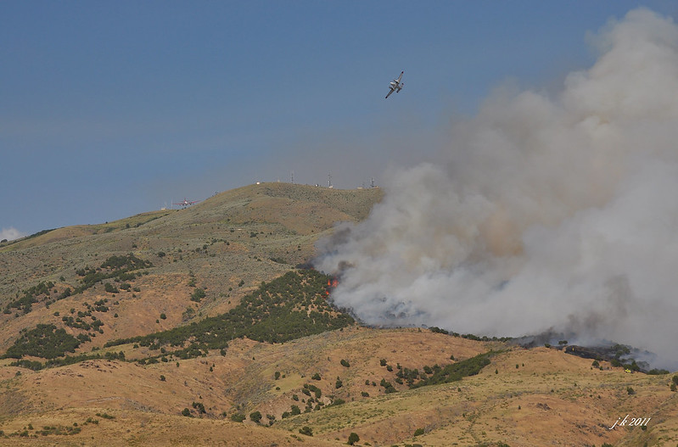
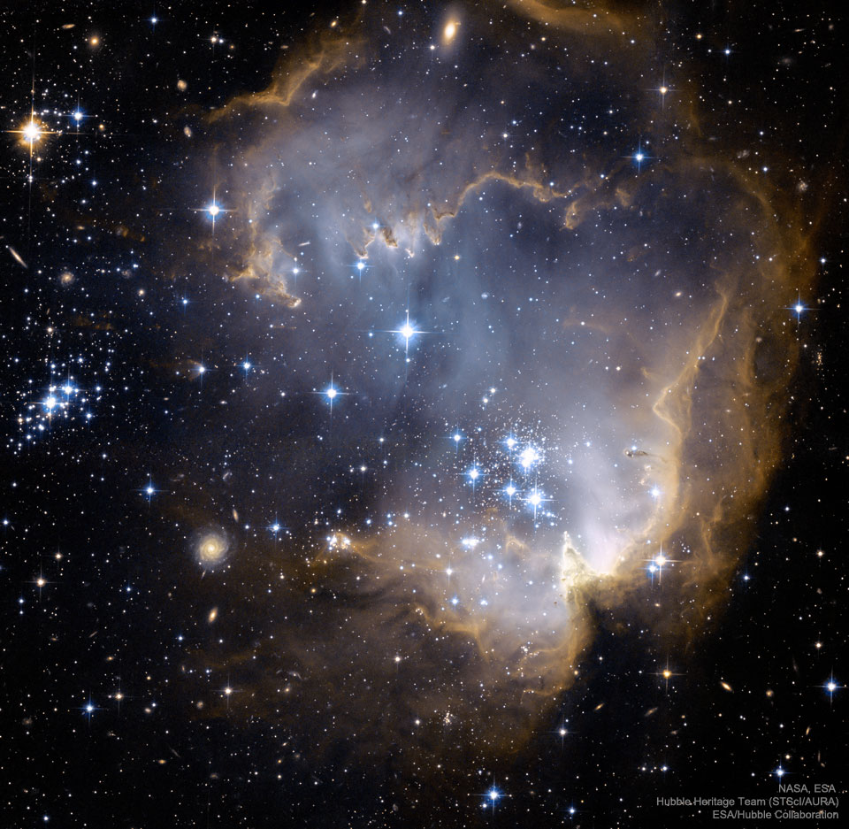
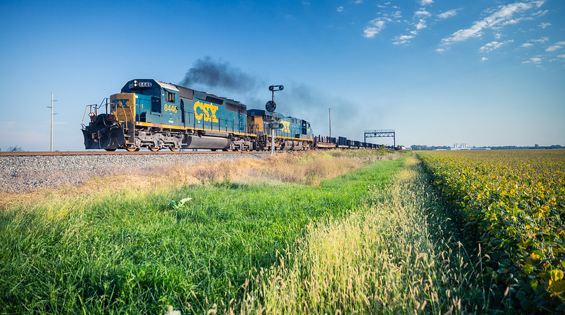
Introduction
Science involving hydrocarbons is everywhere. From forest fires to vehicular emissions to interstellar clouds, hydrocarbons are essential chemical components of a wide variety of reactions, from earth to deep space.
Soot is the biproduct of incomplete hydrocarbon combustion and is formed far from equilibrium conditions. The interaction of soot with the human body, which usually occurs when small hydrocarbon particles are inhaled, can lead to asthma, cancer, heart attacks, and a variety of other respiratory and pulmonary conditions. Environmentally, soot contributes to the acidification of water bodies, the depletion of nutrients in the soil, and is a major contributor to the effects of global warming.
Understanding how soot is formed, reacts, and interacts with other matter has a wide variety of scientific and environmental applications. Understanding and preventing soot formation has the potential to positively impact human and biological health on a global scale.

Slide 3
Experimental Design
Shooting high energy short X-ray pulses (~10KeV,$λ\sim 1.25$ Angstroms), through acetylene and ethylene flames at different heights above burner (HAB)
Using the Macromolecule Femtosecond Crystallography (MFX) endstation and EPIX detector to ‘freeze’ soot particles with fs timescale pulses and resolve interparticle correlations via beam coherence

Slide 4
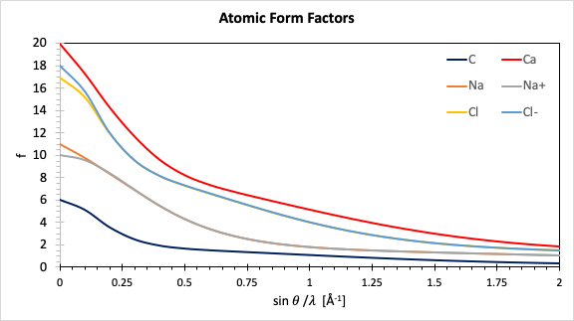
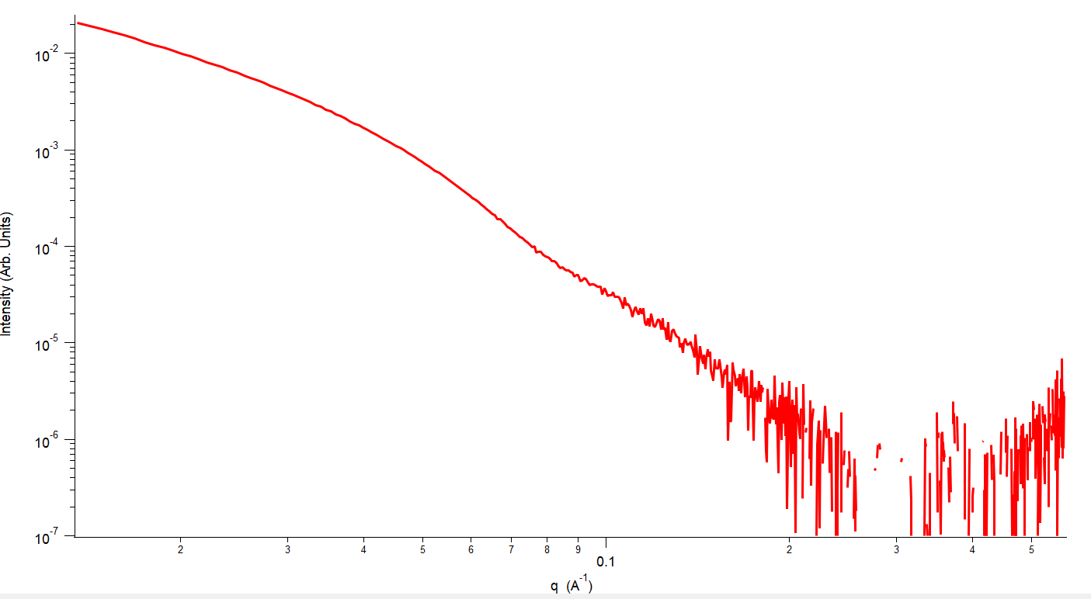
Theory
$$\left|q\right|=\left|k−k_{0}\right|=4πsin\left(θ\right)/λ$$
For a single atom, the intensity as a function of q is given by the atomic form factor f_{atom}:
$$f_{atom}=Σ_{n}\int_{0}^{∞}{4πr^{2}ρ\left(r\right)(sin\left(qr\right)/qr)dr}$$
For a molecule the scattering intensity is the sum of the intensities
of each atom at an atomic position
$$I\left(q\right)=I_{0}∗r_{e}^{2}/R^{2}∗Σ_{n=1}^{N}Σ_{m=1}^{N}f_{n}f_{m}e^{iq\left(\vec{r_{n}}−\vec{r_{m}}\right)}≈I_{0}{(r}_{e}^{2}/R^{2})F\left(q\right)F^{′}\left(q\right)$$
The intensity at each pixel of each diffraction image is related to the phase of the object at each point in space. Reconstructing the phase of the object using phase retrieval algorithms gives us the morphology of our scattered object
Fluctuation Xray Scattering
The correlation function of an object is defined as how the scattering intensity varies as a function of q and phi. Summing the autocorrelation functions over many particles gives information to the particle morphology and geometry.
$$2θ$$
$$C\left(q,q’,Δ ϕ\right)=\int_{0}^{2π}{I\left(q,φ\right)I\left(q^{′},φ+Δφ\right)dφ}$$

Slide 5
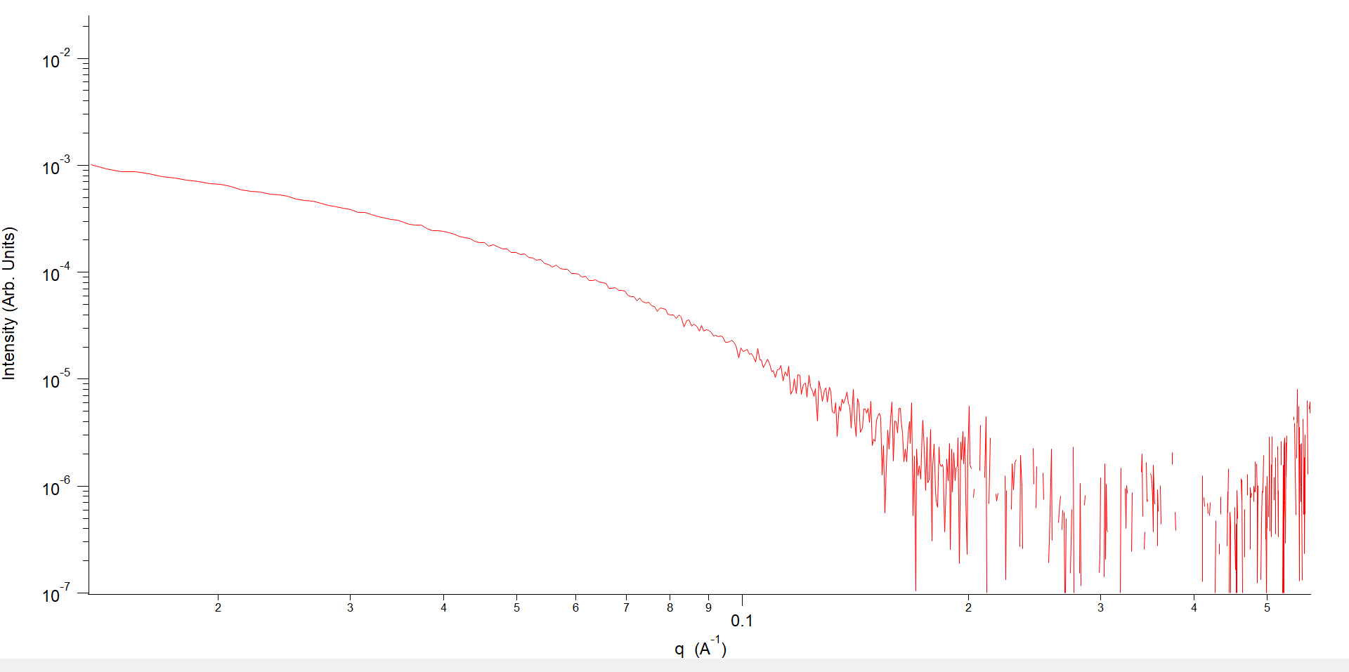
SAXS Analysis
Small Angle X-ray Scattering Analysis allows us to better understand the structure and evolution of soot particles
The two regions of a SAXS curve, the Gunier (at low q) and Porod (at high q) compose the intensity signal for soot particles. Fig 1 (R) displays both the Gunier and Porod regions for a soot SAXS curve, whereas Fig 2 (L) from this experiment only displays the Porod region.
The high q Porod region describes the small scale structures comprising soot, such as the individual precursors. Conversely, the low-q Gunier region describes the larger hydrocarbon aggregates.

Slide 6
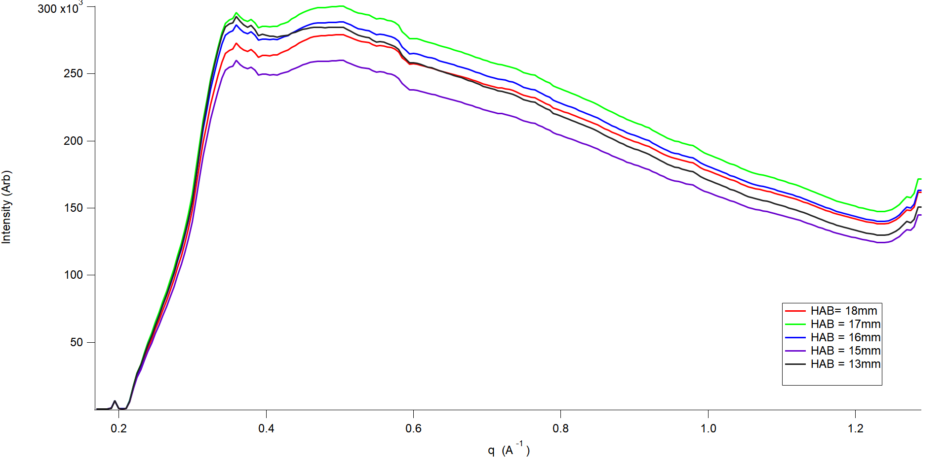
Soot SAXS curves are generally fit with an equation known as a ‘Unified Fit’ which is the sum of a Gunier and Porod regime.
Single Mode Unified Fit is composed of four parameters:
$G$: Contrast and normalizing factors
$R_{g}$: Radius of Gyration
$B$: Contrast and characteristic size
$P:$ Dimensionality of particles
The intensity is defined as : $I\left(q\right)=G_{i}e^{\frac{−q^{2}R_{g}^{2}}{3}}+e^{\frac{−q^{2}{Rg}^{2}}{3}}B{\left(\frac{{\operatorname{erf}\left(\frac{qR_{g}}{\sqrt{6}}\right)}^{3}}{q}\right)}^{p}$

Slide 7
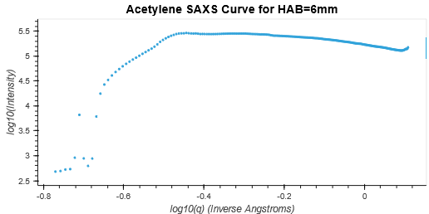
What is wrong with the SAXS signal?
Detector pixels are blocked by a sampling tube
Manually and automatically input masks are not fully removing data
Unexpected high frequency fluctuations in data
Photon energies are not uniform

Slide 8
Autocorrelation Analysis
How do we know the autocorrelation code is working correctly? We run it on a calibrating diffraction standard and compare with known results.
Silver behenate, a silver salt, is often used as the molecules have specific resonances, and diffraction peaks occur at specific q-values
Intensity rings occur at q = [0.1076, 0.2153, 0.3229, 0.4305, 0.5381, 0.6458, 0.7534, 0.8610, 0.9686, 1.0763]
Potential energy landscape

Slide 9
Variable signal at $\frac{π}{2},π,3π/2$ is due to detector geometry and gaps between the detector pixels. Future analysis needs to correct for the detector gaps.
Autocorrelation values along high intensity q-rings shows positive autocorrelation values at low, high values of $φ$, and negative autocorrelation values at intermediate $φ$
$$C\left(q,q^{′},Δφ\right)=Σ_{L≥0}B_{l}\left(q,q^{′}\right)F_{l}\left(q,q^{′},Δφ\right)$$
Where F_{l} is defined as: $P_{l}[\cos\left(θ_{q}\right)\cos\left(θ_{q^{′}}\right)+\sin\left(θ_{q}\right)\sin\left(θ_{q^{′}}\right)cos\left(Δφ\right)]$
And $θ_{q}=\arccos\left(\frac{qλ}{4π}\right)$
$B_{l}\left(q,q^{′}\right)$ is defined as $k_{l}Σ_{m=−l }^{l}I_{m}\left(q\right)I_{m}^{∗}\left(q^{′}\right)$
Finally, we can decompose the intensity I(q) into the phase of the object at each point in space

Slide 10
The autocorrelation functions of both acetylene and ethylene flames show a four-fold symmetry, which may be a product of the detector geometry. However, while the acetylene flame displays the majority of autocorrelation signal at intermediate-high q values, ethylene displays most of its autocorrelation signal at low-intermediate q. The differing intensity of signal between the two functions indicates the Legendre expansion is different between these two cases, and the phase reconstruction will vary.
The autocorrelation function C(q,q’,$Δφ$) of
soot particles in an acetylene flame
(above) and ethylene flame (below)

Slide 11
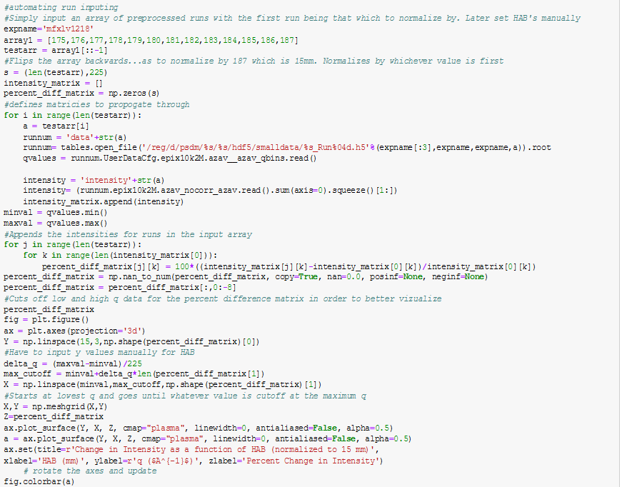
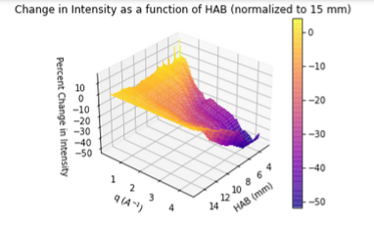
Data Visualization
By visualizing basic data, we are able to better understand how our data changes spatially and temporally ,and intuit how our experimental setup may be affecting our data. Displaying large ranges of data as functions of multiple variables allows us to better understand the big picture of how our experimental parameters influence one another.

Slide 12
Future Work & Conclusions
Date | Work | Justification
Fall 2021 | Finish autocorrelation analysis | Understand detailed changes in structure of soot Understand soot morphology
Winter 2021/Spring 2022 | Complete MFX analysis | Correct for artifacts in the detector geometry Streamline code to run quickly for a greater number of events
Spring 2022 | Conduct second in situ XFEL flame experiment | Generate higher quality data Expand q range to include Gunier regime
Summer 2022 | Conduct data analysis on second flame experiment | Use higher quality data to determine how soot evolves Publish results

Slide 13
References & Acknowledgements
Nature Communications 6, 6187 (2015)
PNAS 46, 115 (2018)
J. Phys. B: At. Mol. Opt. Phys. 45, 22 (2012)
J. Thoracic Disease, 8, 1 (2016)
JGR 118, 5380 (2013)
J. Applied Crystallography 28, 6 (1994)
Thank you to the employees at SLAC, Hsing-Yin Chang, Hope Michelsen, and Andrew Aquila

