Slide 1
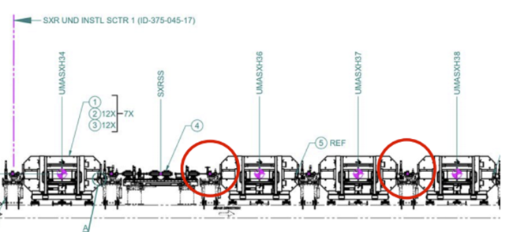
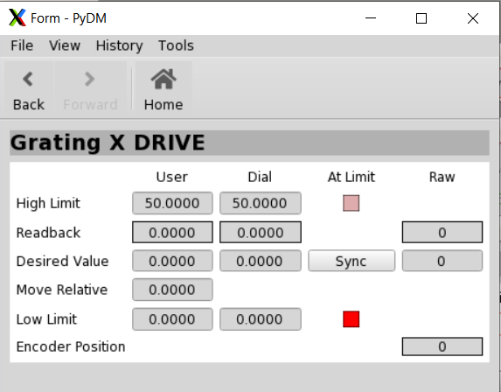
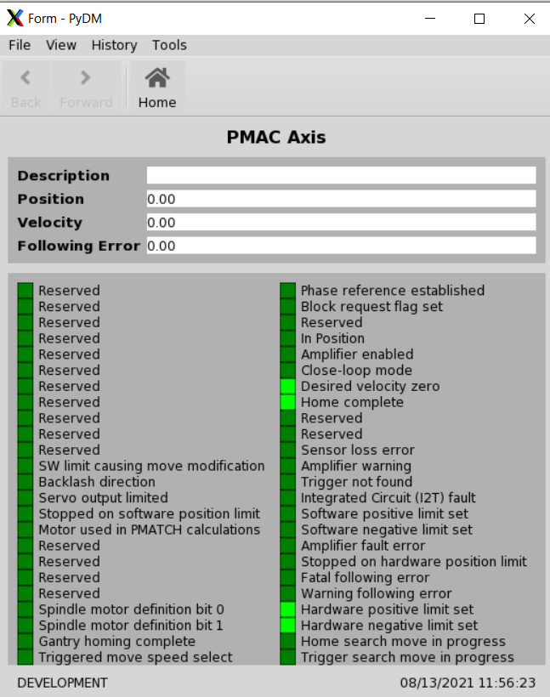
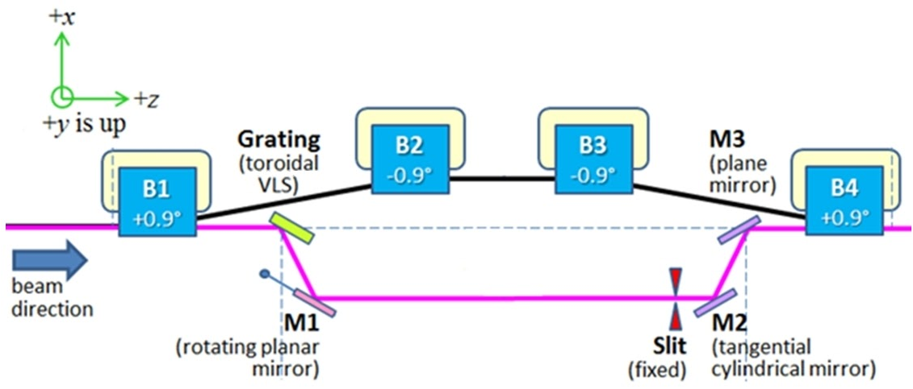
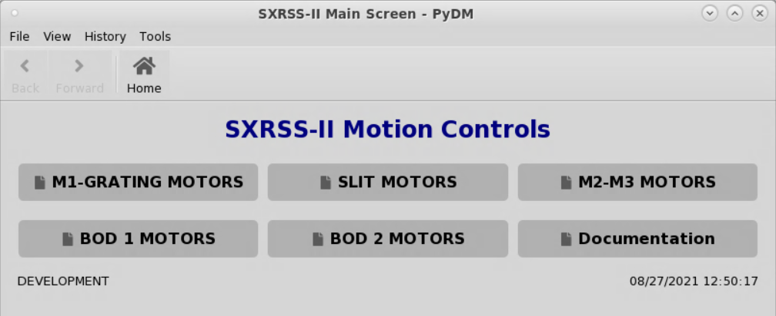
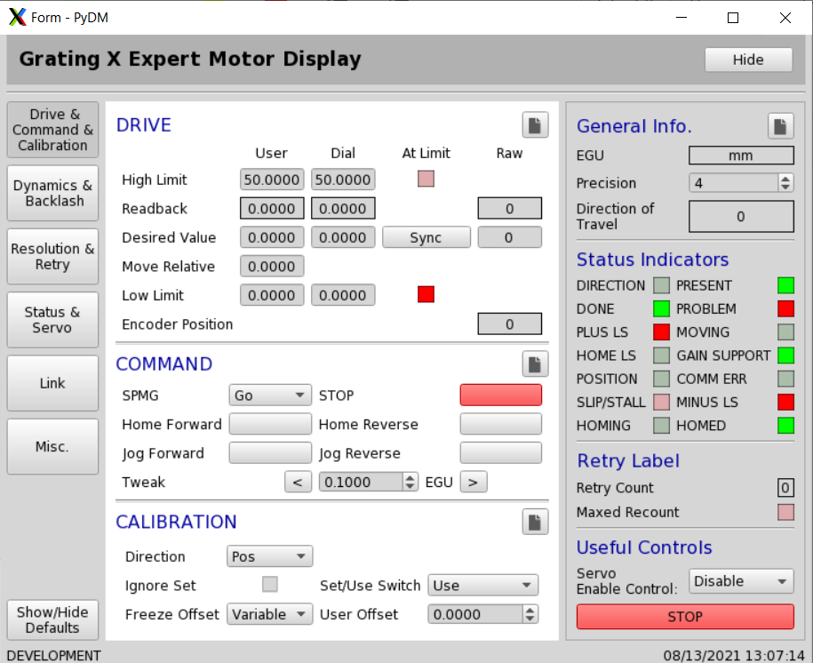
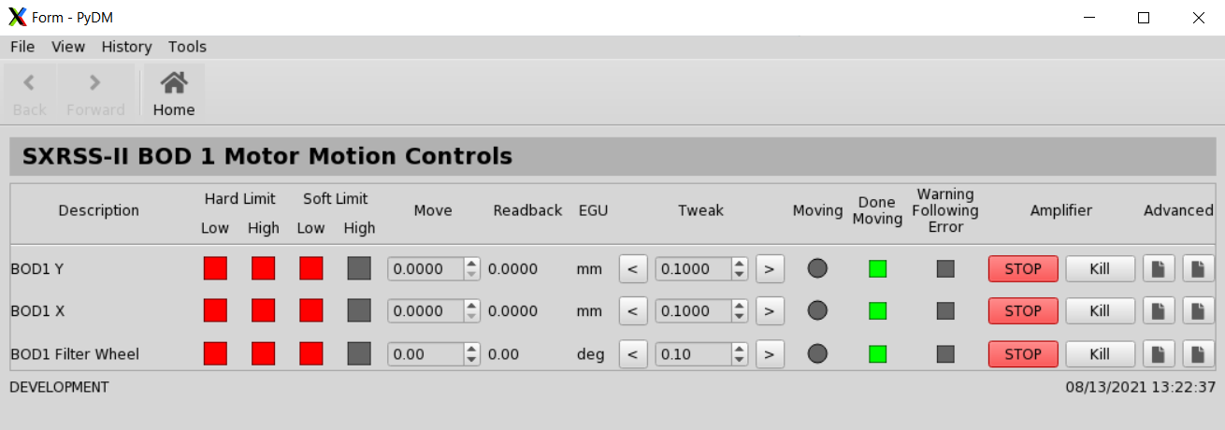
Development of PyDM Graphical User Interface for the upgraded Soft X-Ray Self Seeding System (SXRSS-II)
James Chen, Harmanpreet Bassan
Introduction
Motor Motion Controls
The final expert motor screen is organized in order of the most commonly used field widgets. Since many additional fields were needed compared to the original EDM screen that the screen was based on, categories that are often used together are also put on the same tabs. To make the screen more versatile and minimize the impact of using the stacked widget to display elements, each section of the screen can be opened separately in a new window.
As a part of the LCLS-II upgrade, the SXRSS (Soft X-Ray Self Seeding) device will be upgraded with improvements in cooling and motion controls. The SXRSS-II is located on the Soft X-ray beamline in cell 35 (at the 10th undulator girder) in the Undulator Hall. The system’s purpose is to create a “seed” that can be amplified by the undulators downstream to provide better longitudinal coherence (control over time and spectral resolution) for use in different experimental applications [1].
One component of the improvements to the SXRSS controls includes updating the GUIs (Graphical User Interfaces or “screens”) that are used to control the different components. These screens are created using PyDM (Python Display Manager), a SLAC-built framework built on top of PyQt, which is a Python-based GUI development framework.
The controls for the SXRSS-II involve a series of motor groups. There are 3 motors between the grating (X, Y) and the M1 mirror (Pitch), 2 motors for the slit (X, Y), 4 motors for M2 (X) and M3 (X, Pitch, Yaw). In addition to the device itself, there are two BOD (Beam Overlap Diagnostic) devices that are used to measure the alignment of the X-ray and electron beams, measuring the effects of the SXRSS-II. BOD1 uses 3 motors (X, Y, and a Filter Wheel), while BOD2 only uses 2 motors (X, Y).
Figure 4 Top: A closer look at the same screen in the Qt Designer. Bottom: A screen that is linked by the embedded Display from the motor group screens.
The Grating and M1 motors screen has some variation in widgets due to differences in the motion controllers that are used for each motor. The SXRSS-II motors are controlled by 2 PMAC controllers and a SmarAct controller, and in this case, the PMAC controllers comes with additional controls and screens (Figure 5).
Figure 7
One of the 12 pop-up window that can be opened separately. This one shows the Drive fields for the Grating X motor.
Figure 5 A PMAC specific screen that displays many status indicators of the motor. Although many fields are reserved, the screen shows some important information like whether the motor has any errors or if the motor is in motion.
The SXRSS-II System
Conclusions
Figure 2 Diagram of the positions of BOD1 and BOD2 are located at the end of cell 35 and in between cells 37 and 38, respectively. [2]
GUIs are a very small aspect of the motion controls for the SXRSS-II; however, they are still a useful aspect to be able to provide users a way to visualize and interact with the large amount of data that comes with a complex system like the SXRSS-II. Although the final design may seem relatively simple, the process of making the screens involve testing different designs and styling customization, and most importantly, addressing user feedback and concerns. Currently, the final screens have been added to the production servers and can be accessed from the LCLSHOME screen.
SXRSS-II Screens
A series of screens were created including the main screen, sub-screens for each of the motor groups, general screens, and one for documentation.
The main screen provides users with an easy way to navigate to the more specific screens through a simple click. The motor-specific screens provide some basic controls and status information to the motors as well as buttons to navigate to more detailed screens.
In addition to the basic screens, an advanced screen is necessary for full control of the motors. The expert motor control screen incorporates all the public PVs included in the Motor Records documentation [4]. The screen encompasses over 100 accessible PVs that need to fit into a single screen.
Because of the large amount of information that needs to be displayed, the screen was built using a system of buttons and a stacked widget. A Python file backs the GUI, giving it the added ability to show and hide aspects of the screen to save space, including components like the navigation bar and status bar that PyDM opens with by default.
References
Figure 1 Top: Graphic representation of the SXRSS device. Bottom: A model of the SXRSS-II [2].
[1] E. Hemsing, et al., “Soft x-ray seeding studies for the SLAC Linac Coherent Light Source II”, Phys. Rev. Accel. Beams 22, 110701 (2019).
[2] Dunning, Michael, “SXRSS-II Motion Control” SLAC Confluence, confluence.slac.stanford.edu/display/~mdunning/SXRSS-II+Motion+Control (2021)
[3] S. Svitozar, et al., “Soft X-ray Self-Seeding simulation methods and their application for the LCLS”, SLAC-PUB-16163 (2014)
[4] Peterson, Kevin, “Motor Record and Related Software”, EPICS ANL, epics.anl.gov/bcda/synApps/motor/motorRecord.html (2020)
The system separates the previously collinear electron beam and X-ray pulse through the use of magnetic dipoles and a monochromator setup, respectively. The electron bypass portion (black line) constitutes 4-dipole chicanes that steer the electrons beam away from the optic motors, delay the electron beam for realignment with the diverted X-ray pulse, and smooth out the microbunching effects from the SASE (Self-amplified Spontaneous Emission). On the X-ray side (pink line), the monochromator is composed of a grating, a slit, and three mirrors. The toroidal grating helps amplify specific energies and dampen others, while the M1 mirror and slit help select a particular bandwidth of the X-ray [3]. The seed is then amplified as it travels the remaining length of the undulator hall, producing the desired X-ray for various experimental needs.
Figure 6
The first page showing the Drive, Command, and Calibration fields of the new PyDM Expert Screen for the Grating X motor.
Acknowledgments
Figure 3 Top: The main screen for navigation between the different screens. Bottom: The screen for the Grating and M1 Motors running on the development server. The remaining motor screens also follow the same template.
Use of the Linac Coherent Light Source (LCLS), SLAC National Accelerator Laboratory, is supported by the U.S. Department of Energy, Office of Science, Office of Basic Energy Sciences under Contract No. DE-AC02-76SF00515.

