Slide 1
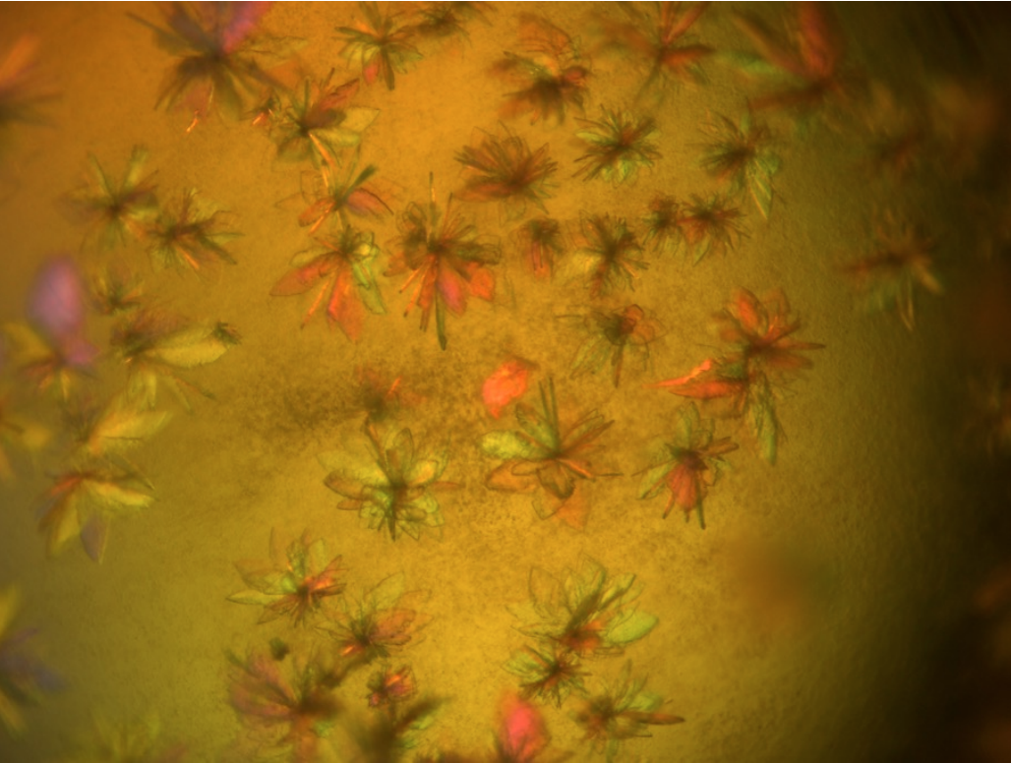
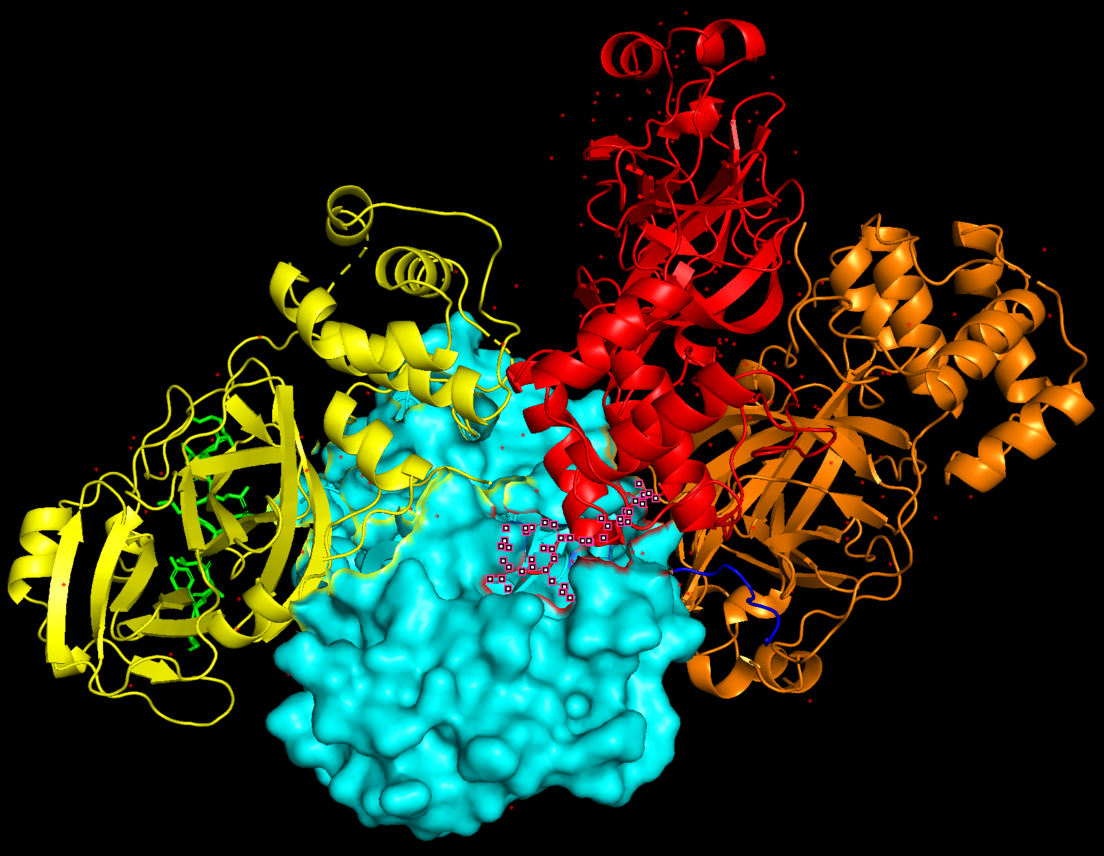
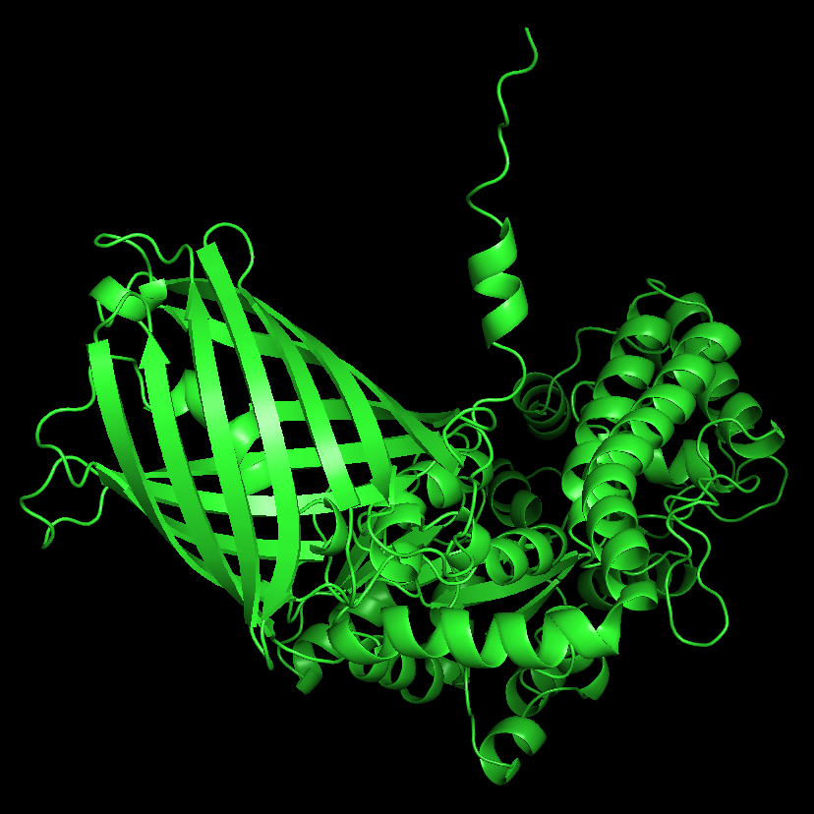
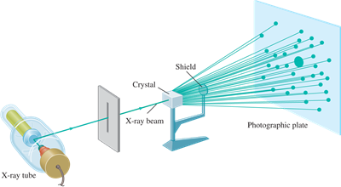
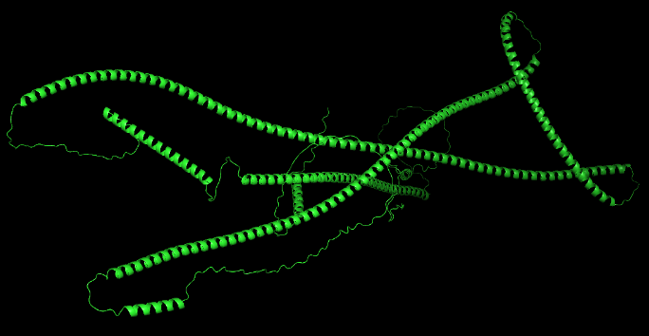
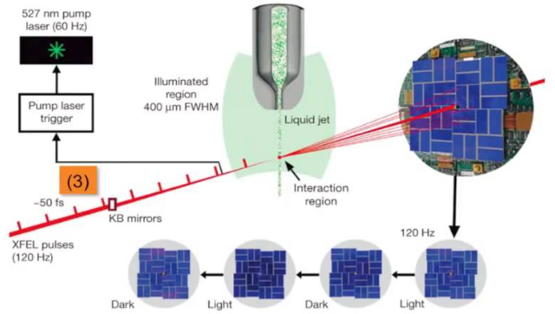
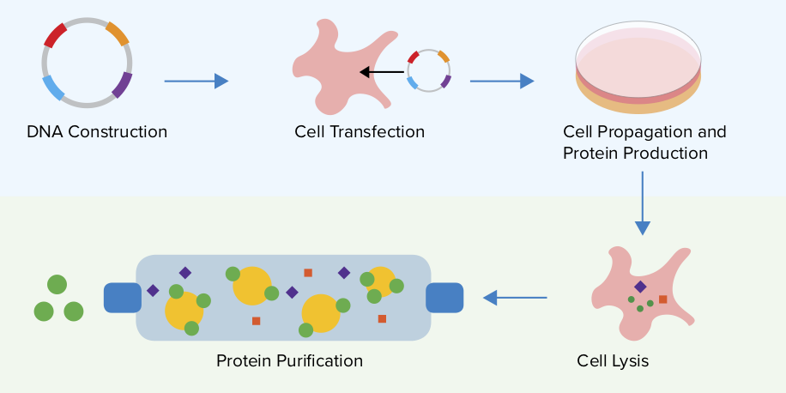
Determining cleavage and bound complexes between SARS-COV2 main protease and human substrates
Iyshwary Vigneswaran Warren_{1,2,3}, Christopher Kupitz₃, Soichi Wakatsuki_{2,3}
Departments of Bioengineering1 & Structural Biology2, SLAC National Accelerator Laboratory3
Introduction
Cleavage of human host-cell substrates by 3CLpro
Binding of 3CLpro to human host-cell substrates
Results
The 3C-Like protease (3CLpro) is the main protein that is pivotal for the replication of SARS-COV2, as it prepares viral proteins for replication in host cells. The inhibition of 3CLpro would help stop the spread of COVID-19. The conformational dynamics of 3CLpro determine its specificities towards host-cell or viral substrates. This dynamic specificity could be used to target drugs to SARS-COV2 proteases and avoid targeting host-cell proteins that share substrates with these proteases. Information regarding the binding and cleavage processes of 3CLpro to human host-cell substrates is instrumental in the design of protein inhibitors. This project focuses on the structures of the complexes between the selected human protein substrates and 3CLpro.
Protein crystallization is necessary to determine the structure of protein substrates. Once cleavage of the human protein substrates by 3CLpro is confirmed, crystallization of the substrates fused to the C-terminal tail of 3CLpro is conducted to determine the binding process of 3Clpro to human host-cell substrates.
Fig 3. Cleavage sites and surrounding residues of GOGA2 (cyan) as taken from the overall structure aligned with the AlphaFold model (green) of just the 28 shown residues.
I designed peptide constructs using PyMOL modeling/visualization software. I designed these peptides to be of the same amino acid chain length: eight amino acids surrounding the cleavage site, and ten amino acids in the sequence on either end acting as linkers. This means that the molecular weight (MW) of these peptides is similar.
Fig. 8 C145A sequence 1 crystals.
Cysteine derivative gene for reference was received from the laboratory of Dr. Jason Chin.
Protocol for synthesis of modified cysteine has been established from a commercial precursor.
Reference constructs of C145S sequences 1-6 have gone through mutagenesis to provide inactive 3CLpro mutants, C145A sequences 1-6.
C145A sequences 1-6 have been expressed, purified, cleaved by TEV protease, run through SEC, and sent for mass spectrometry analysis.
Reference constructs have been crystallized.
Current efforts for human peptide constructs to be sent to mass spectrometry analysis are underway.
Human peptide constructs
Fig 4. GOGA2 human peptide construct. MBP-Linker-Peptide-mGL-Linker-His Tag.
I added the necessary protein tags and linkers to allow the peptide to remain stable through its expression, purification, and cleavage by 3CLpro. Maltose-binding protein (MBP) is a large protein tag that is used for solubility and purification; it can improve the solubility and folding of eukaryotic proteins expressed in prokaryotes. Alanine-Glycine-Alanine (AGA) is the amino acid sequence for the first linker used for these constructs; this is a linker that allows for protein folding. mGreenLantern (mGL) is a bright monomeric fluorescent protein with rapid expression that allows a clear way to see if cleavage occurs with its green coloration and illumination. Glycine-Serine-Glycine (GSG) is the amino acid sequence for the second linker I used for these constructs; this is a linker that allows for protein folding. His Tag is used for affinity and purification; it is very small in size and rarely affects function. The final construct structure is MBP-Linker-Peptide-mGL-Linker-His Tag.
Fig 6. GOGA2 peptide construct fused to the C-terminal tail of 3CLpro.
I designed the peptide constructs to fuse to the C-terminal tail of 3CLpro using PyMOL. These modeled structures show the binding processes of the substrates to the active site using 3D movies.
3CLpro is identified to bind to 384 different human host-cell proteins. These proteins vary in size and structure. The first aim of this project is to determine the cleavage of the selected proteins by 3CLpro. The cleavage site is the location where the peptide bonds are broken between amino acids in proteins. Determining cleavage can be done utilizing a peptide of the protein that includes the four residues on either side of the cleavage site and ten residues on either side of those four residues to work as linkers for stability. The entire protein structure is not needed to determine if cleavage occurs. This is a cost-effective, stable, and more accessible method for that objective.
Future Directions
For a select set of human protein substrates, time-resolved serial synchrotron crystallography (TR-SSX) at room temperature could be used to see the dynamic interactions between human protein substrates and 3CLpro. With this, how SARS-COV2 protein inhibitors exploit protein dynamics to exclusively target viral proteases could be determined. In the long term, this information could be used to develop drugs that specifically target SARS-COV2 proteases and avoid targeting host-cell proteins with shared substrates.
Fig 7. X-ray crystallography of protein crystals.
Using the determined structures, I will crystallize the protein constructs fused to the C-terminal tail of 3CLpro in its bound structure.
I will use X-ray crystallography to determine the structure of the complex between the selected human protein substrates and 3CLpro.
I will process the resulting diffraction patterns, initially to yield information about the crystal packing symmetry and the size of the repeating unit that forms the crystal. This is obtained from the pattern of the diffraction spots. The intensities of the spots can be used to determine the “structure factors” from which a map of the electron density can be calculated. Various methods can be used to improve the quality of this map until it is of sufficient clarity to permit the building of the molecular structure using the protein sequence. The resulting structure is then refined to fit the map more accurately and to adopt a thermodynamically favored conformation.
I will build atomic models of the bound complexes between 3CLpro and the human protein substrates.
Fig 1. Golgin subfamily A member 2 (GOGA2). 3CLpro may control ER–Golgi homeostasis maintenance by acting on GOGA2.
GOGA2 helps regulate Golgi structure and vesicular transport and helps mediate the unconventional trafficking of select glycoproteins to the cell membrane. GOGA2 is predicted to bind and be cleaved by 3CLpro.
Fig. 9 TR-SSX.
Fig 5.
I will express and purify each peptide construct by itself as a control. I will repeat this, and then cleave each peptide construct with 3CLpro. I will run these samples with size exclusion chromatography (SEC) to separate the desired protein constructs out from the rest of the sample for the control, and in the case of the cleavage, separate the cleaved peptide from 3CLpro and the rest of the sample. I will collect SEC fractions of the protein constructs and send for mass spectrometry to see if cleavage occurred by 3CLpro as it is identified to and compare those samples to the controls.
Acknowledgments
Chin et. al, ACS Publications, 2014.
Wang et. al, Am J Cancer Res., 2020
SLAC National Laboratory, LCLS
Stanford University Department of Structural Biology, Wakatsuki Laboratory
Dr. Christopher Kupitz
Dr. Soichi Wakatsuki
Dr. Alan Fry
Fig 2. Cleavage site (cyan) and surrounding residues (magenta, green) of GOGA2 by 3CLpro, as taken from the overall structure.
The peptide constructs take 28 residues from the overall protein sequence. These 28 residues are comprised of four residues on either side of the cleavage site, and then ten residues on either side of those which act as linkers.

