Slide 1
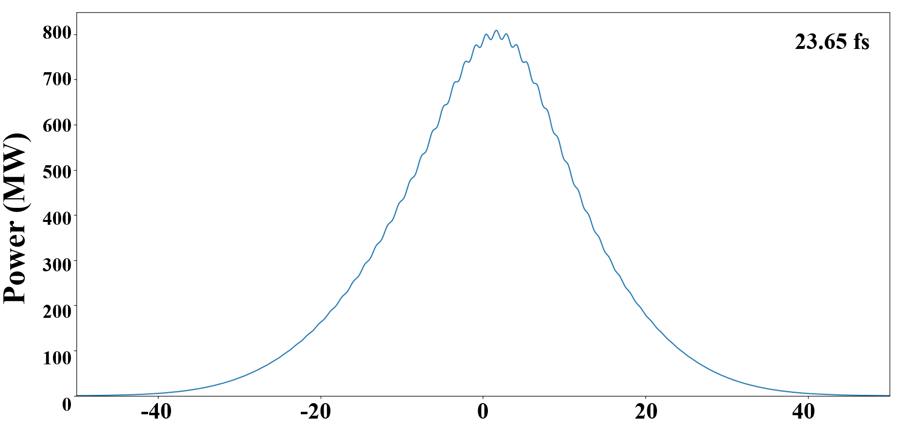
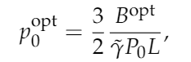
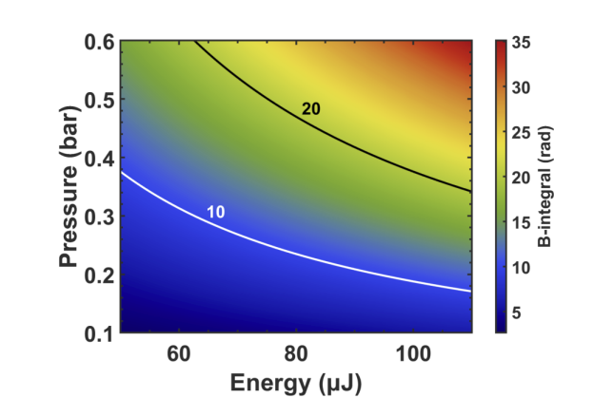
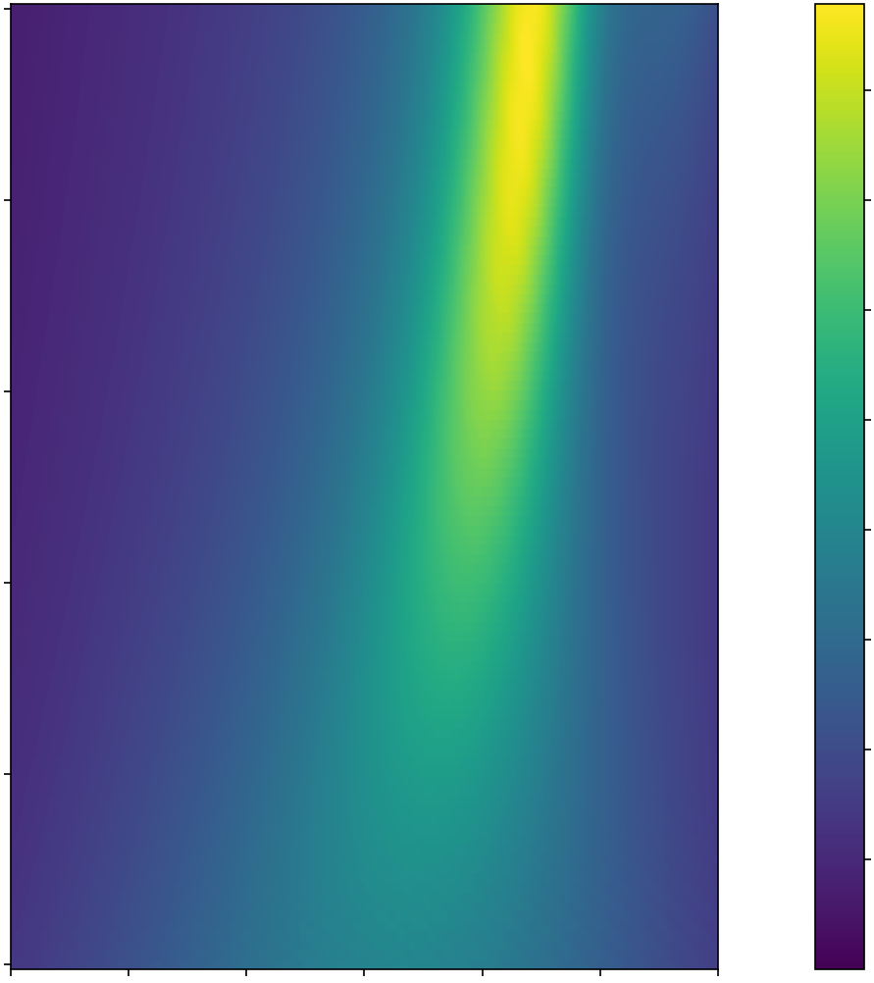
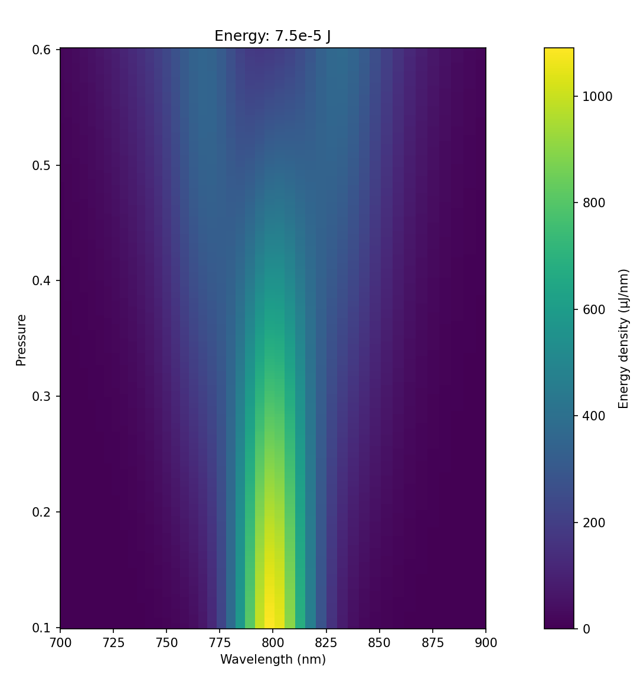
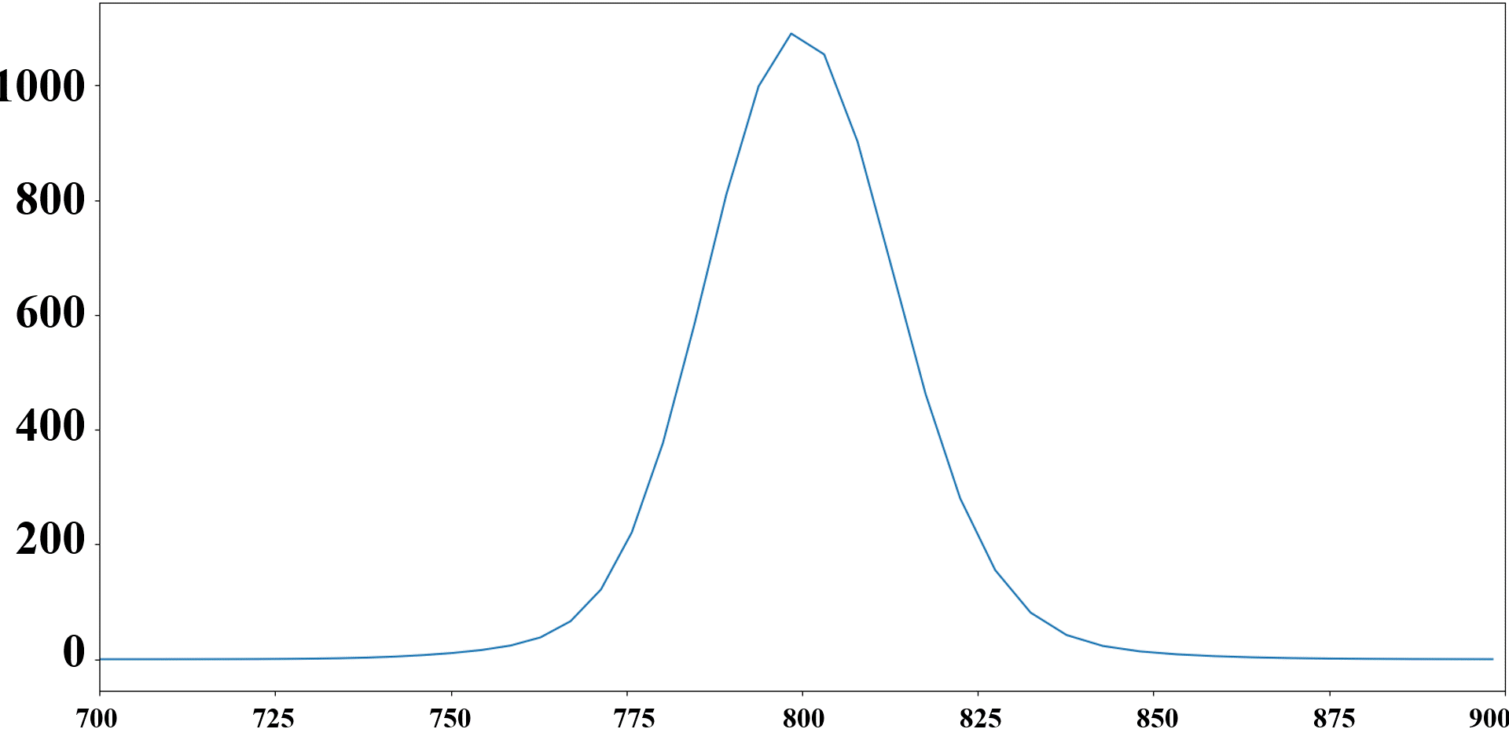
Nonlinear Processes In
Hollow Core Fibers (HCFs)
By: David Sims, Ruaridh Forbes
Introduction
Self-compression
The interaction of laser pulses through matter can alter the temporal and spectral properties of the pulse.
HCFs are due to their ability to guide focused light over a long distance.
Optical solitons occurs through a balance of a positive nonlinear refractive index as well as a negative linear dispersion, which results in the self-compression laser pulses within HCFs.
Equation 1: Example of one of the many methods of calculating peak power.
Figure 1: Depicts wave through HCF
Simulations
Time (fs)
Figure 5: Depicts the optimal range of B integral.
Pressure (mbar) | 1-6
Gas | Ar
Energy (μJ) | 50-100
Fiber Length (m) | 3
Initial Wavelength (nm) | 800
Initial FWHM (Fs) | 30
Fiber Radius (μm) | 100
Figure 4: Depicts reduction in the duration of the laser pulse as the gas pressure is increased.
Running simulations allow for users to see how laser pulses and HCFs of different conditions interact with one another.
Luna developed by Chris Brahms and John Travers provides a solid baseline platform for these simulations to be ran. (GitHub: https://github.com/LupoLab/Luna.jl)
Altering Luna and certain examples they have on their GitHub page allowed for multiple parameters to be ran simultaneously.
Conclusions
​.6
.5
.4
.3
.2
.1
Energy: 50 μJ
Though self-compression occurs over a wide range of parameters (see figure 5). Optimization of the temporal contrast and peak power of these pulses is challenging to achieve.
Altering this program and incorporating various methods of optimization. Those calculations can now be done instantaneously and accurately.
Simulations within Luna can explore a wide range of phenomena that occur within a HCF quickly and accurately.
1.6
1.4
1.2
1.0
.8
.6
.4
.2
Table 1: depicts test parameters ran with Luna.
Pressure (bar)
Peak Power (GW)
Self-Phase Modulation
Self-Phase Modulation (SPM) occurs due to the Kerr effect.
Due to SPM the pulses wavelengths becomes more blue or red shifted (Spectral Broadening).
​.6
.5
.4
.3
.2
.1
Energy: 50 μJ
1000
800
600
400
200
0
-15 -10 -5 0 5 10 15
Time (fs)
Figure 6: Depicts how peak power changes over time in a variety of pressures.
Spectral Energy Density (μJ/nm)
Future Applications
References
Pressure (bar)
Utilize these laser pulses for further experiments at LCLS.
By accurately modeling waves in the Intense VIS/IR spectra we can make further predictions and have applications for High Harmonic Generation.
Brabec, and Krausz. “Intense Few-Cycle Laser Fields: Frontiers of Nonlinear Optics.” RMP, vol. 72, no. 2, 2000, pp. 545–591., https://doi.org/10.1103/revmodphys.72.545.
Galán, et al. “Optimization of Pulse Self-compression in Hollow Capillary Fibers Using Decreasing Pressure Gradients.” Opt. Express, vol. 30, no. 5, 2022, p. 6755., https://doi.org/10.1364/oe.451264.
Thank you to the LCLS team for funding this project!
Spectral Energy Density (μJ/nm)
700 725 750 775 800 825 850 875 900
Wavelength (nm)
Wavelength (nm)
Figure 3: Depicts alterations in Argon’s spectral energy density as pressure increases.
Figure 2: Depicts alterations to the wave as pressure increases.
Notes:
a = 100e-6
gas = :Ar
λ0 = 800e-9
τfwhm = 30e-15
flength = 1
λlims = (100e-9, 4e-6)
trange = 400e-15
# Scan dimensions:
energies = collect(range(500e-6, 100e-6; length=3))
pressures = collect(range(.1, .6; length=50))

