Slide 1
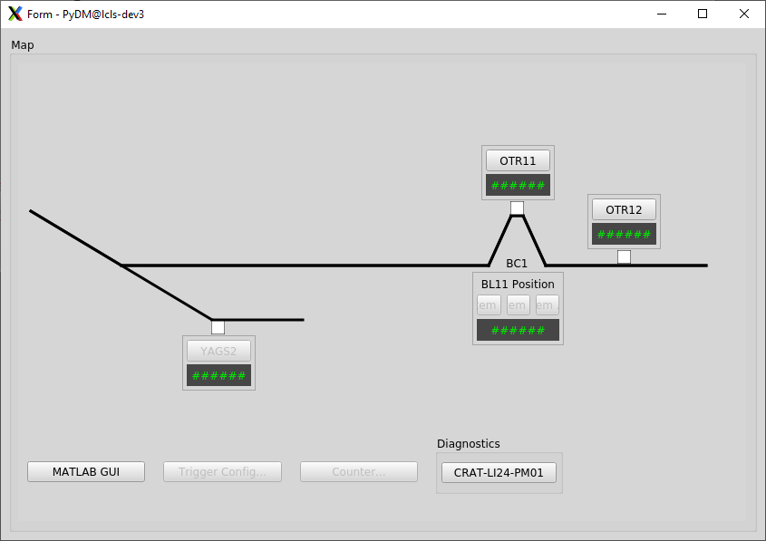
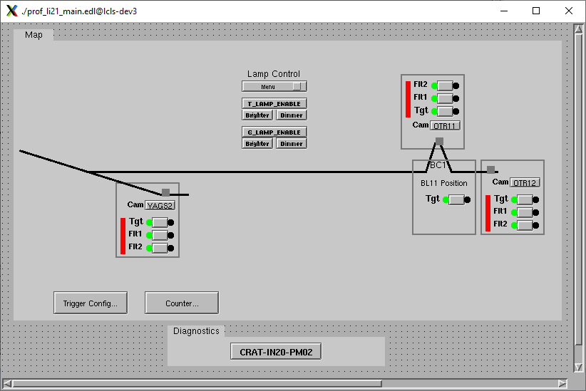
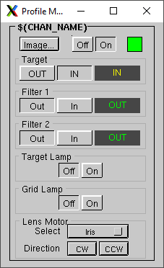
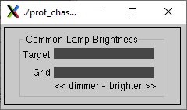
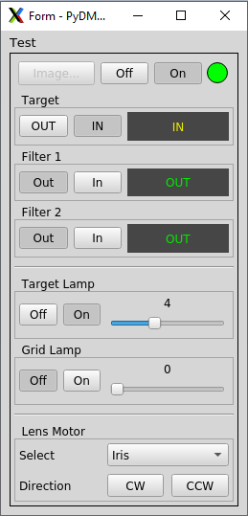
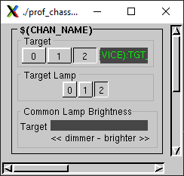
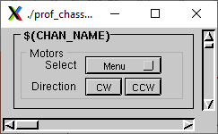
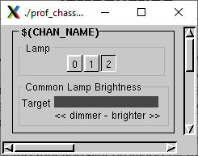
Profile Monitor Screen
Update & Upgrade
Cora Leigh Moss
I was tasked with updating Profile Monitor screens which currently exist in EDM, an EPICS Display Manager that is no longer supported or updated, and redesigning them in PyDM (Python Display Manager). I focused on a core set of screens that are used in LCLS in order to learn about the functionality provided by these screens and improve their overall functionality. I primarily used PyQT Designer software to build the screens and I tested each of the included features and controls with my mentor in the Profile Monitor Lab. During this internship, I became aware of certain areas that could be improved and certain features in PyDM that are not currently being utilized—namely built-in accessibility features—that could be important in the future of SLAC’s development.
Conclusions
Introduction
Before (EDM)
After (PyDM)
QT widgets in PyDM provide a feature-rich paradigm with which to build dynamic screens for Profile Monitors. One feature in particular has proven especially valuable: PyDM Rules. I am able to build conditional visibility into each device’s controls in a way that makes obsolete the need to have five separate files in EDM. Any features or controls that were added after the main screens were built, in EDM, I have consolidated into a single screen to give the necessary context clues to their purposes without extraneous text labels and to increase overall organization. In the interest of greater visual accessibility I have made some notable changes: The space in between buttons and other controls have been increased, approaching industry UI standards. All the screens that I have built can now be dynamically resized, by mouse click-and-drag.
The examples that appear on this poster are just a couple from the dozen files that I worked on. In some cases, the file became obsolete as I became more experienced in designing the files and added additional functionality that is not present in the EDM files. In other cases, like the example to the right, the completion of the file is still in progress while connected files are not currently in production (note the empty readback fields, green characters on a black field, since the PYDM files for those screens have not been written yet).
For these Beamline Map screens, I have removed some of the extraneous controls for the different devices per an ongoing conversation with my mentor. The reasoning behind the change is two-fold: To reduce instances of accidental button presses, especially in tight spacing, and those controls will appear on the profile monitor screen that pops up when the device button is pressed. Additionally, a MATLAB button has been added to all Map screens for scientist’s convenience.
It was necessary to spend many hours educating myself on EDM files as well as the many features of QT Designer software in order to create new Profile Monitor screens in PyDM. One of the biggest challenges I faced is the limited documentation that exists for PyDM and PyQT thus far. Normally, I would spend a substantial amount of time reading docs in the language I’m becoming familiar with, but lacking that, I had to reach out to a number of software engineers at SLAC for details and tips. With their consistent help, I was able to “mess around” and tackle the steep learning curve of getting up to speed.
Challenges
Moving Forward
As more screens get updated and put into production, LCLS is moving toward greater functionality and hopefully longevity as well. Given this opportunity of change, it is important to focus on making improvements that meaningfully contribute to growing the capacity of the work that can be done at SLAC. One important aspect of that work, I believe, includes improving accessibility in design processes and available tools. Accessibility is a value that not only allows for a greater pool of talent to hire from but can also improve the quality of working environment for all laboratory members. I believe SLAC can and should be a leader in accessibility in the scientific community, and I would like to continue to research and implement accessible features in the tools that are used. This work is important in order to support the inclusion and well-being of a wider, more diverse SLAC community into the future.
Five different files were previously being used by different Profile Monitor devices, but can now be consolidated into one screen, where only the relevant controls and fields for the specified device that is connected to the screen will appear.
I wish to express gratitude to the following people for going out of their way to support me during this internship: Courtney Curtis for being such a welcoming, encouraging, and enthusiastic mentor; Tasha Summers for sharing multiple one-on-one PyDM info sessions and resources; Matt Gibbs for answering at least a dozen questions in half as many weeks; Yekta Yazar who reached out to me early on to make sure I had access to necessary directories; and Chris Hoover for making this opportunity known to me and encouraging me to pursue it.
Acknowledgments

