Slide 1
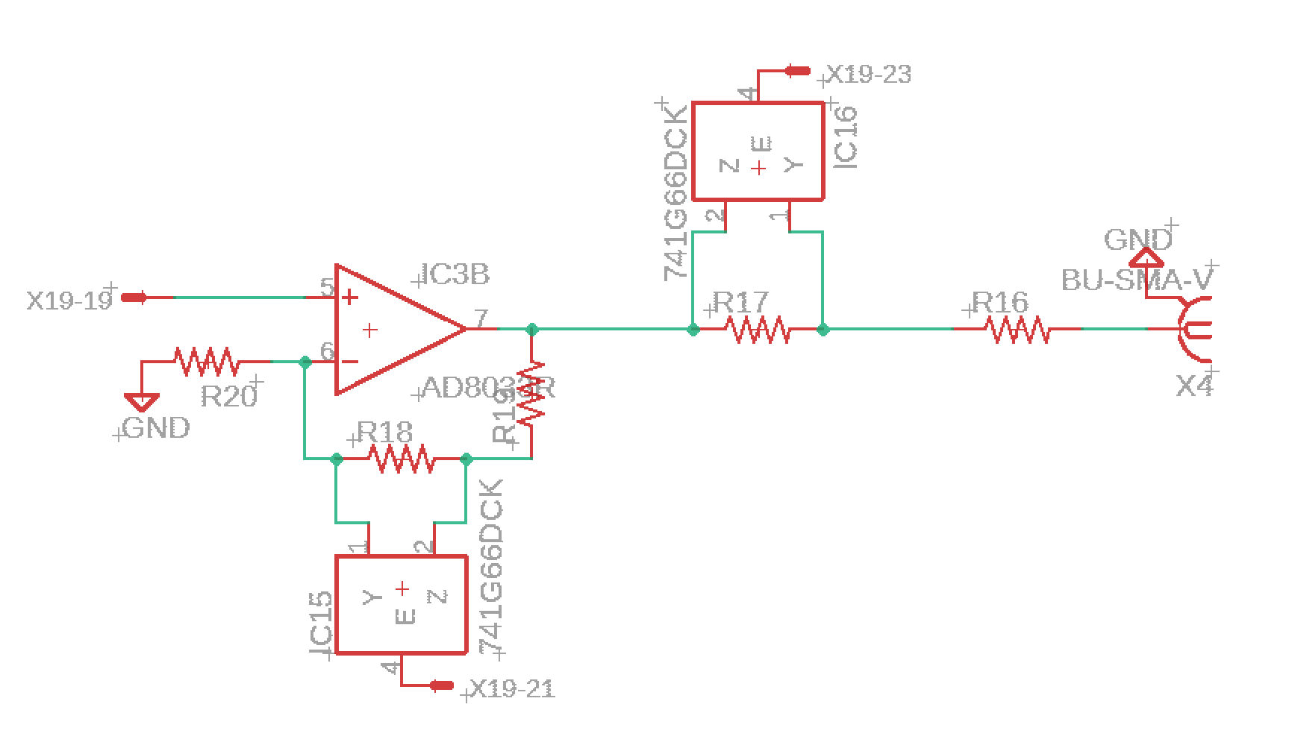
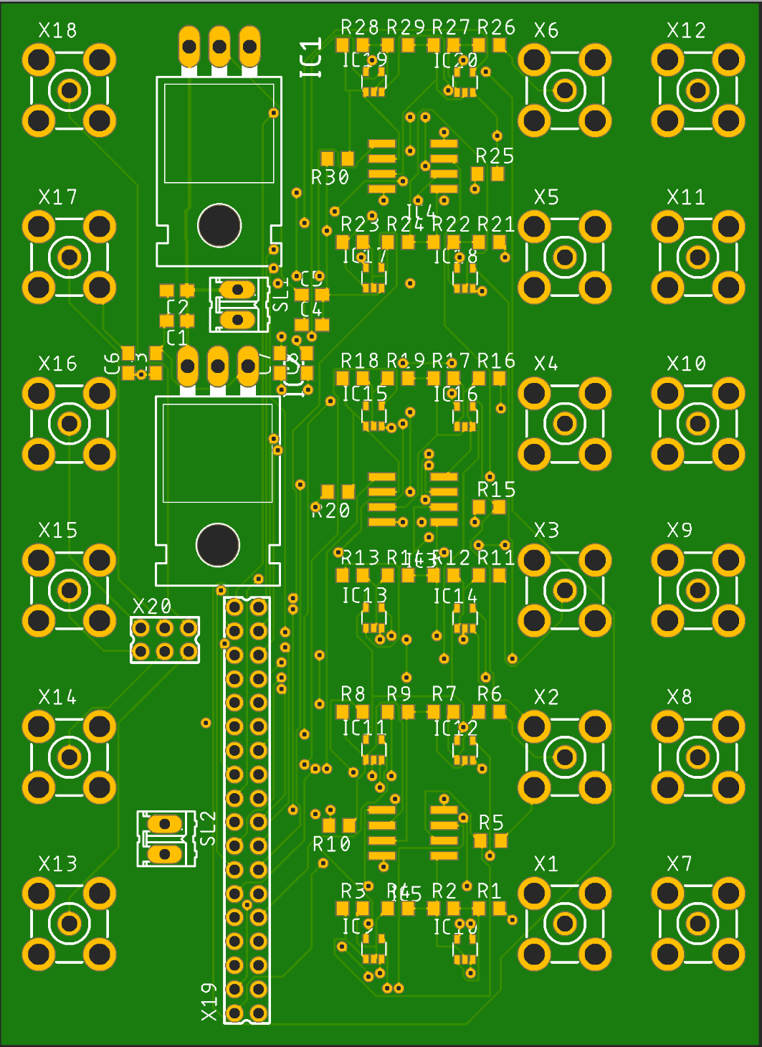
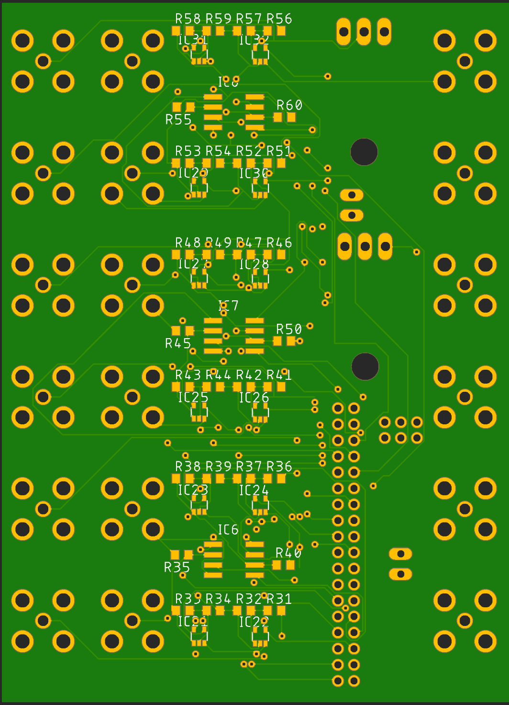
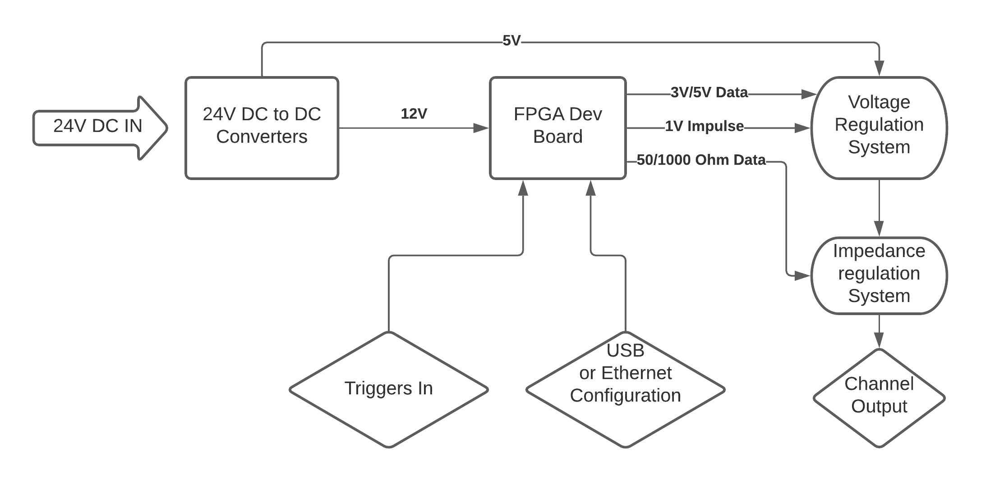
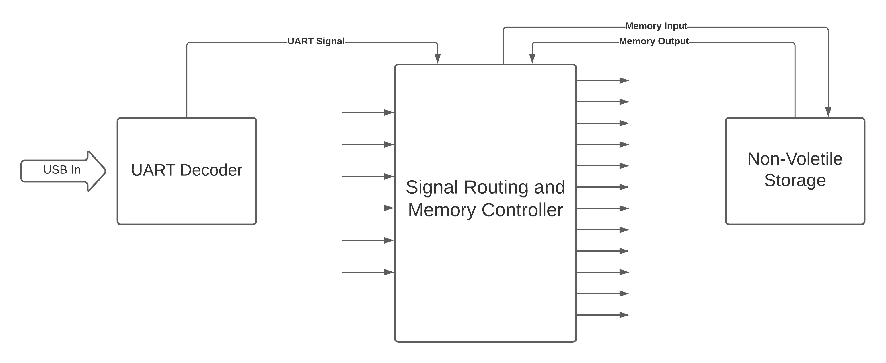
FPGA Based
Trigger Fanout
Austin Gnecco¹, Tyler Johnson²⁺
¹Your Affiliation.
²Linac Coherent Light Source, SLAC National Accelerator Laboratory, 2575 Sand Hill Road, Menlo Park, CA 94025, USA.
⁺Contact: tjohnson@slac.stanford.edu
Introduction
Visualized Board and Code Structure
Conclusion of Previous Project
The goal of this year’s project was to create a trigger fanout board, that would be capable of taking in 5 trigger signals and independently mapping them to any of 12 outputs.
This system is to be implemented on the NEH laser system to allow laser signal triggers for different system components to be routed and dynamically reassigned to meet the daily needs of experiments conducted in the NEH.
Although there are still software bugs that need to be worked out, and a final revision of the board to be made with an FPGA on board rather than on a separate FPGA development board, this project is well on its way to completion and can even be implemented in its current development-board based status.
This is an example of one of the 12 output circuits that is used to change the voltage and impedance of the output signal. The base pulse is provided by the FPGA logic according to the logic which determines which input will trigger it. The pulse is then modified in its voltage by an op amp to generate the desired output voltage.
Additionally, the finishing touches have been applied to my project from last year: A BiSS-C signal splitter. This device was designed to sit inside of a BiSS-C based feedback loop between a motor encoder and a motor controller and split off the encoder position information into a separate signal. This signal could then be read by the greater control system at LCLS to allow the device position to be read from a control panel.
As this project was previously left, the project had been validated in MATLAB, but the auto-generated HDL code that was created had not been simulated on an actual FPGA.
This summer I was able to complete that step, and successfully simulate the workings of the board. Most all conceivable cases were able to be simulated with the expected results, however the final step of confirmation that the design works as intended will be to test the board with actual BiSS-C hardware, to make sure that it behaves appropriately with a real-life signal rather than just a simulated one.
I hope to be able to return to SLAC in person next year in order to complete this final step in the testing of this BiSS-C splitter.
The completed board design is shown below. Six inputs were chosen rather than 5 for symmetry reasons. The dimensions end up being 3.5 x 2.5 inches which is well within the desired space requirements while still providing all of the intended functionality.
Design
The given constraints for the trigger fanout box were as follows:
The system shall be powered by a single +24VDC input supply
The system shall use SMA connections for input and output triggers.
The system shall be remotely configurable.
The system shall accept up to 5 input triggers and 12 output triggers.
All output triggers shall be configurable to follow any of the input triggers.
Output triggers shall support output currents of at least 100mA and output terminations of 50 and 1000 Ohms.
The output trigger voltage level shall be selectable, with two options: 3.0V, and 5.0V.
Output skew shall be no more than 100 ns.
Given these design constraints, a test board was created with 6 inputs and 12 outputs that could be changed between 3V and 5V triggers and 50 ohm and 1000 ohm impedance.
This test board has all of the functionality desired of the final product, with the exception of the FPGA being located on the board itself; it is instead located on a separate development board. The current test board includes the power regulation hardware to convert the 24V DC input to 12V DC, which the FPGA development board can run on.
The board routing can currently be programed over USB during normal operation without re-flashing the VHDL code, but modular design of the software would allow the device to be programed over nearly any standard protocol including an ethernet network with minor adjustments.
Continuation From Here
Despite the progress on this board, there is still a significant amount of work to be done on this board for a final version to become operational.
In terms of software, the AXI and AXI-Lite connections between the main, UART, and non-volatile storage modules need to be connected in order to function properly (an implementation that was giving me trouble during development).
Additionally in terms of hardware, a final version of this board should be designed that has an onboard FPGA to shrink the total size of the solution and allow for laser table mounting.
I hope to be able to return to SLAC next year to complete and implement this project in its entirety.
Below is an overview of the system and all its inputs and outputs.
Below is a very basic block diagram of the software, the directions that data flows within it, and the protocol that each data stream uses
Acknowledgments
Use of the Linac Coherent Light Source (LCLS), SLAC National Accelerator Laboratory, is supported by the U.S. Department of Energy, Office of Science, Office of Basic Energy Sciences under Contract No. DE-AC02-76SF00515.
Date: 9/10/2021

