Slide 1
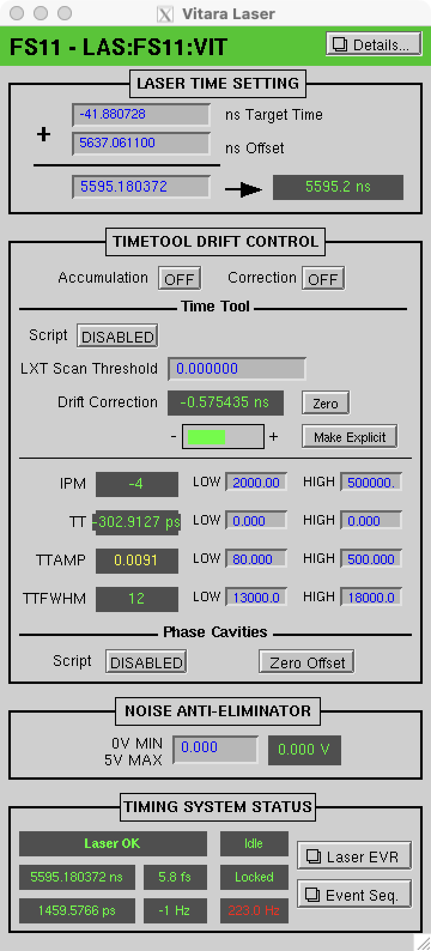
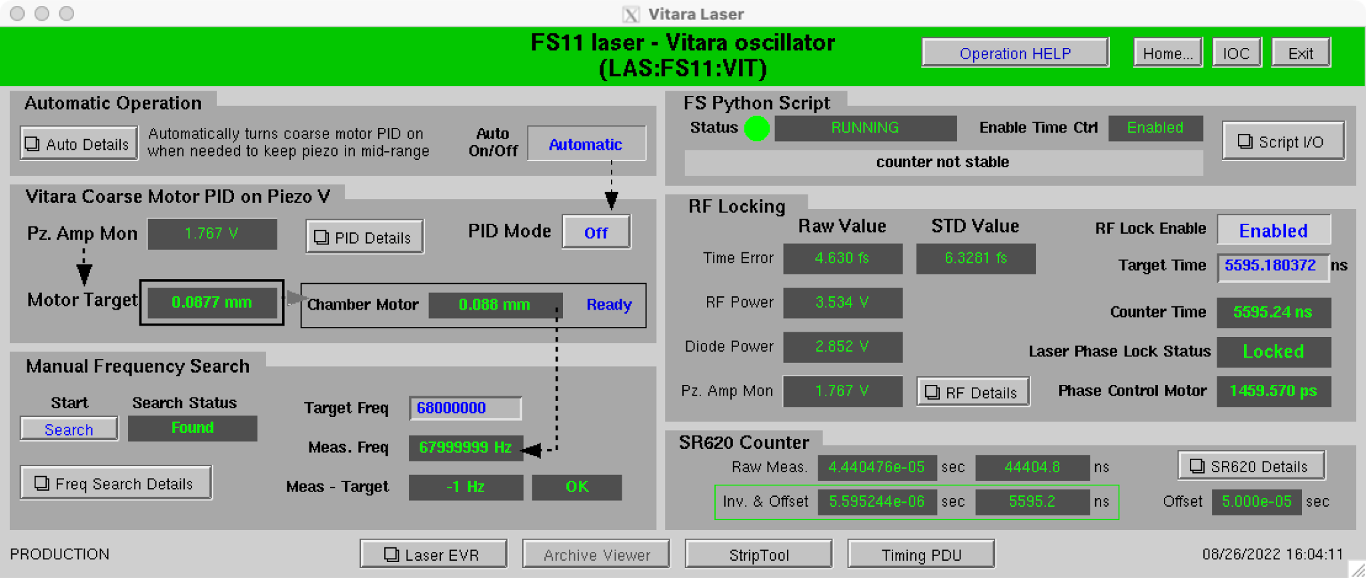
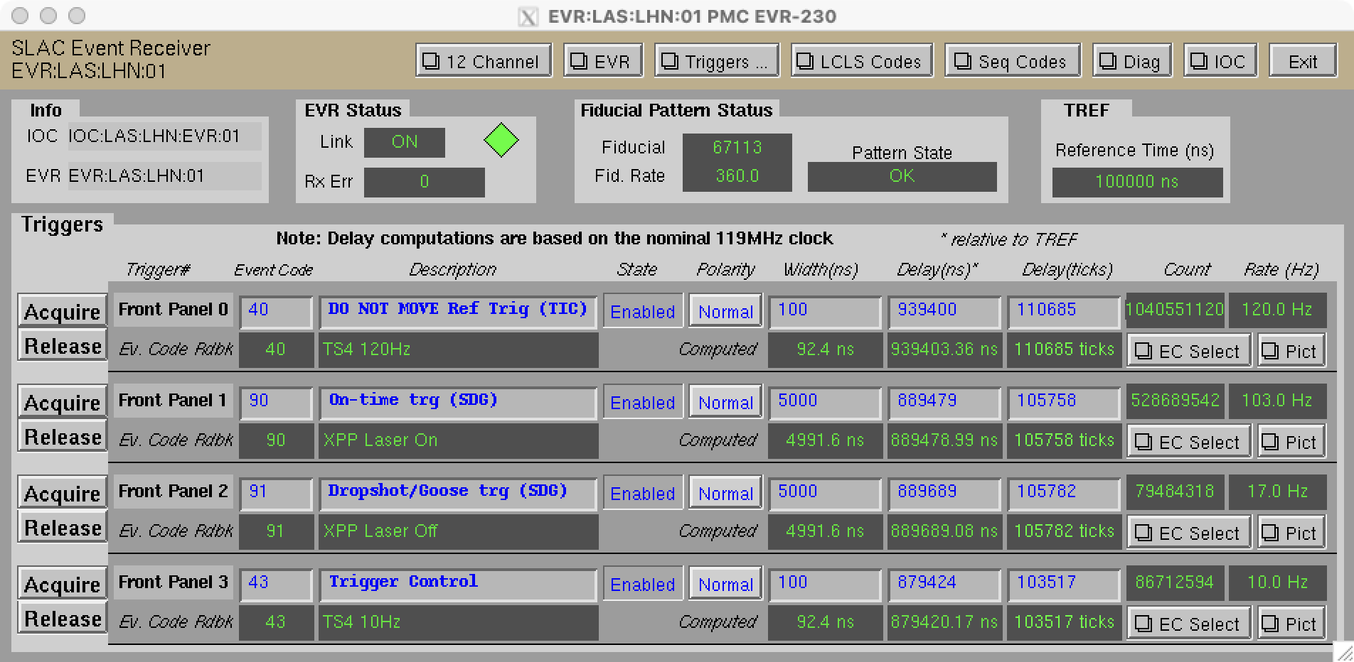
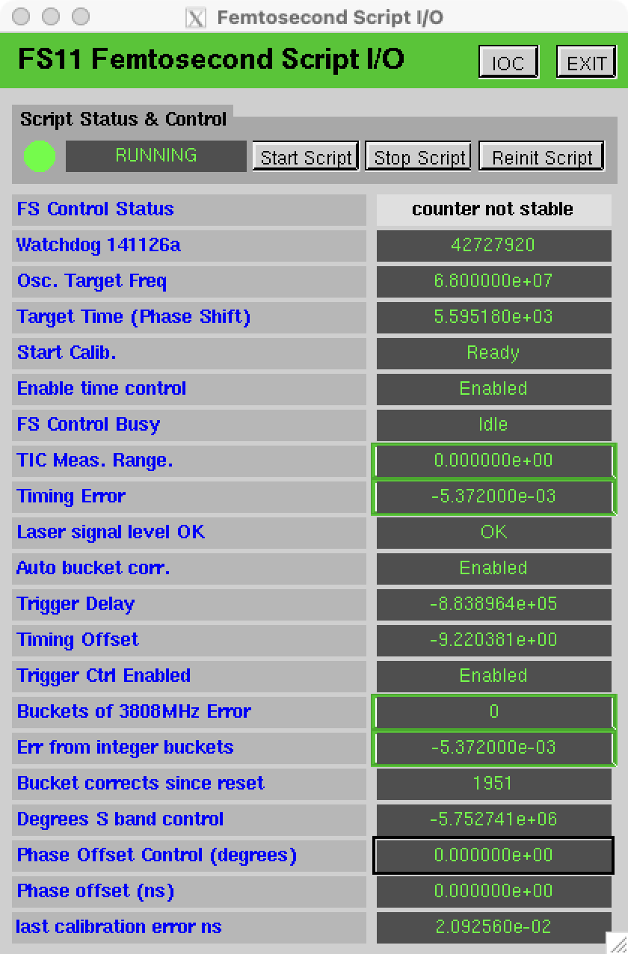
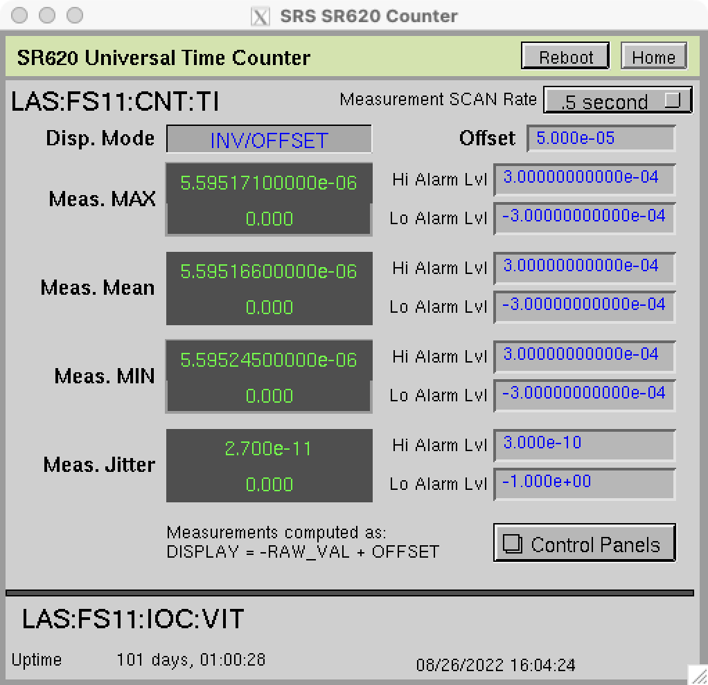
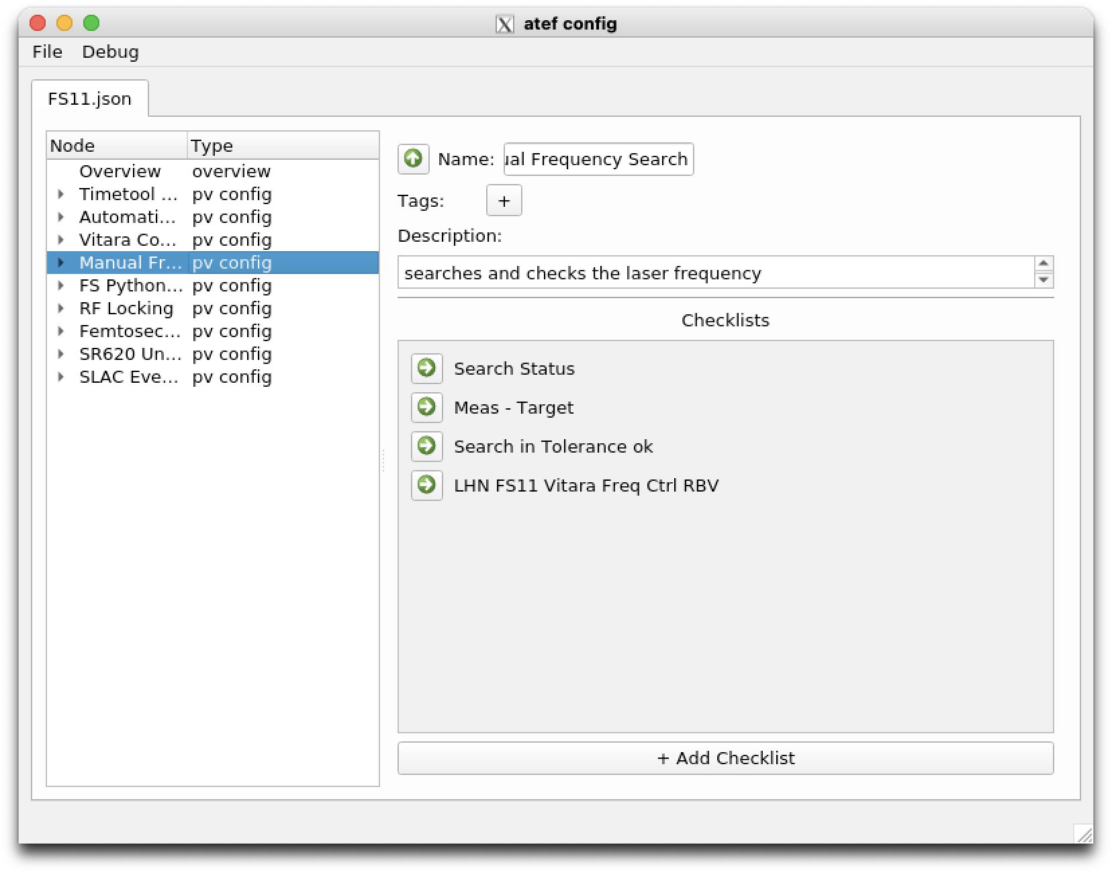
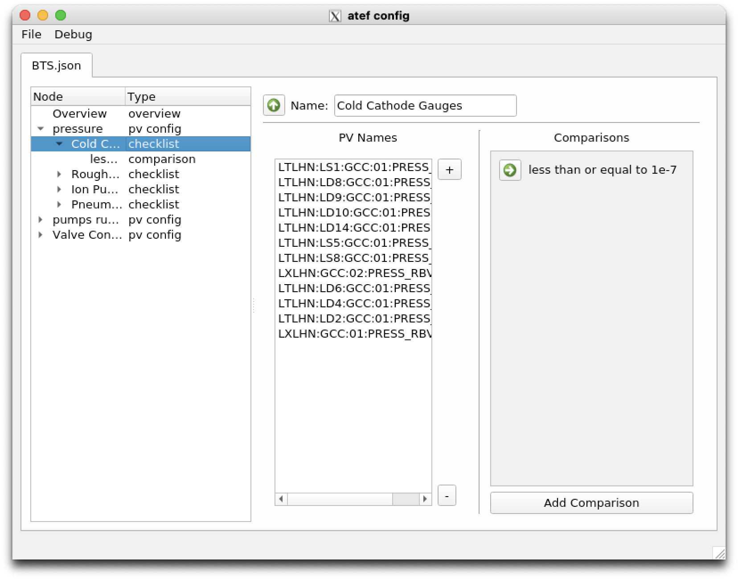
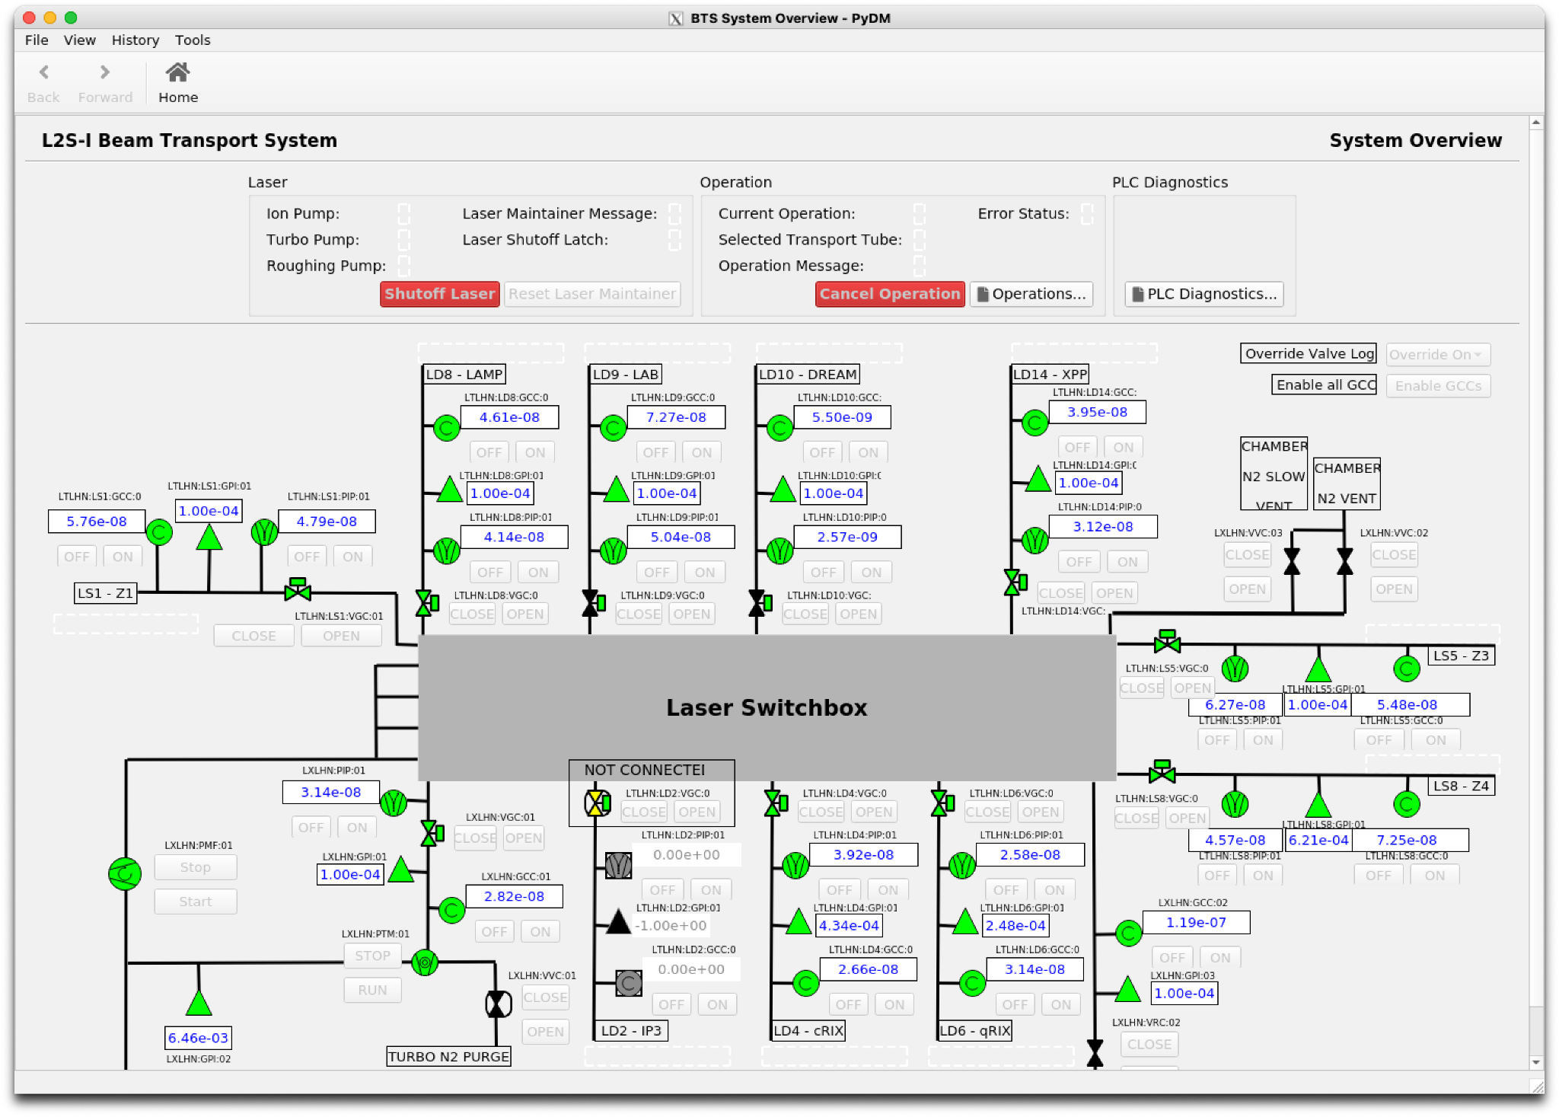
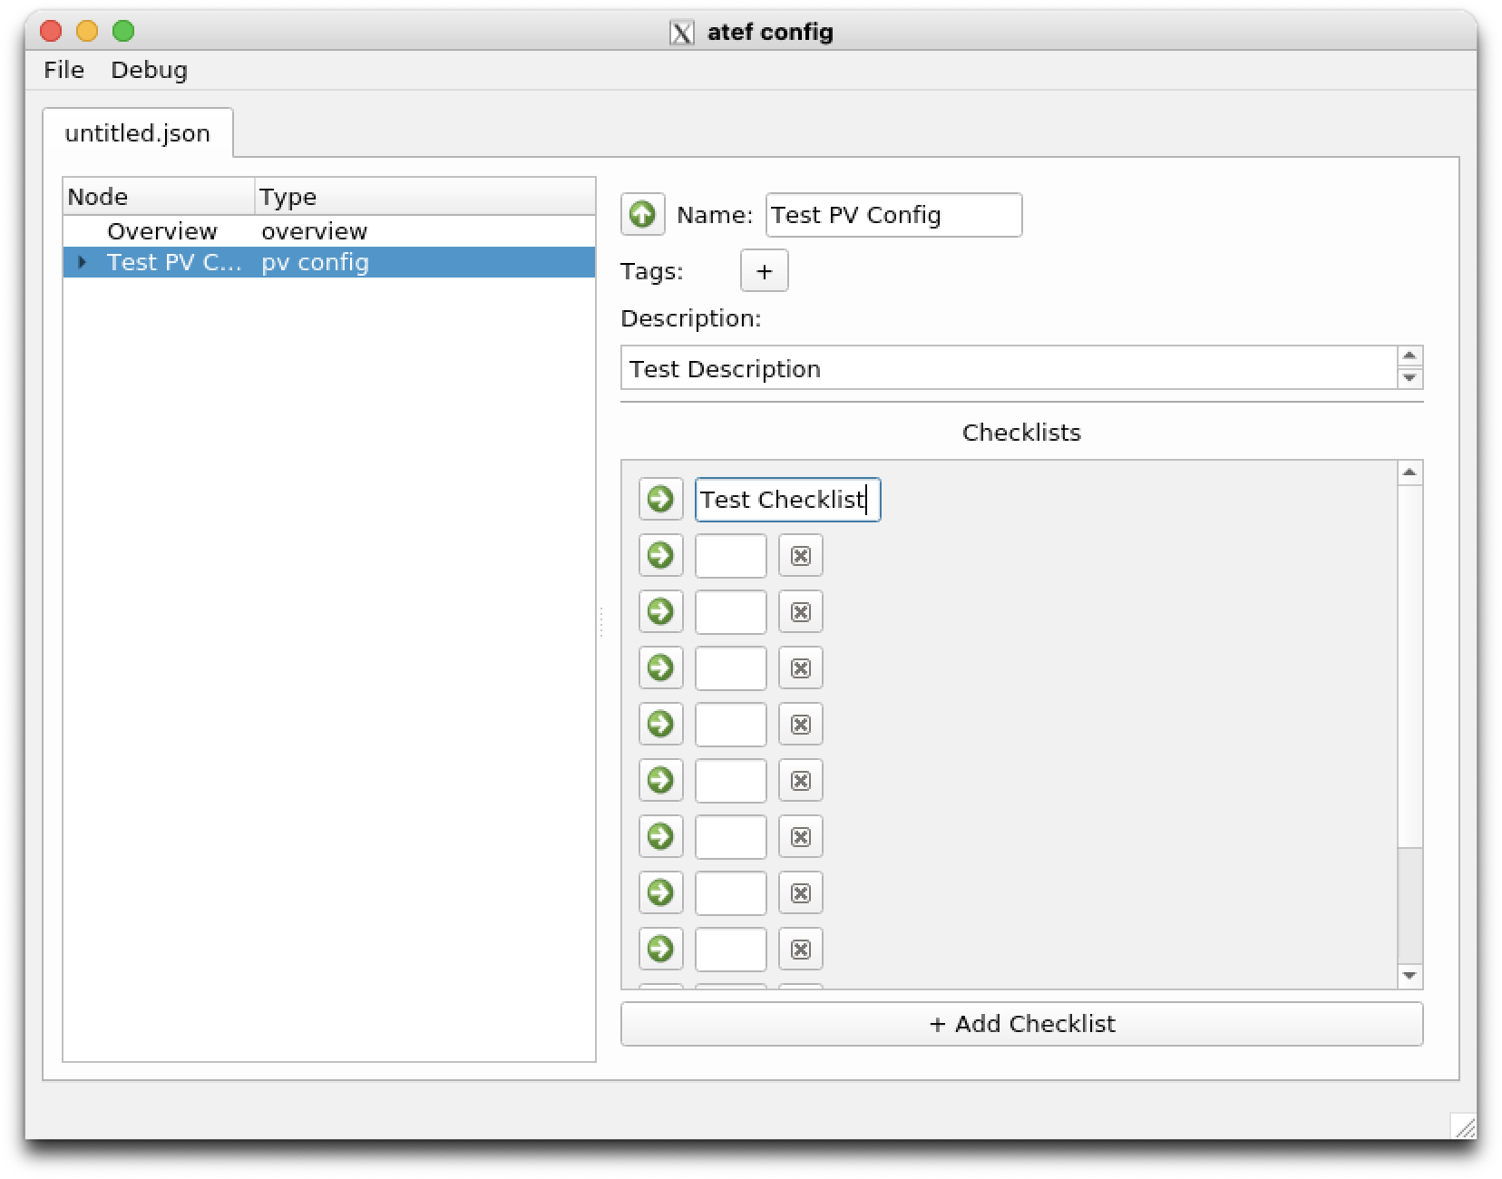
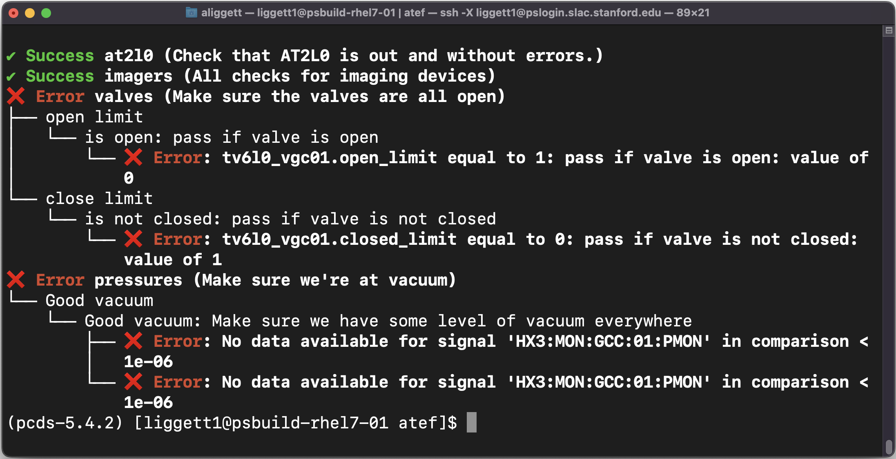
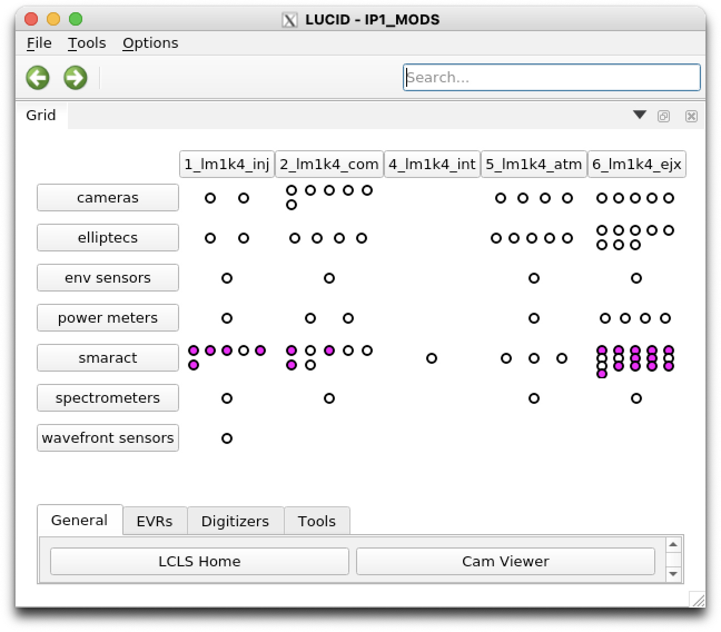
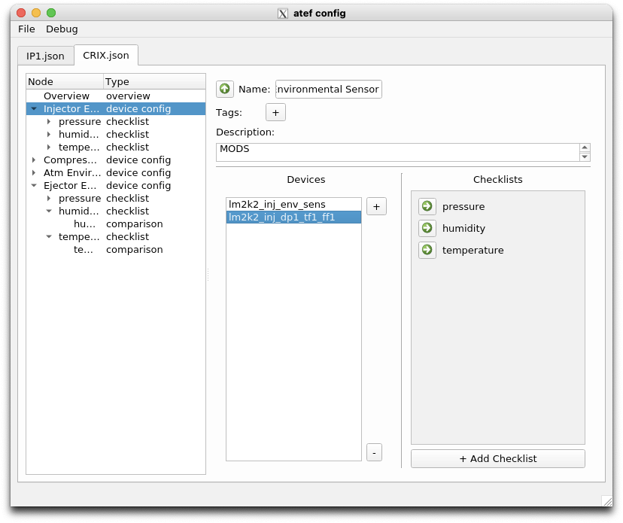
Beta Testing ATEF Using Timing, MODS, & BTS Checks
Andrew Liggett Mentor: C. Pino | Dev. Team: Z. Lentz, K. Lauer, R. Tang-Kong Engineers: T. Johnson, A. Wallace
What is ATEF
ATEF is an acronym for Automated Test Execution Framework. It is a program that compares process variables (PVs) and device signals to user set points. The main purpose of ATEF is to automate the checkouts of various PVs and devices before the use of lasers. This process is originally done manually, but the goal of ATEF is to perform the checkout automatically.
Scope of Internship
The scope of this internship was to test the GUI in creating configurations with JavaScript Object Notation (JSON) files. These configurations are the blueprints to the automated checks. Feedback was given to the development team on bugs that came up as well as enhancement suggestions. Aide in debugging code was also provided.
PV Configs ➤ Timing Lockers
The timing lockers require checks before operating the lasers. The current version of ATEF is able to do passive checkouts on the timing devices. Since each PV corresponds to its own checklist, there are a variety of ways to organize these checklists. One example that has been used is to correspond a PV configuration to each section from the timing GUI and incorporate the PVs that are part of that section into the config.
Bugs & Enhancements
There have been a total of five bug fixes and enhancements to ATEF. These include:
a scroll bar has been added to the checklist page
a typing cursor bug fix
the option to ping a device has been added to the check
There was also a bug that prevented newly created files in GUI not save as .json files automatically. I added lines of code that checks if name of saved file ends with “.json”. If the name of the saved file does not end in “.json”, it is then added to the end of the file name. Bash scripts were also created in order to launch the checks for the MODS and timing lockers. The purpose of these scripts is to run the commands for the checks that ATEF currently provides more efficiently and be used in a reduced amount of time.
Checks & Configs
Config → GUI
The goal of the config GUI is to allow users to manually input addresses of PVs and devices into “configurations”. These are saved as JSON files for now; there are also plans to incorporate yaml files. Some features of the GUI include:
Lock/unlock editing
Side menu for easy navigation
Can create new file in GUI and save them
Currently, passive checkout comparisons are limited to static quantitative values. Future development includes comparisons to additional dynamic values.
Checks
ATEF performs checks based on comparisons made in JSON file. These checks give detailed feedback to the command line for the user.
PV Configs ➤ Beam Transport System
The Beam Transport System (BTS) is responsible for supplying lasers to all of the hutches in both the Near End and Far End Halls. It is important that before running experiments, the laser is within a satisfactory vacuum limit, all of the controls are closed, and all of the pumps are running. ATEF is capable of passively checking these PVs and provide timely results of the status of the BTS.
Device Configs ➤ MODS
MODS is an acronym for Modular Optical Delivery System. It consists of Table-top Integrated Laser Elements (TILEs) with a number of devices per TILE. The first devices tested with ATEF were environmental sensors; a JSON file was created to do a passive checkout of the pressure, humidity, and temperature of each of the TILEs. A device config can contain multiple instances of the same device type and make comparisons to different PVs by having their own checklists. However since there are many different devices per TILE, in an ideal scenario, each MODS would correspond to its own JSON file and each TILE would have its own device config, allowing multiple categories of devices as well as individual devices be able to be within a single device config. As of now, the only way to incorporate MODS is to have each individual devices correspond to its own device configuration.
Conclusion
ATEF is fully functional and ready to be used on the Timing Lockers and Beam Transport System for Passive Checkouts. It will provide results from these systems in a timely manner and reduce time spent performing checkouts. There are still a couple more enhancements in development that will further enhance the use of ATEF including:
Dynamic comparisons between PVs
Organization and restructuring of GUI to incorporate the MODS
After completing and testing the passive checkouts, the next goal of ATEF will be to automate active checkouts. ATEF will be a necessary and useful program that will increase checkout efficiency, decrease time performing checkouts, and allow users to perform their work in a more timely manner.
Notes:
This means that each TILE will correspond to its own JSON file with many device configs and each MODS would be its own directory. ATEF is currently being re-coded to incorporate the format of the MODS.

