Slide 1
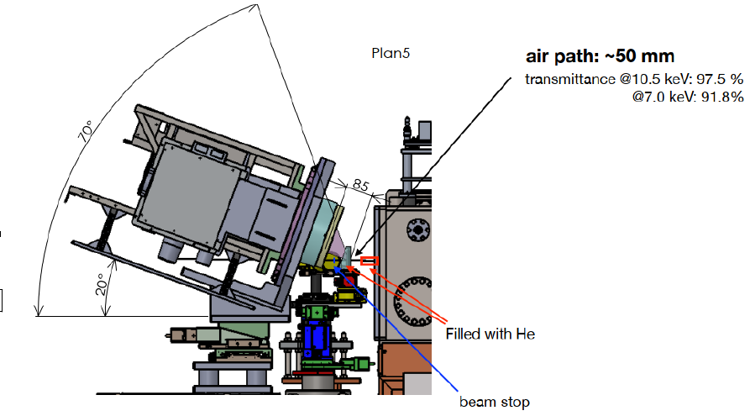
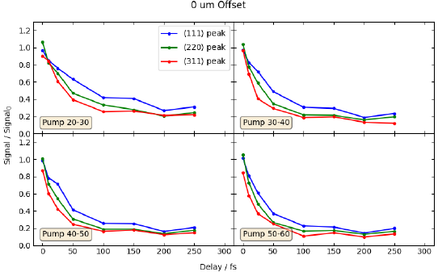
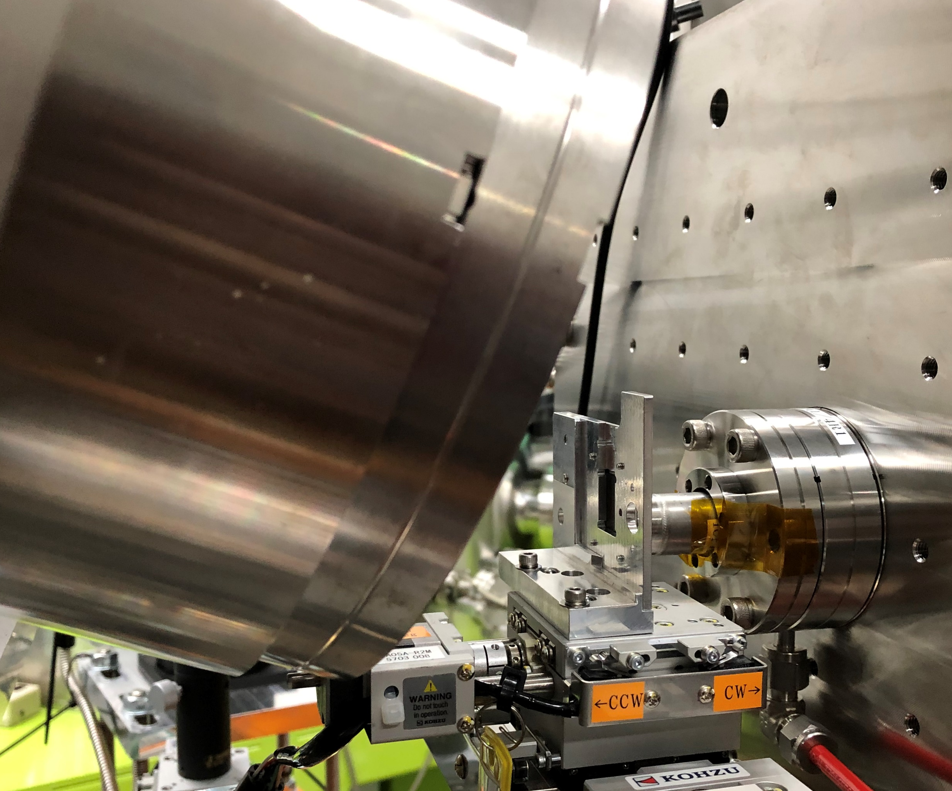
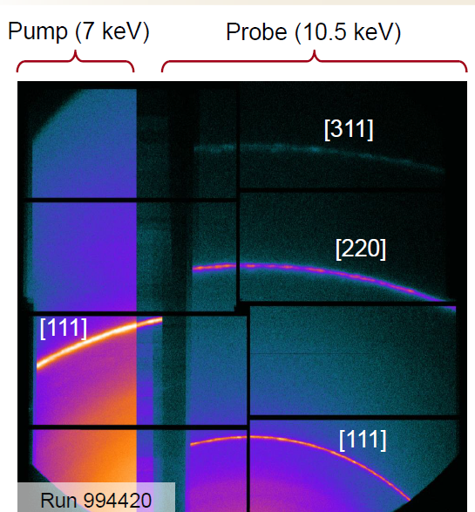
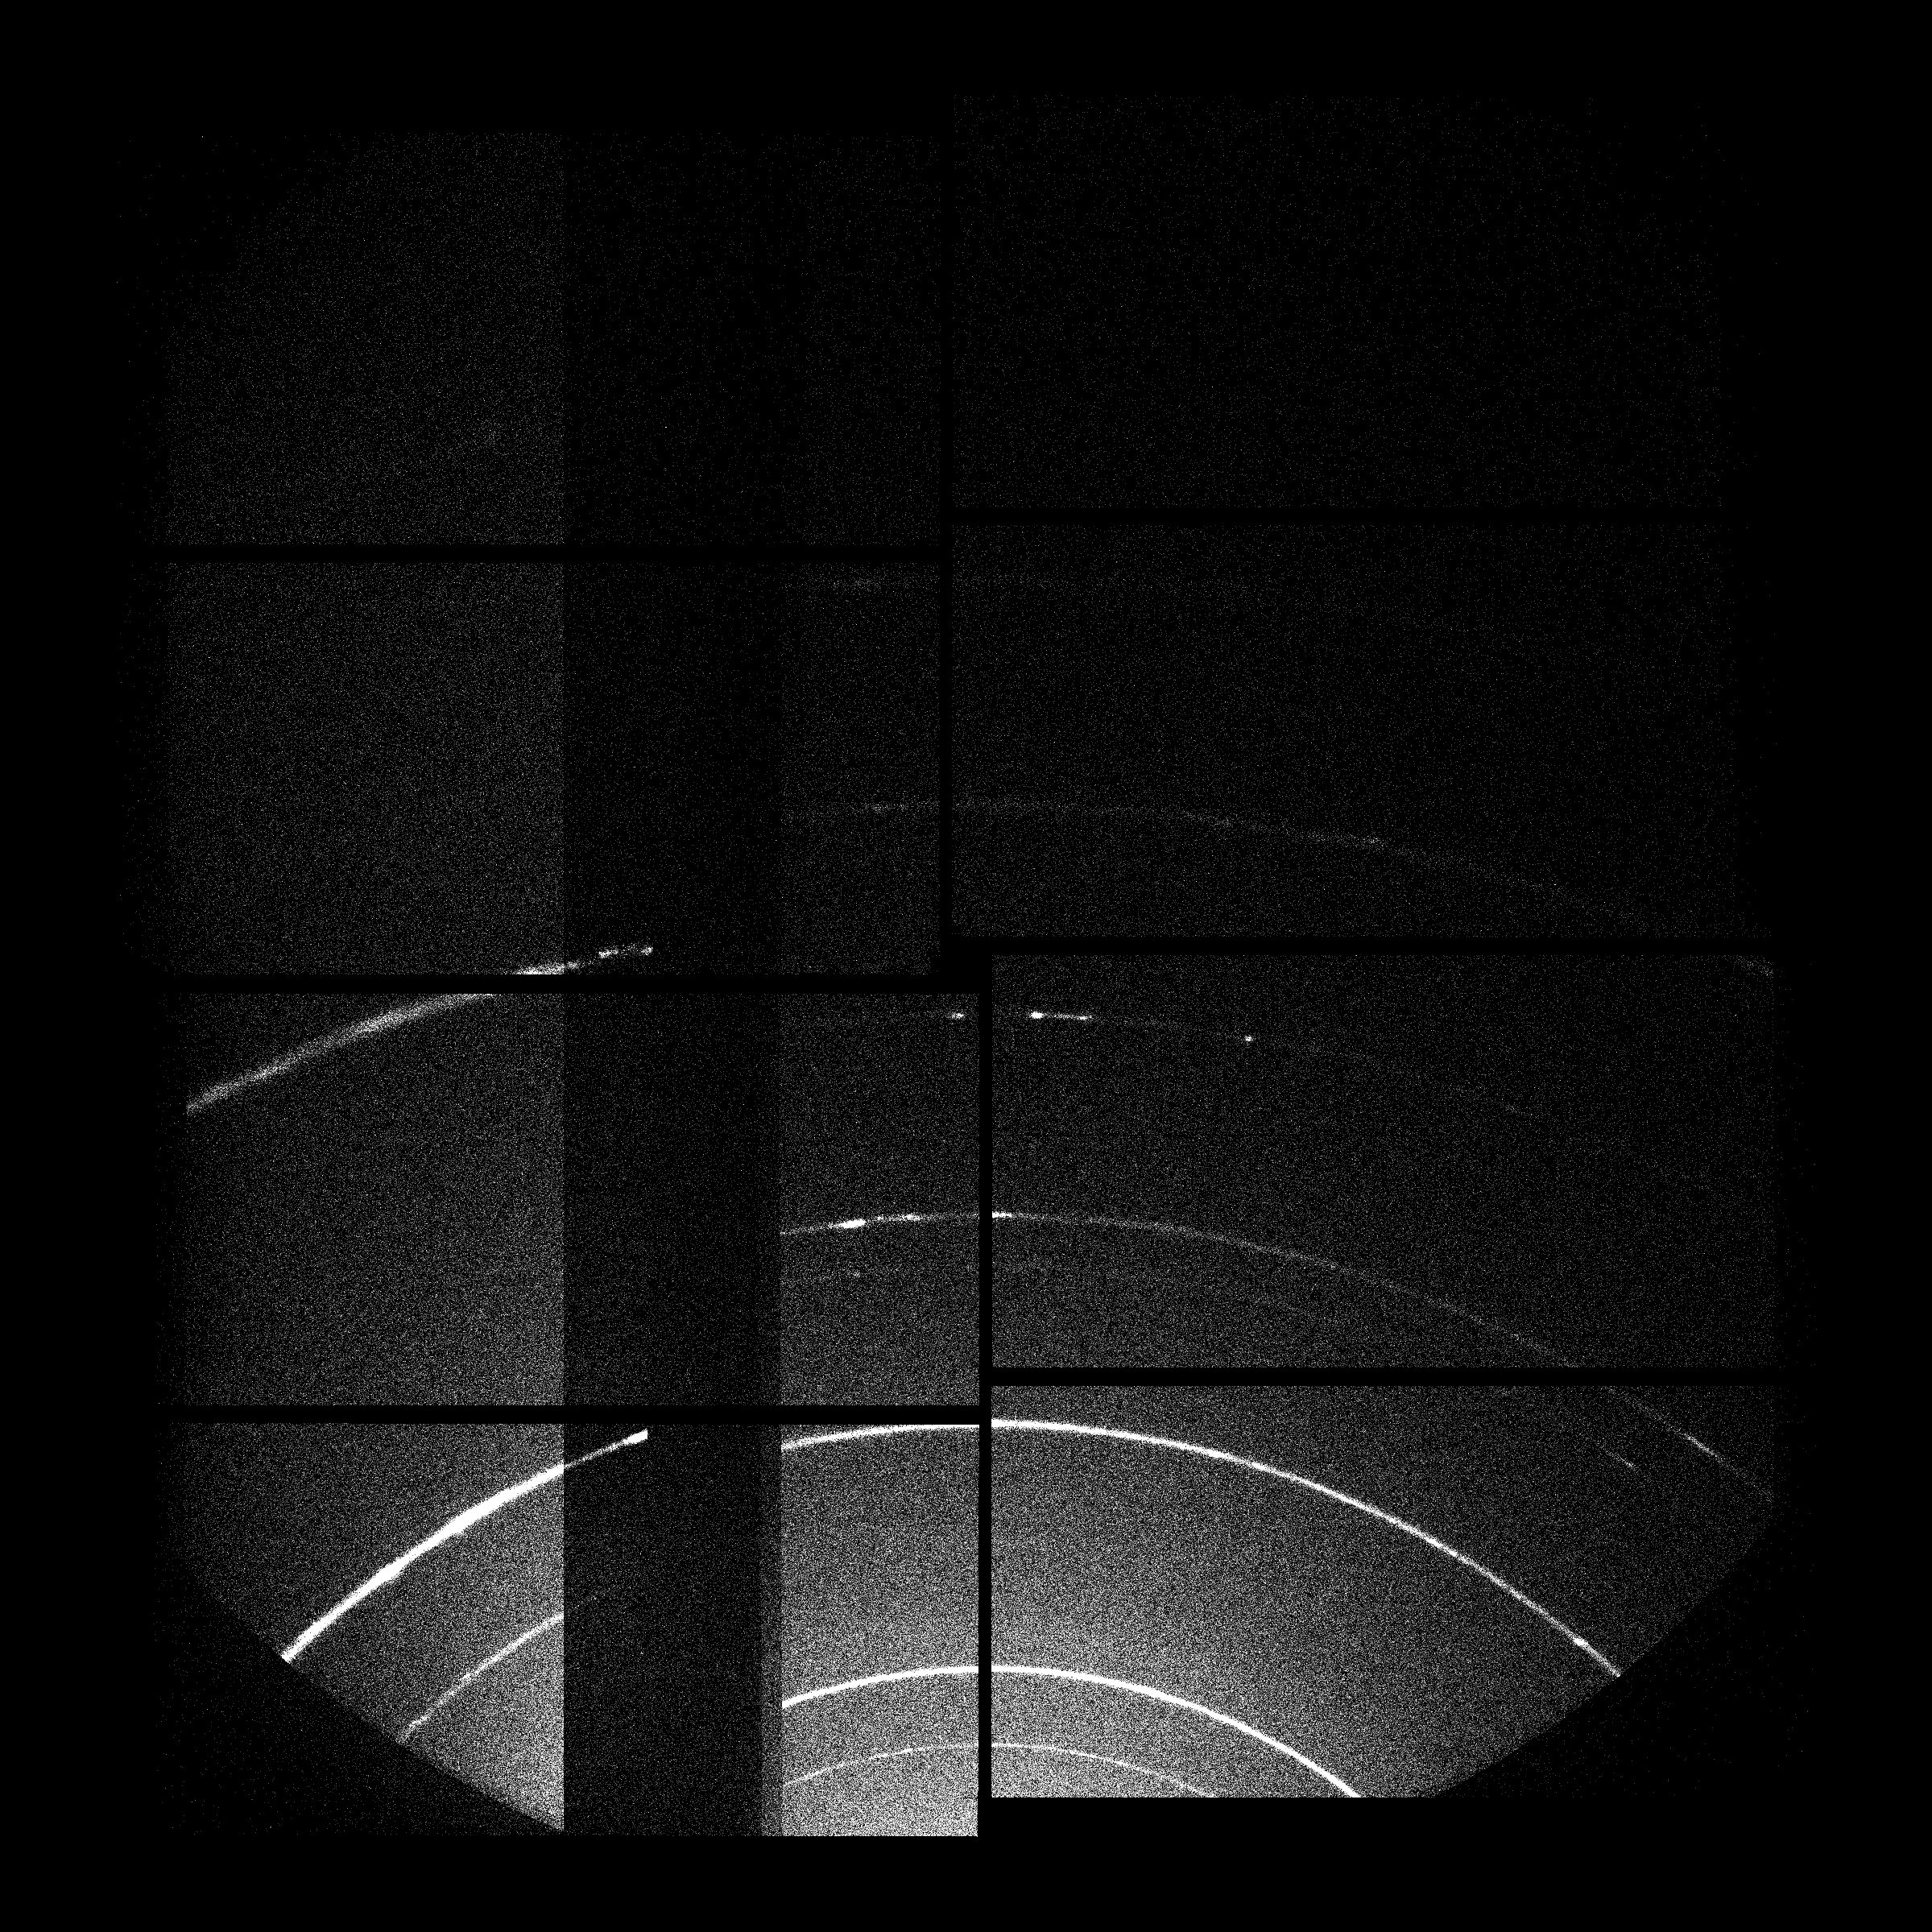
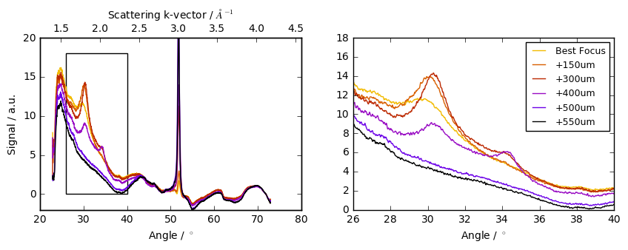
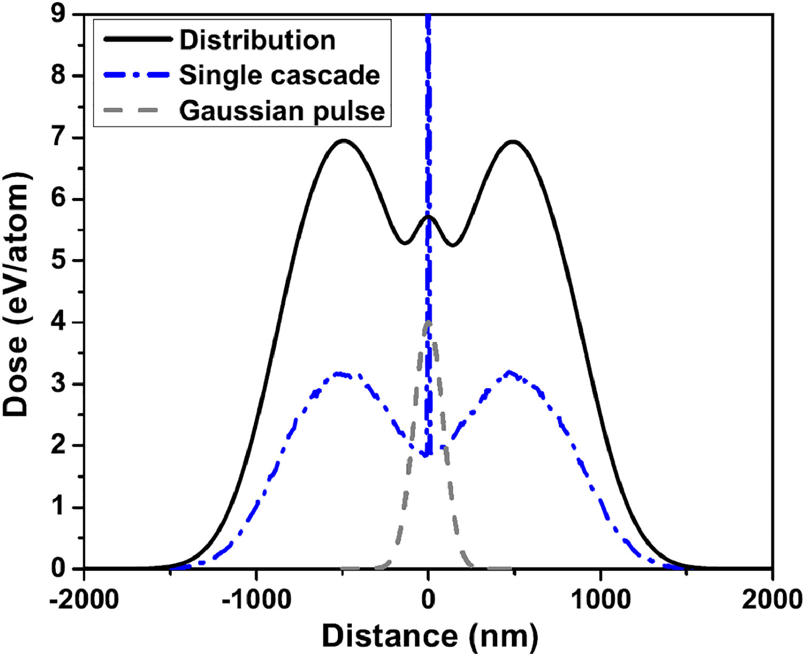
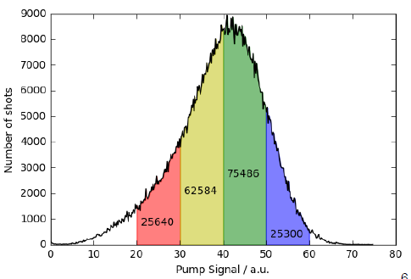
Ultrafast Phase Transitions in Crystalline Materials at the SACLA XFEL
Andre Antoine¹, Nicholas Hartley², Phil Heimann^{2,} and Graphitization experiment collaboration
¹Applied Physics, University of Michigan, Ann Arbor, MI 48105, USA.
²Linac Coherent Light Source, SLAC National Accelerator Laboratory, 2575 Sand Hill Road, Menlo Park, CA 94025, USA.
⁺Contact: paheim@slac.stanford.edu
Introduction
Results/Discussion
Diamond
Medvedev et al predicted the effect of nonthermal graphitization of diamond induced by a femtosecond x-ray laser pulse. This effect is yet to be experimentally confirmed which led our team, lead by Phil Heimann, to investigate this effect at the SACLA XFEL. We studied an additional material, NaCl to observe disordering on the fs time scale.
Highest fluence
NaCl
Theory
Under femtosecond irradiation, the crystalline samples are predicted to undergo a cascade of absorption and electron scattering processes. First, photo-absorption promotes electrons from core or the valence bands, which can cause the holes to decay through Auger processes. The Auger emission produces more electronic excitation from valence to conduction. The photo and Auger electrons continue to scatter inelastically though impact ionization.
We expect with greater pulse energy, that the reordering will occur faster, and graphitization may not occur at higher energies. At lower energies we can't detect the transition. We see peak decay as a function delay/time. Lower plot: the data was collected by long time (~33ms) delays. At long delays we see the peak shift to graphite
Differential filtering allowed the pump and probe region to be distinguish on detector. The High energy probe allows observation of multiple diffraction lines.
Filters: Cu for pump, cu-K edge is 9keV-. Higher absorption
Al for probe , lower absorption
X-ray focus: 200nm
Two color pulses: 7keV (pump), 10.5keV (probe)
Time delay:0 – 286.4fs
Pulse energies: 26uJ (pump), 17uJ (probe)
Detector angle range(2theta): 20 - 70 deg
Conclusions
We observed fluence dependent ordering on the femtosecond timescale. There seem to be correlations to peak suppression. Long time (~ms) reordering is observed. Femtosecond timescale reordering, however, was not observed. Further investigation is also necessary to validate correlation between peak decay and pulse power.
Setup/Methods
We conducted the experiment remotely with the help of the staff at SACLA. We made use of pump-probe x-ray diffraction to observe a time resolved change in structure of the material, altering the delay between pump and probe during shots.
The target was raster scanned across the surface.
1.1808Å
1.771Å
Acknowledgments
0-286.4 fs
We would like to thank the SACLA instrument scientists, and staff, as well as LCLS support staff for making this internship possible.
Data sorted by pump pulse energy normalized to the probe pulse energy.
Notes:
Spot size : @150, 0.4um, @focus 1.5um
Focal length
Position (um) Width V (um) Width H (um)
0 0.15 0.15
150 0.37 0.37
300 0.71 0.71
500 1.04 1.04
750 1.16 2
1000 1.98 2.77

