Slide 1
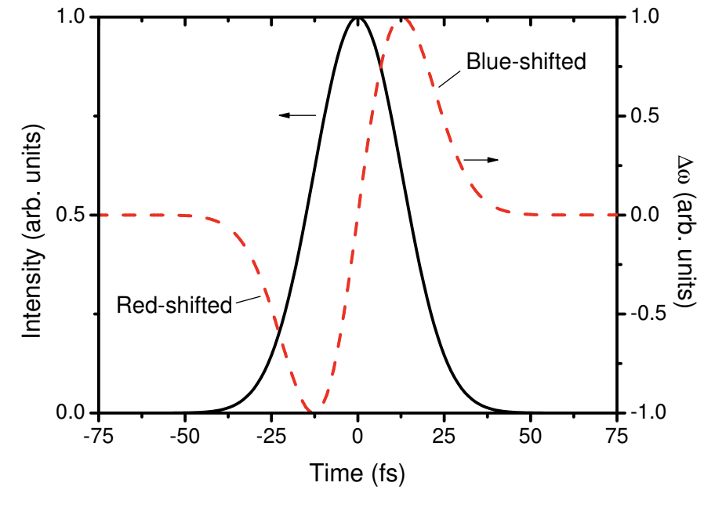
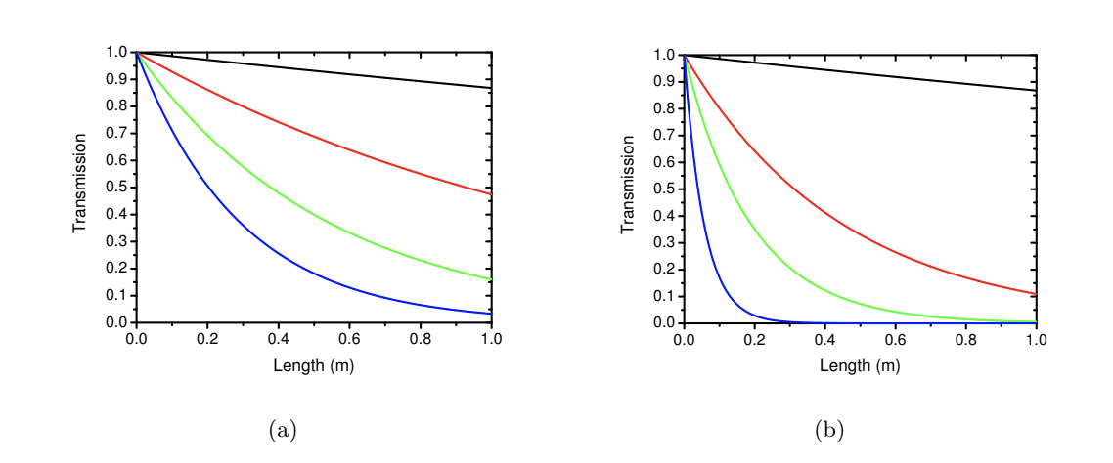
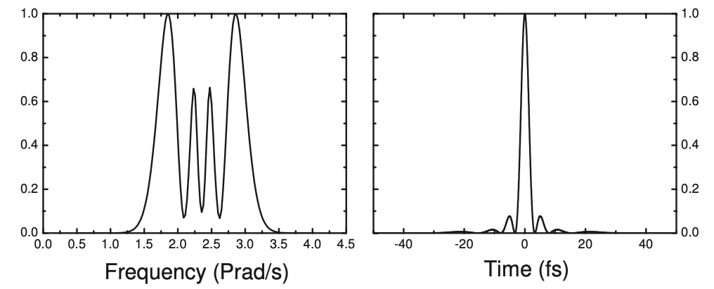
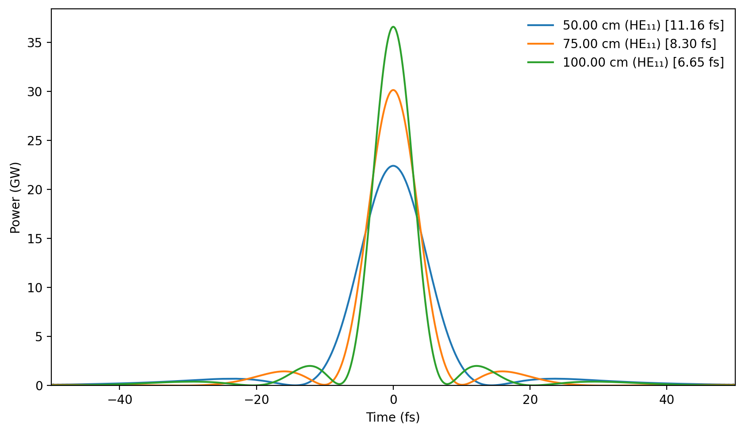
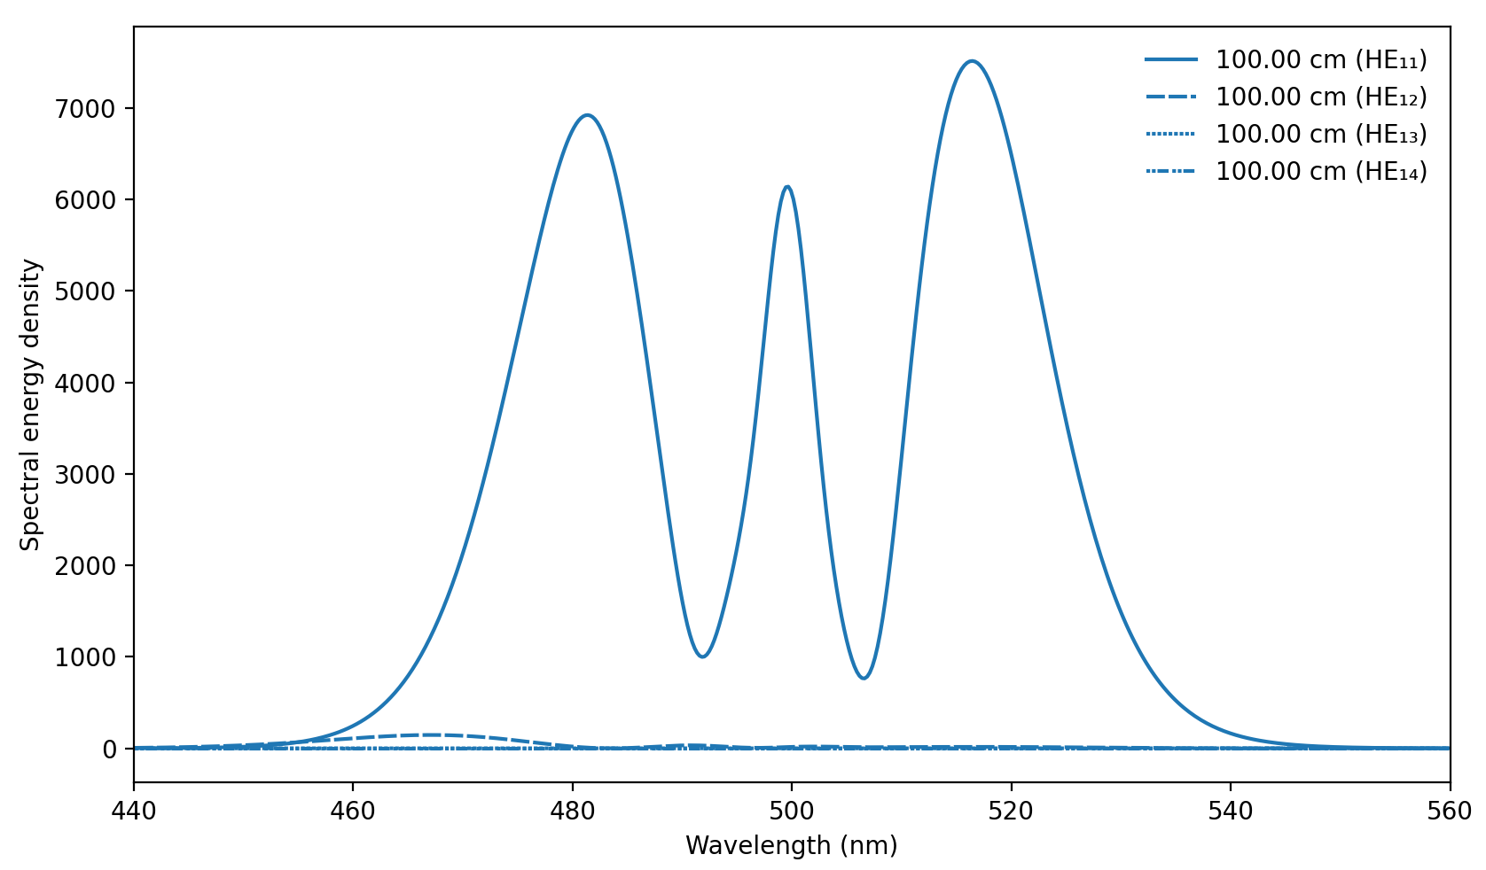
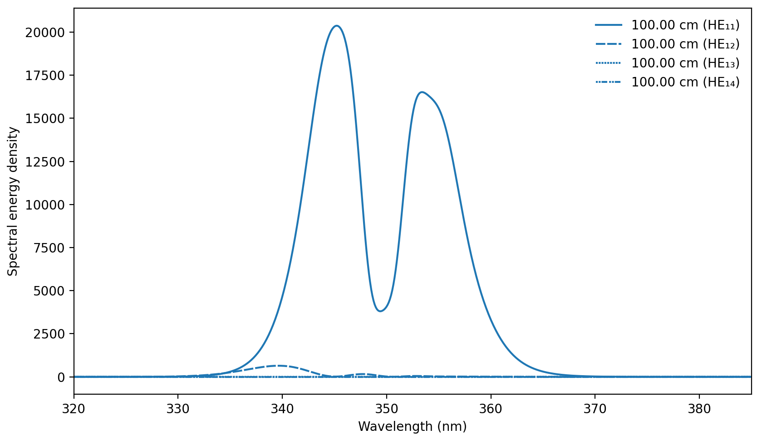
Alyse Graham-Martínez
Modeling wavelength dependent spectral broadening in gas filled hollow core fibers (HCFs)
Background
My Project
Results
Ultrashort laser pulse allow one to study events on extreme timescales.
HCFs provide a platform for the manipulation of the spectral and temporal properties of laser pulses
Parameters such as fiber length, diameter, gas pressure, etc matter.
Used Luna to model the behaviors of high ultrashort laser pulses in HCFs.
Simulations allow for quick changes in parameters involved and and quick collecting and processing data.
Mostly simulated effects of pressure, alone and in conjunction with other parameters.
Optimizing transmission lead me to restrict the parameters
Lots of parameter effect propagation.
Models provide preliminary results to inform future decisions made before experiments
In the future, I would like to collect more data on other parameters such as fiber length and explore wavelength dependence in further detail.
When the electric field of the pulse is sufficiently strong to alter the time-dependent refractive index of the gas, the spectral bandwidth of the pulse is widened causing Self-Phase Modulation.
Acknowledgements
Acknowledgments
Spatial Modes
Fiber Length
I would like to thank Alan Fry and Ruaridh Forbes for their incredible support and mentorship this summer.
Robinson J. S. (2006). The generation and application of intense, few-cycle laser pulses.[Thesis, Imperial College].
https://github.com/LupoLab/Luna.jl
EH11 250µm
EH12 100µm
EH13 75µm
EH14 50µm
Notes:
To optimize transmission in the fiber, the Gaussian beam is best coupled with the fundamental mode of the fiber (HE11). This restricted the pressures I tested in the models.

