Slide 1

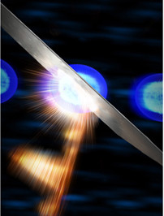
Frontiers of THz Science
ZX Shen
SLAC Chief Scientist
Notes:
This slide represents both our beginning with accelerating electrons (in the SLAC logo) and our future with light sources (the star in the upper right).
Dot represents an electron
Double beam line indicates capability to accelerate both electrons and positrons

Slide 2
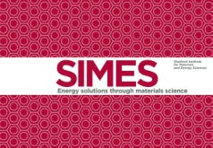






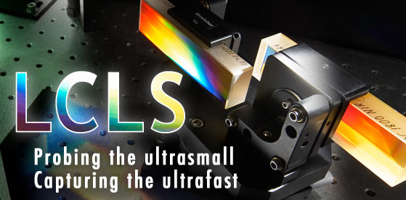

SLAC Today:
Diversified Portfolio
X-ray Science
Super-Computing:
All areas of the LAB
Astrophysics
High Energy Physics
Kavli Institute for Particle Astrophysics and Cosmology
Future Accelerators
Facility for Advanced Accelerator Experimental Tests
Facilities for Scientific Users
Stanford Synchrotron Radiation Lightsource
Linac Coherent Light Source
Notes:
This slide illustrates that SLAC is now a multi-disciplinary laboratory. This is a core part of SLAC’s mission statement going forward.
In order:
SUNCAT: Center for Sustainable Energy through Catalysis
The SUNCAT Center for Interface Science and Catalysis explores fundamental challenges relating to advances in energy technology. The Center focuses on atomic-scale design of catalysts in energy conversion and storage.
PULSE: Photon Ultrafast Laser Science and Engineering
PULSE focuses on ultrafast structural and electronic dynamics in atomic physics, chemistry, biology, & physics.
SIMES: Stanford Institute for Material and Energy Sciences
SIMES addresses key challenges in the areas of condensed matter physics and materials science. The emphasis of this core group is in the general area of scattering, spectroscopy and imaging using the two major national user facilities – SSRL & LCLS.
KIPAC: Kavli Institute for Particle Astrophysics and Cosmology
FACET:
LCLS: Linac Coherent Light Source
SSRL: Stanford Synchrotron Radiation Lightsource;
Persis Message: SLAC has reinvented itself. It is a great strength of the National Lab system that we can do this
New scientific frontiers are being opened and we are in a time of extraordinary opportunity
Biggest surprises are yet to come!

Slide 3

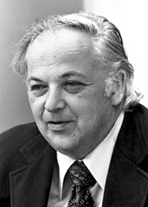
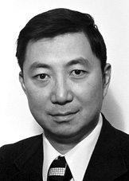
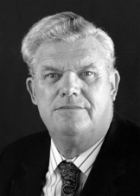
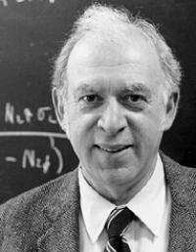
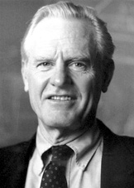
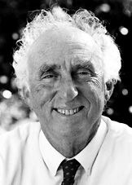
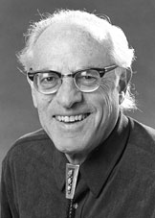
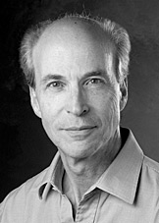
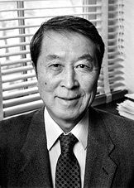
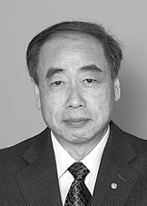
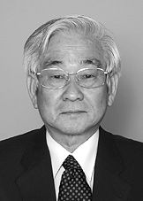

Hold Slide for Nobels
Nobel Prizes
Physics,
1976
Pioneering experimental contributions to lepton physics.
Physics,
1990
Deep inelastic scattering of electrons on protons and bound neutrons
Essential for the development of the quark model
Burton Richter
Samuel C.C. Ting
Richard E. Taylor
Jerome I. Friedman
Henry W. Kendall
Physics,
1995
Discovery of the
tau lepton
Chemistry, 2006
Studies of the molecular basis of eukaryotic transcription
Martin L. Perl
Frederick Reines
Roger Kornberg
Physics, 2008
Theory of broken symmetries later observed by BaBar
Chemistry, 2009
Studies of the structure and function of the ribosome, foundation studies at SSRL
Yoichiro Nambu, Makoto Kobayashi, Toshihide Maskawa
Ada Yonath
Notes:
6 attributed Nobel Prizes to SLAC are highlighted in red
SLAC research has been directly involved with several Nobel Prizes, almost all of which were possible because of the rich history of high energy physics research.
SSRL has also figured prominently in a few of these Nobels.
Tour guides have an opportunity to reference the SLAC Nobels later when discussing new research and the possibilities for breaking new ground there.
Not bottom two squares: scientists related to SLAC research in some form.
Good example of how SLAC lab benefits our own and other scientist throughout the world.

Slide 4
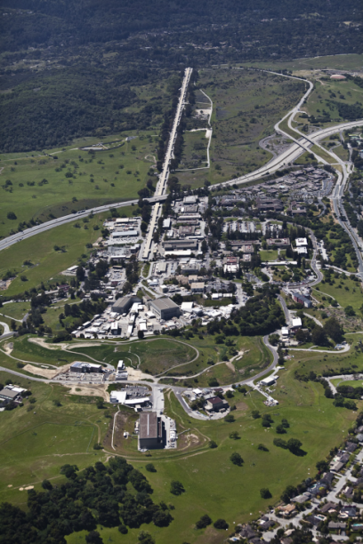
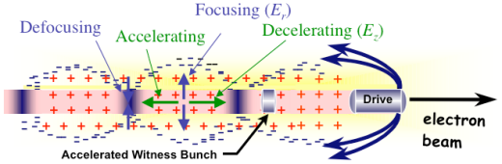
Accelerator Physics Tradition at SLAC

Slide 5
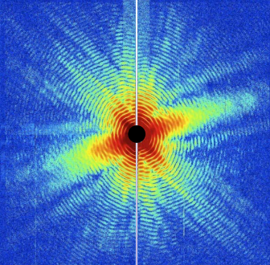
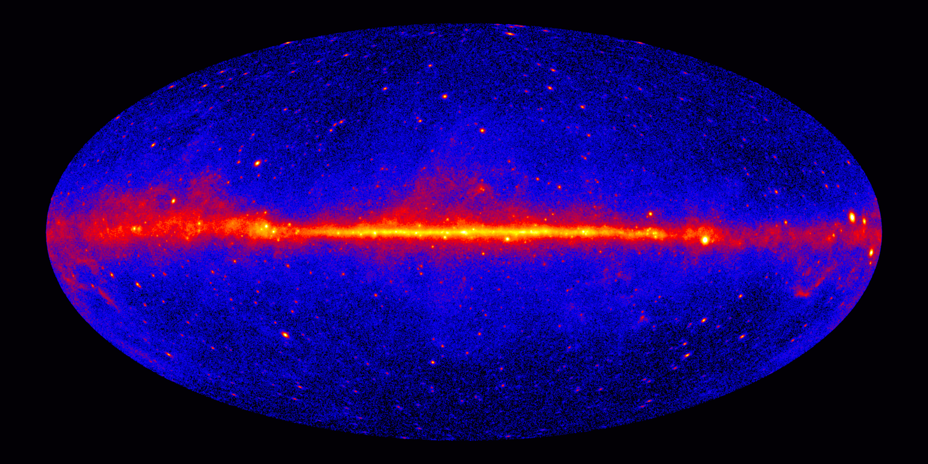
Mission of the New SLAC
Grow into the premier Photon Science Laboratory
  Build and operate world leading facilities
  Perform world leading science at these facilities
Maintain our position as the premier accelerator laboratory
Pursue strategic programs in particle physics, particle astrophysics and cosmology

Slide 6
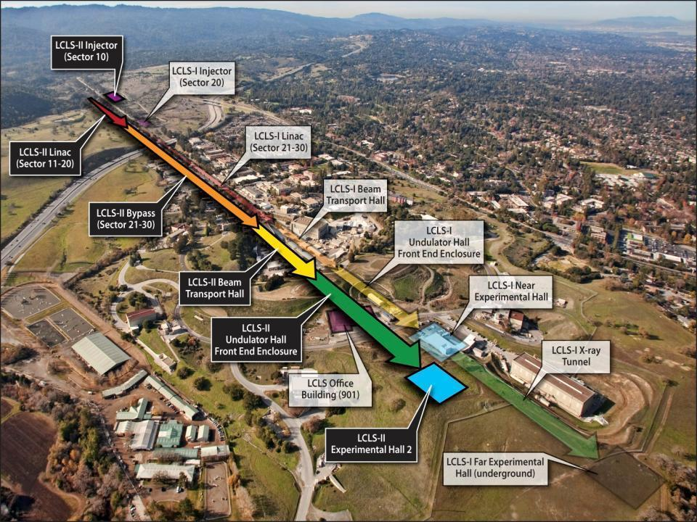
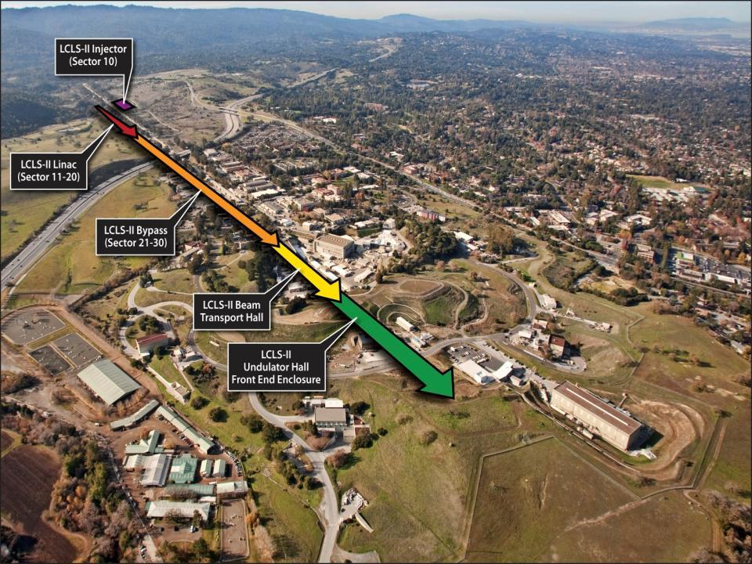
FACET National User Facility
SSRL
Notes:
Message: investing at SLAC is the cheapest way for DOE to stay at the forefront. Since we don’t see growing budgets for new project, we give DOE the solution.

Slide 7

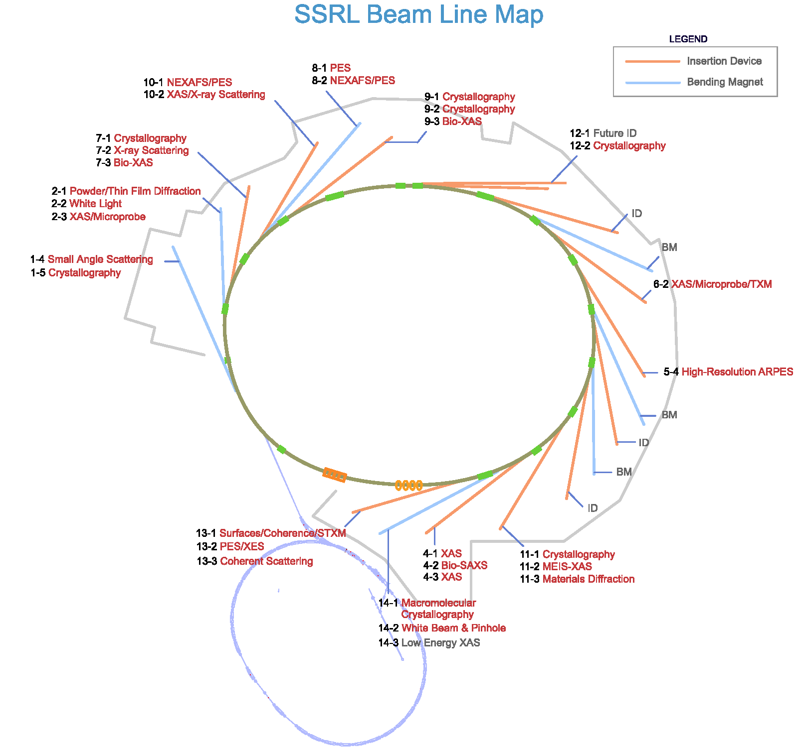
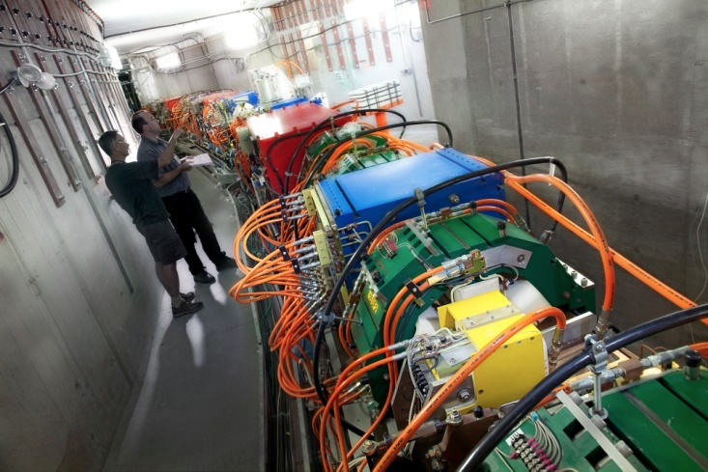
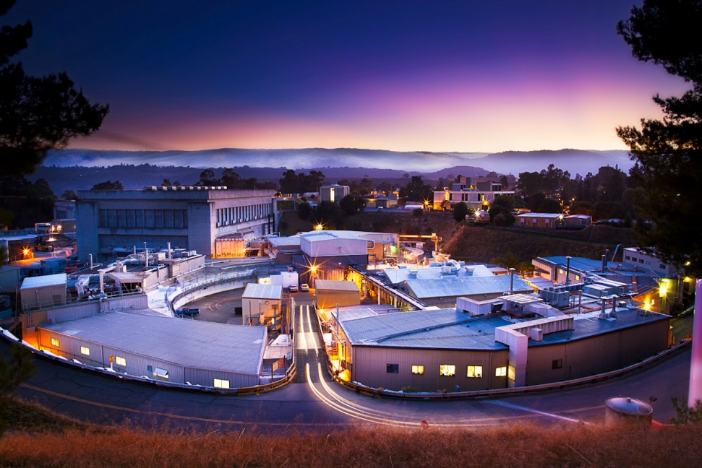
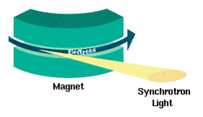
SSRL: Science
Notes:
The variety of SSRL science… but what makes SSRL Tick: http://www-ssrl.slac.stanford.edu/aboutssrl/index.html
Electrons are “bent” using powerful magnets pictured. SSRL provides synchrotron radiation, a name given to x-rays or light produced by electrons circulating in a storage ring at nearly the speed of light. These extremely bright x-rays can be used to investigate various forms of matter ranging from objects of atomic and molecular size to man-made materials with unusual properties.
SSRL provides technical tools for world-leading science at no charge for scientists who conduct non-proprietary research, with the understanding that significant results are to be publicly disseminated; access is also available for proprietary research on a cost-recovery basis. Scientists from academia, industry, government agencies and research institutions worldwide compete for access by submitting proposals for beam time that are peer reviewed on the basis of scientific merit and potential impact. Annually, over a thousand scientists conduct their research at SSRL, revealing scientific insight that may not be obtained through other methods. Benefits of utilizing SSRL include:
-Access to large scale facilities not otherwise available in an individual investigator laboratory
-Access to specialized, state-of-the-art machines, instrumentation and capabilities
-Access to technical expertise from experienced facility scientists, engineers and technical support staff
- The number of users and experiments conducted at SSRL continues to increase with about 2,000 scientists and 300 institutions annually.
History: http://www-ssrl.slac.stanford.edu/aboutssrl/history.html
- SSRL began in 1973 as the SSRP, Stanford Synchrotron Radiation Project
SSRL was the first multi-GeV storage ring based synchrotron radiation source in the world
SPEAR became fully dedicated to SSRL in 1992
Upgraded in 2004
Psi particle (charm quark) discovered 1974
Nobel prize (Burton Richter/Sam Ting) 1976
Tau lepton discovered 1976
Nobel prize (Martin Perl) 1995

Slide 8
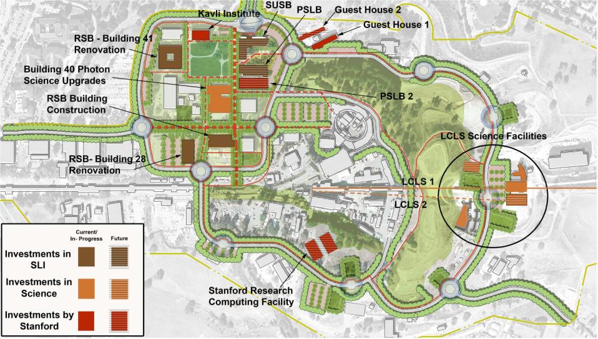
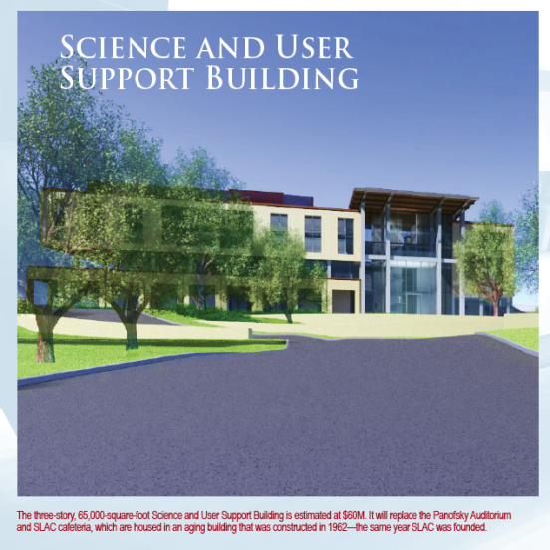
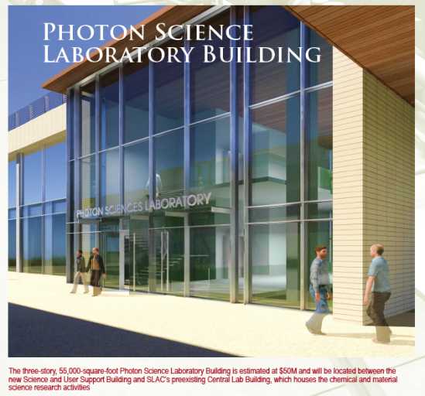
Our New Mission drives the need for New Infrastructure
Arrillaga Sports Facility

Slide 9
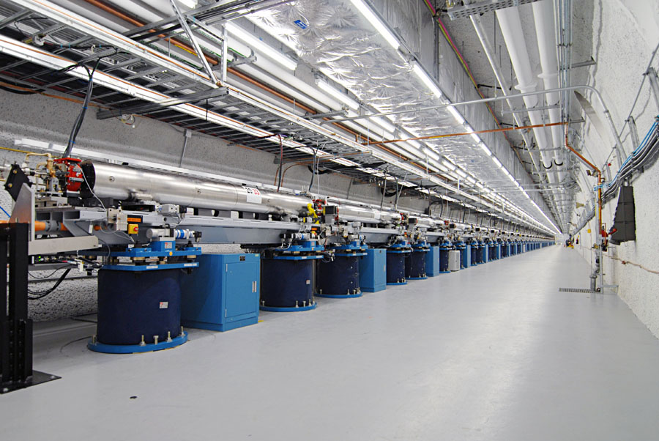
Inside View: LCLS Undulator Tunnel
Lasing ‘campaign’ started at 7PM on 4/10/09
By 10PM, the world’s first x-ray free electron laser was lasing!
First experiments started 10/1/09
Notes:
Undulator Tunnel

Slide 10
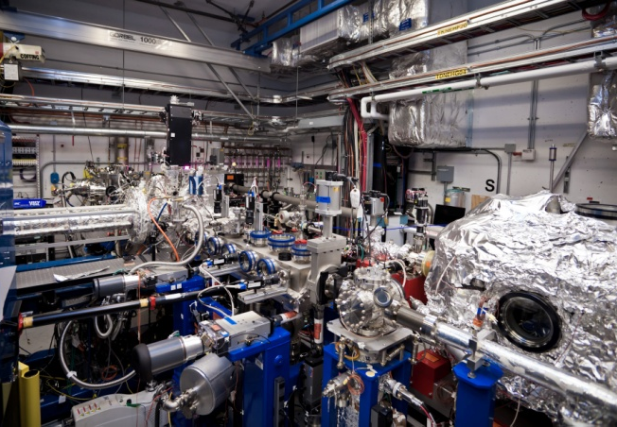
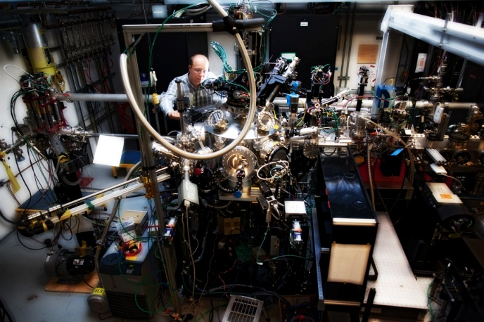
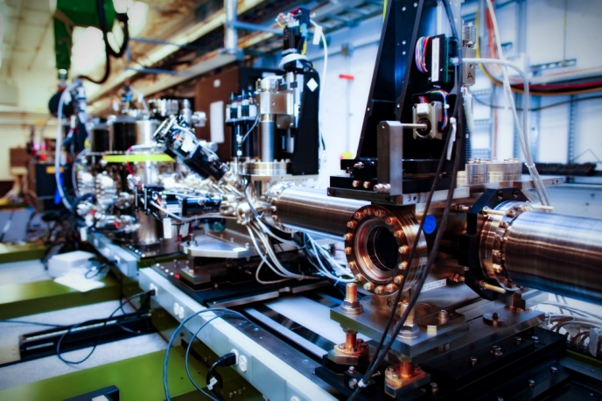
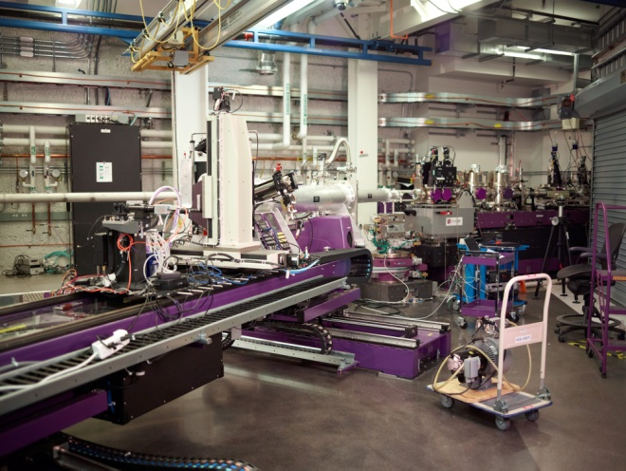
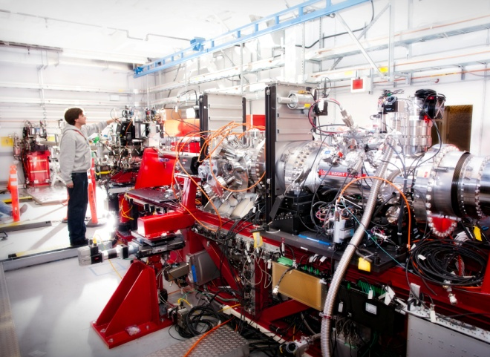
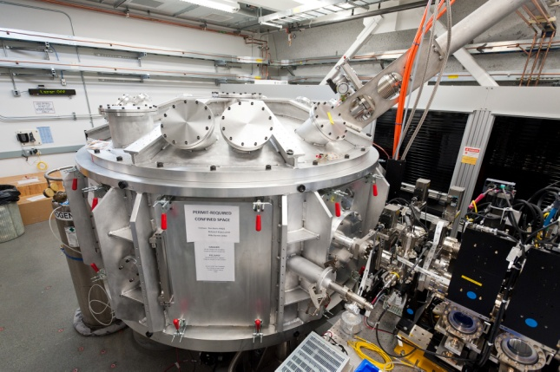
LCLS: Experimental Stations
Hutch 1: AMO
Atomic, Molecular, and Optical
Hutch 2: SXR
Soft X-ray
Hutch 3: XPP
X-ray Pump Probe
Hutch 4: XCS
X-ray Correlation Spectroscopy
Hutch 5: CXI
Coherent X-ray Imaging
Hutch 6: MEC
Matter in Extreme Conditions
Notes:
Every experiment station is different, and the previous slide is a good jumping off point to explain how the science differs in each hutch photo shown on this slide.
LCLS performs Hard X-ray and Soft X-ray science (“Hard” is defined as >2,000 eV photons)
Hutch 1: AMO – Atomic Molecular and Optical Science
Hutch 2: SXR – Soft X-Ray Science (meaning 400-2000 eV photons)
Hutch 3: XPP – X-ray Pump Probe Science – study of fundamental structure of matter
Hutch 4: XCS – X-ray correlation spectroscopy – advanced imaging
Hutch 5: CXI – Coherent X-ray Imaging – advanced imaging
Hutch 6: MEC – Matter in Extreme Conditions

Slide 11
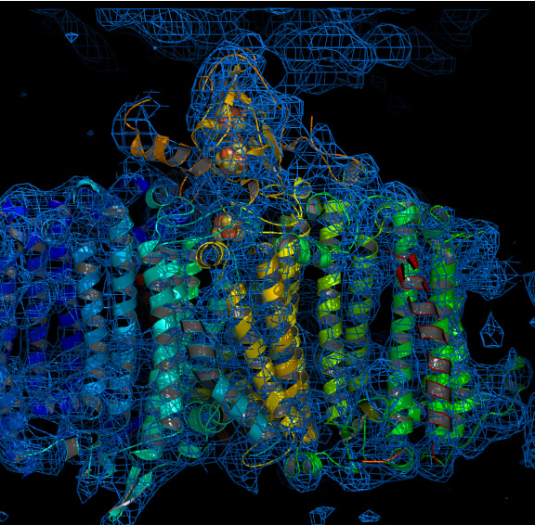
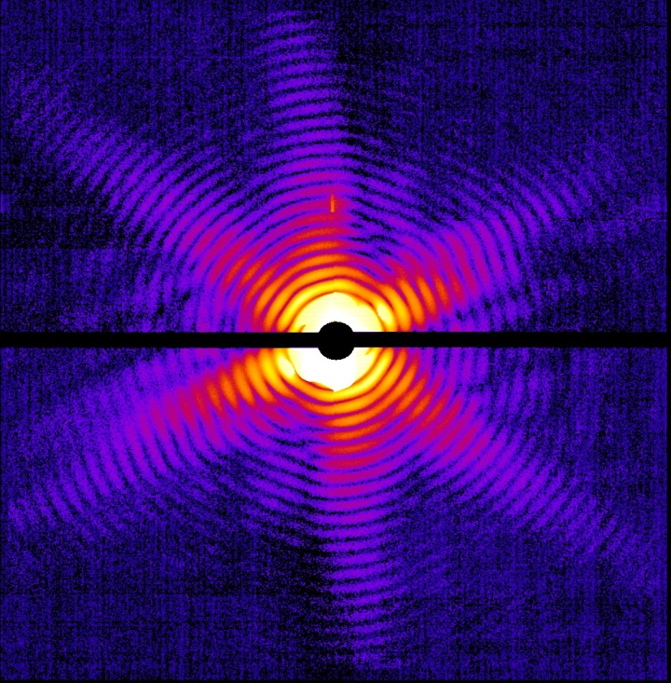
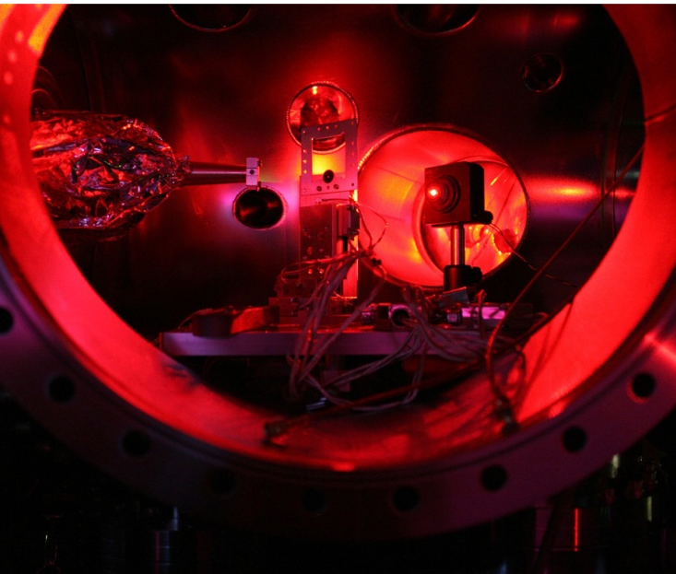
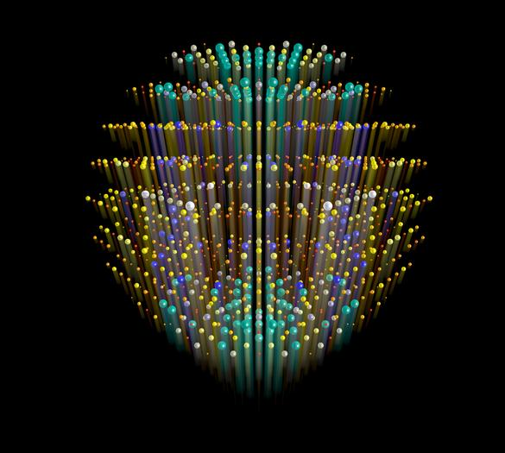
LCLS: Results
Protein Structure for Photosystem 1 used during
photosynthesis
Imaging a Mimivirus
Molecular structure of proteins as measured by X-ray Patterns
Creating 2,000,000 ºC plasma
Notes:
Plasma: https://news.slac.stanford.edu/press-release/world%E2%80%99s-most-powerful-x-ray-laser-creates-2-million-degree-matter
Photo system1 and Mimivirus : http://home.slac.stanford.edu/pressreleases/2011/20110202.htm
X-Ray Patterns: https://news.slac.stanford.edu/features/lcls-teams-desy-shortest-x-ray-exposure-protein-crystal-ever
Goals:
To look at molecular processes that happen on scales never before achieved.

Slide 12
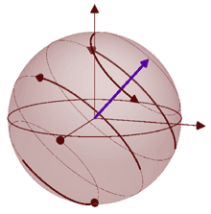
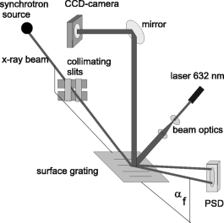
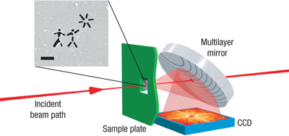
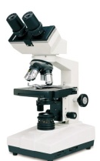

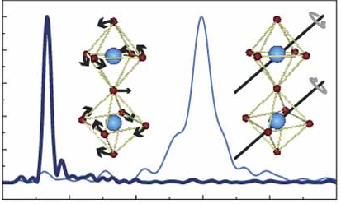
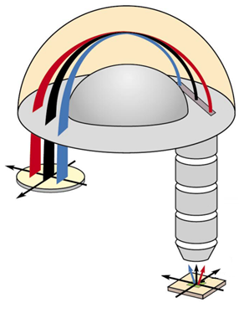
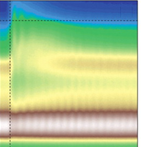
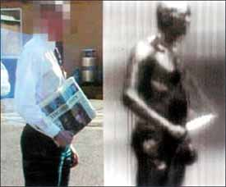
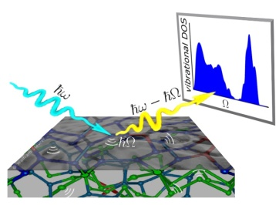
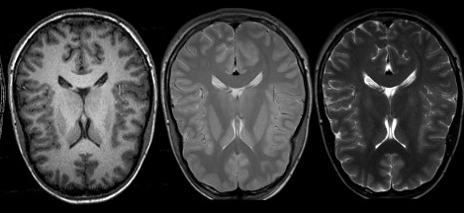
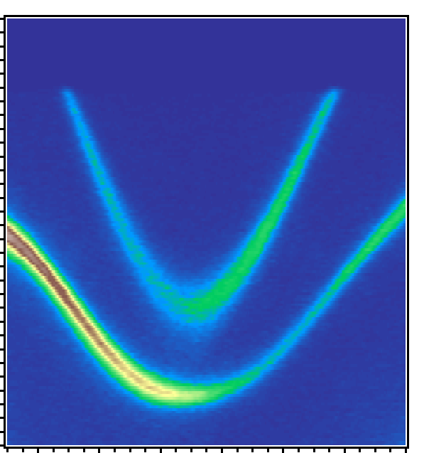
Electromagnetic spectrum
Soft X-ray
THz
10⁻¹¹
10⁻¹⁰
10⁻⁹
10⁻⁸
10⁻⁷
10⁻⁶
10⁻⁵
10⁻⁴
10⁻³
10⁻²
10⁻¹
10⁰
λ (m)
Hard X-ray
UV
Vis
IR
Microwave
In-situ
X-ray Monitoring
Diffractive X-ray imaging
Optical
microscope
Lasers
THZ-Mid-IR material control
NMR, NQR: spin dynamics
X-ray scattering for structural and spectral analysis
Soft x-ray absorption
Photoelectron
spectroscopy
IR-induced
collective modes
THz imaging: security
and medical usage
MRI: life science
Shen group, 2012
Notes:
Material control: Forst et al. Nature Physics 7, 854–856 (2011)
IR collective modes: Schmitt et al. Science 321 (5896): 1649-1652
Diffractive X-ray imaging: Nature Physics 2, 839 - 843 (2006)
X-ray scattering: http://www.esrf.eu/news/spotlight/spotlight127/spotlight127/ “Mapping disorder with X-rays”
In-situ X-ray monitoring: J. Appl. Phys. 87, 7712 (2000)

Slide 13
Electromagnetic spectrum
Penetration
(“hitting through”)
Penetration
(“tunneling”)
Soft X-ray
THz
10⁻¹¹
10⁻¹⁰
10⁻⁹
10⁻⁸
10⁻⁷
10⁻⁶
10⁻⁵
10⁻⁴
10⁻³
10⁻²
10⁻¹
10⁰
λ (m)
Hard X-ray
UV
Vis
IR
Microwave
Living world→
solar, lighting, heating, .. Photo-synthesis ..
“Collective Excitation”
Phonons, magnons, collective modes, spin resonances, plasmons of 2D gas, Landau levels, cyclotron modes, Zeeman splitting, energy gap of collective states…
Living world
→ communication, TV, radio, cell phone, computers, electricity …
Chemical sensitivity
→ element, chemical, resonance edges …
Precision in knowing the atoms,
→ structure, symmetry, …
Resolution
Sensitivity to electrons
→ elementary excitations, spin orbit physics
Penetration
Ionization line
(“life” to the right)
Shen Group, 2012
Notes:
Material control: Forst et al. Nature Physics 7, 854–856 (2011)
IR collective modes: Schmitt et al. Science 321 (5896): 1649-1652
Diffractive X-ray imaging: Nature Physics 2, 839 - 843 (2006)
X-ray scattering: http://www.esrf.eu/news/spotlight/spotlight127/spotlight127/ “Mapping disorder with X-rays”
In-situ X-ray monitoring: J. Appl. Phys. 87, 7712 (2000)

Slide 14
Electromagnetic spectrum
Soft X-ray
THz
10⁻¹¹
10⁻¹⁰
10⁻⁹
10⁻⁸
10⁻⁷
10⁻⁶
10⁻⁵
10⁻⁴
10⁻³
10⁻²
10⁻¹
10⁰
λ (m)
Hard X-ray
UV
Vis
IR
Microwave
In-situ
X-ray Monitoring
Diffractive X-ray imaging
Optical
microscope
Lasers
THZ-Mid-IR material control
NMR, NQR: spin dynamics
X-ray scattering for structural and spectral analysis
Soft x-ray absorption
Photoelectron
spectroscopy
IR-induced
collective modes
THz imaging: security
and medical usage
MRI: life science
Shen group, 2012
Notes:
Material control: Forst et al. Nature Physics 7, 854–856 (2011)
IR collective modes: Schmitt et al. Science 321 (5896): 1649-1652
Diffractive X-ray imaging: Nature Physics 2, 839 - 843 (2006)
X-ray scattering: http://www.esrf.eu/news/spotlight/spotlight127/spotlight127/ “Mapping disorder with X-rays”
In-situ X-ray monitoring: J. Appl. Phys. 87, 7712 (2000)

Slide 15


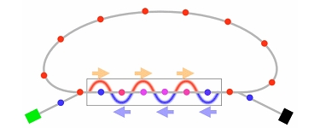
Electromagnetic spectrum
Accelerator Based Sources
LINAC?
ERL
Soft X-ray
THz
10⁻¹¹
10⁻¹⁰
10⁻⁹
10⁻⁸
10⁻⁷
10⁻⁶
10⁻⁵
10⁻⁴
10⁻³
10⁻²
10⁻¹
10⁰
λ (m)
Hard X-ray
UV
Vis
IR
Microwave
In-situ
X-ray Monitoring
Diffractive X-ray imaging
Optical
microscope
Lasers
THZ-Mid-IR material control
NMR, NQR: spin dynamics
X-ray scattering for structural and spectral analysis
Soft x-ray absorption
Photoelectron
spectroscopy
IR-induced
collective modes
THz imaging: security
and medical usage
MRI: life science
Shen group, 2012
Notes:
Material control: Forst et al. Nature Physics 7, 854–856 (2011)
IR collective modes: Schmitt et al. Science 321 (5896): 1649-1652
Diffractive X-ray imaging: Nature Physics 2, 839 - 843 (2006)
X-ray scattering: http://www.esrf.eu/news/spotlight/spotlight127/spotlight127/ “Mapping disorder with X-rays”
In-situ X-ray monitoring: J. Appl. Phys. 87, 7712 (2000)

