Slide 1
Plasma-Based Attosecond X-ray pulses
FACET-II PAC
Ago Marinelli on behalf of the PAX collaboration

Slide 2
Science Goals
Terawatt soft X-ray pulses with few-cycle duration (combine bandwidth of HHG in gas with peak power of FELs!)
6 months: install and commission VUV spectrometer, observe e-beam chirping
Definition of success:
- Successful installation of photon diagnostic beamline
observe coherent radiation from beam on VUV spectrometer (ub instability, nonlinear compression)
Measure correlated energy-spread growth from plasma (E-300 experiment)
1 year: install and commission magnetic chicane, experiments using linac-generated beam
Definition of success: observe coherent synchrotron radiation below 100 nm from plasma-compressed beam
2-3 years: attosecond pulses from plasma-generated beam (see E304 talk)
Definition of success: observe coherent synchrotron radiation from plasma-generated beam at 50 nm or less

Slide 3
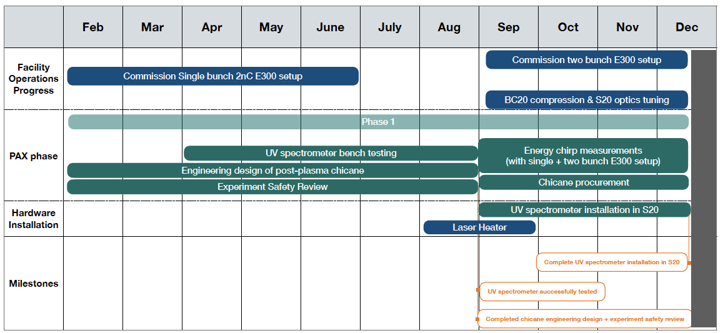
Timeline

Slide 4
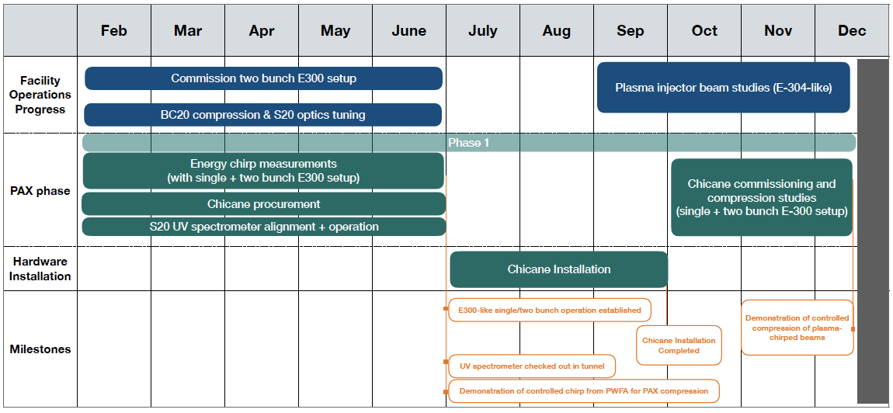
Timeline

Slide 5
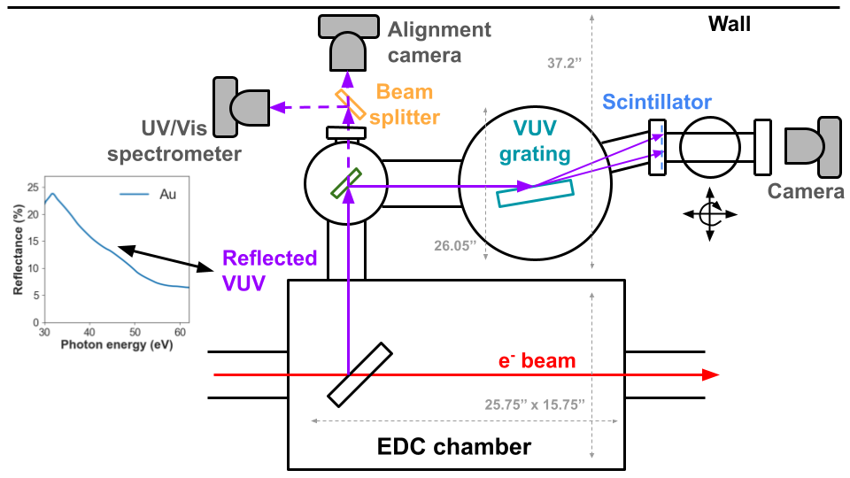
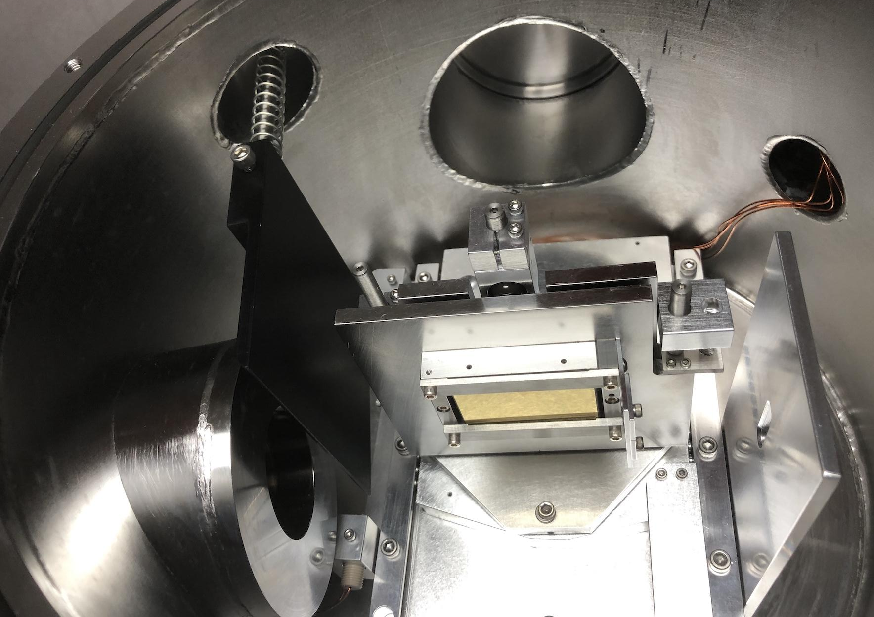
Experimental Layout
SPECTRAL/SPATIAL
DIAGNOSTICS
Plasma source
Magnetic chicane
Spectrometer dipole

Slide 6
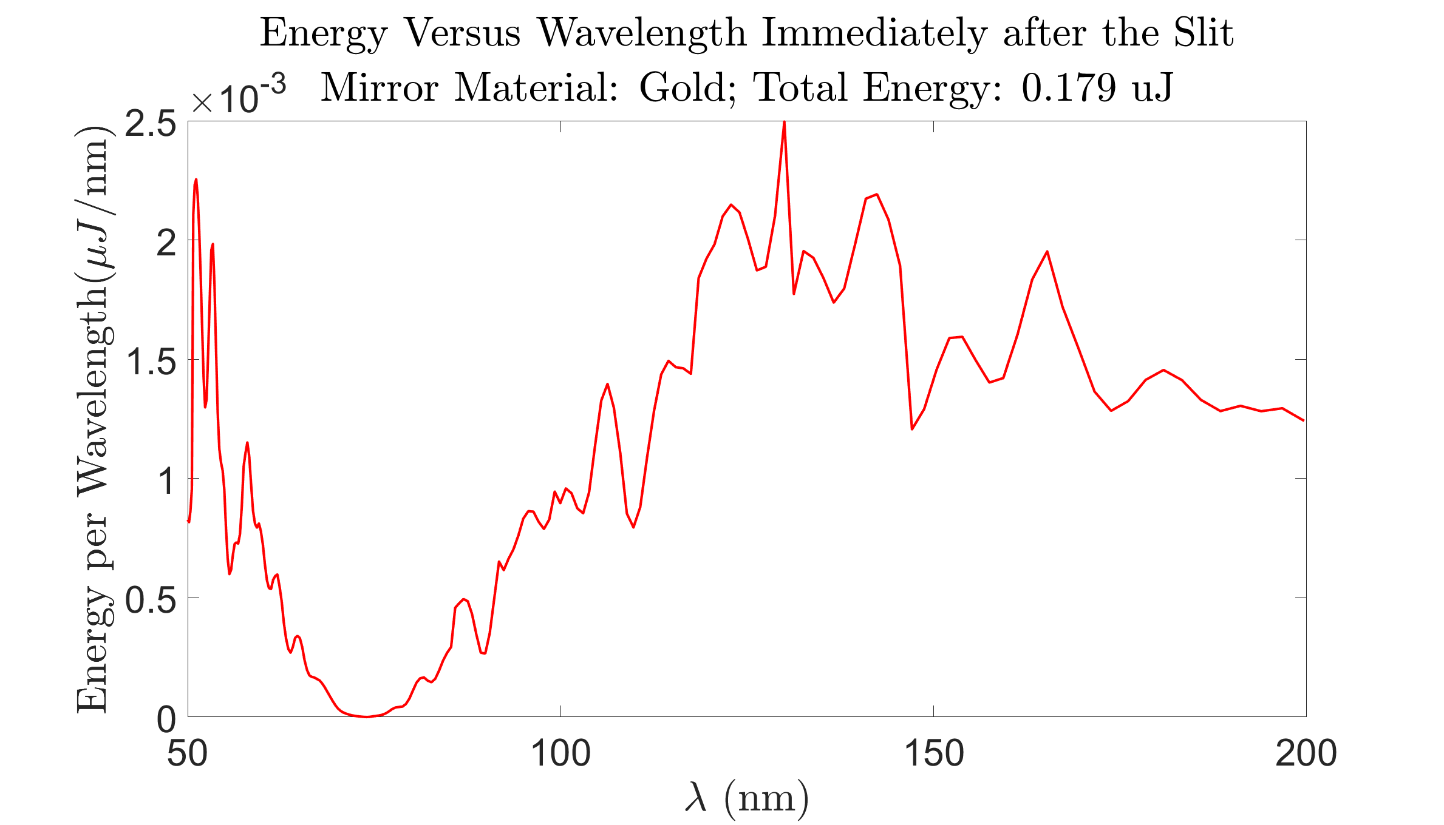
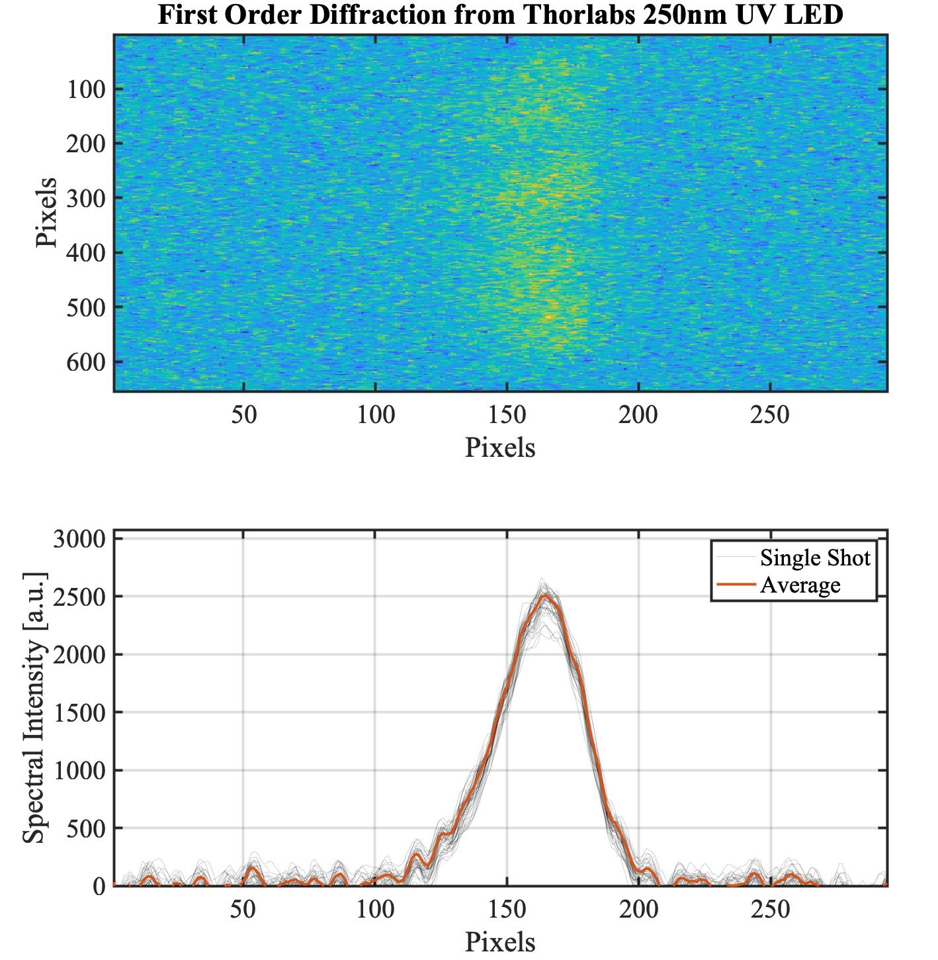
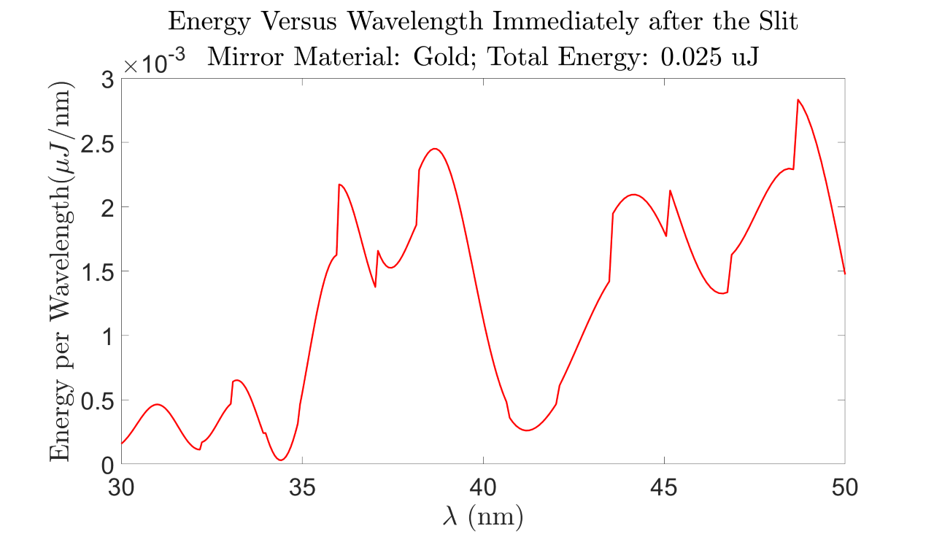
Diagnostics and Observables
Synchrotron radiation from compressed e-beam
Expected spectrum uJ/nm (including mirror losses)
PLASMA-GENERATED BEAM

Slide 7
Potential Evolution of the Experiment
1) Extension to > 250 eV central to scientific future of PAX (core energy levels of light elements)
Harmonic up-conversion enables operation up to 1 keV.
If successful, implementation to future LCLS beamline:
Soft X-ray undulator at LCLS-II HE or future SXR beamline within undulator farm.
Science program with few-cycle soft X-ray pulses in TMO instrument or equivalent
2) Extension to laser-plasma accelerators would enable a much broader application

Slide 8
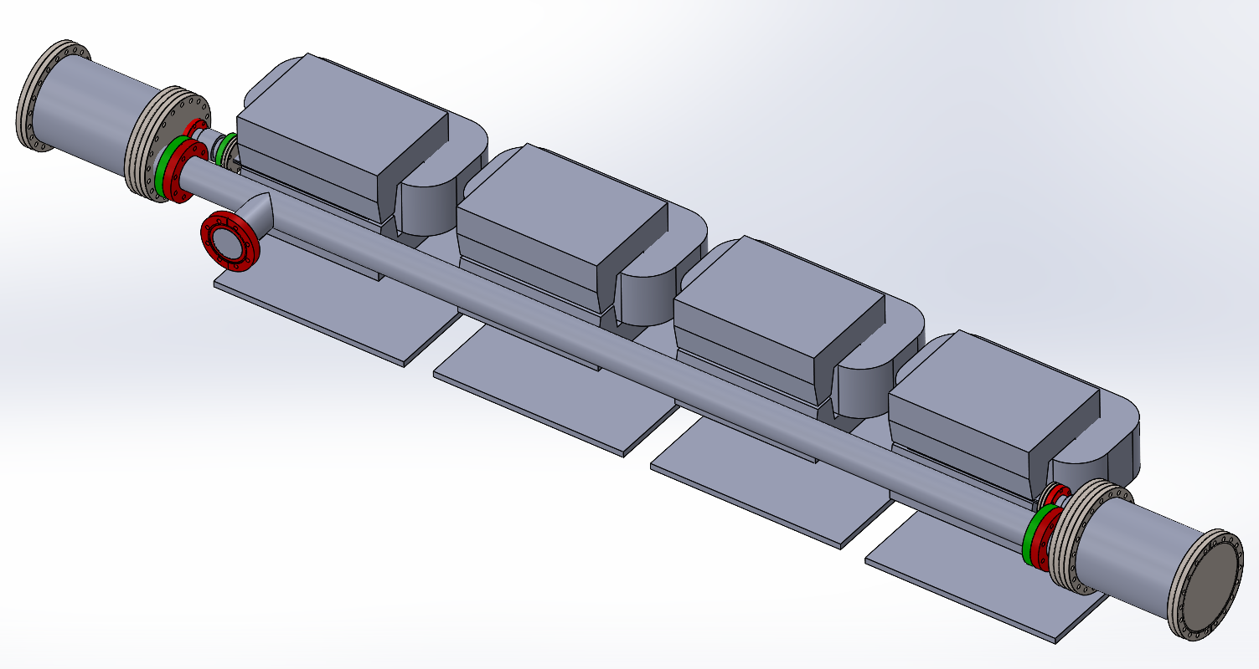
Desired Facility Upgrades
NEW CHICANE GOES HERE
Chicane + bypass line design
4-dipole compact chicane
Length 2m
Max R56 = 150 um x (E/10GeV)²
Movable stage to accommodate larger vacuum chamber.
White paper completed, preliminary design from Radiabeam received.

Slide 9
Collaboration
PAX team at SLAC
Claudio Emma, Rafi Hessami, River Robles, Kirk Robles, Ago Marinelli
UCLA EE
Chan Joshi, Chiaojie Zhang and ECE group
UCLA Physics
Pietro Musumeci’s group
Synergy with E300 E304 334 E31X
Concept is applicable to any plasma-injector experiments.
Possible collaboration with other groups (e.g. Trojan Horse with B. Hidding, J. Rosenzweig).
White paper on applications of magnetic chicane at FACET-II included contributions from E320 and new experiments from J. Rosenzweig

