Slide 1
Nonlinear and Relativistic Coherent Transition Radiation
FACET-II PAC
Ago Marinelli on behalf of the E-334 collaboration

Slide 2
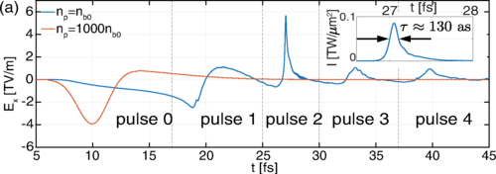
Science Goals
Y. S. You et al., Nature Phys, 13, 345, 2016
X. Xu et al. Phys. Rev. Lett. 126, 094801 (2021)
Study nonlinear and relativistic optics using intense relativistic electron bunches.
Generation of attosecond VUV pulses
Why e-beam?
Accelerate free-carriers to relativistic energies
Strongest half-cycle field available
Strongly non-perturbative interaction regime
At FACET max $ω_{B},ω_{R}, ∼keV$. $“U_{p}”∼mc^{2}$ $Keldysh “γ_{K}”∼{10}^{−6}$

Slide 3
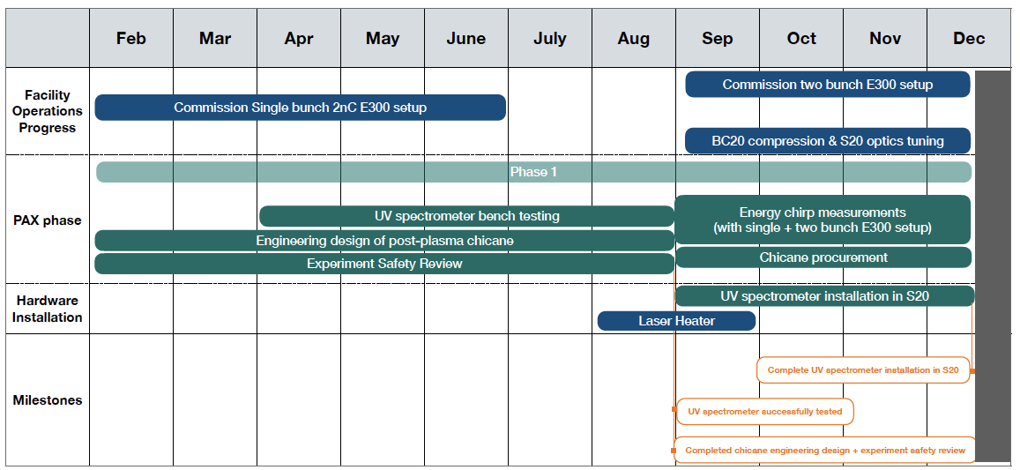
Timeline

Slide 4
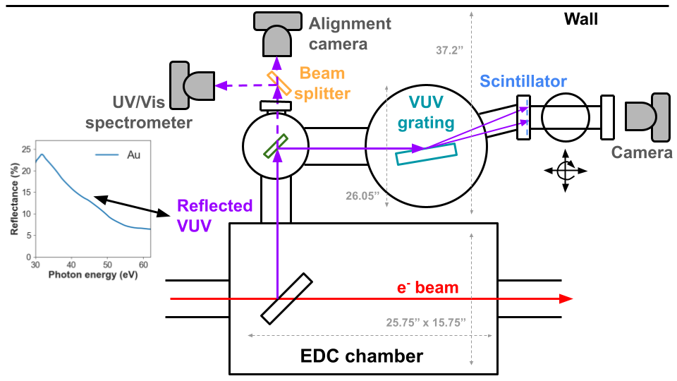
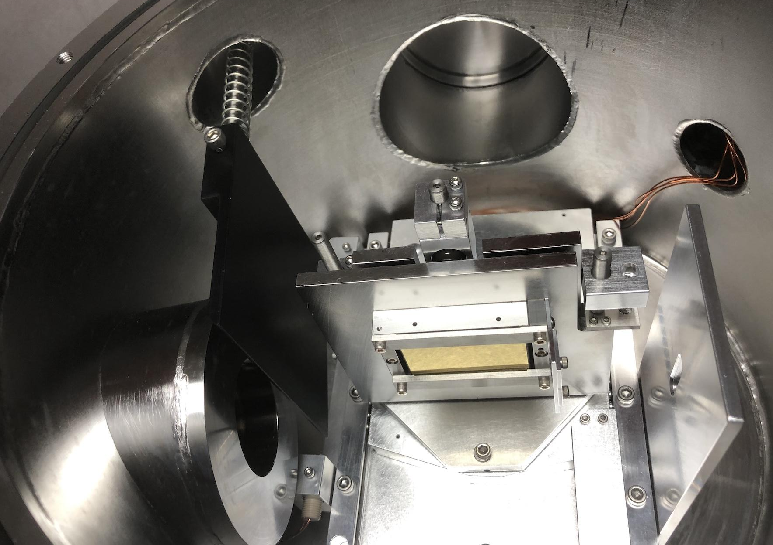
Experimental Layout
SPECTRAL/SPATIAL
DIAGNOSTICS
Solid sample
(picnic basket)
Outcoupling
Mirror (EDC)

Slide 5
Experimental Layout
SPECTRAL/SPATIAL
DIAGNOSTICS
Solid sample
(picnic basket)
Outcoupling
Mirror (EDC)
polarizer

Slide 6
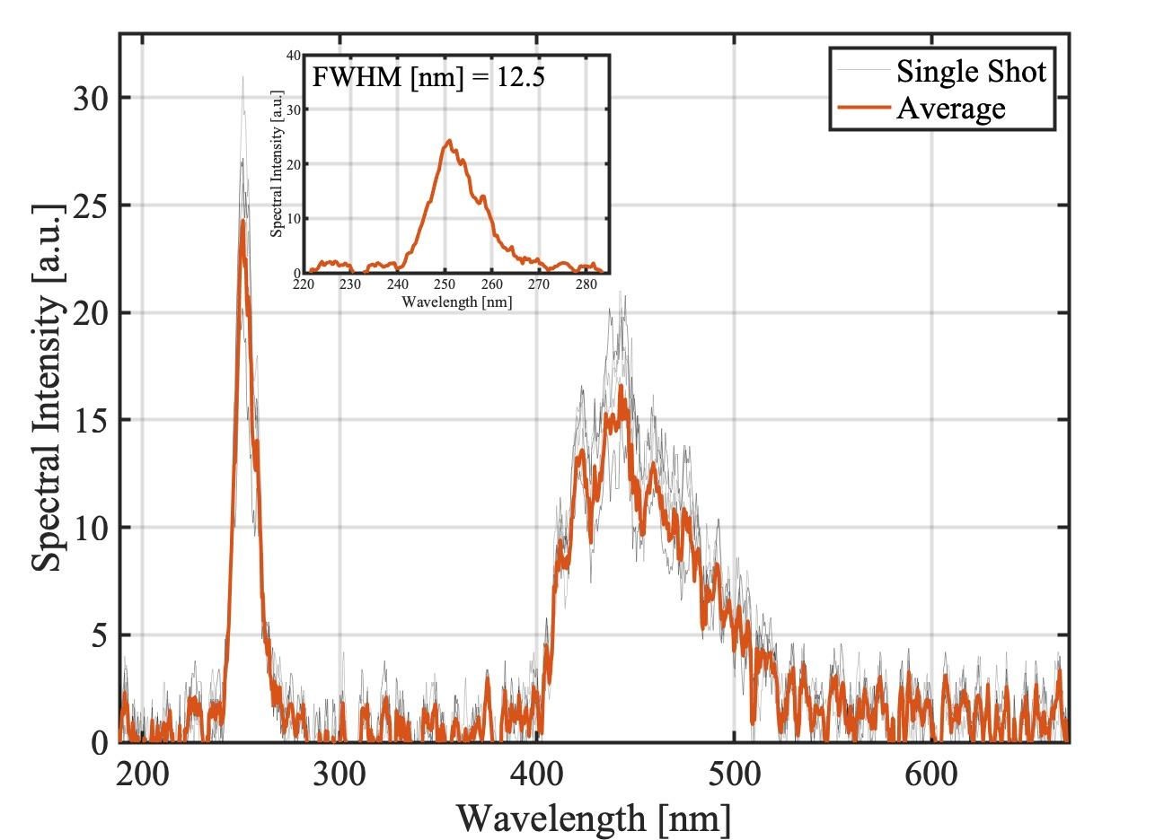
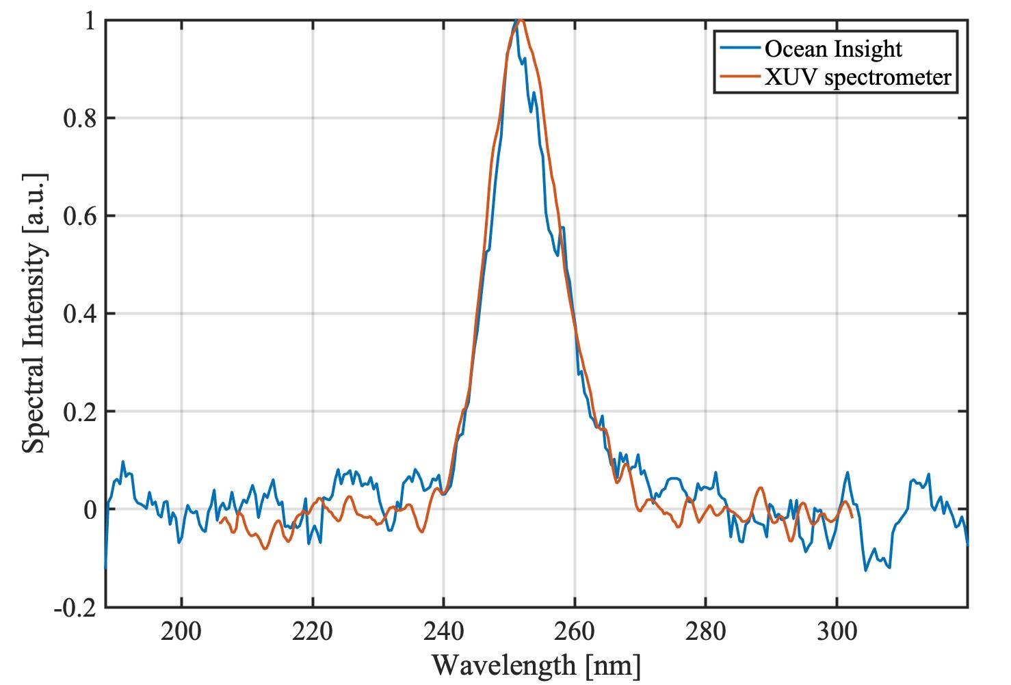
Diagnostics and Observables
UV/vis spectrometer
VUV spectrometer
Initially focus on well-studied systems: MgO, GaAs, ZnO
Study spectrum as a function of focusing optics and compression.
Observe field-dependent shifts in forward CTR spectrum.

Slide 7
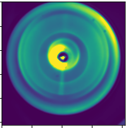
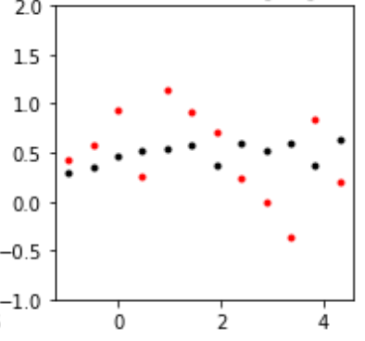
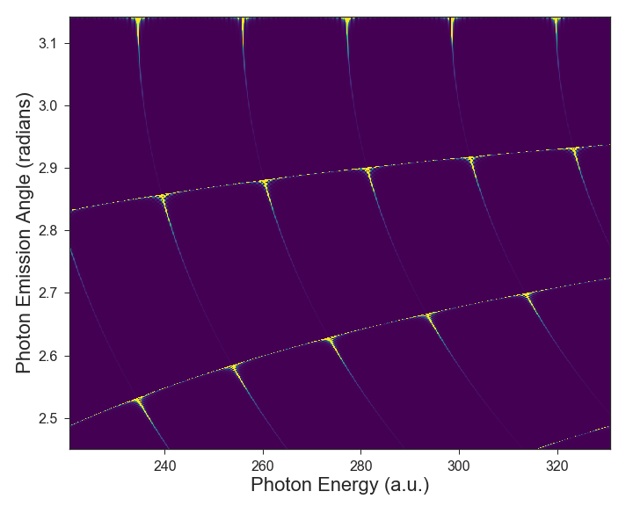
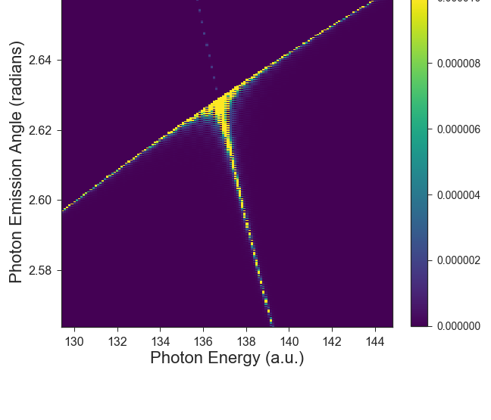
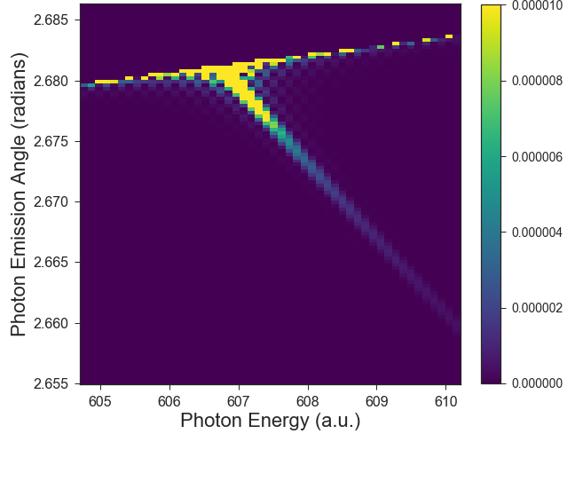
Potential Evolution of the Experiment
1) Extension to CXTR at LCLS
Experiments at LCLS show CXTR from microbunched
beams is detectable by heterodyne with X-rays.
Combine with nonlinear/relativistic space-charge interactions
2) Using parametric X-ray radiation to detect structural dynamics in strong-field
3.7 keV ~10⁵ photons
16 keV ~10² photons

Slide 8
Desired Facility Upgrades
- 1 um³ beam
Experiment sensitive to field amplitude.
Improvements to beam focusing highly desirable.
Installation of EPIX detectors
Detection of PXR signal challenging using YAG screens.
Epix detectors would enable detection of ~ 100 photons per Bragg peak at
16 keV: structural dynamics with atomic resolution!
Relativistic TR requires repeatable way to expand thin films with laser.

Slide 9
Collaboration
PULSE institute:
David Cesar, James Cryan, Shambhu Ghimire, Christian Heide, Ago Marinelli, Sebastian Meuren, David A. Reis and River Robles
Given similarity in science case and instrumentation collaboration with E305 is beneficial.
We have reached out to E305 group an agreed to collaborate on experiments as needed, details will be discussed once we have firm experimental plans

