Slide 1
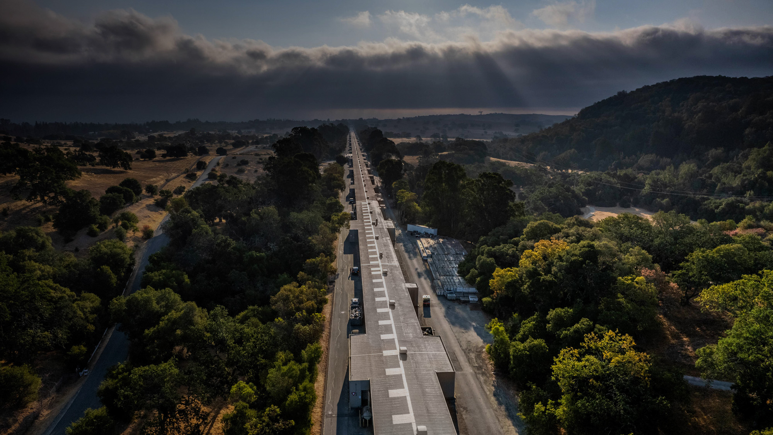
E327: FY22 Progress and Plans for FY23
Virtual Diagnostic for phase space prediction and customization at FACET-II
Claudio Emma / SLAC National Accelerator Laboratory
FACET-II PAC Meeting, 26 October 2022, SLAC

Slide 2
E327 Science Goals
Science Goal | Target Time | Definition of Success
Implement a single-shot non-destructive ML diagnostic to predict the e-beam LPS along the linac. | 1-2 years | LPS virtual diagnostic operational. Successful LPS prediction in S20 first, then S14 and Injector.
Use the ML-diagnostic to customize/control the LPS for different experiments. | 2-4 years | Successful optimization of LPS for main beam configurations (single bunch full comp, single bunch long beam, two bunch).
FACET-II PAC Meeting, October 26, 2022 C. Emma E327: FY22 Progress and Plans for FY23

Slide 3
E327 Experimental timeline
Phase 1: LPS prediction (years 1-2)
Software/diagnostic commissioning for LPS virtual diagnostic
Training of ML models to predict LPS in single bunch 2nC config in S20
Extend to 2 bunch, long bunch configurations
Extend to S10 and S14 TCAVs
Development of LPS virtual diagnostic GUI for facility/users
Phase 2: LPS optimization (years 2-4)
Optimization for machine setup of multiple beam configurations (single bunch 2nC, 2 bunch, long bunch)
Extend to LPS control for same beam configurations
FACET-II PAC Meeting, October 26, 2022 C. Emma E327: FY22 Progress and Plans for FY23

Slide 4
E327 Diagnostics and Observables
= TCAVs
= bunch length pyros
First experiments
Scanned machine parameters:
L1,L2,L3 RF phase & amplitude
BC11, BC14,BC20 peak current set points
Inputs to ML model:
L0,L1,L2,L3 voltage & phase readbacks, BC11,BC14, BC20 current monitor
SYAG, EOS, Edge radiation, THz spectrum
= Edge radiation cameras
= SYAG
DAQ/DAN used to collect/analyze scalar + image data during TCAV operation
S20 TCAV was the only one used (S10 & S14 TCAVs expected to come online next year).
~150 scalar diagnostics (e.g. BPMs, toroids, RF readbacks, BLEN pyros) and multiple image diagnostics (SYAG, EOS) were correlated with bunch length/LPS variations
Diagnostics along the linac used to predict phase space in experimental area
FACET-II PAC Meeting, October 26, 2022 C. Emma E327: FY22 Progress and Plans for FY23

Slide 5
Progress to date FY22 - shift timeline
E327 shifts all shared beam time with E331 (see Auralee’s talk for details)
Software developed to take, analyze + pre-process DAQ data for ML applications
Five TCAV-centric shifts taken during FY22. Four include parameter scans.
Bunch length + current profile predictions made using L2 phase scan shift data.
First shifts tested data acquisition, TCAV operation and training of first ML models.
FACET-II PAC Meeting, October 26, 2022 C. Emma E327: FY22 Progress and Plans for FY23

Slide 6
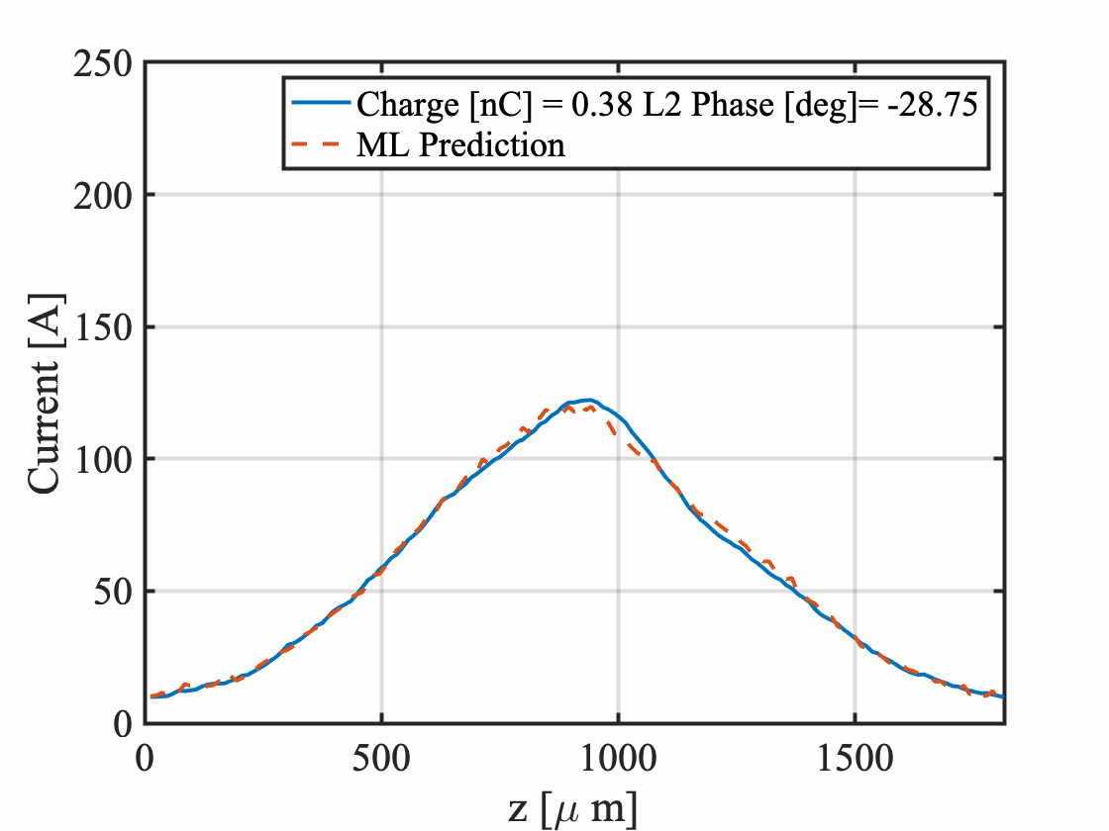
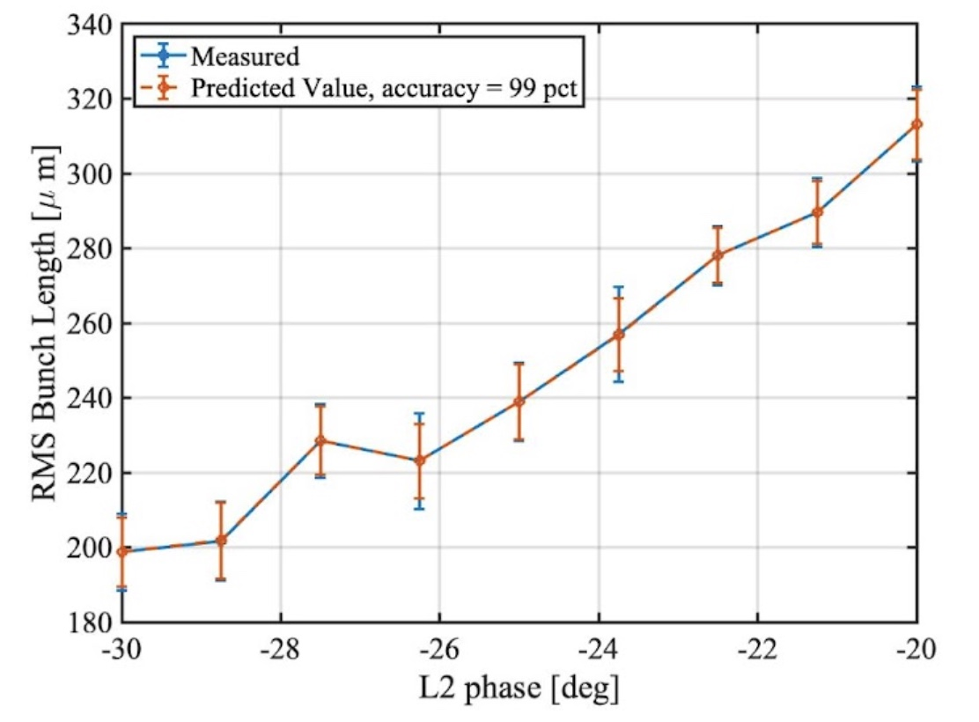
Progress to date - ML prediction of current from L2 phase scans 12/17/21
Experimental data at low Q (0.5 nC out of injector) from 12/2021
At low charge/long bunch length, ML model accurately predicts changes in the current profile
FACET-II PAC Meeting, October 26, 2022 C. Emma E327: FY22 Progress and Plans for FY23

Slide 7
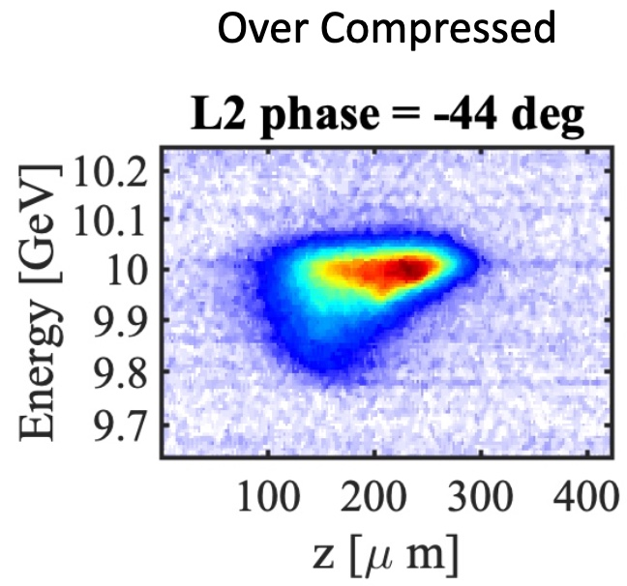
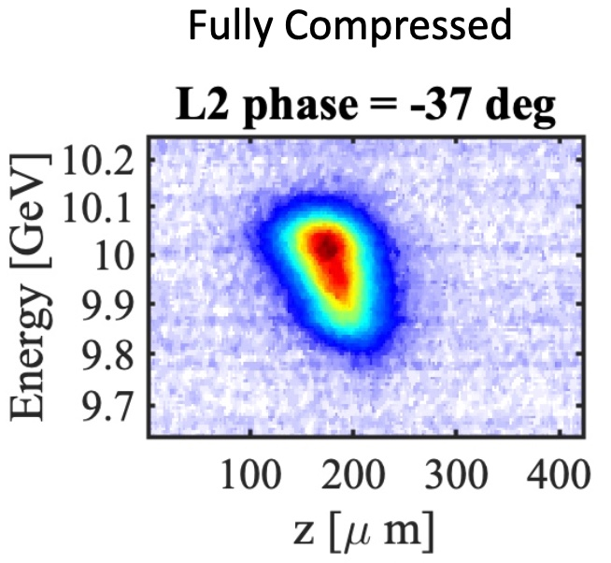
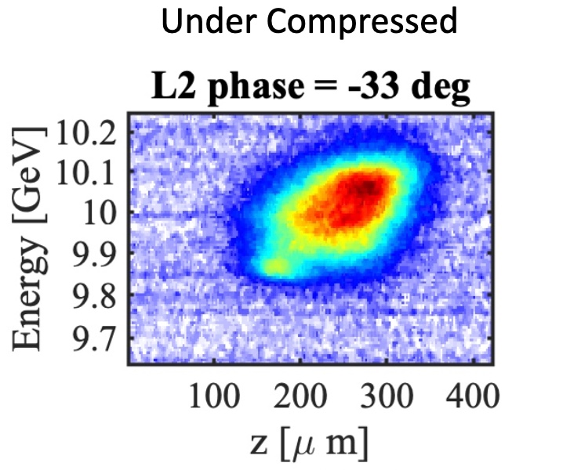
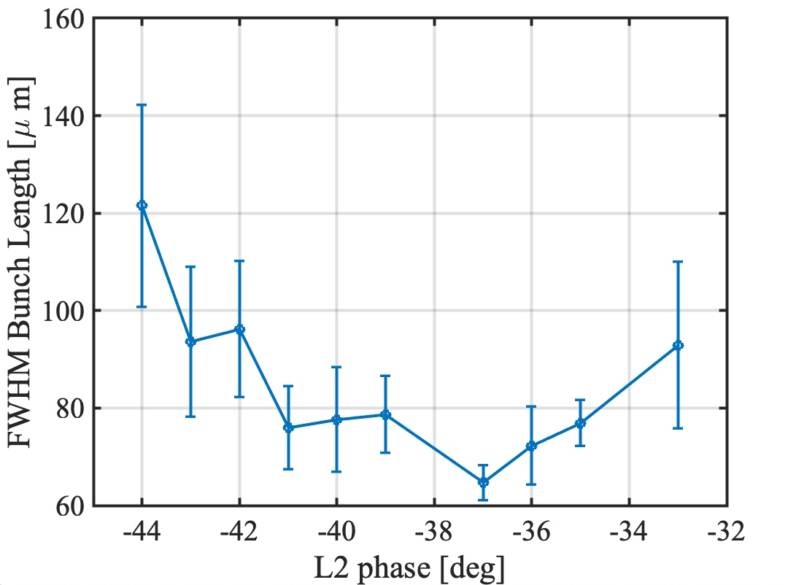
Progress to date - L2 phase scans through full compression
Q = 750 pC
Data from 7/8/22
LPS measured scanning L2 phase through full compression. TCAV resolution limits shortest measurable bunches
FACET-II PAC Meeting, October 26, 2022 C. Emma E327: FY22 Progress and Plans for FY23

Slide 8
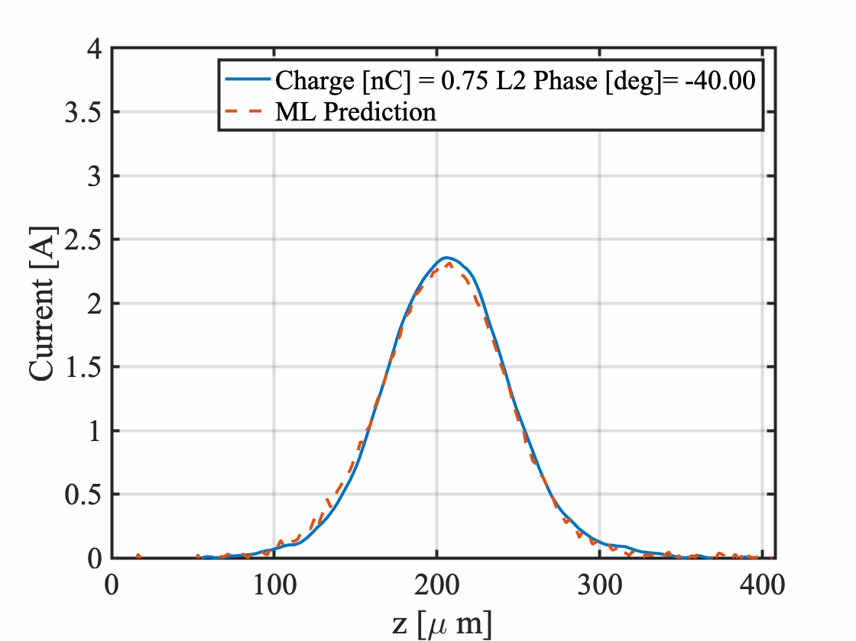
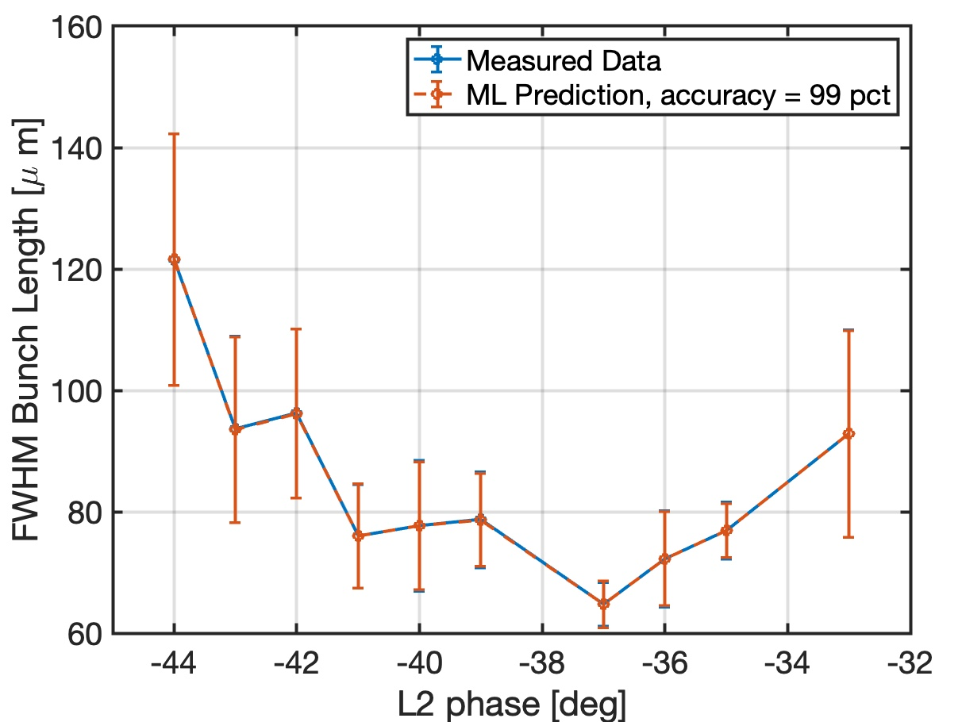
Progress to date - L2 phase scans through full compression: ML predictions
ML models trained to predict bunch length and current distribution through full compression
FACET-II PAC Meeting, October 26, 2022 C. Emma E327: FY22 Progress and Plans for FY23

Slide 9
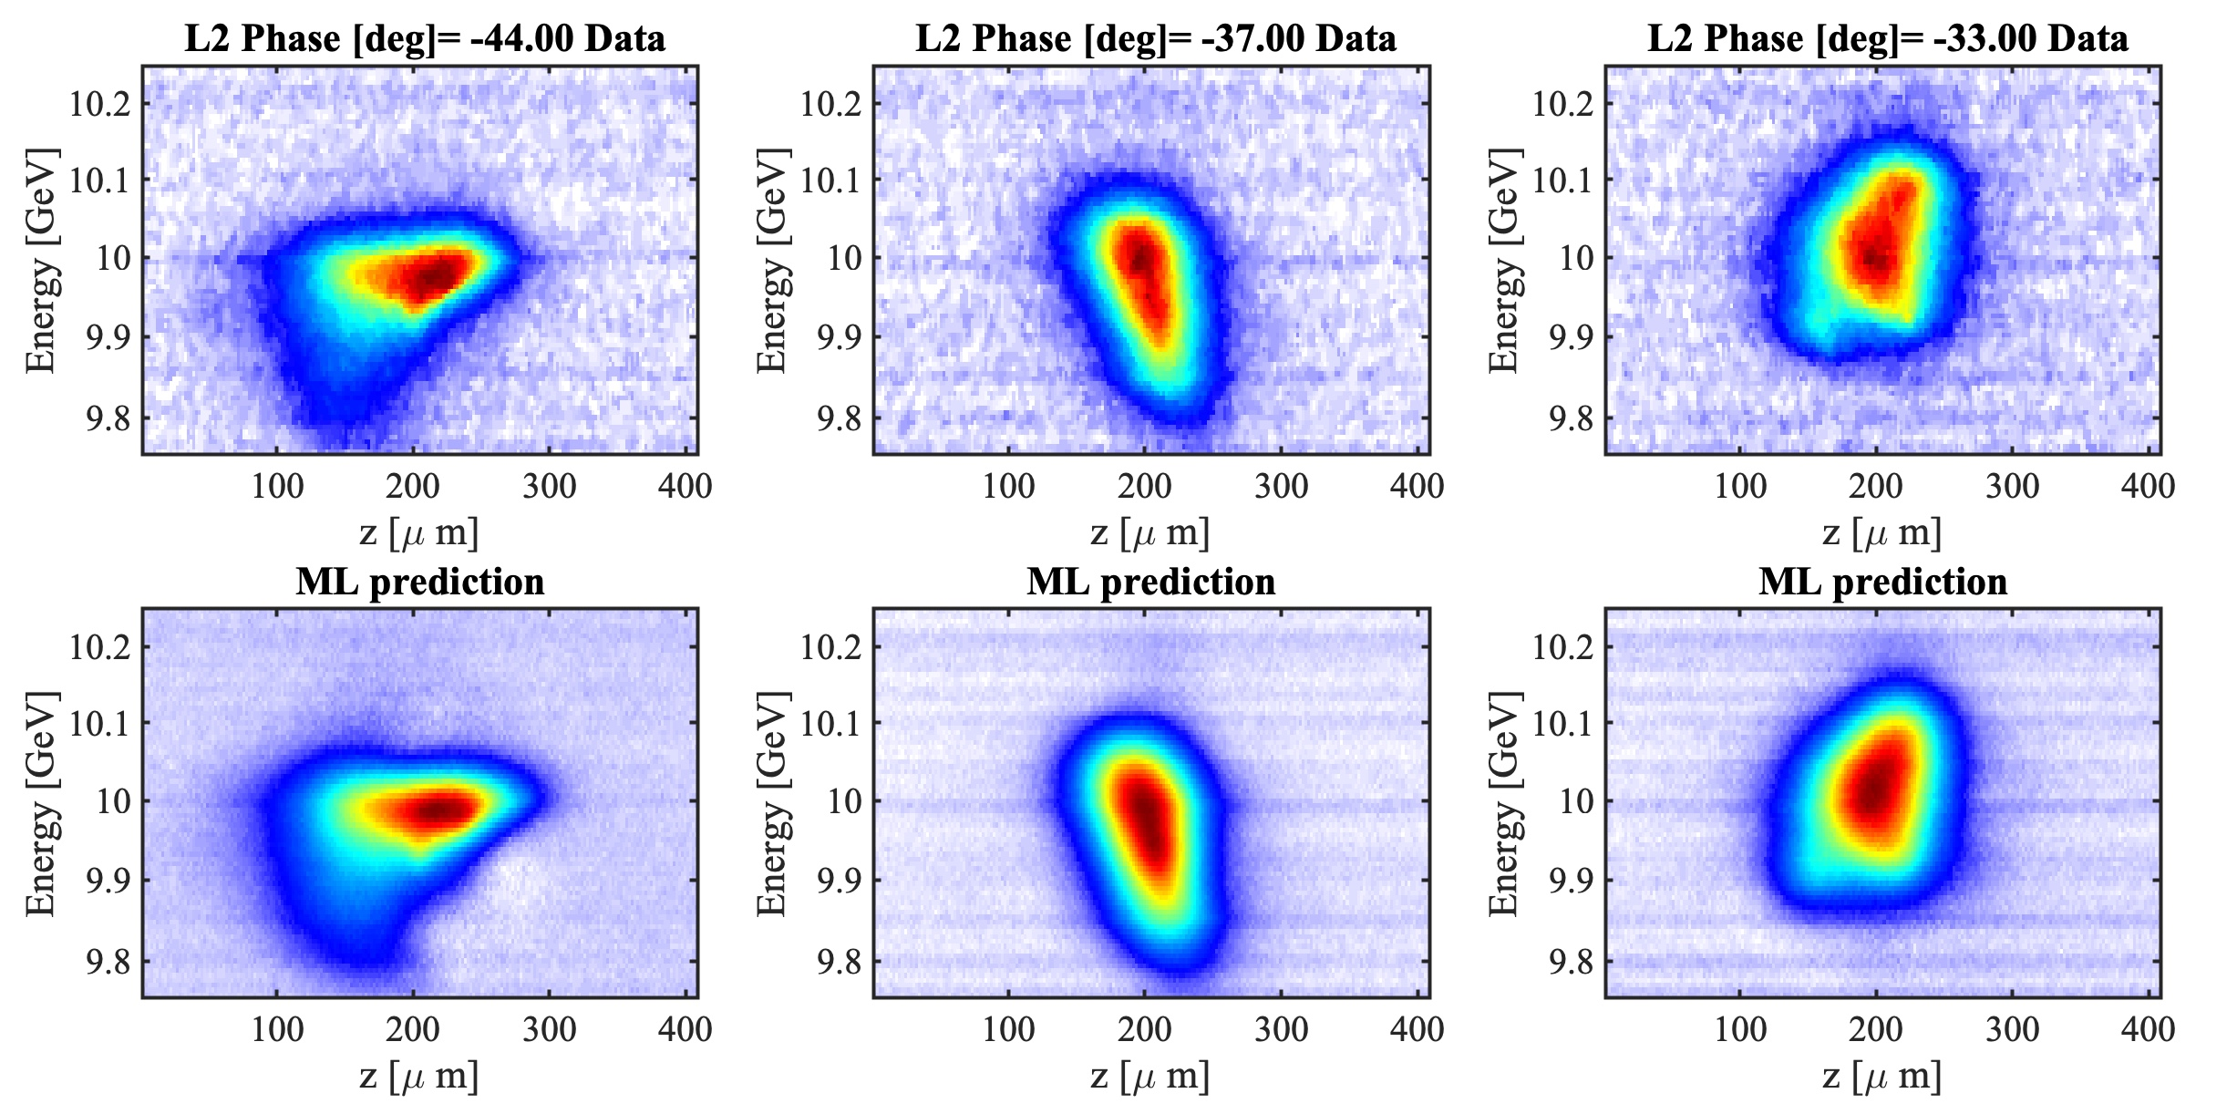
Progress to date - L2 phase scans through full compression: ML predictions
Q = 750 pC
Data from 7/8/22
ML model trained to predict 2D LPS distribution from L2 phase scan through full compression
FACET-II PAC Meeting, October 26, 2022 C. Emma E327: FY22 Progress and Plans for FY23

Slide 10
Potential evolution of experiment
Transition of LPS diagnostic tool to similar facilities e.g. LCLS (synergy with existing AD ML group efforts)
Use of LPS diagnostic beyond e-beam setup for online PWFA optimization:
Reduction of beam jitter (synergy with E325 + E331)
LPS tuning/control using downstream PWFA diagnostics (synergy with E325 + E331)
ML based prediction of LPS shaping with the laser heater
FACET-II PAC Meeting, October 26, 2022 C. Emma E327: FY22 Progress and Plans for FY23

Slide 11
Desired facility upgrades
Laser heater to reduce shot-to-shot jitter of LPS and COTR effects
BC11 and BC20 bunch length pyros operational
S14 and S10 TCAVs operational
S20 TCAV resolution optimized (increased voltage, optimized optics)
FACET-II PAC Meeting, October 26, 2022 C. Emma E327: FY22 Progress and Plans for FY23

Slide 12
Backup Slides
FACET-II PAC Meeting, October 26, 2022 C. Emma E327: FY22 Progress and Plans for FY23

Slide 13
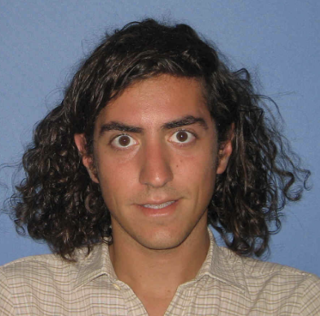
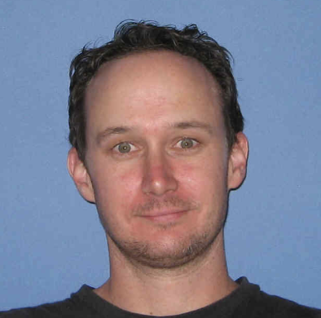
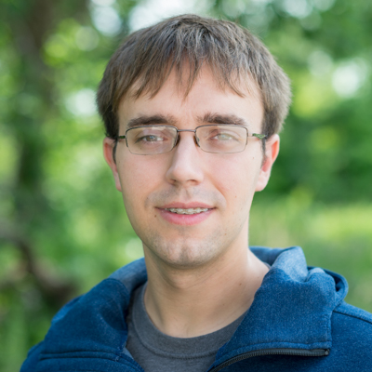
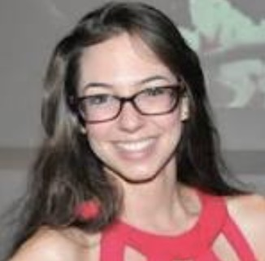
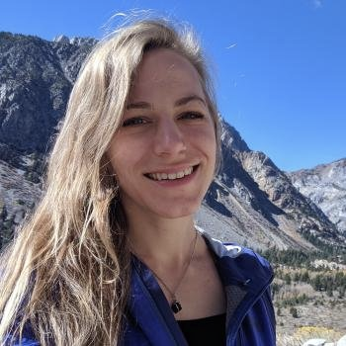
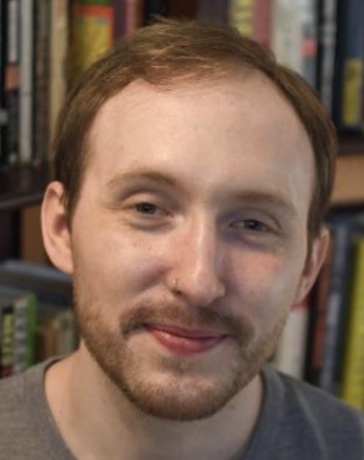
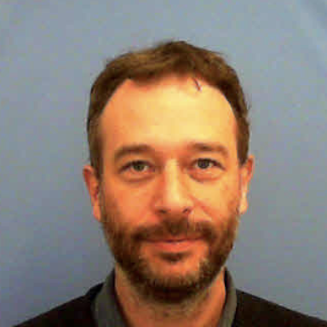
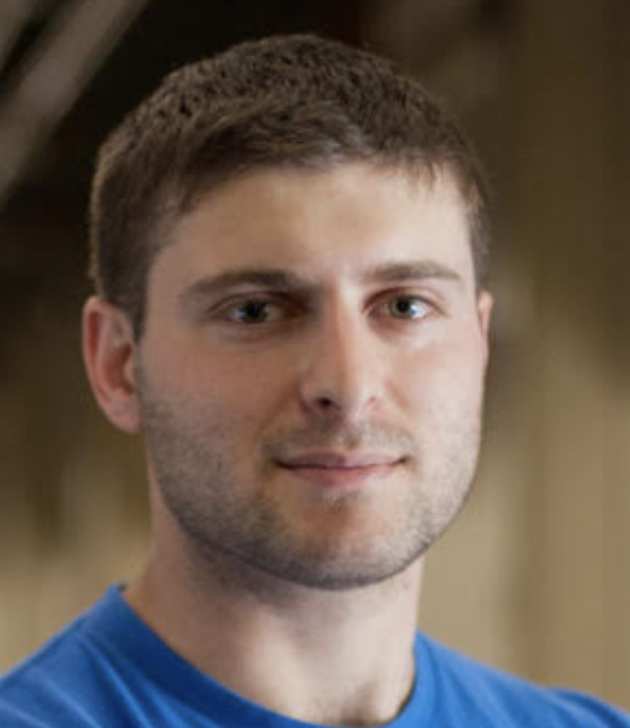
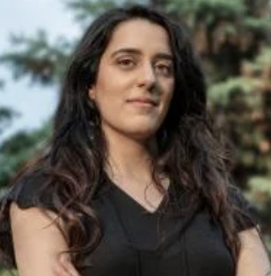
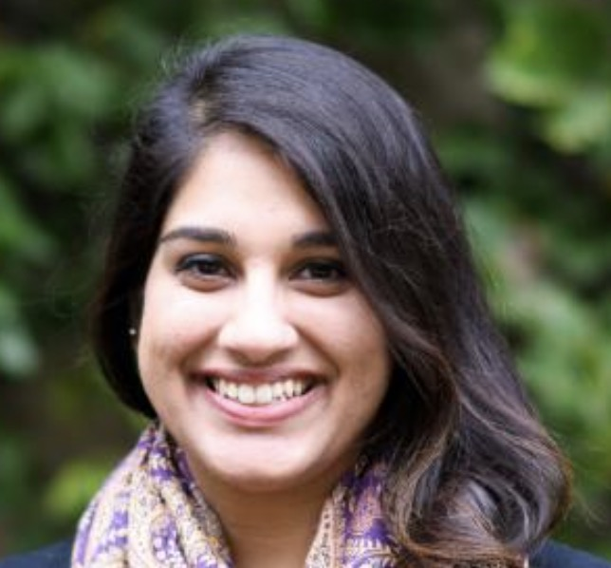
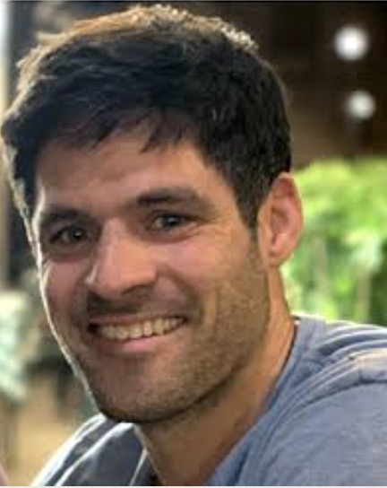
Collaboration
SLAC: C. Emma, B. O’Shea, A. Hanuka, A. Edelen, G. White, S. Gessner, L. Gupta, R. Roussel, S. Miskovich, W. Neiswanger
LANL: A. Scheinker
FACET-II PAC Meeting, October 26, 2022 C. Emma E327: FY22 Progress and Plans for FY23

Slide 14
Publications
C. Emma and A. Edelen, et al., “Machine learning based longitudinal phase space prediction of particle accelerators”, PRAB 21, 112802 (2018)
Scheinker, A., Emma, C., Edelen, A., and Gessner, S.. Mon . "Advanced Control Methods for Particle Accelerators (ACM4PA) 2019". LANL Workshop Report, United States. doi:10.2172/1579684. https://www.osti.gov/servlets/purl/1579684.
A. Hanuka, C. Emma et. al., “Accurate and confident prediction of electron beam longitudinal properties using spectral virtual diagnostics” Scientific Reports, 11, Article number: 2945 (2021)
C. Emma, A. Edelen, A. Hanuka, B. O’Shea, A. Scheinker, “Virtual diagnostic suite for electron beam prediction and control at FACET-II” Information 2021, 12(2), 61; https://doi.org/10.3390/info12020061
FACET-II PAC Meeting, October 26, 2022 C. Emma E327: FY22 Progress and Plans for FY23

Slide 15
Landscape of AI/ML Activities at FACET-II
E326
E327
E327
E325
E325
E331
Synergistic experiments, individual success enhances all research + facility operation
FACET-II PAC Meeting, October 26, 2022 C. Emma E327: FY22 Progress and Plans for FY23

