Slide 1

E-324 Optical visualization of beam-driven plasma wakefield accelerators.
Status and plans for year 2023 and beyond
R. Zgadzaj, J. Brooks (PhD student), Mike Downer University of Texas at Austin
+ SLAC staff: M. Hogan, V. Yakimenko & others
+ FACET-II collaborators: M. Litos (UC-Boulder) & students, K. Marsh (UCLA) & others
+ computational collaborators: T. Silva, J. Vieira (IST); K. Lotov & students (Budker Inst.)
FACET-II PAC Meeting, Oct. 26, 2022

Slide 2
Science Goals
Goal 1 (6months-1year) Long-time dynamics of post-wake plasma (with and without pre-ionization). In FACET-I, E-224 obtained data covering <1.4ns delays, with a small amount of data reaching 10microseconds using electronic delay.
• delays from 0 to ~4ns (optical delay line - high temporal resolution)
• delays from 0 to ~μs or ~ms (coarser electronic delay up to full recovery of the medium)
• Parameter scans, plasma density, beam charge, loaded/unloaded wakes if injection mechanism will be available (e.g. downramp injection, trojan horse, etc.)
Goal 2 (1-1.5 years) Medium-time dynamics (0 to ~100ps) of post-wake plasma .
• Formation and evolution of ion wake (including central density peak and its decay into a channel)
Goal 3 (2 -3 years) Short-time and long-time dynamics – plasma wake structure behind the electron driver
• loaded and unloaded wake structure with and without pre-ionization
• structure of electron wake formed within the evolved ion wake
Goal 4 (2 -3 years) Faraday and Cotton-Mouton effect based measurements of magnetic fields
• magnetic field detection and mapping of its structure, and that of the wake structure. Magnetic field detection can extend optical measurement sensitivity well below measurements relying on interferometry.

Slide 3
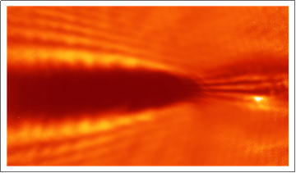
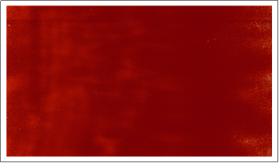
Science Goal 1 - motivated by need to establish shot repetition limits for PWFAs
Goal 1 (6months-1year) Long-time dynamics of post-wake plasma (with and without pre-ionization).
• delays from 0 to ~4ns (optical delay line - high temporal resolution)
• delays from 0 to ~μs or ~ms (coarser electronic delay up to full recovery of the medium)
• Parameter scans, plasma density, beam charge, loaded/unloaded wakes if injection mechanism will be available (e.g. downramp injection, trojan horse, etc.)
1.4ns after excitation ion wake is still rapidly expanding radially. Energy dissipation involves complex dynamics of outward electron streaming, followed by ions and complex impact ionization and excitation dynamics.
Optical measurement indicate full recovery does not occur in lithium of 8 10¹⁶cm⁻³ density after 10microseconds. Probe still deflected from the field of view after this time.
0.3 ns
This work expands the study started in E-224, which covered 1.4ns at fine time resolution, and up to 10microseconds with very coarse resolution. The work has been published:
Zgadzaj, R., Silva, T., Khudyakov, V.K. et al. Dissipation of electron-beam-driven plasma wakes. Nat Commun 11, 4753 (2020). https://doi.org/10.1038/s41467-020-18490-w
10 µs
Another apporoach, for establishing the recovery time has been published recently:
D’Arcy, R., Chappell, J., Beinortaite, J. et al. Recovery time of a plasma-wakefield accelerator. Nature 603, 58–62 (2022). https://doi.org/10.1038/s41586-021-04348-8
D’Arcy et al. Establish that for a single drive pulse in Argon plasma of density 1.75 10¹⁶cm⁻³, recovery occurs after 63ns, in the sense that no observable change in the parameters of drive and witness bunch are observed 63ns after previous driver.
D’Arcy et al. establish an upperlimit of 10’s of MHz, based on the recovery from a single pulse. This measurement does not take into account accumulating energy in the medium. Our results indicate that the medium is not in its quiescent state after 10ms. More detailed physical understanding of the dissipation dynamics is needed.

Slide 4
Experimental layout
Transit angle through the plasma column increased to allow probe penetration of lithium plasma column at up to about 10¹⁷cm⁻³ density.
Lithium oven, bypass pipe, or other dedicated chamber as was used in FACET I.
Vacuum chamber
M4
FP1
FP2
FP3
~ 0.02 rad
Plasma
column
Plasma oven
>4” objective to capture all scatter light emerging from pipe.
BP
shutter
Current/Initial 1-camera
Probe detection setup
λ/2
reducer
CCD 2
Probe input time delay, polarization control, size reduction, optionally color change by frequency doubling. Probe can also be resized anamorphically to allow better fit in the beam pipe at oblique transit.
CCD 3
CCD 2
CCD 1
Imaging system with nonlinear element at internal focal point for phase contrast imaging
Full probe detection setup, cameras to be added when channels become available. Additionally, bandpass filters can be used to study the evolution of the plasma in different wavelength ranges, to probe more accurately compositional changes in the plasma.
Δt~0-4ns
CCD 1
Polarization state detection for final phase of experiment.
CCD 1

Slide 5
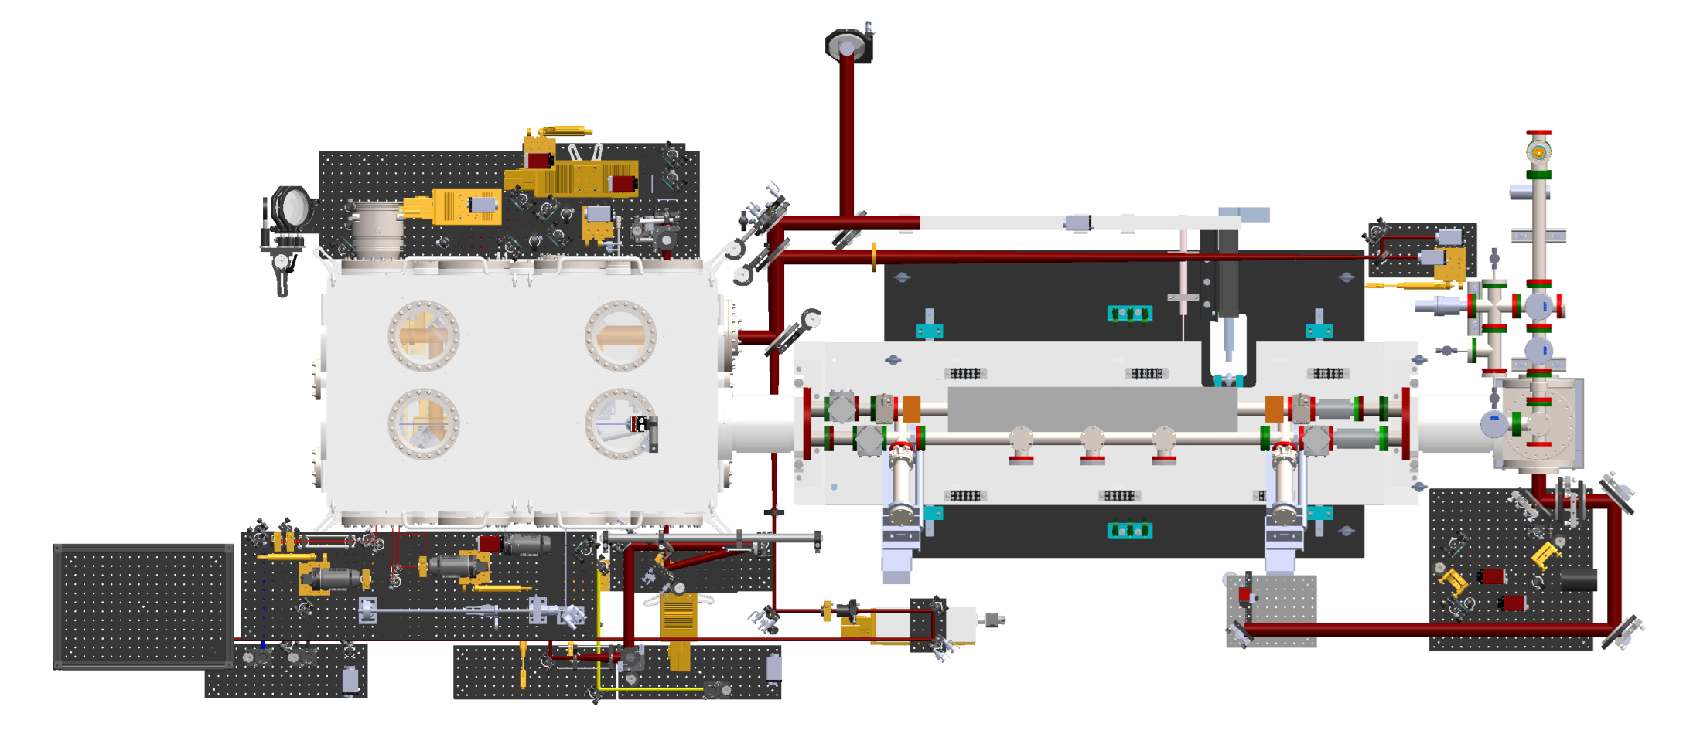
Experimental layout as of 2022
Optical setup for E324 was constructed and tested in Texas, then parts were shipped to FACET in early 2021 and prepositioned by FACET staff. Our group aligned the setup during access time in January 2022.
E324 imaging of one or more object planes within the plasma oven, or other plasma source. Holed mirror used to eliminate residual light from plasma generating laser
E324 delay, resizing of probe, polarization control, frequency doubling, anamorphic resizing
E324 setup

Slide 6
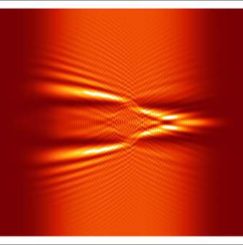
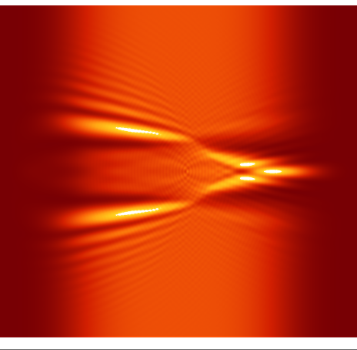
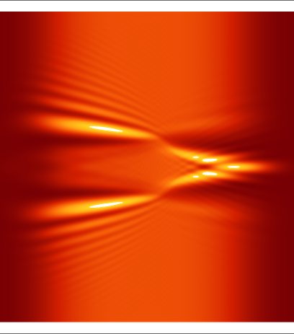
Science Goals
Goal 2 (1-1.5 years) Medium-time dynamics (0 to ~100ps) of post-wake plasma .
• Formation and evolution of ion wake (including central density peak and its decay into a channel). The current optical setup will allow observation of the formation of the central ion peak with reduced spatial resolution. The resolution will be much higher after switching from lithium to other gases, in a wider chamber.
T. Silva et al., “Stable Positron Acceleration in Thin, Warm, Hollow Plasma Channels,” Phys. Rev. Lett. 127, 104801, 2021
V K Khudiakov et al., “Ion dynamics driven by a strongly nonlinear plasma wake,” 2022 Plasma Phys. Control. Fusion 64 045003
Complex intermediate dynamics are predicted before the formation of the central ion peak.

Slide 7
Science Goals
Goal 3 (2 -3 years) Short-time and long-time dynamics – plasma wake structure behind the electron driver
• loaded and unloaded wake structure with and without pre-ionization
• structure of electron wake formed within the evolved ion wake
Multishot measurement of wake structure.
Geometric walkoff @ θ_{pr} = 20 mrad: +40 µm
Group-velocity walkoff: -2 µm
probe
Walk-off ~38μm
20 mrad
e-bunch
e-bunch
Overlap region ~ 20cm*
probe

Slide 8
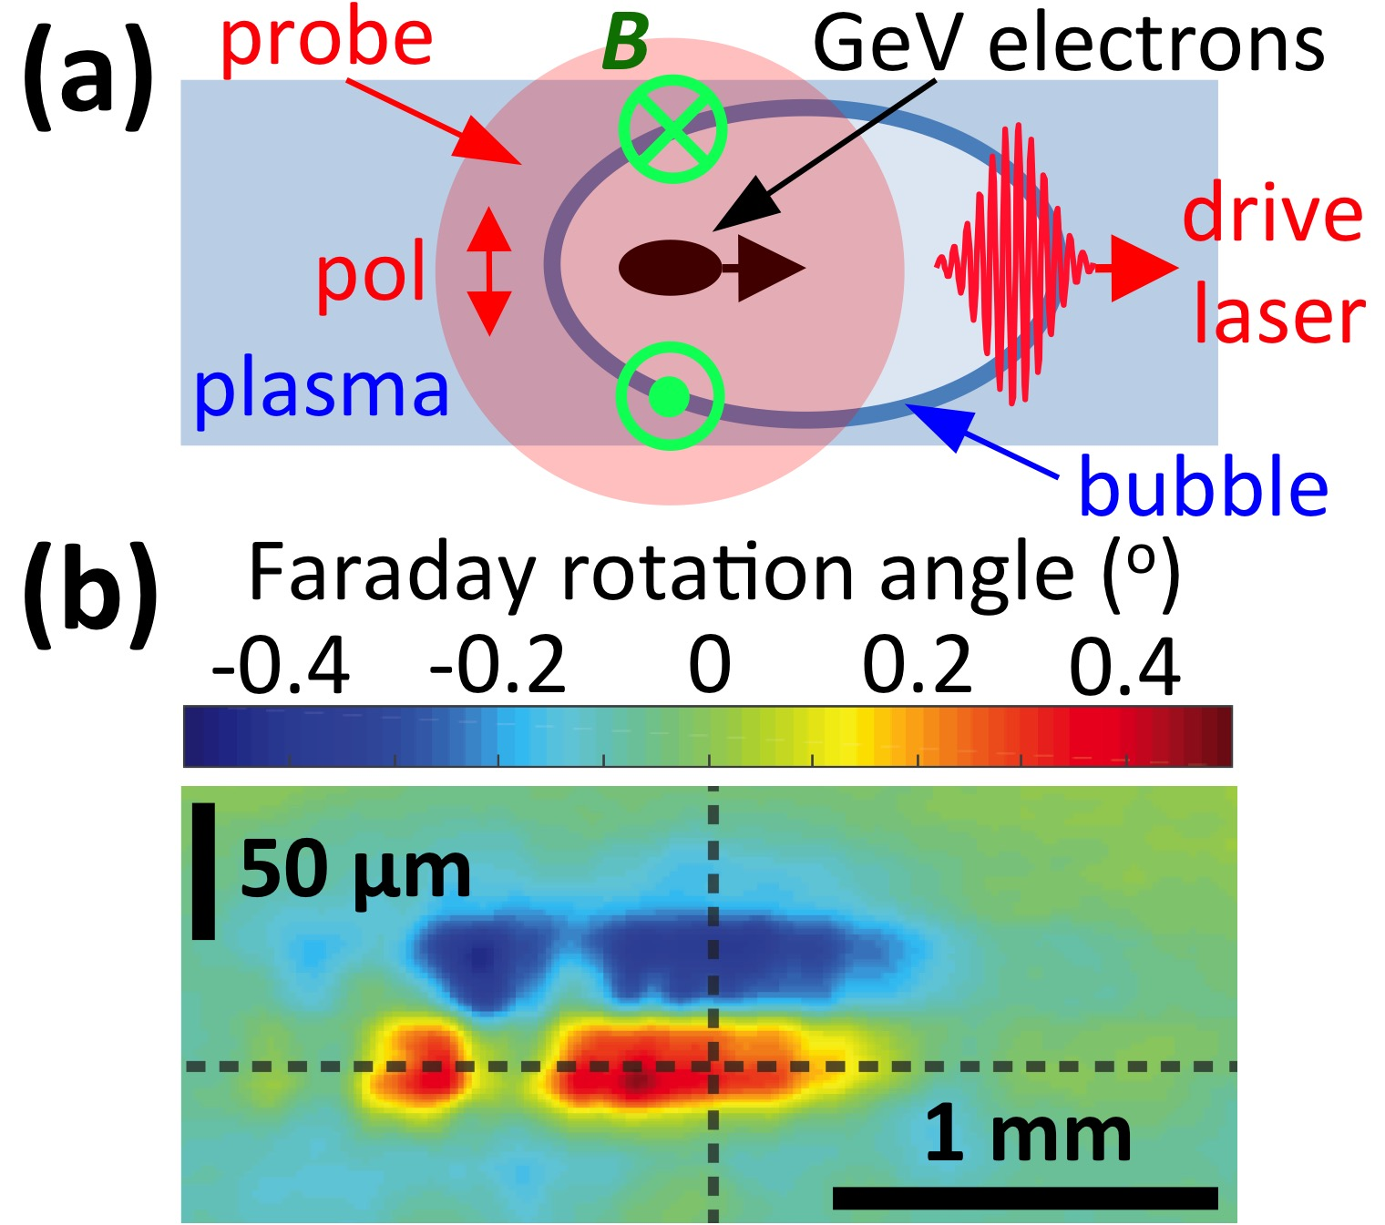
Science Goals
Goal 4 (2 -3 years) Faraday and Cotton-Mouton effect based measurements of magnetic fields
• magnetic field detection and mapping of its structure, and that of the wake structure. Magnetic field detection can extend optical measurement sensitivity well below measurements relying on interferometry.
Cheng Y-y, et al., Phys. Plasmas 28, 123105 (2021); https://doi.org/10.1063/5.0072262
Faraday probe setup
Faraday rotation results
Texas PW
pump
100 J, 150 fs
e-bunch driver or
probe
2 GeV
e⁻
10 cm gas cell
(n_{e0} = 2•10¹⁷ cm⁻³)
anamorphic
imaging
CCD
polarizer
polarizer
4
measure-
ments
• separation of ± lobes: bubble size
• |∆ϕ_{Faraday}|: bubble wall density
• width of each lobe: bubble wall thickness
• longitudinal variations: bubble evolution
CCD

Slide 9
Summary of plans for FACET II E324 studies
• We will extend the study of long term evolution dynamics of post-wake plasma, to establish full recovery time for a range of parameters.
• We will visualize on-axis e- and ion-wake structures,
taking advantage of larger θ_{pr}, higher-resolution imaging, lower n_{e}
than in FACET-I.
∆t ≥ 30 ps
∆t < 1 ps
on-axis ion-density peak
(2) hollow-channels
(3) e-wake structure & propagation dynamics
(4) transverse & longitudinal e-wake instabilities
• Current challenges:
Probe images are low contrast → use phase-contrast imaging
convolved with plasma-edge signatures → use probe-reference pulse pair.
• We will detect magnetic field induced polarization changes in the probe to study the wake structure at low densities. Magnetic polarimetry is a possible extension of optical metrology of wake structures at low densities, where direct phase changes become very low.
Thank You

