Slide 1
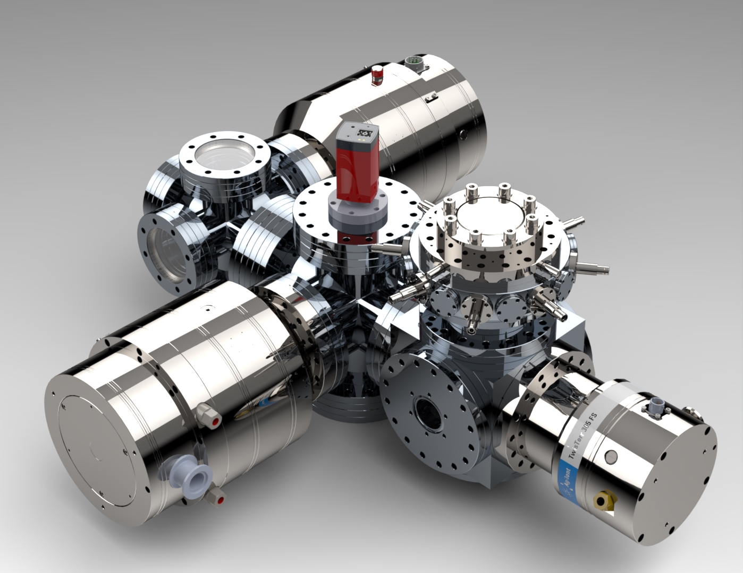





E-322: Gas Sheet Viewscreen
G. Andonian
FACET–II Program Advisory Committee Meeting
October 25-27, 2022
SLAC

Slide 2
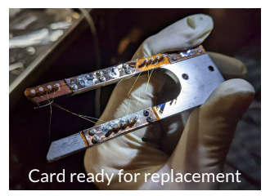
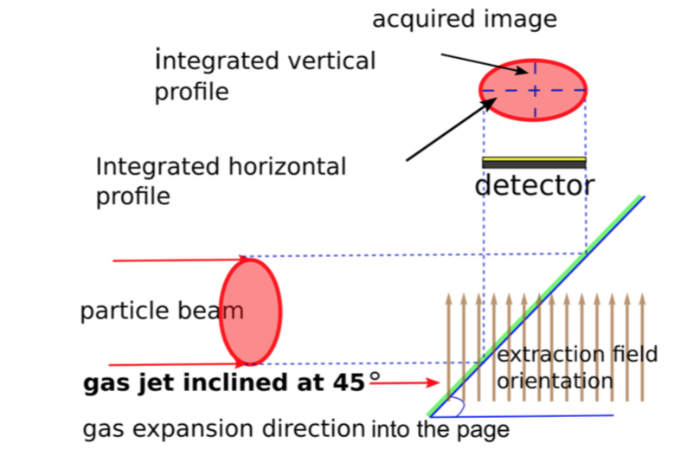
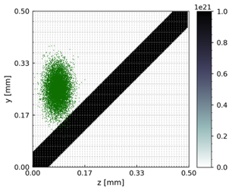
Science Goals
High-intensity beams present unique challenges in transverse profile diagnostics
Single-shot, regenerative diagnostic for FACET-II
“Gas sheet ionization viewscreen”
  Generate a gas sheet, or “curtain” @ 45˚ with nozzles and beam skimmers
  FACET beam ionizes neutral gas
  Ions imaged by an “ion microscope”
  Resolve high-intensity beams with reconstruction algorithm
“Consumable diagnostics”
M. Hogan
Beam
  Y. Hashimoto, et al, Proc. PAC 2001, Chicago, USA (2001)
  V. Tzoganis, et al, PRAB 20, 062801, 2017
Gas sheet
Main science goal: Test Gas Sheet Viewscreen at FACET-II
Compare to available diagnostics at ‘lower’ intensity
Use at highest intensity as online viewscreen

Slide 3
Progress
Experiment E-322 has made “offline” progress since last PAC meeting
  Bench top tests for gas curtain
  Electrostatic column for imaging
  Beam tests with low charge (ongoing)
  Reconstruction algorithm

Slide 4
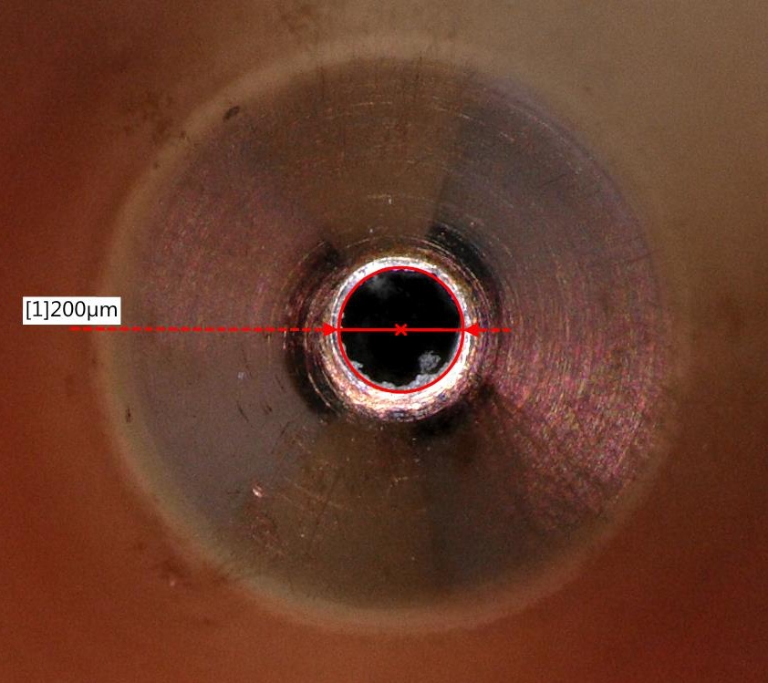
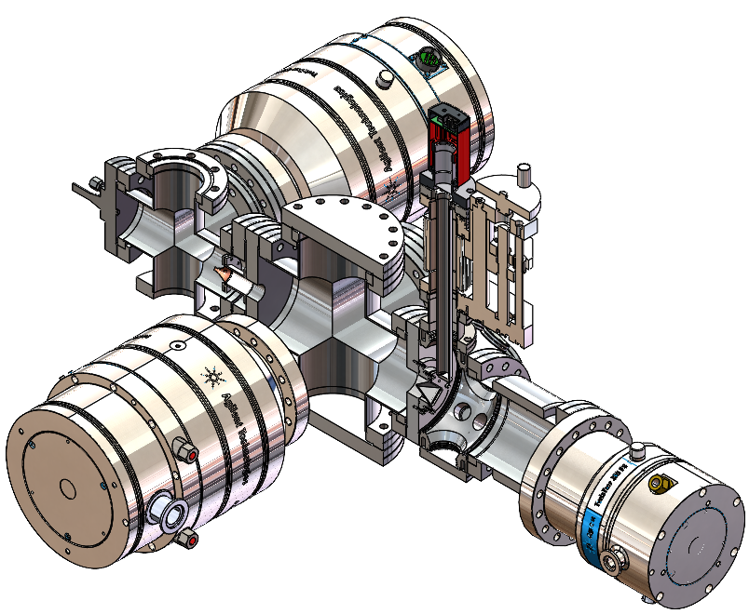
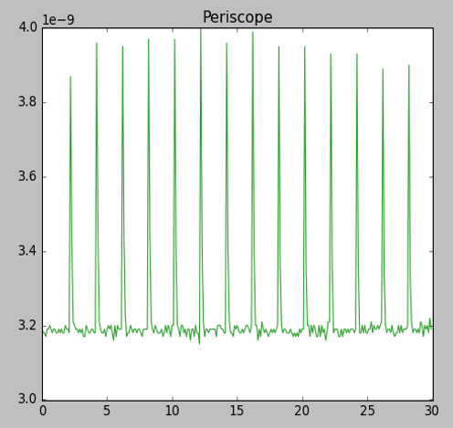
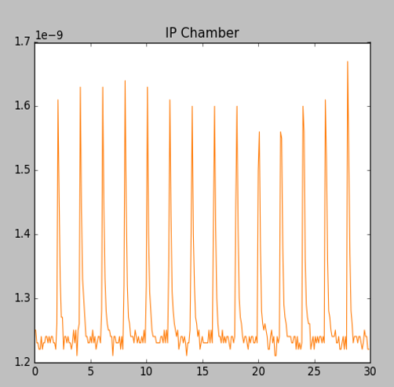
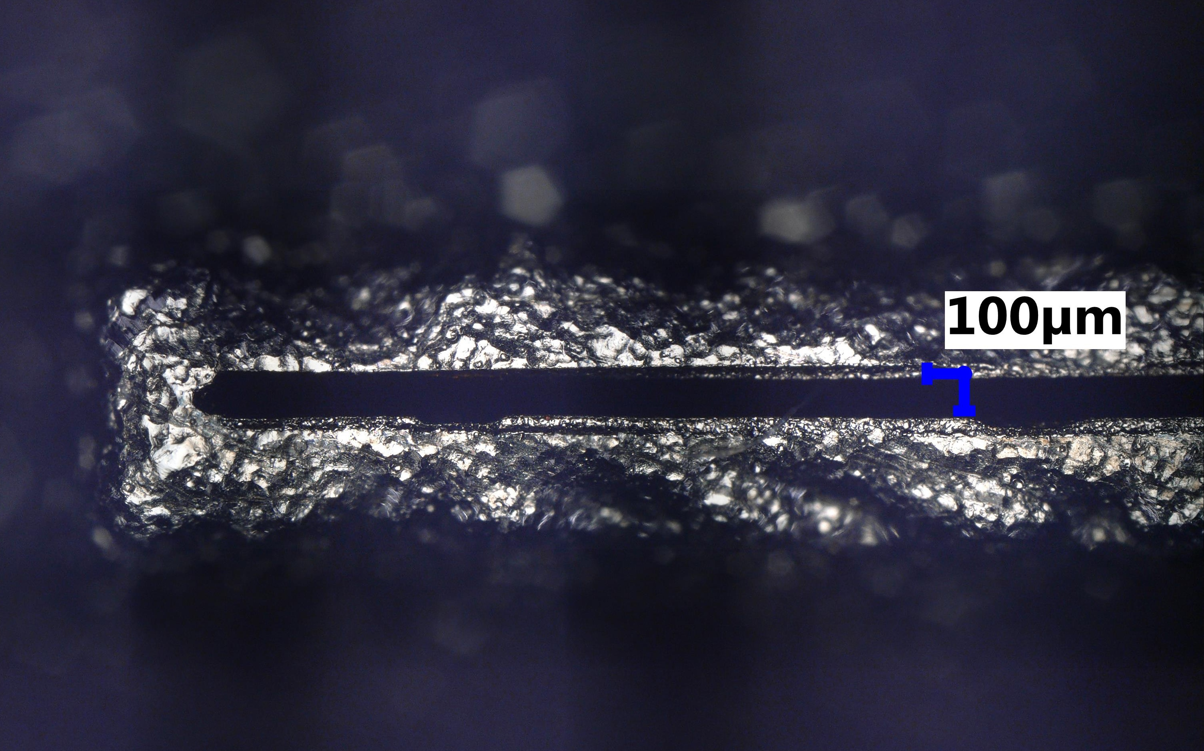
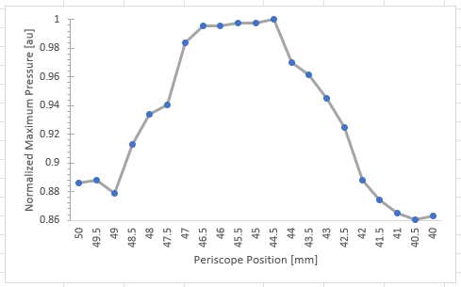
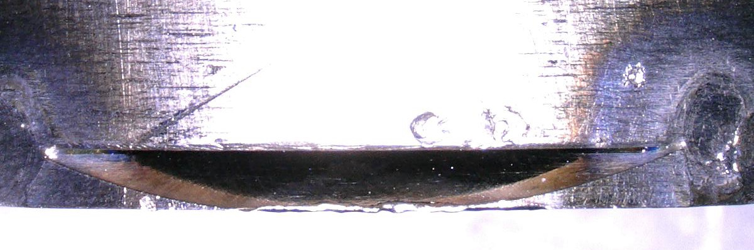
Gas Sheet Generation
Benchtop tests
  “fast” valve + nozzle (40-400µs, <kHz)
  Fast recovery of vacuum after gas sheet operation (N₂)
  various skimmer sizes (200µm → 4mm)
Vacuum recovery is fast
Diagnostic Configuration
Periscope
Gas Flow
skimmer
Vacuum Readings @ 0.5 Hz
‘Shaper’ (rectangular 100µm x 8mm)
IP cube
Diagnostic Configuration (no imaging)
Gas dump
Gas Profile at Diagnostic
1mm “Bulldozer” Collector

Slide 5
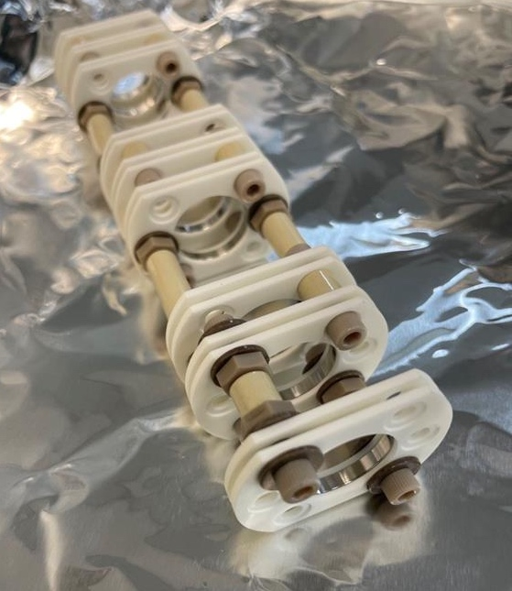
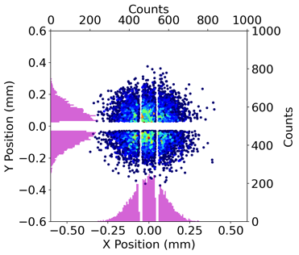
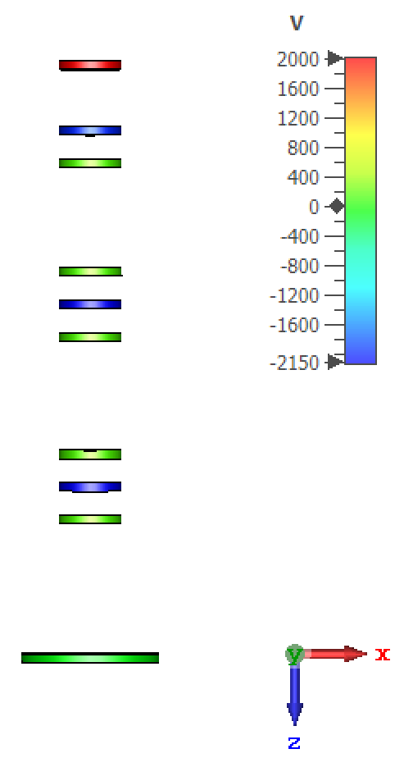
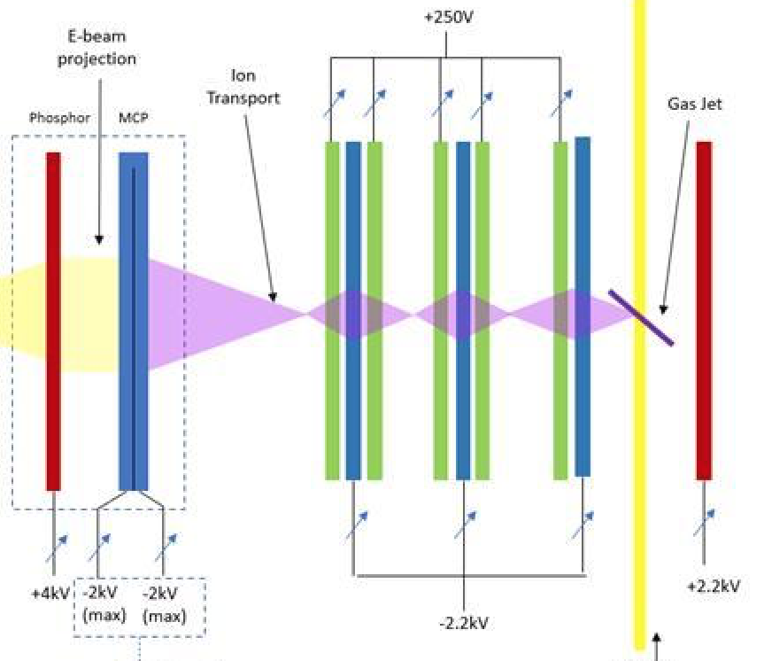
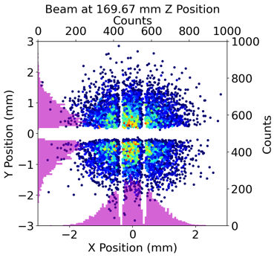
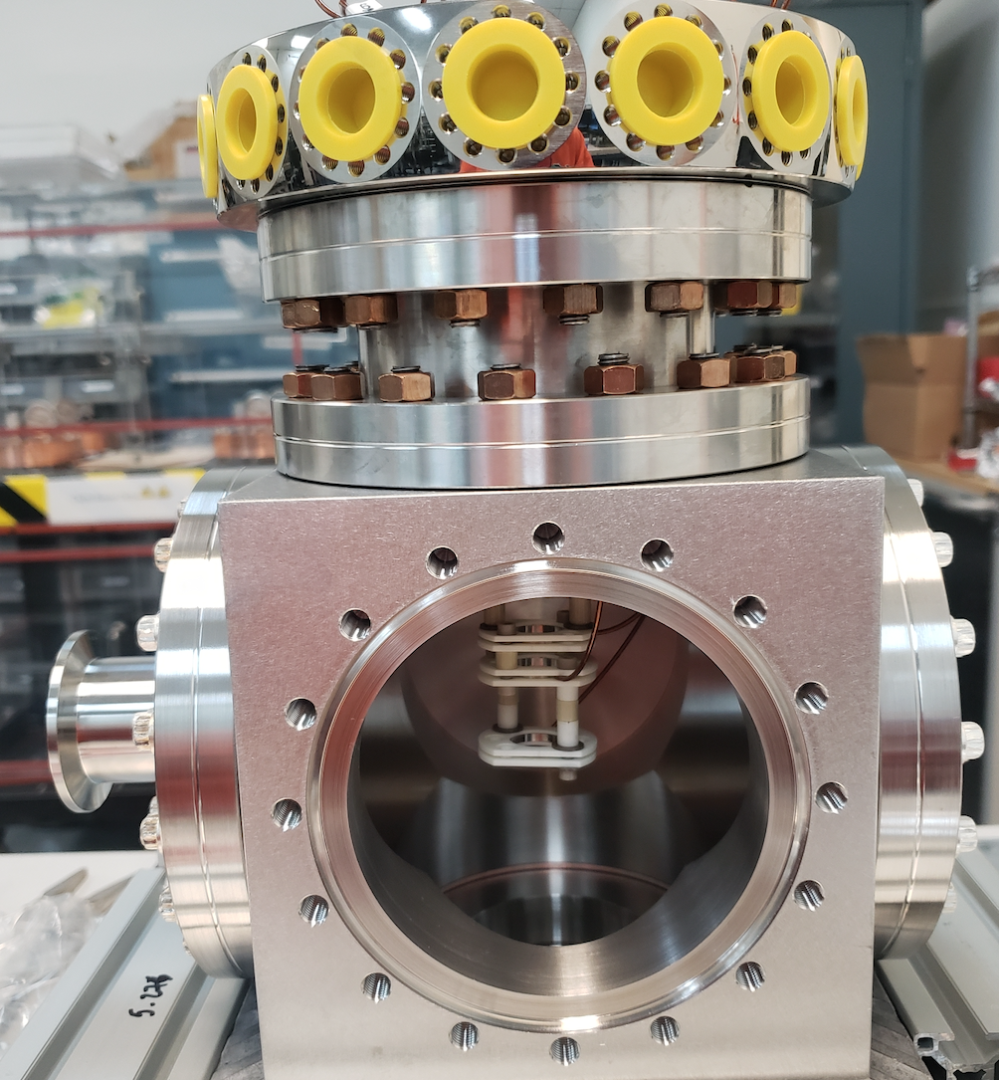
Ion Extraction Column - Design
Transport and magnify generated ion beam to Multi-Channel Plate (MCP) detector
Simulated fields and ion beam transport in CST
Tested magnification imaging ability with test beam with random initial transverse velocity
Design magnification: 8x
Individual controllable lenses offer flexibility
Initial ion dist.
e-
Ion Transport
MCP
CST model
Final ion dist.
e-beam

Slide 6
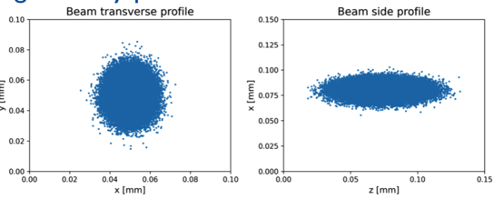
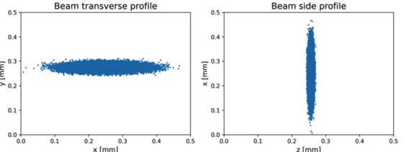
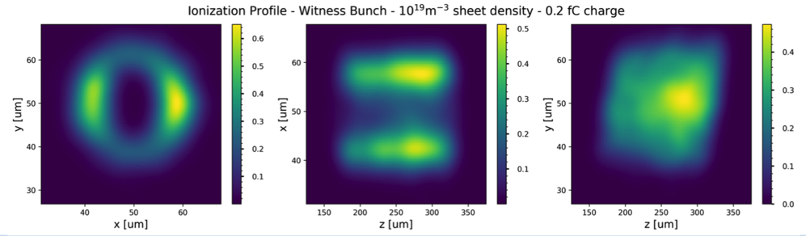
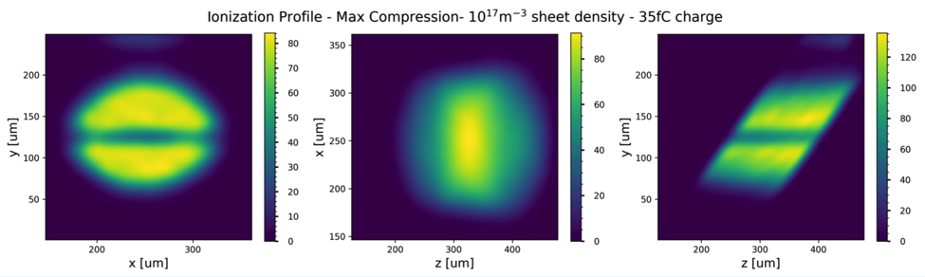
Ionization Dynamics - FACET II
Configuration 1: drive/witness
Configuration 2: max compression
Q = 0.5nC
σ_{x}= 5µm,
σ_{y} = 7.5µm,
σ_{z} = 14µm
Peak field ~20GV/m
Q = 1.4 nC
σ_{x} = 49µm,
σ_{y} = 8.5µm,
σ_{z}= 3.5µm
Peak field ~50GV/m
N₂ gas sheet
Density = 10¹⁹m⁻³
Thickness = 150µm
Q_{ions} = 0.2 fC (10³ ions)
N₂ gas sheet
Density = 10¹⁷m⁻³
Thickness = 150µm
Q_{ions} = 35 fC (>10⁵ ions)
Lower end of acceptable statistics
High gain MCP
Thicker gas sheet?
Substantially larger yield
Reduced densities
flexibility
Gas sheet tunability
WARP simulations: Tunnel ionization at high beam intensity

Slide 7
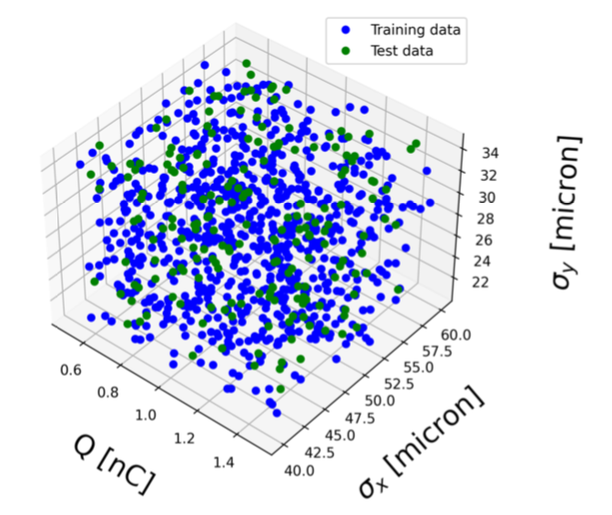
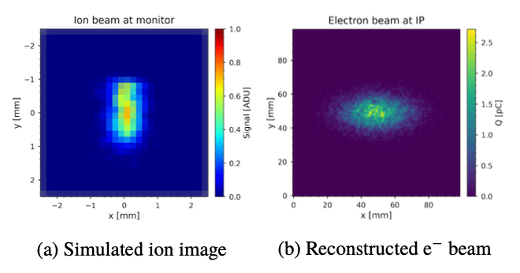
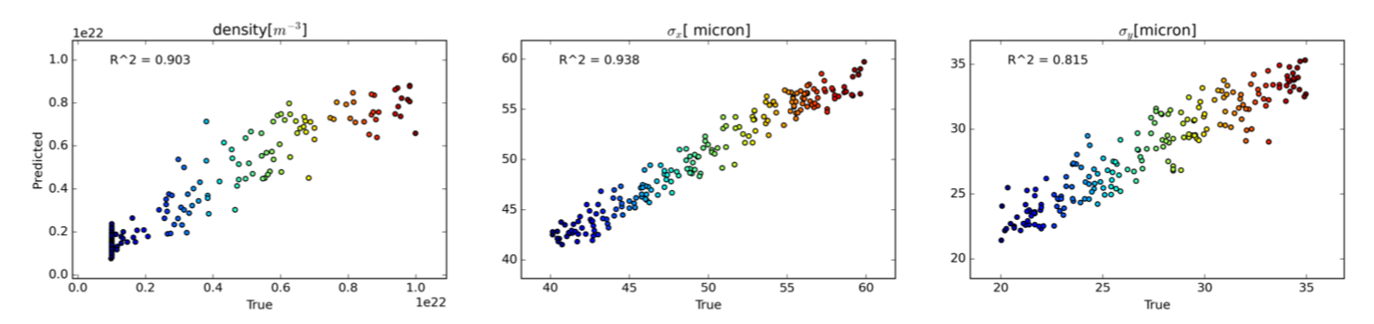
Profile Reconstruction
Test data for surrogate model (WARP)
  Variances in Q, σ_{x}, σ_{y}, σ_{z}, n_{p}
Simulated ion image is used as input to a convolutional neural network (CNN) for reconstruction
Robust performance of CNN
Further enhancement when constraints enforced (e.g. from experimental measurements)
3D parameter space
Sample reconstruction
Performance plots: surrogate model vs truth, and relative R² values

Slide 8
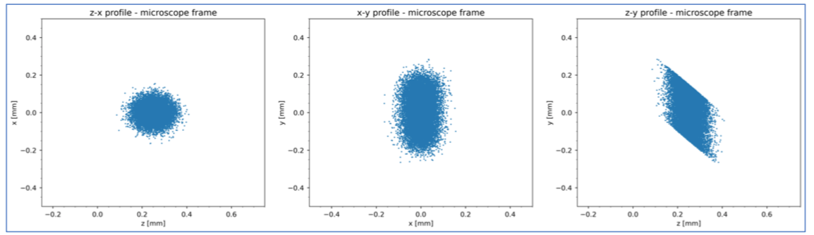
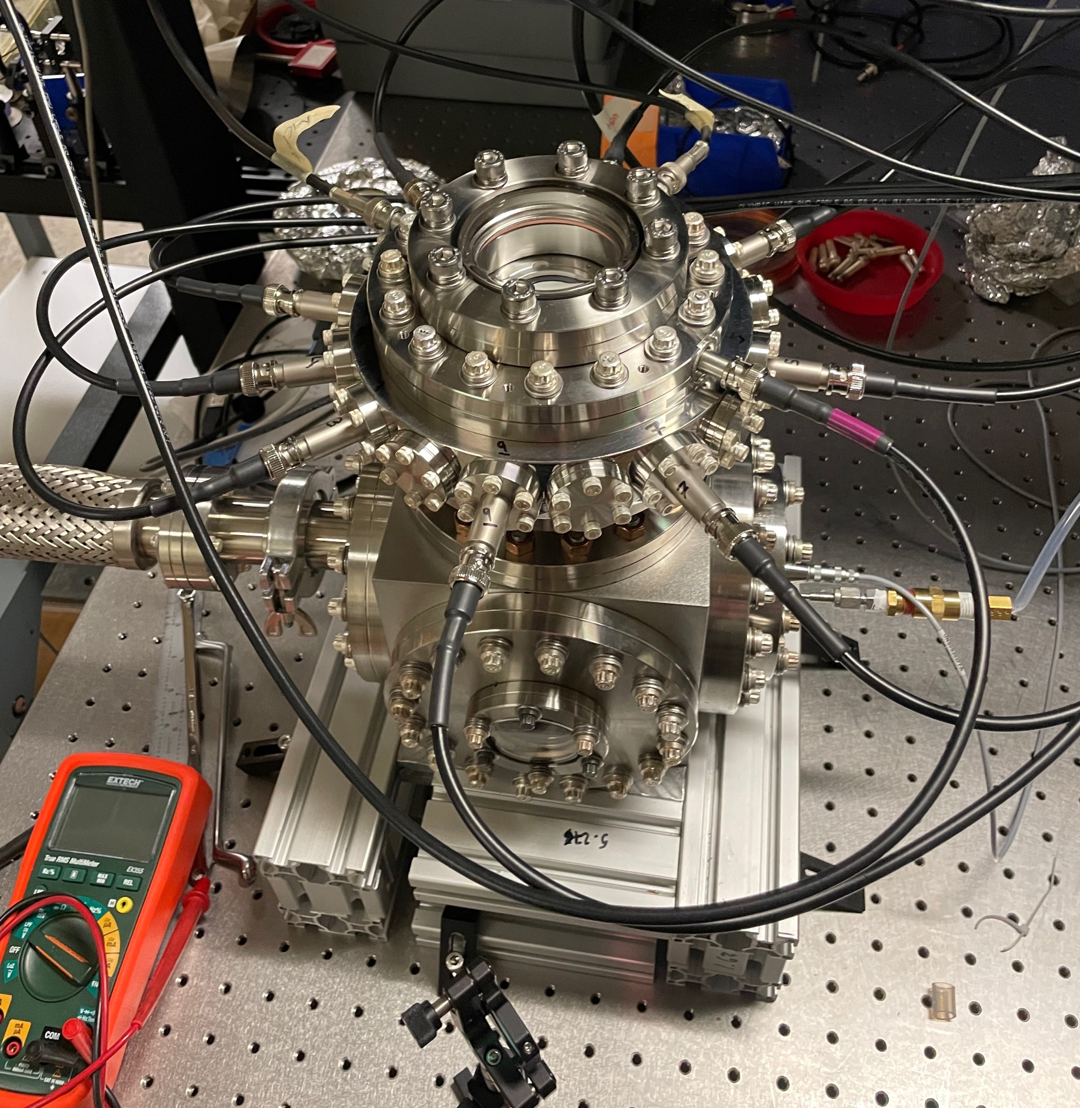
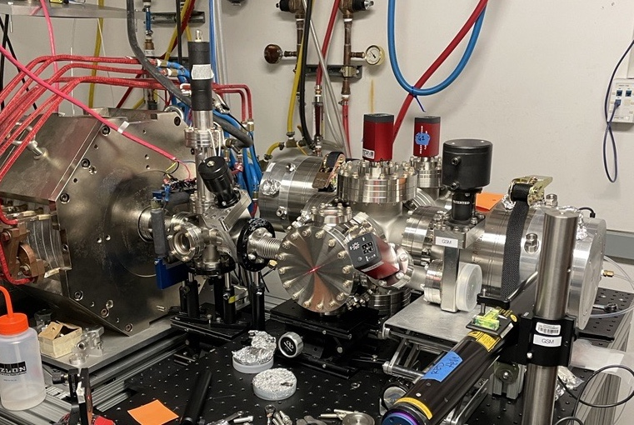
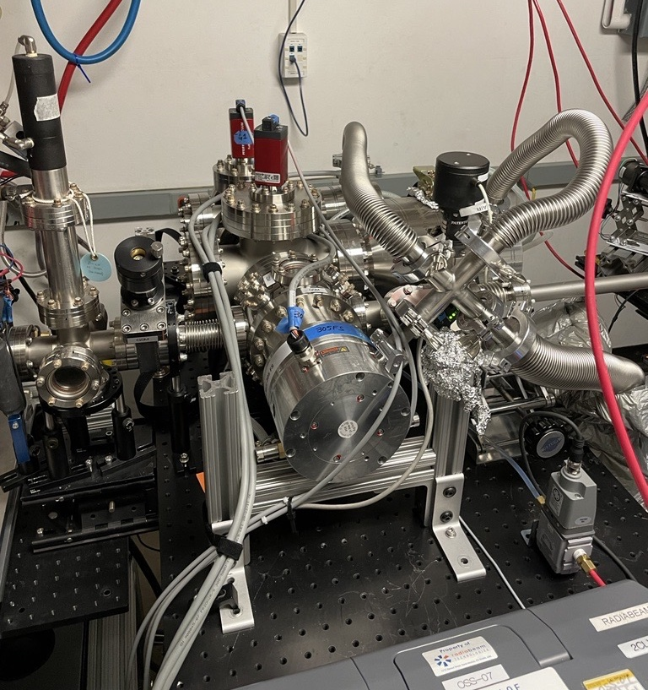
Commissioning at UCLA
UCLA Pegasus beamline
  Validate results with well-diagnosed beams
  Impact ionization gives beam footprint
  Expected ~9 fC charge (~55k ions)
  Resolvable on MCP/phosphor
Status
  Installed on beamline, vacuum <E-9
  Ion microscope commissioned on dedicated laser stand
Pegasus Beam
σ_{x} = σ_{y} = 40 µm
σ_{z} = 200 µm
Q = 0.1nC
Gas Sheet
n_{N2} = 10¹⁴ cm⁻³
L_{N2} = 150 µm
θ = 45˚
WARP simulations for Pegasus parameters
GSM at Pegasus
Microscope Commissioning

Slide 9
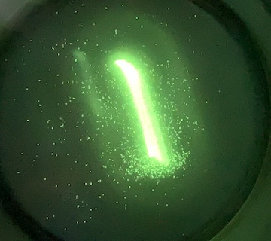
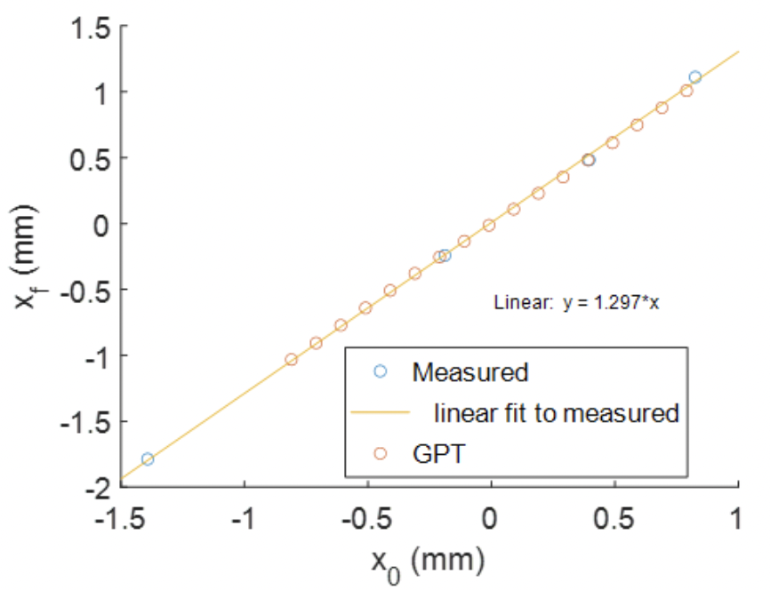
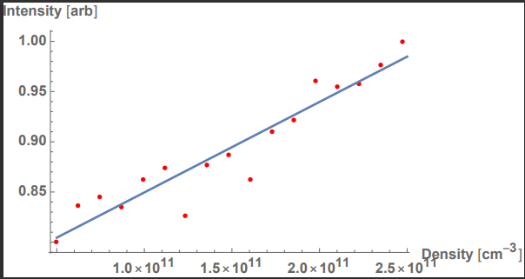
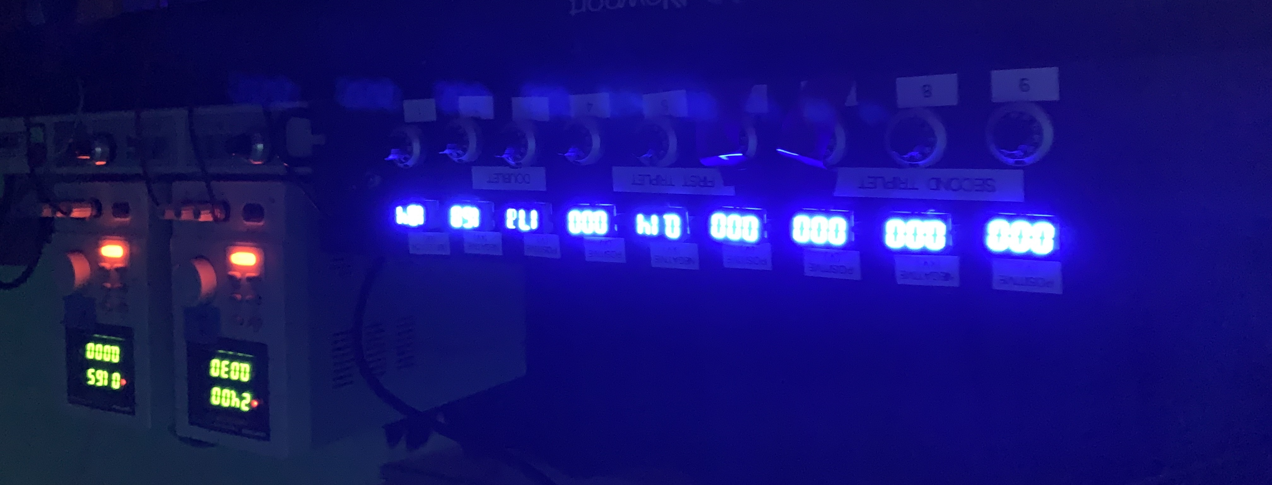
Commissioning results (ongoing)
Gas sheet viewscreen is viable as a diagnostic
Bench tested individual components
  Gas curtain: skimmers + pumping
  Ion microscope: PS + MCP
  Reconstruction methods
First tests at Pegasus UCLA (ongoing)
  Issues with aberrations, discharging?
Initial Ion Capture on Phosphor Screen
R₁₁ measurement
Laser power scan
Density scan
Electrostatic column PS unit + regulators

Slide 10
Experimental timeline
experimental timeline: currently testing at UCLA
  consider it “debugging” for FACET-II test
experimental design (90%) : Spring 2023
installation plan: Spring 2023
ready for Experimental safety review: Spring 2023
ready for installation: Fall-Winter 2023
Ready for commissioning: Winter 2023
  beam requirements: First D/W or max compression, but adaptable to schedule
first science: Winter 2023
  beam requirements: Ultimate test at max compression

Slide 11
Experimental layout
N2 gas flow
TMP
Gauge
Space requirements: ~1m from wall
Gas jet:
  N2 bottle, Low voltage PS for regulators
TMPs need water + power
  Logic for turn-on order
  Can be oriented any direction
MCP, Electrostatic-column
  Existing PS not compatible for FACET
    4kV MCP,
    2kV Phosphor,
    4kV x 9 channels e-column
Install time 2 weeks
  “Flange-flange” distance: 8 inches
Experiment time
  3 shifts, 8 hour each
  Possible to run in semi-parasitic mode depending on location
MCP
TMP
e-beam
TMP
Desired Beam Params
Q = 0.5- 2.0 nC
σ_{x}= 5µm,
σ_{y} = 7.5µm,
σ_{z} = 14µm
Rep Rate: 1-10Hz
Gas Sheet Viewscreen is adaptable to any of the FACET beam configurations

Slide 12
Potential future evolution beyond presented to PAC
First tests for use as transverse diagnostic
  If successful, can be used for beam profiles at focus at FACET-II for other experiments
  Opportunities for integration in beamline feedbacks with machine learning
    Unique source of beam information (minimally invasive)
Shaped molecular beams
  Gaseous sample delivery

Slide 13
Desired Facility upgrades
What is needed for the Gas Sheet Viewscreen to be installed at FACET-II
Unit is roughly “self-contained”, ready for flange-to-flange installation
  Lessons learned
  TMPs need power/water
  TMPs may fail, spares on hand ?
  Power supply
    MCP/phosphor PS is stable and works great
    PS for electrostatic column has fluctuations and cross-talk. Not remote compatible for now. Needs reevaluation for FACET
    local shielding of MCP + CCD at FACET?

Slide 14
Collaboration
Acknowledgements:
G. Andonian*, N. Burger, T. Hodgetts, D. Gavryushkin, J. Penney, A.L. Lamure, N. Norvell, M. Ruelas (RadiaBeam),
A. Diaw, N. Cook, C. Hall (RadiaSoft),
A. Marinelli, D. Cesar, B. Jacobson, M. Hogan, V. Yakimenko (SLAC),
P. Denham, D. Garcia, P. Musumeci, A. Ody (UCLA),
C. Welsch, M. Yadav* (Univ. Liverpool)
*also UCLA
This work supported by Grant No. DE-SC0019717

Slide 15
Publications/Students
N. P. Norvell, G. Andonian, T. J. Campese, A. L. M. S. Lamure, M. Ruelas, A. Y. Smirnov, N. M. Cook, J. K. Penney, and C. P. Welsch, “Gas Sheet Ionization Diagnostic For High Intensity Electron Beams,” Proceedings IPAC 2021, pp. 489–491, Sep. 2021.
M. Yadav, P. Manwani, J. B. Rosenzweig, G. Andonian, O. A. Ö. Apsimon, C. P. Welsch, N. M. Cook, A. Diaw, C. C. Hall, and N. P. Norvell, “Gas Sheet Diagnostics Using Particle In Cell Code,” Proceedings of IPAC2022, pp. 410–413, Jul. 2022.
N. M. Cook, A. Diaw, C. C. Hall, G. Andonian, N. P. Norvell, and M. Yadav, “Electron Beam Phase Space Reconstruction From A Gas Sheet Diagnostic,” Proceedings of IPAC2022, pp. 414–417, Jul. 2022.
N. Burger, G. Andonian, T. Hodgetts, D. Gavryushkin, N. Norvell, N. Cook, C. Welsch, M. Yadav, P. Denham, P. Musumeci, A. Ody, “Experimental Characterization Of Gas Sheet Transverse Profile Diagnostic” Proceeding NA-PAC 2022, #THZE4 (2022)
Students: P. Denham (UCLA) from Pegasus Lab

Slide 16
Thank you!

Slide 17
Back up slides

Slide 18
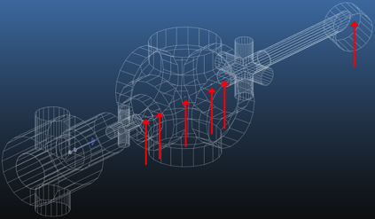
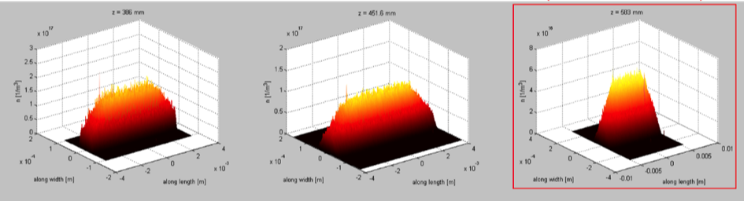
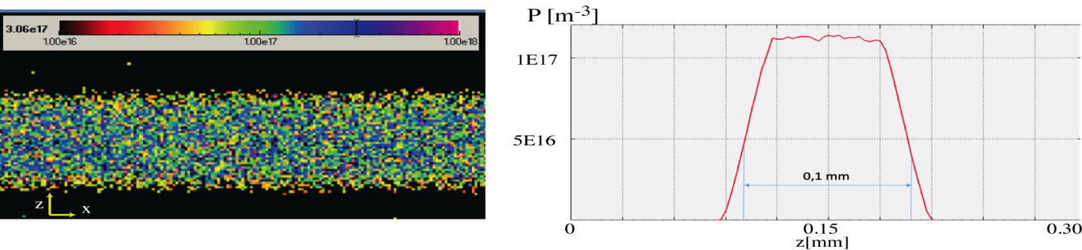
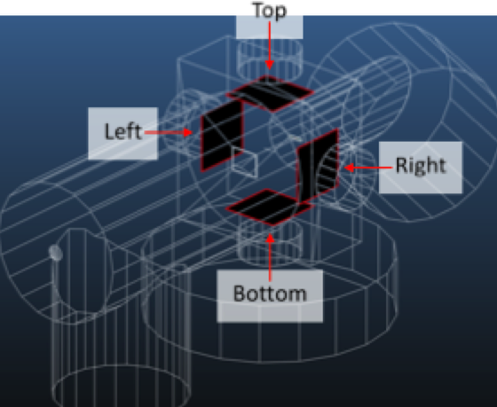
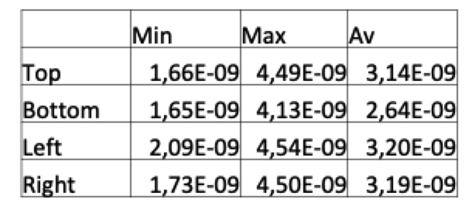
Gas Sheet Generation - Design
Optimization of gas density profile: (Molflow+)
Example to study effect of skimmer size/shape/locations
Compact design to maintain distribution at IP
10¹⁷m⁻³
100µm
Differential pumping:
(Molflow+)
Strict UHV requirements determine pump speed and placement
Vacuum levels near IP (mbar)

