Slide 1
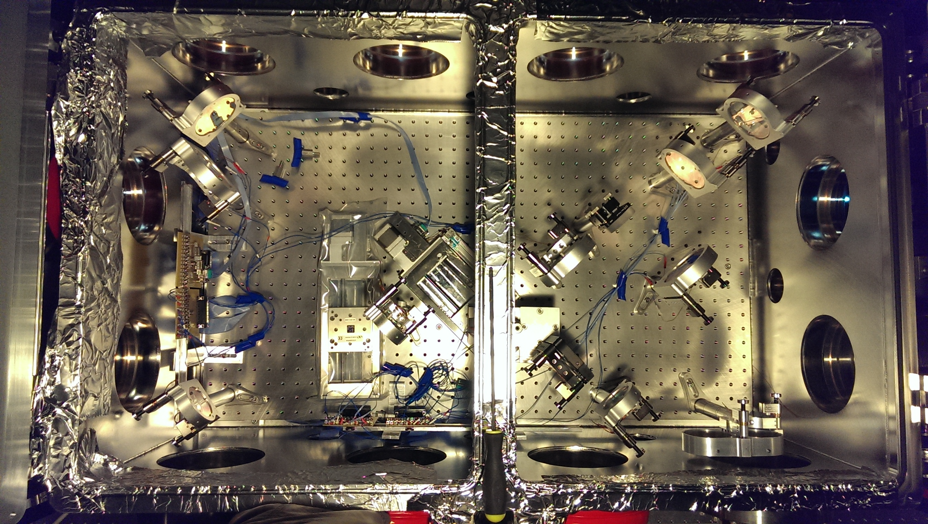
probe
laser
e⁻ beam
ionizing
laser

